Slide 1


AB 205:
California’s Cautionary Tale
Robert Perry,
Principal Analyst
June 22, 2023

Slide 2
Income-Graduated Fixed Charges (IGFC):
A Road to Hell Paved with Good Intentions
The legislature declared that the intent of AB 205 in modifying Section 739.9 of the Public Utilities Code (PU Code) is as follows:
[AB 205, 2022, SEC. 14] (b) In regards to Section 739.9 of the Public Utilities Code, as amended by this act, it is the intent of the Legislature to do both of the following:
(1) Authorize the Public Utilities Commission to establish reasonable fixed charges on default residential customer rates to help stabilize rates and equitably allocate and recover costs among residential customers in each electrical corporation’s service territory.
(2) If the Public Utilities Commission establishes fixed charges on default residential customer rates, ensure that the fixed charges are established to more fairly distribute the burden of supporting the electric system and achieving California’s climate change goals through the fixed charge.
Prior to AB 205, section 739.9 of the PU Code capped fixed charges in default residential rates to $10 per customer per month for customers not enrolled in the CARE program and $5 per customer per month for CARE customers. AB 205 lifts those restrictions.
Source: R.22-07-005, Phase 1 Track A: Income Graduated Fixed Charge Guidance Memo

Slide 3
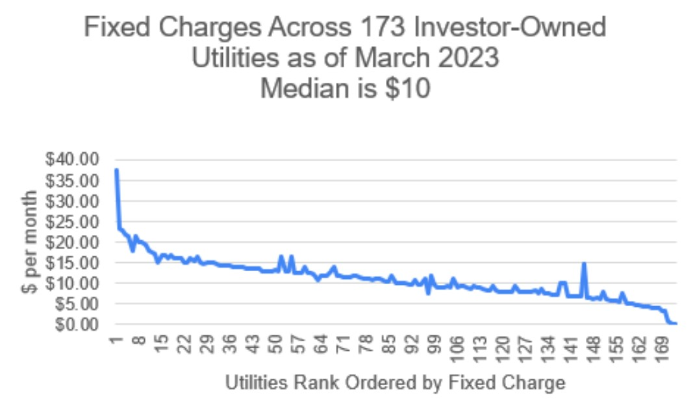
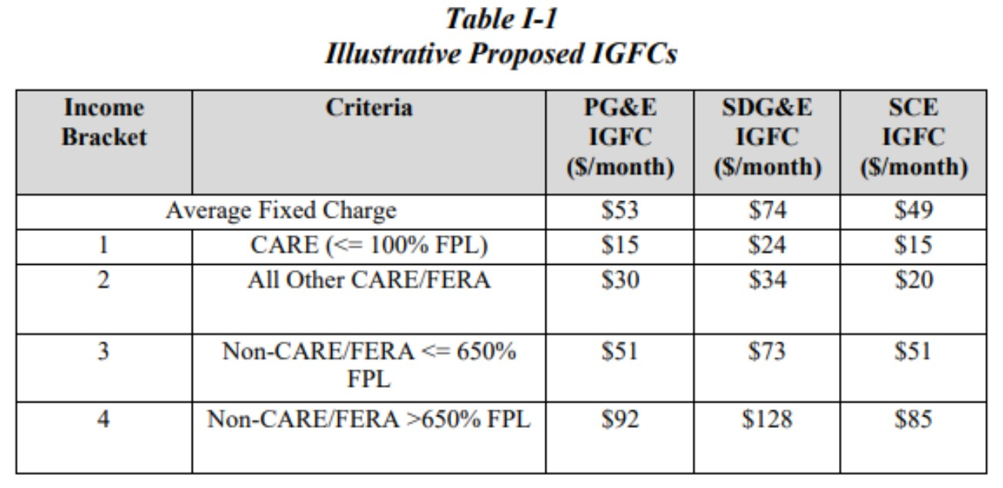
AB 205: IGFC Unintended Consequences
Source: Ahmad Faraqui, “How will the income-graduated fixed charges (IGFC) proposed by California’s investor-owned utilities affect customer bills?,” EnergyCentral, April 17, 2023
“For a household of four, 650% of the federal poverty level (FPL) is $195,000 per year (based on 2023 guidelines). The California Alternative Rates for Energy (CARE) income threshold is $55,500 for a household of the same size; $69,375 for a Family Electric Rate Assistance (FERA) eligible household.”
Source: Richard McCann (CESA), “Prepared Rebuttal Testimony of Richard McCann on Behalf of the California
Energy Storage Alliance,” Demand Flexibility Rulemaking (R.22-07-005)

Slide 4
IGFC Pros and Cons
FOR: Prof. Severin Borenstein (UC Berkeley) [Infrastructure] costs are currently being passed to customers through the kilowatt per hour usage rate, which is now three to four times higher than the actual cost of providing electricity, according to Borenstein.
“It’s massively distorting the electricity system,” Borenstein says — so the proposal is meant to rectify this by making the usage rate more reflective of the actual cost of providing electricity, and by making up that lost revenue through the fixed monthly charge.
AGAINST: Economist Ahmad Faraqui “My view is: The legislature really wants to assist the low-income customers, and I'm all for that,” Faruqui says. “Do it with a tax code, do not do it through the rate design, because there is no cost basis for saying that high-income customers are more expensive to serve than low-income customers.”
Faruqui says the fixed charges are much higher than the charges of peer utilities departments in other cities and countries — while the lowest-income customers would see a benefit, many middle class customers will actually see their bills go up.

Slide 5
IGFC Pros and Cons
AGAINST: Richard McCann (CESA) “Fixed charges, by definition, are not appropriate tools for achieving a flexible rate design, which is this rulemaking’s core focus. The more revenue collected through flat, fixed charges each month, the less revenue is collected through volumetric rates. Thus, the strength of the price signal that can be influential to augmenting customer behavior and choice via a flexible rate design is dampened when paired with a high fixed charge, which cannot be avoided by the customer, and thus does not communicate anything to a customer about how their behavior could benefit the grid or themselves through bill savings or adoption of new energy technologies.”
Source: Richard McCann (CESA), “Prepared Rebuttal Testimony of Richard McCann on Behalf of the California Energy Storage Alliance,” Demand Flexibility Rulemaking (R.22-07-005)
AGAINST: Chris Villareal (former CPUC Analyst) “California’s proposal would shift cost recovery to the fixed portion of customers’ bills, which would remove the price signal to enable energy efficiency and match consumption with grid conditions,” Chris Villarreal, a utility expert, former California Public Utilities Commission analyst, and my colleague at the R Street Institute. He argues that the plan “will make it more difficult to integrate renewable energy and electric vehicles efficiently (and) undermines its clean energy transition.”
Source: Stephen Greenhut, “Income-Based Utilities Plan Is the Most California Plan Ever,” The American Prospect, April 19, 2023

Slide 6
Takeaways
Equity is the goal of AB 205, but not all energy is created equally. AB 205 claims to create equity by lowering costs for grid energy, which is inherently inferior to distributed energy that is more price stable, reliable and resilient. True equity is created through equal access to the future: high quality energy delivered via distributed energy technologies.
IGFC has already become a political football. “We should be charged based on usage, not on our income,” said Sen. Janet Nguyen, R-Huntington Beach and chair of the GOP caucus, in a phone interview Friday. “It’s unfair that (utility customers) would be paying more than what they’re using. It’s considered a regressive tax.” AB 205 was “jammed through the legislative process in three days with no real deliberation, discussion, or debate on policy committees.” Both parties need to forcefully reject AB 205!
IGFC is basically a grid access charge. This charge is assessed prior to consumers receiving one electron via the grid. Although there may be a cost rationale underlying IGFC, most consumers will view these cost increases as a tax wholly unrelated to their energy use.
Grid Defection will become a status symbol. As IGFC is not static and will increase over time, both property owners and communities will aspire to release themselves by investing in microgrids and municipalization. This trend will directly disadvantage low-income communities.

Slide 7
Sources
R.22-07-005, Phase 1 Track A: Income Graduated Fixed Charge Guidance Memo: https://docs.cpuc.ca.gov/PublishedDocs/Efile/G000/M501/K282/501282487.PDF
Ahmad Faraqui, “How will the income-graduated fixed charges (IGFC) proposed by California’s investor-owned utilities affect customer bills?,” EnergyCentral, April 17, 2023: https://energycentral.com/c/um/how-will-income-graduated-fixed-charges-igfc-proposed-california%E2%80%99s-investor-owned
Richard McCann (CESA), “Prepared Rebuttal Testimony of Richard McCann on Behalf of the California Energy Storage Alliance,” https://www.cpuc.ca.gov/-/media/cpuc-website/divisions/energy-division/documents/demand-response/demand-response-workshops/advanced-der---demand-flexibility-management/track-a-reply-testimony/cesa-r2207005-rebuttal-testimony.pdf
Demand Flexibility Rulemaking (R.22-07-005): https://www.cpuc.ca.gov/industries-and-topics/electrical-energy/electric-costs/demand-response-dr/demand-flexibility-rulemaking
Stephen Greenhut, “Income-Based Utilities Plan Is the Most California Plan Ever,” The American Prospect, April 19, 2023: https://spectator.org/income-based-utilities-plan-is-the-most-california-plan-ever/
San Diego Union-Tribune (paywall): https://www.sandiegouniontribune.com/business/story/2023-04-21/california-senate-gop-blasts-income-based-fixed-charge-on-utility-bills

