Slide 1


Vehicle-to-Everything (V2X):
A Moonshot Technology
Robert Perry,
Principal Analyst
July 27, 2023

Slide 2
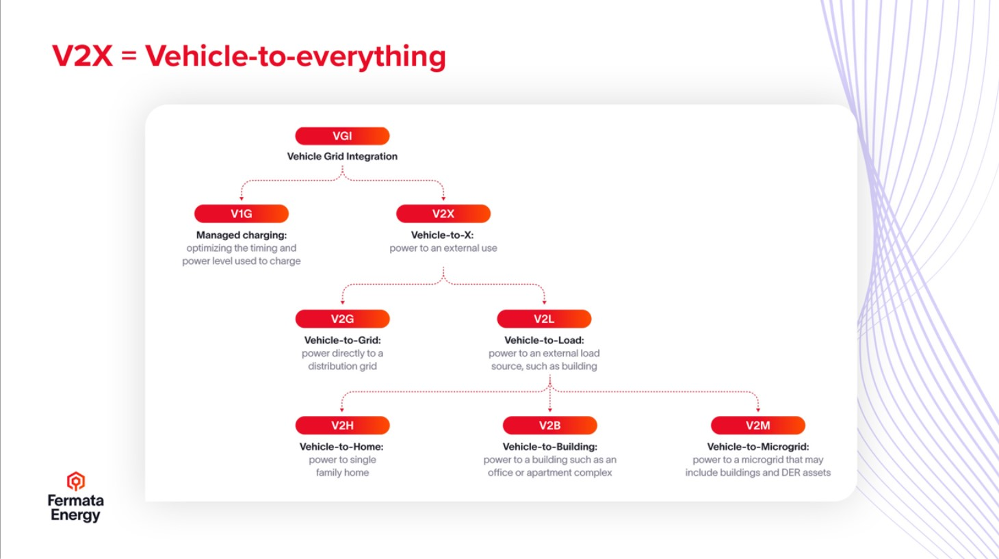
What is V2X?
(and what is missing in this chart?)

Slide 3
What is V2X?
(and what is missing in this chart?)
V2V _
Vehicle-to-Vehicle:
Transfer between EVs
(a range anxiety solution)

Slide 4
EV Battery Statistics (2022)
Source: California Energy Commission, “Zero Emission Vehicle and Infrastructure Statistics”

Slide 5
EV Capacity (2023-All Classes)
The California Energy Commission provides ZEV registrations broken down by the number of each make/model
https://www.energy.ca.gov/data-reports/energy-almanac/zero-emission-vehicle-and-infrastructure-statistics
Energy: 70.1 GWh
Number of Vehicles: 957,635
Source: Redwood Energy, “The Power of Bidirectional Electric Vehicles in California”

Slide 6
V2X Offers Massive Storage Capacity
Vehicles in U.S. drive an average of 37 miles/day and EV efficiency is about 3.4 miles/kWh
Each car is using ~11 kWh/day
Avg. battery is ~73 kWh, daily use is 15% of total battery
Drivers want ~80 miles (23.5 kWh) of range left after discharging.
About 37 GWh of Vehicle battery remains for Grid Use
California expected to host 12.5 million EVs by 2035, providing ~125 GW of power if bidirectional = over 2x California’s highest “peak load” of 52 GW (Sept. 6, 2022).
37 miles Daily Use
80 miles of reserve range
Source: Redwood Energy, “The Power of Bidirectional Electric Vehicles in California”

Slide 7
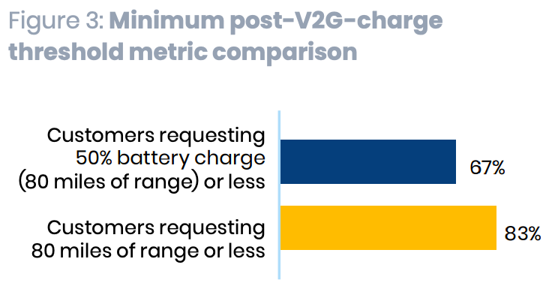
Barriers to Participation
Access to / cost of bidirectional chargers
Concerns about battery degradation from cycling more often
Concerns about privacy and lack of control (distrust of utility)
Confusing software or technology
Range anxiety (solved through V2V)
  Customers willing to discharge more EV battery capacity if remaining mileage range is known (as opposed to remaining percentage)
  Problem: mileage varies according to driving style and environmental conditions
Source: Energy Saving Trust, “Powerloop Vehicle-to-Grid Trial,” May 2022

Slide 8
Battery Degradation
Concern: Additional V2X discharge cycles will erode battery performance in violation of automaker vehicle miles traveled (VMT) warranties.
Solution: Decouple EV / battery warranties and measure battery performance on a KWh basis. Contrasting examples (assuming identical KWh):
Long-Distance Commuters: VMT-based battery use
Home-based Charging: Mix of VMT/V2X
Studies indicate that Bidirectional EVs can not only protect battery health but also extend battery life because batteries sitting idle for extended periods of time degrade faster than batteries in use. “Evidence suggests that V2X could prolong battery life through integration with optimized management algorithms and that cost effective V2X services may be dependent on battery chemistry.”

Slide 9
A Likely V2X Use Case Progression
Vehicle to Home/Building (V2H/V2B). The simplest use case, requiring only a bidirectional charger connected to a residential energy management system. Key Vendors: Ford, GM, Dcbel.
Vehicle to Microgrid. The most likely use case for businesses/employers and public parking facilities.
Vehicle to Vehicle (V2V). Often ignored, this capability could eliminate range anxiety, the primary barrier to EV adoption.
Vehicle to Grid. By far the most complex as it requires access to the distribution grid and facilitation by utilities/DSOs.
Question: Is V2G a requirement, or just icing on the BTM cake?

Slide 10
SB 233 Bidirectional Mandate:
A Matter of Public Safety / National Security
SB-233 Electric vehicles and electric vehicle supply equipment: bidirectional capability. “This bill would require that, beginning in model year 2030, all new electric vehicles sold in California be bidirectional capable, including light-duty motor vehicles and school buses, except as exempted by the state board.”
Public Safety and National Security Interests require a mandate. President Eisenhower justified the 1956 National Interstate and Defense Highways Act on national security grounds. V2X would leverage this infrastructure to create a secondary, mobile energy system that will provide energy security.
Climate Change makes implementing V2X a “life or death” issue. Power outages during extreme heat (Phoenix) or cold (Texas) will claim lives.
Auto Manufacturer Opposition: Thou Doth Protest Too Much (Again). Automakers have fought past mandates (seatbelts, catalytic converters, etc.) tooth and nail. They claim to support V2X but oppose the mandates based on alleged consumer choice and cost considerations.
A mandate ensures equal access as a “standard feature”. Optional offerings will limit implementation to high-end models and trims, delaying access by used-EV buyers.
Source: The Climate Center, “SB 233 Fact Sheet”

Slide 11
Takeaways
V2X Bidirectionality is Essential to a Successful Electrification Transition. V2X storage capacity is just too great given limited mineral resources.
All V2X Use Cases must be Assessed equally. Benefits from BTM use cases (V2H, V2B, V2V) are sufficient to warrant implementation irrespective of V2G hurdles.
V2G Will Likely be the Last V2X Use Case Implemented (Do we even need it?).
Successful V2X Deployment will Require Integration of Workplace/Public Charging with Residential/ Public Discharging. Local/state planning must identify likely charge/discharge scenarios.
The V2X debate is not “If” but “When” and more importantly, “How.” No stakeholder directly opposes V2X, but many advocate for a market-based approach. Public interest demands strong government oversight to ensure proactive development and equitable access.
Incremental Costs are Relatively Minimal. Adding bidirectional capability to EVs typically requires an inexpensive software upgrade at negligible cost to automakers (and occasionally requires an inexpensive diode change). Hundreds, not thousands, of dollars.
My personal experience with Audi Beam “Rings” (see below). I didn’t ask for it, but it came with the car. I would trade it for V2X in a heartbeat!

Slide 12
Thank You!
Robert Perry, Principal Analyst
Robert.Perry108@gmail.com
(818) 384-4557

