Slide 1

October 2018
Wastewater Treatment Plants as Energy Resource and Resiliency Centers
August 24, 2023
Jim Dodenhoff
Principal
Silent Running LLC
James.Dodenhoff@gmail.com
www.silentrunning.biz
municipal and state
energy edge forum
Notes:
It is useful to look at Wastewater Treatment Plants through some slightly different lens: 1) Resiliency 2) WWTP’s as Resource Providers, 3) Community Infrastructure; and 4) The Interplay or Nexus between WWTP’s and Energy

Slide 2
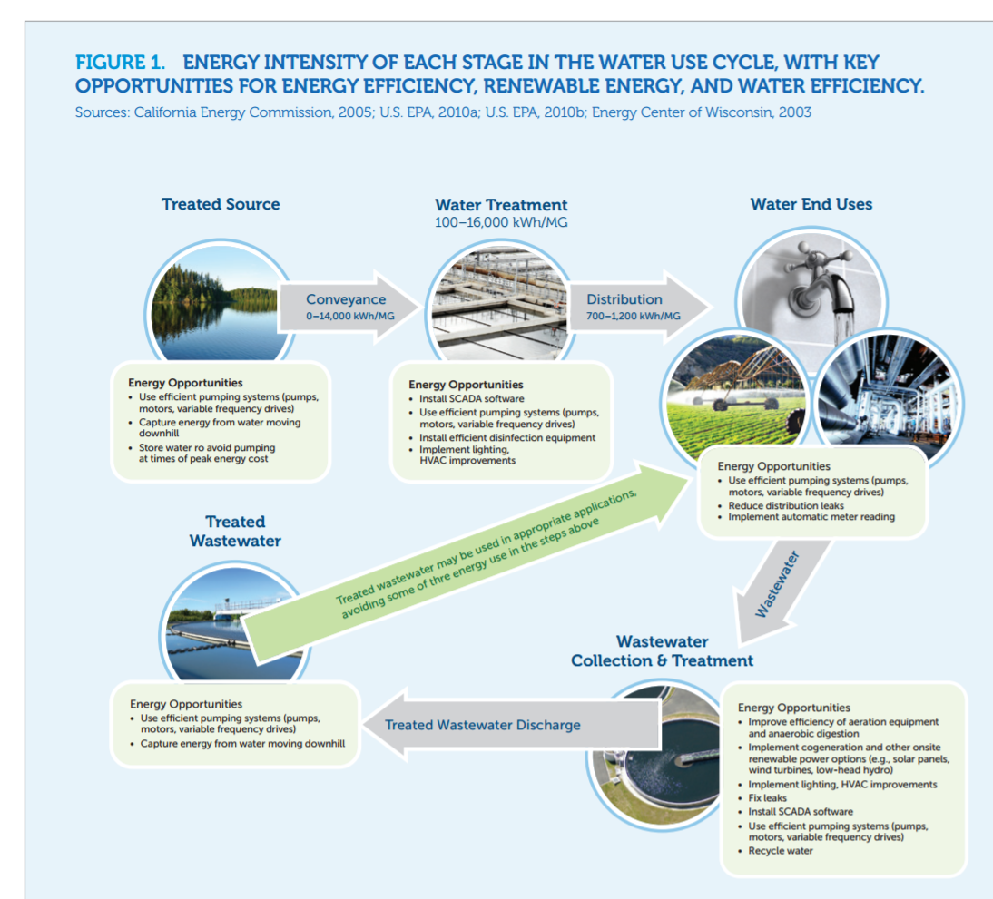
Overview of the water use cycle
Notes:
In 2015 or thereabouts a collaborator of mine, Noah Mundt did some general research focused on Water Distribution Systems, and what we determined was that a Systems Approach was critical to understanding Water Distribution Systems and that the greatest opportunity for energy-water savings was in conveyance of supply and distribution of of treated water to end uses.
Today’s presentation focuses broadly on Wastewater Treatment and the opportunities for Energy and Water Conservation. We also take a peek at the importance of factoring in the beneficial use of treated wastewater.

Slide 3
An Overview of
U.S. WWTP Technology
Notes:
Best viewed in presentation format to bring in animation

Slide 4
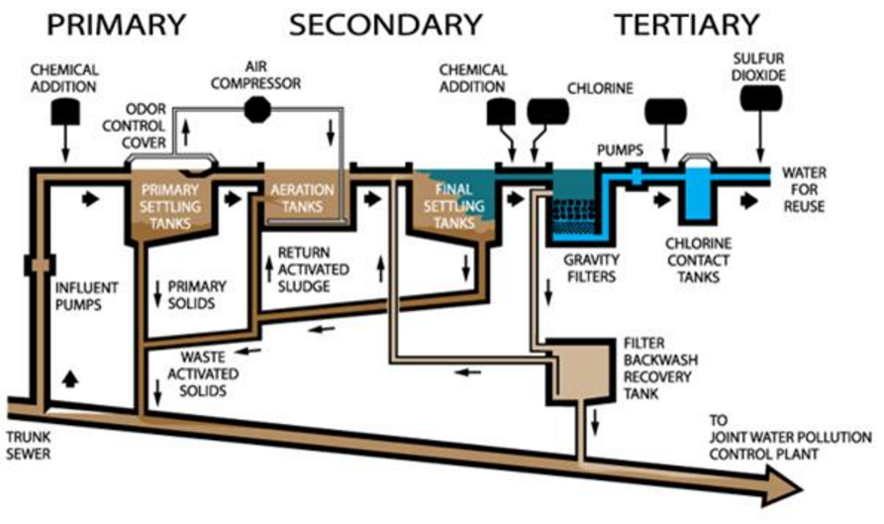
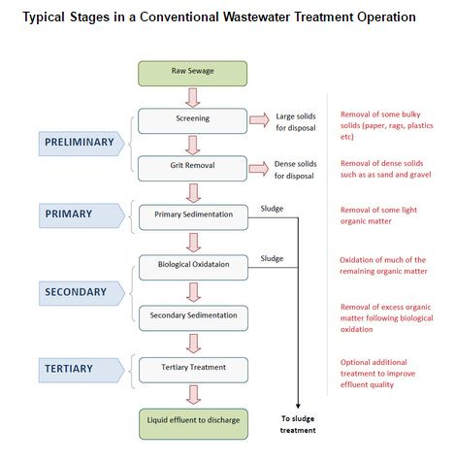
Typical WWTP Process
Notes:
At a high level, Wastewater Treatment has three primary objectives
Remove pathogens that could be dangerous to drinking water
Remove Nutrients (namely Phosphorus and Nitrogen) that could result in algae accumulation
Remove organics that contribute to low dissolved oxygen levels in water
Pause at the Primary, Secondary, Tertiary Graphic……….
This type of process, which is the most widely used in the industry, has many mechanical elements: Pumps, mechanical aerators, blowers, diffusers, compressors, filters, and tanks. It also speaks to a paradigm where “dirty wastewater’ is “treated” primarily through addition of “cleaning chemicals” to “remove” the bad stuff and bad smells…..with the end product being cleaned water and “sludge” which might require additional treatment…………a Wastewater Treatment Plant. We’ll come back to this “old paradigm”.

Slide 5
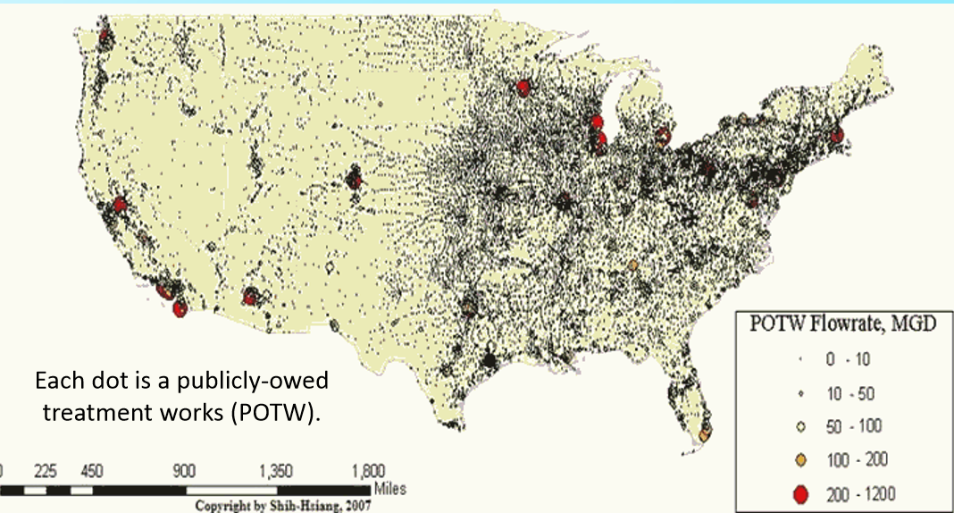
U.S. Municipal wastewater treatment industry: 15,000+ Plants treating 33,000 Million Gal/day
Notes:
*From EPA-This is # of Facilities that treat domestic wastewater from residential and commercial establishments
…..an additional 500+in older cities and major urban areas collect rainwater in the same pipes as domestic wastewater
15,000 + WWTP facilities in the U.S.*
Total flow of 33,000 MM Gallons/day
Serve 75% of U.S. Population
Vast Majority of WWTP’s publicly owned
WWTP Electricity Use 1-2% of Total U.S. consumption
Energy Use can range from 20-40% of the overall cost to operate a WWTP
WWTP Energy Costs key driver for muni/county budgets----a potential “budget breaker”

Slide 6
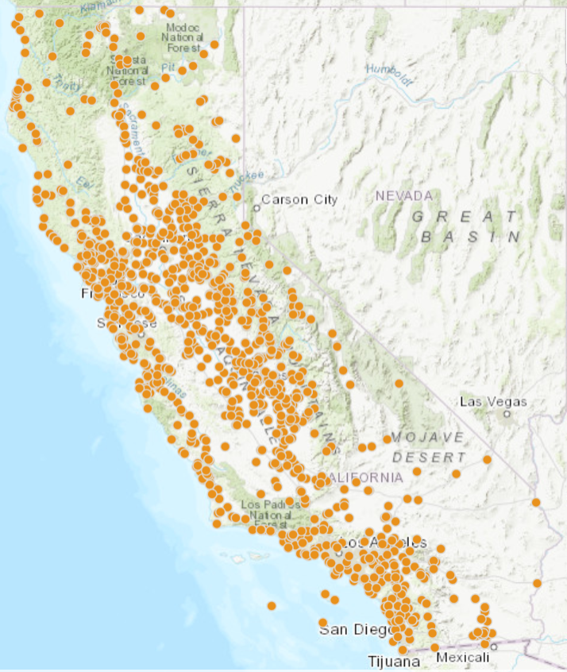
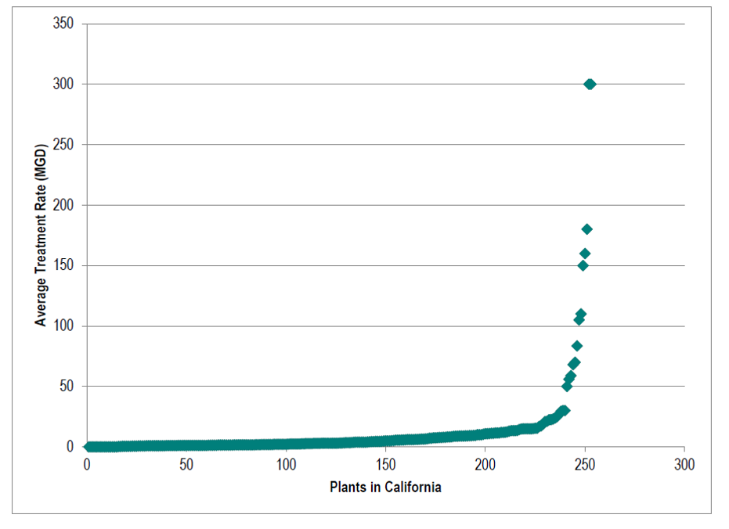
Distribution of WWTP’s in CA
Distribution of Wastewater Treatment Plants in California Sorted by Average Flow Rate, Source: Measure, Application, Segment, Industry (MASI): Wastewater Treatment Facilities, Prepared for Southern California Edison by Navigant Consulting, March 2015
California State Geoportal,
Wastewater Facility Mapping
Notes:
Note geographic dispersion and the very few # of “large WWTP’s”

Slide 7
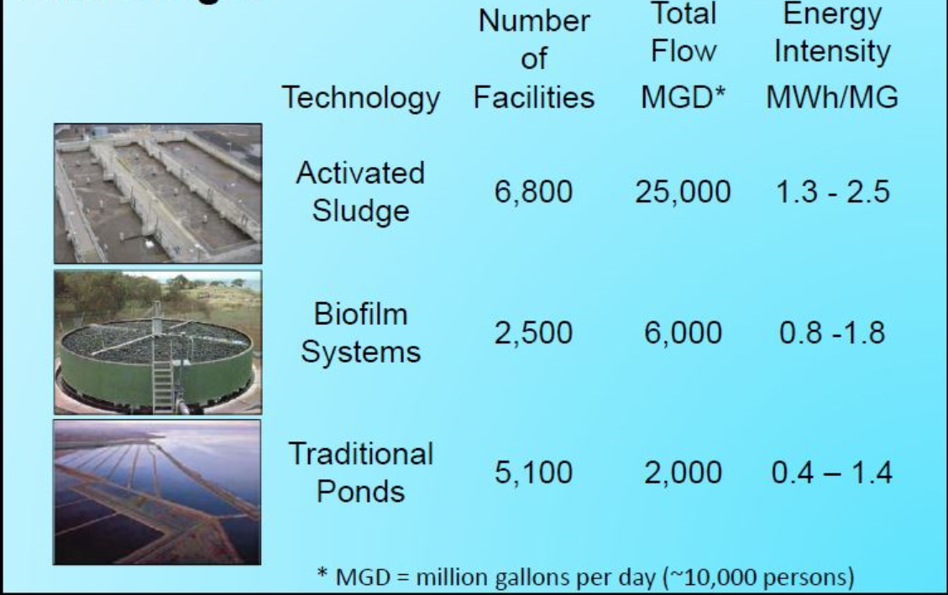
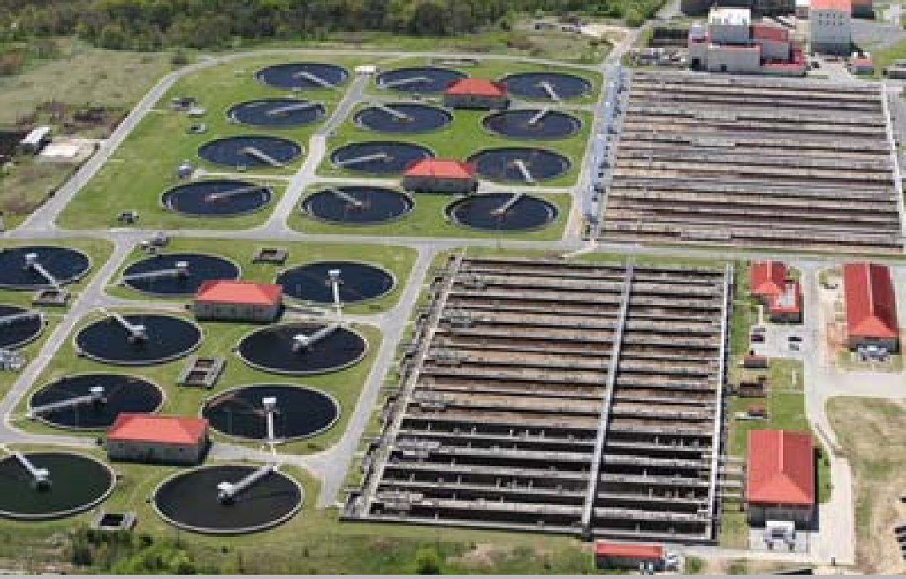
Wastewater treatment is performed using three major technologies
The RNEW® Process: Recycled Water, Fertilizer, and Power from Wastewater; ABO-WEF Water Forum | October 23, 2016 | Tryg Lundquist, Ph.D., P.E., Presenter R. Spierling L. Parker, C. Pittner, L. Medina, T. Steffen, J. Alvarez, N. Adler, J. Benemann
Notes:
-Provide a brief overview of each Major Technology
-Note differences in Energy Intensity

Slide 8
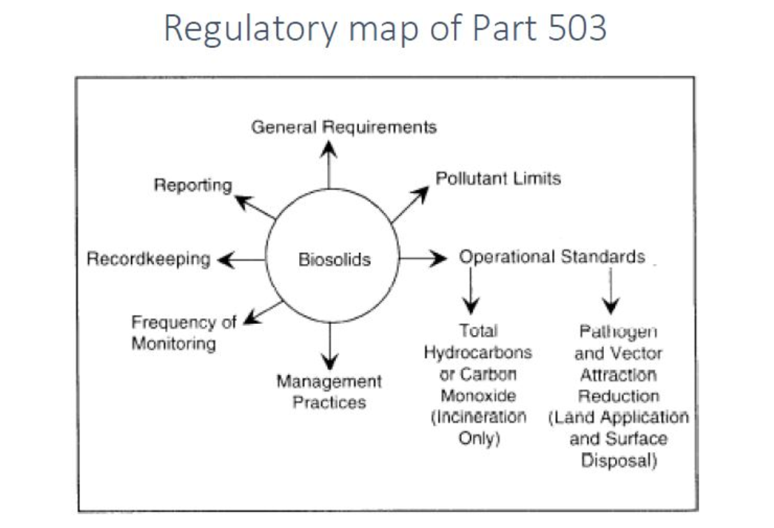
Key Regulatory Driver for WWTP relates to quality of discharge
Notes:
40 CFR Part 503 for Biosolids………..(also applicable to algae solids from Wastewater Treatment)
-Minimum national requirements applicable to the use/disposal of sewage sludge
-Part 503 includes, for Class A and Class B
-Sewage Sludge quality limits
- Management practice requirements
-Monitoring/Recordkeeping/Reporting Requirements
-Additional State, local requirements
--Applicable to algae solids from Wastewater

Slide 9
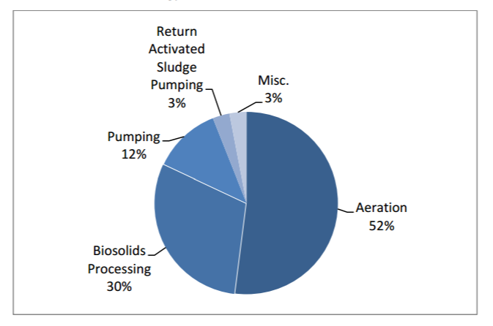
Typical energy use in wastewater treatment plants
Source: Hazen & Sawyer, Electricity Use and Management in the Municipal Water Supply and Wastewater Industries; Water Research Foundation and EPRI; November 2013

Slide 10
Benefits of On-Site Renewables & Storage Technologies

Slide 11
How WWTP’s benefit from Renewables, chp, and energy storage
Attain Renewables Objectives
Improved Energy Use Intensity (EUI)
Resiliency Benefits
Lower Life Cycle Costs
Decarbonization

Slide 12
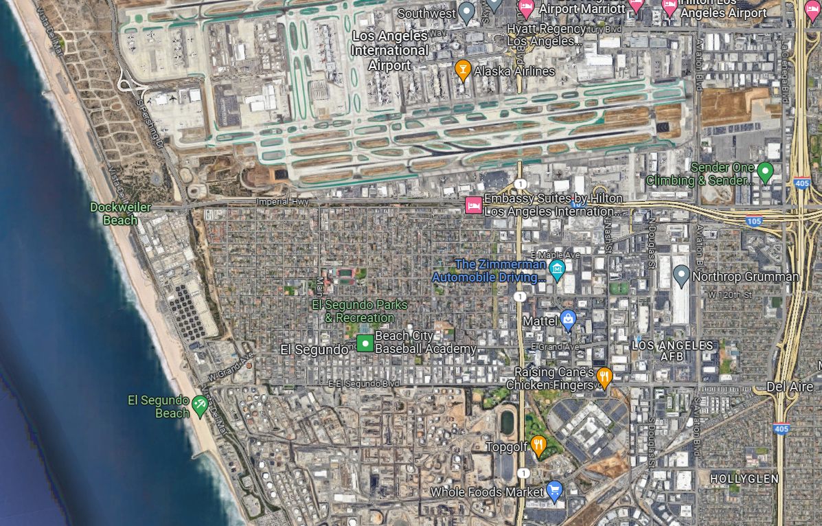
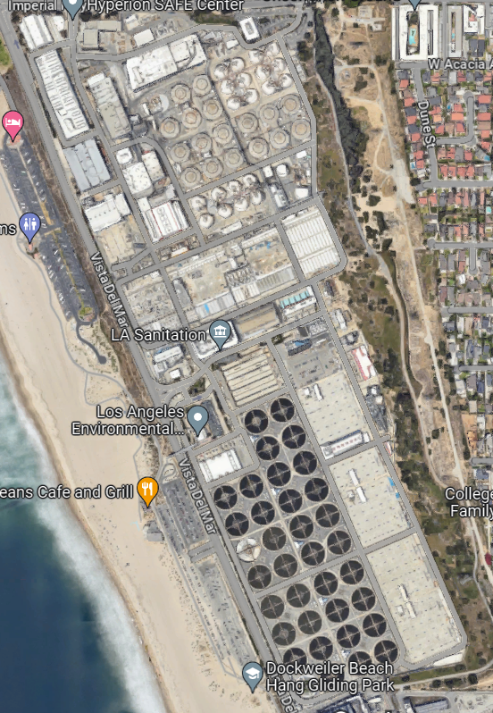
Hyperion WWTP-LOS ANGELES
Notes:
2021
More than two weeks after a flood of raw sewage inundated the Hyperion Water Reclamation Plant and triggered a massive discharge into Santa Monica Bay, the damaged facility has continued to release millions of gallons of partially treated wastewater into the Pacific Ocean, in violation of its environmental permit (LA Times)
Each day, the plant discharges 260 million gallons of wastewater into the ocean through a five-mile pipe about 12 feet in diameter. State regulators and environmental experts say that because the wastewater is not fully treated, it could harm people and marine life.
2023
Two years have passed since a catastrophic system failure at the Hyperion Water Treatment Plant led to a massive spill of 12.5 million gallons of raw sewage into the plant’s one-mile outfall pipe. This disaster on July 11, 2021, was our region’s most devastating sewage spill in decades. In its aftermath, LA Sanitation & Environment (LASAN) is working with the Los Angeles Regional Water Quality Control Board (LA Regional Board) on a plan to address its numerous violations related to the spill. Depending on the outcome of negotiations between these agencies, robust penalties for this spill could create an opportunity for local community investments focused on ecological restoration, as well as investments that would modernize our wastewater system to protect our region from similar spills in the future.
Equipment failure at Hyperion caused the catastrophic flooding of this facility in July 2021. The flooding led to a slow-motion disaster that lasted for weeks, with partially treated sewage continuing to spill from Hyperion’s outfall pipe directly into the ocean for several weeks while the plant was repaired and not yet able to return to normal operations.
Though initial reports theorized that the system failure was a result of a large influx of debris that overloaded the system, an audit conducted by the City (and reviewed by the Hyperion Ad Hoc Committee) concluded that, instead, the devastating spill was the result of a perfect storm of operational and equipment failures. When debris screeners stopped functioning properly and caused internal flooding, pervasive flooding within the plant occurred. LASAN staff ultimately worked diligently to prevent the disaster from being even more catastrophic. But it was understaffing and missed warning signs that contributed significantly to the spill in the first place. It was this flooding that caused the plant to have reduced treatment capability for many weeks, and led to extended discharge of partially treated sewage into the bay.

Slide 13
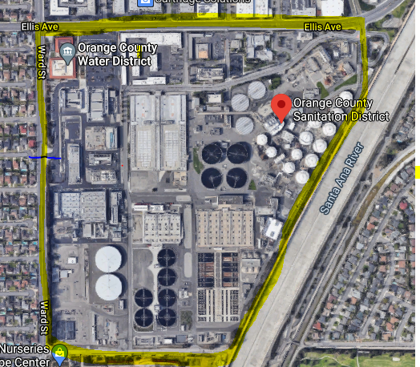
Orange County Sanitation District and
Orange county Water District
North
Entrance: 18700 Ward Avenue, Fountain Valley, CA 92708
West
East
South

Slide 14
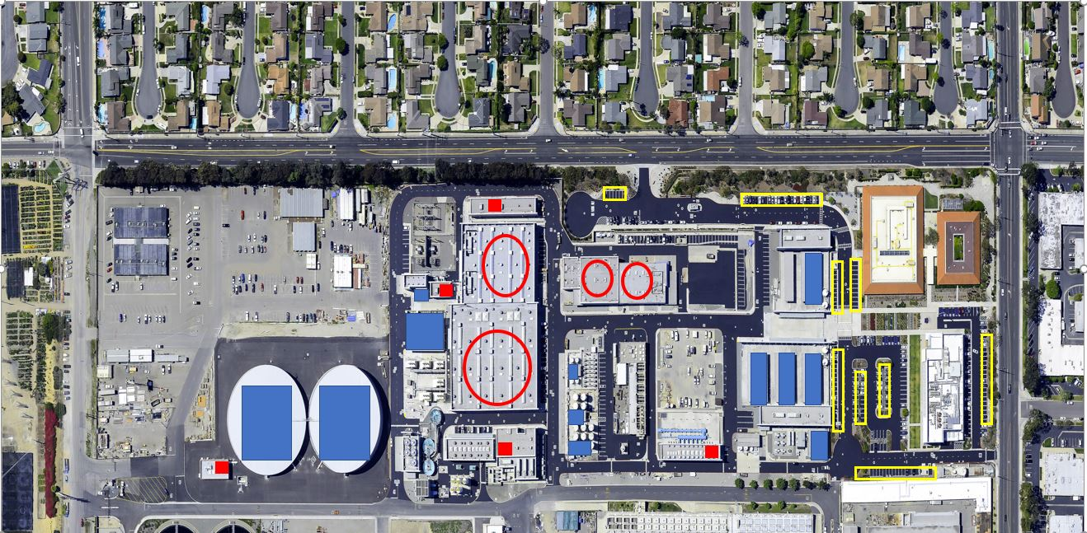
Entrance: 18700 Ward Street
Fountain Valley, CA 92708
WEST

Slide 15
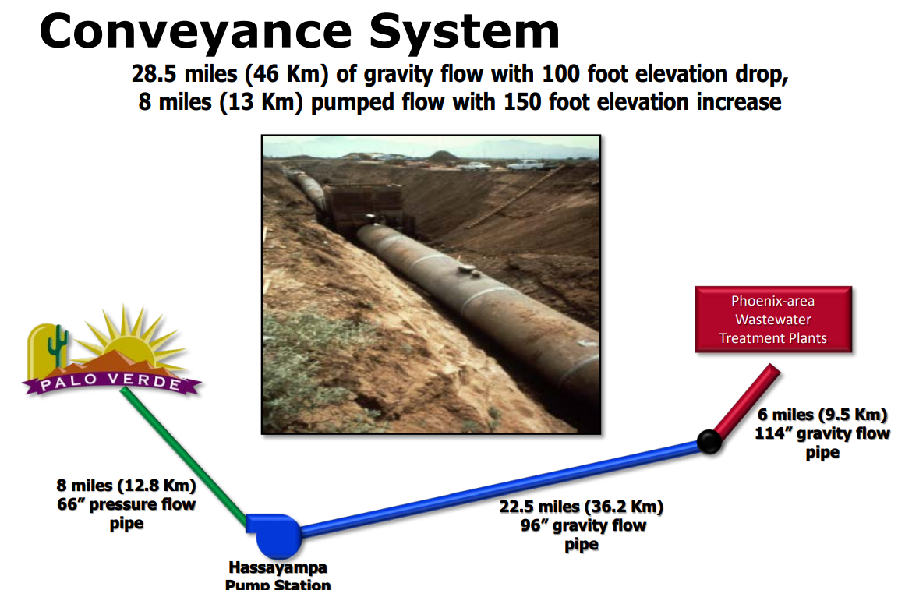
Phoenix 91st WWTP to Palo Verde Nuclear Plant, AZ
Source: Arizona Public Service

Slide 16
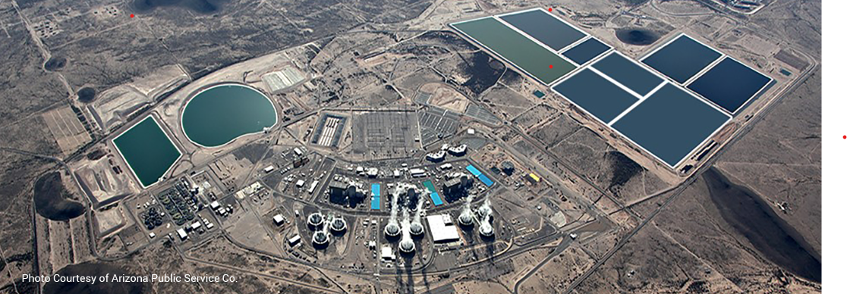
Palo verde Nuclear Generating Station, AZ

Slide 17
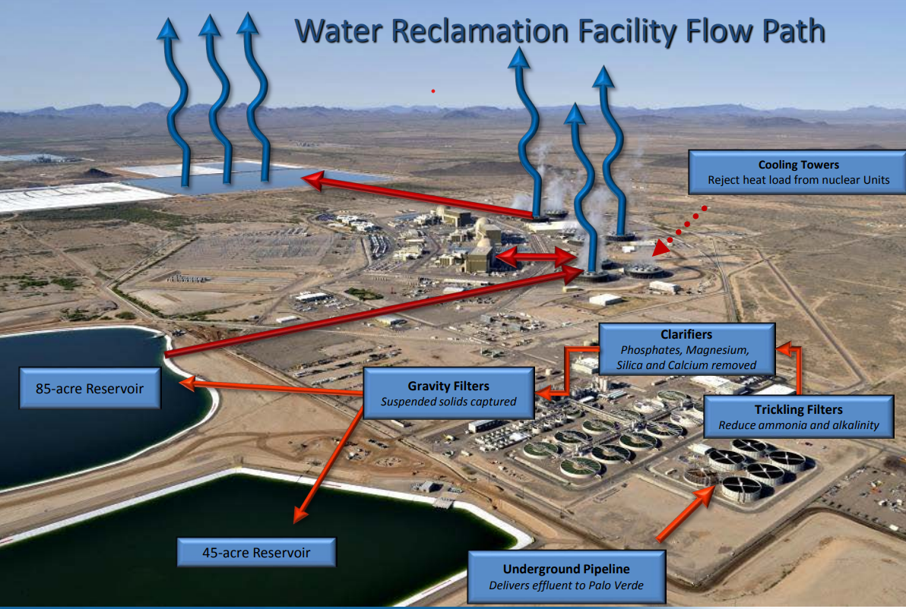
Source: Arizona Public Service

Slide 18
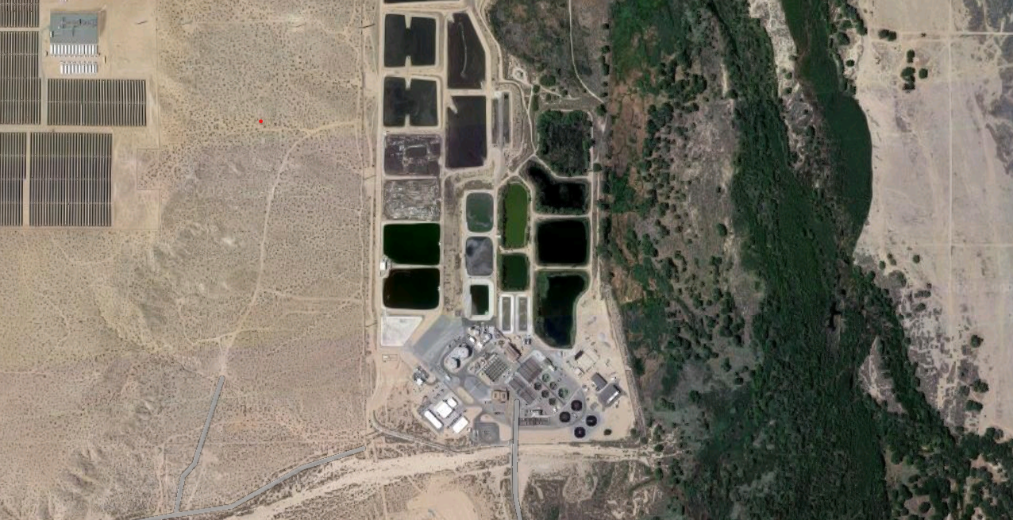
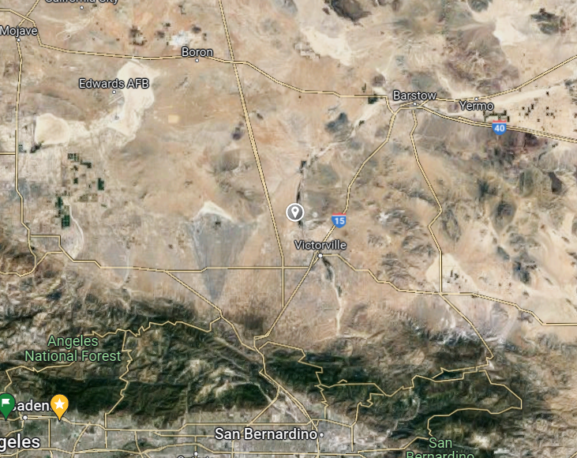
Victor Valley Wastewater Reclamation Facility, CA
Notes:
Victor Valley Wastewater Reclamation Authority (VVWRA) owns and operates a wastewater treatment plant in Victorville, California that serves a 279-square mile area that includes Apple Valley, Hesperia, Victorville, Spring Valley Lake, and Oro Grande and treats about 10.7 million gallons of wastewater a day. The plant has facilities that produce recycled water and renewable energy
VVWRA generates recycled water to meet California Code of Regulations Title 22 standards, that is repurposed for multiple uses. The recycled water is generated using an ultraviolet light treatment system that is one of the largest consumers of energy at the wastewater treatment plant and is very sensitive to changes in power quality. Electricity from Southern California Edison, the local utility, powers the ultraviolet system, and when small fluctuations occur in the power quality, the ultraviolet system shuts down. These small fluctuations in grid power quality, commonly known as blackouts or brownouts, are called “quality events.” Quality events and their resulting shut down of the ultraviolet system require at least one hour to reset and return to producing recycled water.
VVWRA also generates renewable energy at its wastewater treatment plant. To treat wastewater, VVWRA uses anaerobic digestion, which creates digester gas, a renewable fuel. The digester gas is used to fuel two 800-kilowatt generators that generate renewable energy and have the potential to supply 100 percent of the energy and power for the wastewater treatment plant.
Flow Batteries Battery technology has existed for many years. Recent developments from companies like Tesla and applications such as cell phones have increased battery capacity while decreasing the size and weight of the batteries. These batteries overwhelmingly use solid-state lithium-ion technology. Solid-state lithium-ion technology is well suited for many applications; however, it has drawbacks that limit its applicability at wastewater treatment facilities. Solid-state lithiumion batteries have a relatively short life span when compared to energy projects and have an inherent fire hazard. Primus Power has developed an innovative hybrid flow battery system based on the zinc bromine chemistry called the EnergyPod. This hybrid flow battery system uses half the components of other flow battery designs. Also, the EnergyPod uses an electrochemical stack without any membranes or electrodes made of titanium metal. Membranes have proven problematic in other flow battery designs, and titanium is a relatively inexpensive material compared to the other electrode materials. The EnergyPod’s internal components are primarily made of low-cost, high-density polyethylene and are assembled with fewer components than traditional flow batteries. Fewer components enabled by creative design reduce production costs and maintenance and improve system reliability.

Slide 19
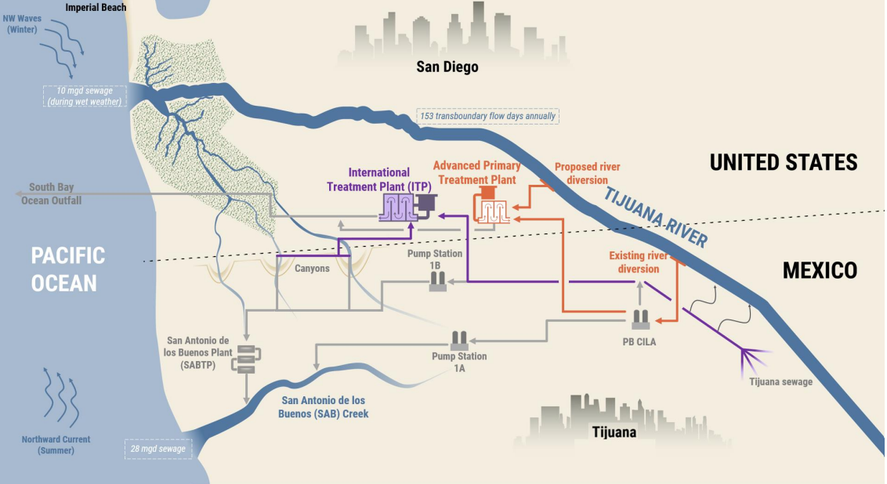
Tijuana River WATERShED Management-CA and Mexico
Notes:
SAN DIEGO, CA — U.S. Senator Alex Padilla (D-Calif.) today traveled to the U.S. International Boundary and Water Commission (IBWC) Wastewater Treatment Plant near the U.S.-Mexico border in San Diego to highlight federal efforts to address transborder water pollution in the area. Padilla received briefings from the U.S. Environmental Protection Agency (EPA) and IBWC on current projects aimed at reducing regional pollution. During the visit, Padilla also heard from stakeholders on the environmental and flooding impacts the proposed Tijuana River border wall project would have on the region. After the briefing, Padilla held a media availability.
“For far too long, toxic waste and raw sewage have flowed across the border into Southern California, bringing health hazards and environmental threats into our own backyards,” said Senator Padilla. “This pollution continues to contaminate Southern California’s air and water, depriving communities of outdoor recreation and economic opportunities. It is critical that we build on the federal investments we secured last year in order to implement a comprehensive, long-term solution to improve sewage treatment in both San Diego County and Tijuana.”
“We are grateful for the Senator’s attention to this plant and for his support on improving sanitation efforts along the U.S.-Mexico border. We look forward to continuing our collaboration on obtaining the funding necessary to achieve the objective of reducing the transboundary flows for the benefit of the beaches and the surrounding communities,” said Dr. Maria-Elena Giner, P.E., Commissioner, IBWC, United States Section.
“Border communities share one watershed, and the solutions to reducing pollution in our shared environment require collaboration across all levels of government,” said EPA Pacific Southwest Regional Administrator Martha Guzman. “Today we discussed the critical role of ongoing maintenance required for success on both sides of the border, especially with the addition of the Customs and Border Patrol bridge and gate infrastructure.”
Senator Padilla successfully secured language in the FY 2023 appropriations package to eliminate red tape and allow the EPA to deliver $300 million previously secured in the U.S.-Mexico-Canada Agreement to the International Boundary and Water Commission for water infrastructure projects. This funding is critical for reducing transboundary water pollution in the San Diego/Tijuana region. Padilla also worked to secure $3.45 million for the Smuggler’s Gulch Dredging Project in San Diego County, which will dredge Smuggler’s Gulch channel to clear trash and sediment and protect downstream properties, habitats, and communities as well as human and environmental health in the Tijuana River Watershed and coastal waters.
Xxxxxxxxxxxxxxxxxxxxxxxxxx
Mexico is experiencing an ongoing environmental disaster as a result of its waste water crisis. Tijuana and Imperial beaches have rivers that carry untreated sewage into the ocean, and Tijuana frequently dumps its sewage into the river. Because of the polluted waters, their beaches are brown and smelly, making them some of the worst beaches on the planet. Swimming in this water can be dangerous. The 62 km long underground wastewater treatment tunnel, known as the Eastern Discharge Tunnel / Eastern Wastewater Tunnel / East Issuing Tunnel, has been used by Mexico City to treat its sewage. Despite the Ocean Dumping Ban Act of 1988, which prohibits the disposal of “medical waste,” municipal sewage sludge, and industrial wastes in the ocean, raw sewage is still discharged into rivers and seas on a regular basis. In 2021, raw sewage was pumped into rivers and seas 350,000 times, according to data from that year. Mexico must take additional action to protect its water and people in this case in order to prevent further degradation of its water and waste management systems.

Slide 20
Why Energy Resiliency Is a good thing at a WWTP
Mitigates risk of contaminated water being discharged~~~Environmental Compliance
Customer & Stakeholder Satisfaction
Reduced Equipment wear related to hard stops and starts
Reduces Quality and Operational Costs related to demobilization and remobilization
Reduced Reputation Risk

Slide 21
how different technical tactics address WWTP challenges
Notes:
Action: Review this Chart by line item to assure alignment……and bring in source excel spreadsheet.

Slide 22
Isn’t beneficial water reuse at the heart of the water energy nexus
WWTP
BioGas
BioFuels
Fertilizer
Raw Sewage
Compost Feedstock
X
Produced Consistently, at Required Quality Levels
Evaporation
Saltwater Discharge
On-Site Water Reuse
Off-Site
Water Reuse
Aquifer Recharge
Surface Water Recharge
(Freshwater)

Slide 23
Thank you!
CONTACT INFO:
Jim Dodenhoff
www.silentrunning.biz
James.Dodenhoff@gmail.com
310-936-9456

