Slide 1


Systemic Benefits of Hydrogen Electrolysis
Robert Perry,
Principal Analyst
September 27, 2023

Slide 2
Some Background Observations
Legacy Energy Infrastructure: Based on 100% stored energy in fossil fuels, generation can be closely matched to consumption, allowing for operations within tight margins.
Renewable Energy Infrastructure: Variations in generation require flexible systems based on planned surplus generation to ensure sufficient direct electrification in fallow periods, with secondary uses for excess capacity, resulting in zero curtailment.
It’s Algebra v. Geometry:
  Fossil-Fuel dispatchability allows for precise balancing of generation and load.
  Renewable systems require a more geometric analysis using Venn diagrams
Modular Renewable Technologies Allow for Scale (in both Directions)
  There are Macro- to Mid- to Micro-Solutions for every Situation

Slide 3
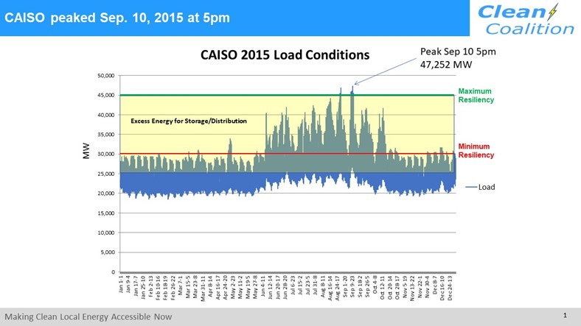
Resilience from a Demand-Side Perspective

Slide 4
Resilience Supply-Side Implications
Resilience Requires that Sub-Optimal Generation Scenarios still Meet Demand.
Planned System Excess Assures Reliable Supply Under Most Conditions.
Energy Curtailment is Virtually Eliminated:
  All excess can be redirected to electrolysis
  During shortages, electrolytic hydrogen production is the only resource curtailed
Renewable
Generation
Electrolysis
Ratio Adjustment for
Environmental Variations
Fuel
Cell
Gen.

Slide 5
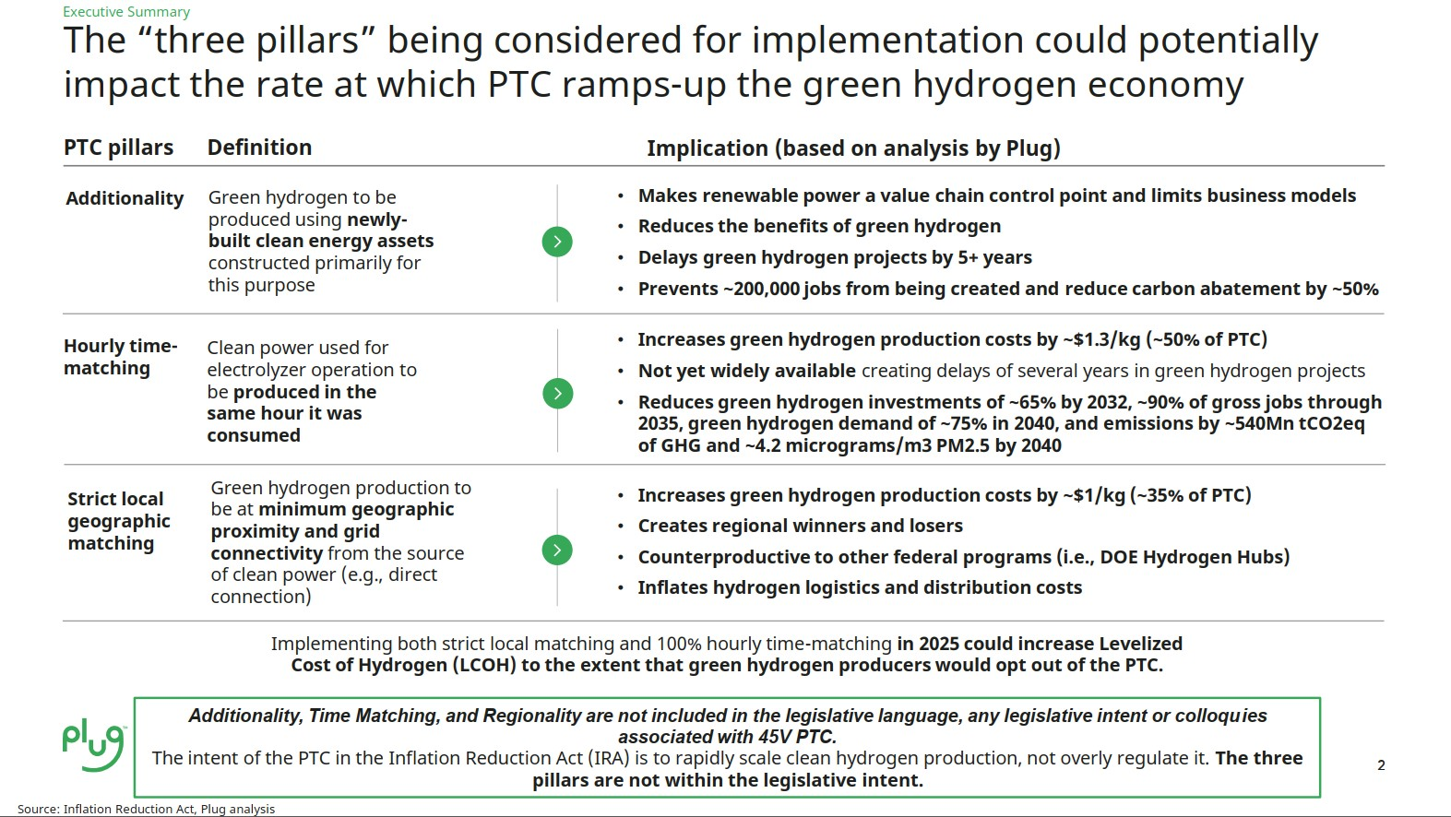
Debating the 3 PTC Pillars of Green H2 Production
Counter Argument to Plug Power:
Plug Power’s opposition is based on a reactive, centralized arbitrage model that will exacerbate grid congestion, requiring massive transmission investments to be borne by ratepayers.
Rather than proactively co-locating electrolysis with generation to avoid grid stress, the Plug Power arbitrage model relies on curtailment as a lever for off-taking excess generation that is indiscriminately located throughout the transmission grid.
Source: Plug Power Comments in opposition to NRDC Analysis, IEPR Commissioner Workshop on the Potential Growth of Hydrogen, September 8, 2023

Slide 6
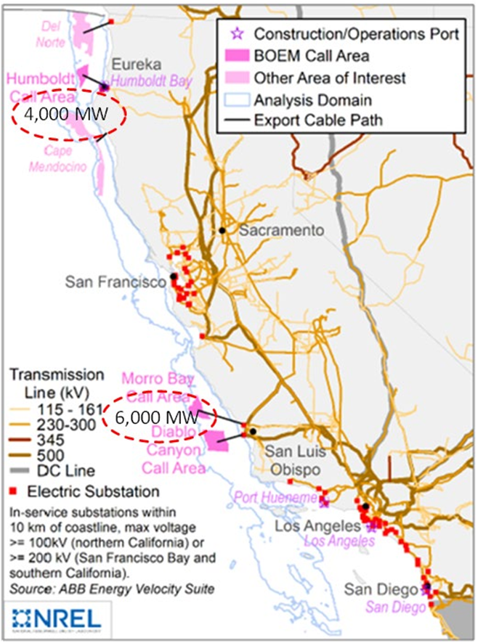
Macro Use Case: Offshore Wind
Problem: Right-Sizing Transmission Capacity. Requires a “measure thrice, cut once” approach to avoid costly expansion.
Off-shore Electrolysis Enables OSW Expansion. Current 10GW could be doubled without adding transmission requirements.
Off-shore Hydrogen Production can be Transported by Ship to Nearby Ports.
  Port heavy infrastructure an ideal match.
  Ports also a distribution point for heavy industry.

Slide 7
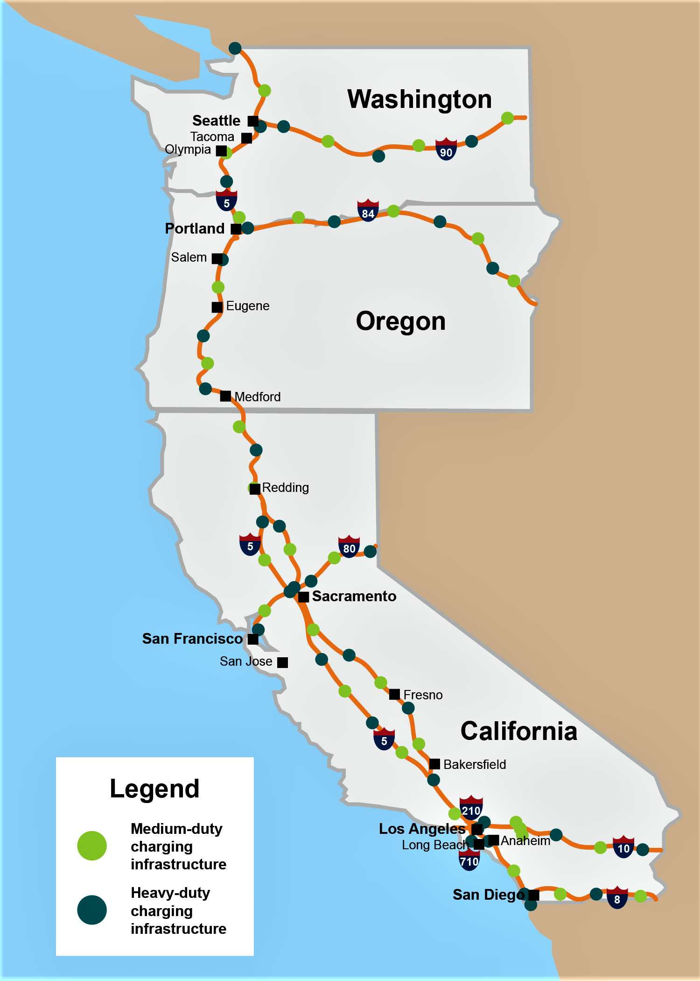
Mid-Use Case: Transit Corridor Refueling
EVSE is Critical Infrastructure Requiring High Resilience. The only solution is by developing a high level of co-located distributed capacity to ensure continuous operations.
MW Charging Standard (MCS) will Require Utility-Scale Generation.
Fuel-Cell Vehicles: Must include a power export function similar to bidirectional charging in BEVs
Relevant Proceeding: GFO-23-602 – Up to $20 million for Charging and Refueling Infrastructure for Transport in CALifornia Provided Along Targeted Highway Segments (CRITICAL PATHS).
Source: CleanTechnica

Slide 8
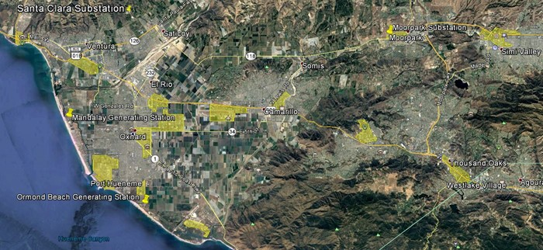
Micro-Use Case:
Commercial-Industrial Zones
C-I Infrastructure Offers Massive On-site Capacity. Flat warehouse roofs and acres of parking can be net generators.
Shared Electrolysis Capacity serves as a Critical Off-ramp for Local Excess Generation. Strategic location of refueling depots in C-I zones ensures distribution grid reliability/resilience.
Insufficient Local Production can be Offset with distribution of OSW shipments to Ports (See Macro Case).
You-Tube Flyover:
https://youtu.be/HOG9_zYVJiA?si=skZiD3FIHCpOaG6f&t=87

Slide 9
Takeaways
In all cases, accelerating renewable energy deployment is the overriding objective, and proactive incorporation of electrolysis into system planning guarantees maximum deployment of resource capacity with little to no grid curtailment.
Current policy towards hydrogen electrolysis is reactive and positions electrolysis outside or independent of planned renewable energy systems.
Co-located electrolysis withing energy systems avoids reactive grid stress and is essential for energy system agility/flexibility up and down the scale spectrum.
The path to a clean hydrogen economy is fraught with moral hazard, and many concerns by opposition groups are justified. Some hydrogen non-starters are:
  Blending hydrogen into natural gas power/transport infrastructure and residential heating. Decarbonization is a small fraction of the amount blended.
  “Blue” hydrogen production (SMR + CCS). CCS is unproven, perpetuating fossil fuel production.
  Absent technological advances, installation of long hydrogen pipelines. Emerging technologies account for leakage/boil-off but are still conceptual.

Slide 10
Thank You!
Robert Perry, Principal Analyst
Robert.Perry108@gmail.com
(818) 384-4557

