Slide 1



SOLAR PERMITTING IN TEXAS AND BEYOND
Presented by
Michael Fladmark
Designer: MJFladmark LLC / TRCSS Inc.
Council Member, City of Tool, TX

Slide 2

WHAT IS SolarAPP+ ?
ORIGIN: SOLAR ABC’s: CALIFORNIA 2013
2018: STAKEHOLDER MEETING ORGANIZED BY THE SOLAR FOUNDATION & SEAC & FACILITATED BY RMI
2021: DOE / NREL & Code Officials & AHJ’s & Solar Industry
Standardized plan review software to run compliance checks and speed up building permit approvals for eligible solar rooftop systems.
Known as Solar APP+ (Solar Automated Permit Processing)
Free, innovative software for municipality permitting departments.
Key facets include:
Integrates with existing government software.
Automates plan review, permit approval, and project tracking.
Standardizes up to 90% of standard system plans.
Provides an inspection checklist and final sign-off after installation.

Slide 3
WHAT DOES SolarAPP+ SUPPORT ?
2017 National Fire Protection Association 70 National Electrical Code (NEC) for rooftop PV permits
CA Title 24 Modifications
Inspection checklists
2018 I-Codes (International Residential Code and International Building Code) for rooftop PV permits
State and local license verification
2017 NEC for residential battery storage permits
2020 NEC for residential rooftop PV and battery storage permits
2021 I-Codes for rooftop PV and residential battery storage permits
Residential main panel upgrade permits

Slide 4
WHAT IS COMING FOR SolarAPP+ ?
New home construction permits for rooftop PV and residential storage
Roofing integrated PV products
All future versions of NEC and I-Codes for each supported technology
Reroof permits
Multi-family rooftop PV storage permit
Solar thermal permits
Residential EV charging permits

Slide 5
WHO IS USING SolarAPP+ ?
62 communities have publicly launched SolarAPP+ as of July 2023
78 communities are piloting SolarAPP+, with 27,660 permits issued across 646 contractors
END OF 2022:
• Arizona—5 AHJs • California—24 AHJs
• Colorado—1 AHJ • Connecticut—1 AHJ
• Florida—1 AHJ • Illinois—2 AHJs
• Iowa—1 AHJ • Michigan—1 AHJ
• Texas—3 AHJs • Virginia—2 AHJs
• Wisconsin—1 AHJ

Slide 6
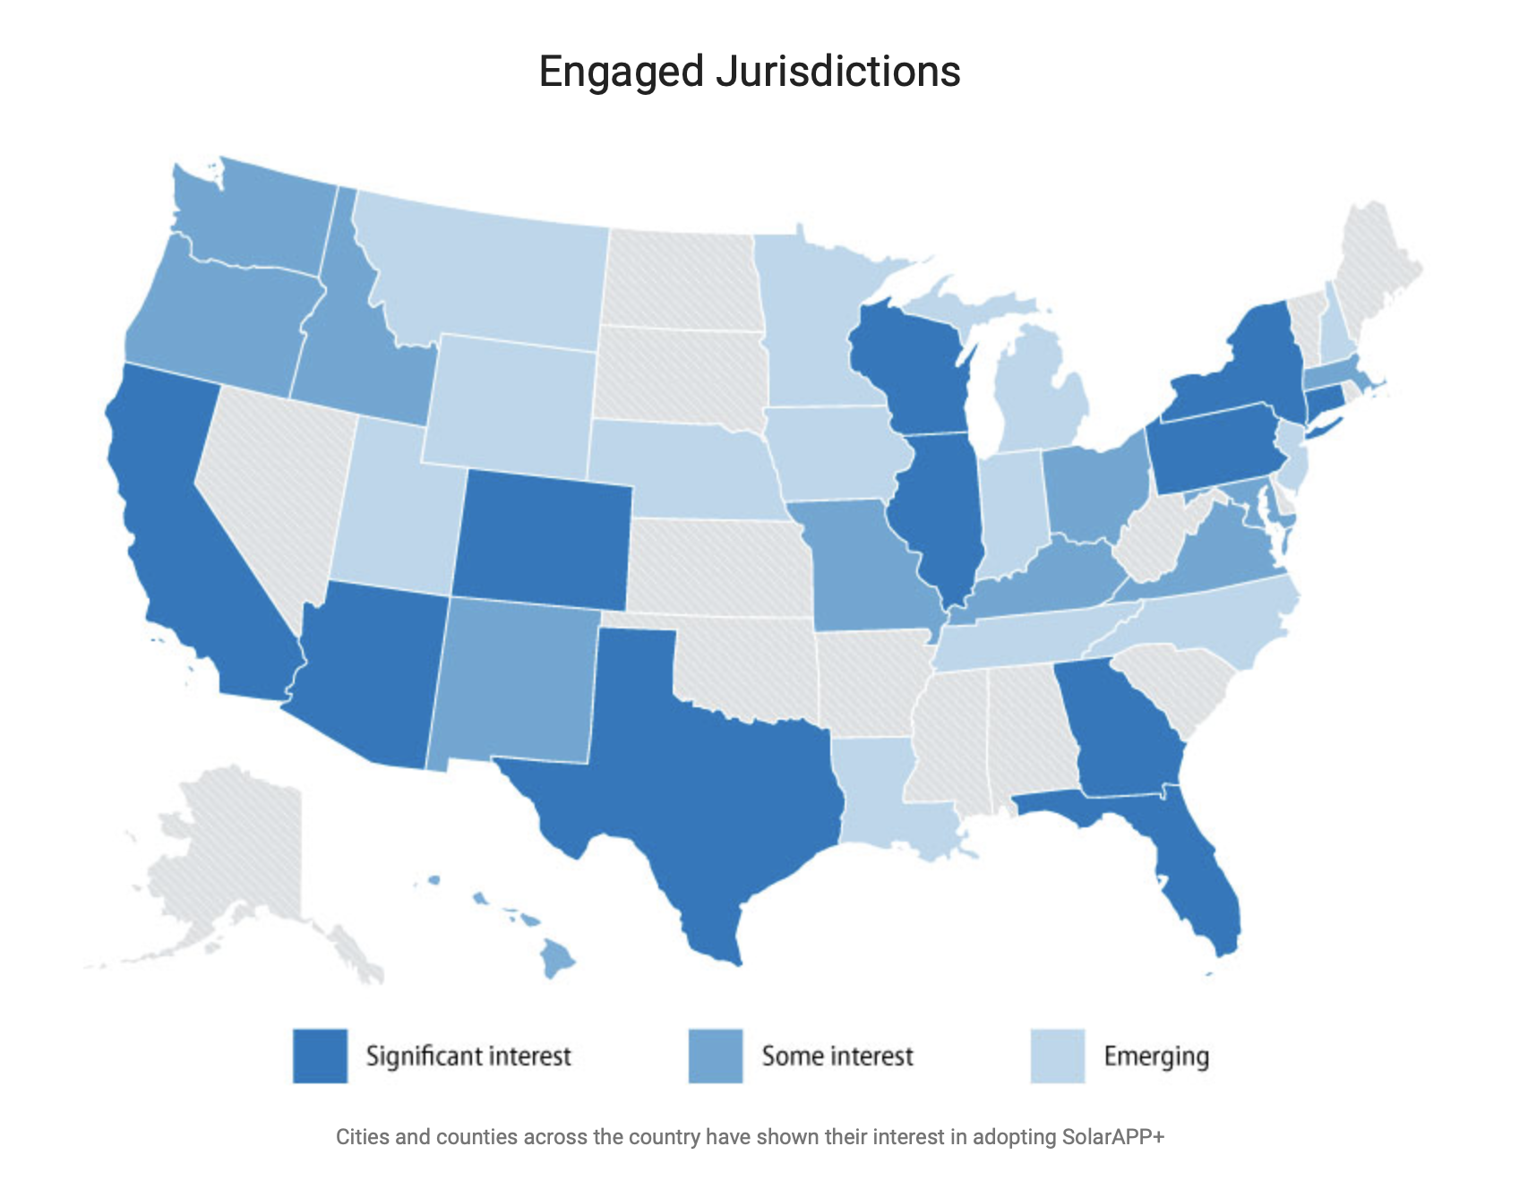
SolarAPP+ in the U.S.,

Slide 7
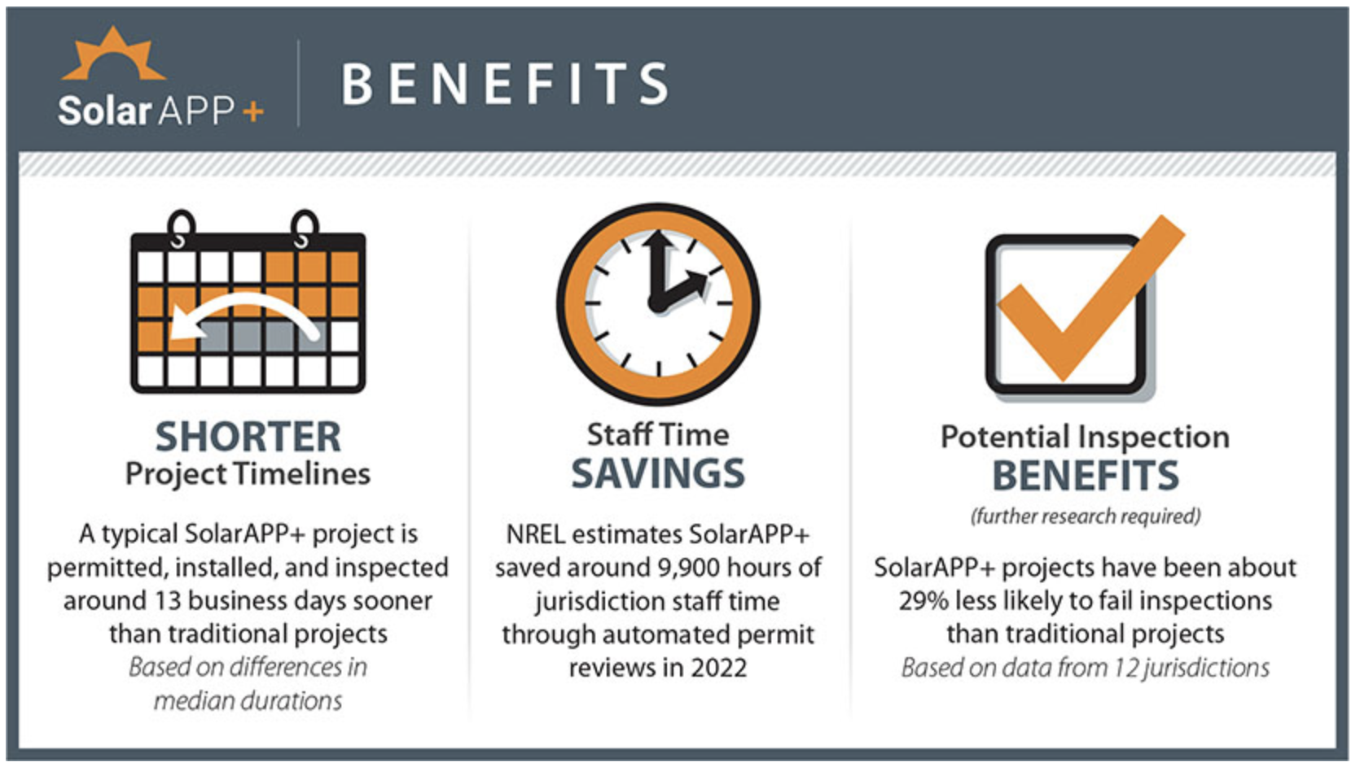
SolarAPP+ BENEFITS

Slide 8

WHAT IS TEXAS UP TO?
• TEXAS — 3 AHJs:
HOUSTON DEPLOYED Q1, 2023
WACO & TOOL: PILOTING
Once approved by the Department of Energy (DOE), SECO will offer a $25K funding opportunity for each qualified municipality to adopt Solar APP+.
In addition to SECO funding, NREL will support the municipalities with free technical assistance and hardware upgrades ­– this means NO cost to municipalities!
• TEXAS 88th STATE LEGISTIVE SESSION: Killed: HB 3010 (Zwiener), would have required cities to use the National Renewable Energy Laboratory’s SolarAPP+ program to expedite permitting and reduce costly wait times. Despite maneuvering and attempting to add the language as an amendment to other bills, HB 3010 did not make it out of House State Affairs Committee. Will try again next session.

Slide 9
HOW TO ADOPT SolarAPP+?
SolarAPP+ is free software and NREL will provide all the support local governments need to adopt. However, it will require a few meetings with the AHJ team to get set up.
Step 1 - SolarAPP+ technical demo and review of compliance checks with AHJ’s engineering team
Step 2 - Onboard planning and execution w building team and relevant departments, like Accounting or IT
  Standalone Option for offline AHJs (email + Stripe)
  Integration Option for online AHJs (fee payment & permits)
Step 3 - Pilot SolarAPP+ in a way that suits the AHJ
Step 4 - Implement adoption strategy and announce new process locally
Step 5 - Go live with SolarAPP+

Slide 10
SolarAPP+ RESOURCES
WEBSITE: https://solarapp.nrel.gov
PUBLICATIONS:
SolarAPP+ Performance Review (2022 Data);
NREL/TP=6A20-85827, May 2023
U.S. Solar Photovoltaic System and Energy Storage Cost Benchmarks, With Minimum Sustainable Price Analysis: Q1 2023;
NREL/TP-7A40-87303, September 2023
Streamlining Permitting with SolarAPP+;
DOE, July 2023

Slide 11

SolSmart: Roadmap to Advance Solar Locally
SolSmart is a national designation and technical assistance program that helps local governments make it faster, easier, and more affordable for residents and businesses to go solar
Five “Solar-Ready” Categories:
Permitting & Inspection
Train permitting and inspection staff on solar best practices (10 points each)
Planning & Zoning
Rooftop solar PV is allowed “by-right” in all major zones (20 points)
Government Operations
Install solar on a local government facility or land (20 points)
Community Engagement
Support a solar information session and/or solar tour (10 points)
Market Development
Support a solarize or solar co-op campaign (20 points)
75 actions across the five categories: • Point value ranging from 5 to 20

Slide 12
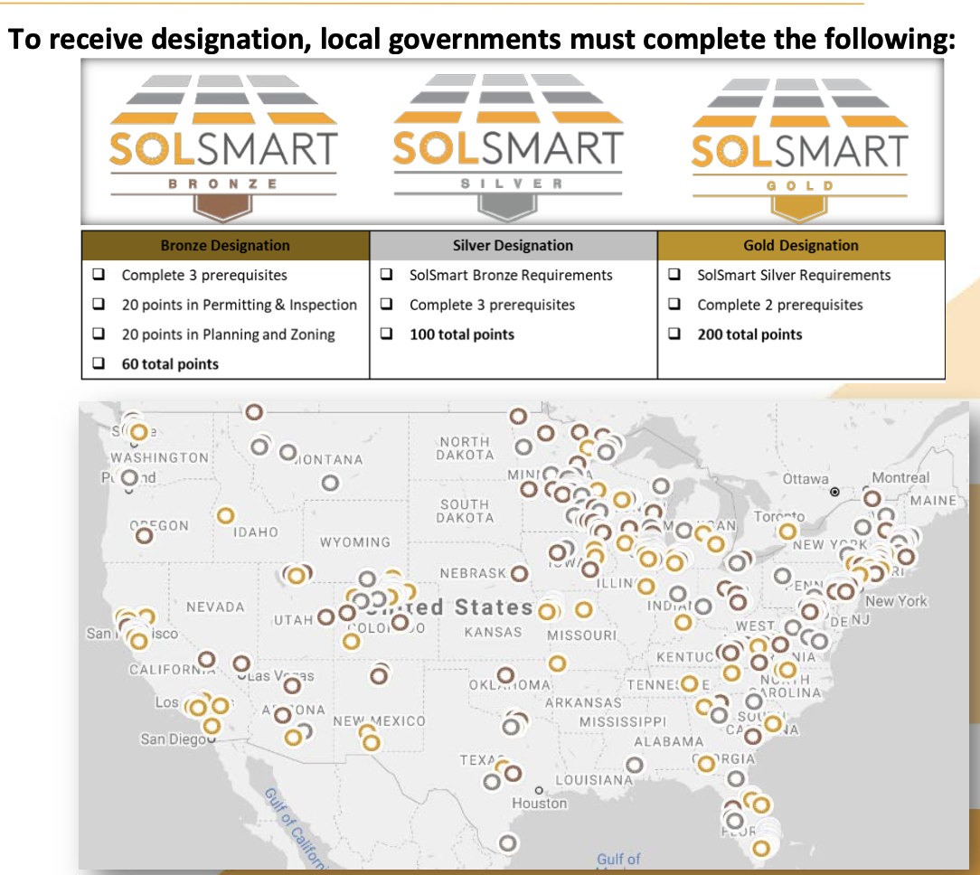
EARNING A SolSmart DESIGNATION
SolSmart designation recognizes local governments that have...
• Addressed local barriers to solar energy
• Fostered the growth of mature solar markets
Over 400 SolSmart designated cities, towns, and counties nationwide, signaling they are “open for solar business”
SolSmart provides no-cost technical assistance to help local governments meet their solar goals and earn SolSmart designation
Just added PLATINUM DESIGNATION for DEPLOYING SolAPP+

Slide 13
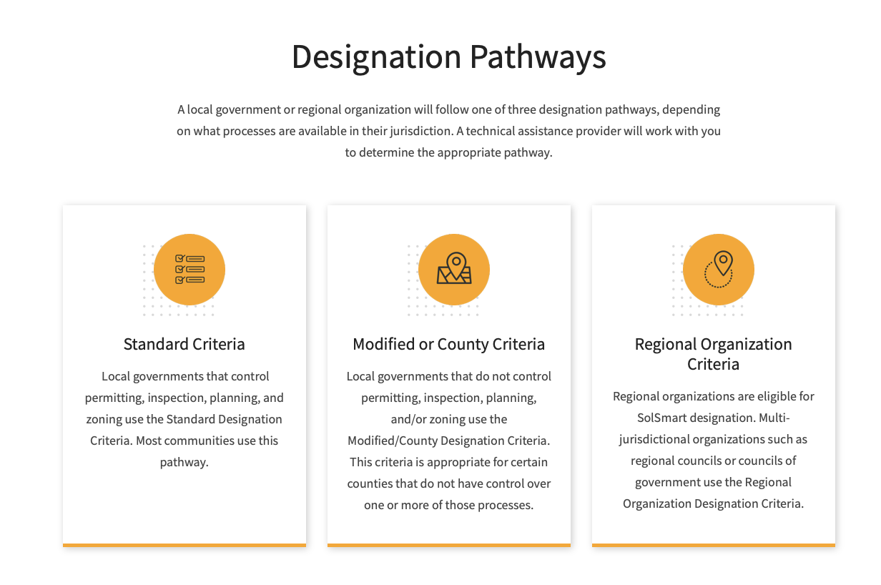
EARNING A SolSmart DESIGNATION

Slide 14
TEXAS SolSmart Cities
CITY | DESIGNATION | YEAR
Plano, TX | BRONZE | 2017
Lewisville, TX | BRONZE | 2018
Smithville, TX | BRONZE | 2019
North Central Texas Council of Governments, TX | BRONZE | 2020
Kennedale, TX | SILVER | 2017
San Antonio, TX | SILVER | 2017
Brownsville, TX | SILVER | 2018
Denton, TX | SILVER | 2020
Smithville, TX | SILVER | 2021
Celina, TX | SILVER | 2023
Harris County, TX | SILVER | 2023
Austin, TX | GOLD | 2016
Cedar Hill, TX | GOLD | 2017
El Paso, TX | GOLD | 2017
Corinth, TX | GOLD | 2018
Denton, TX | GOLD | 2021

Slide 15
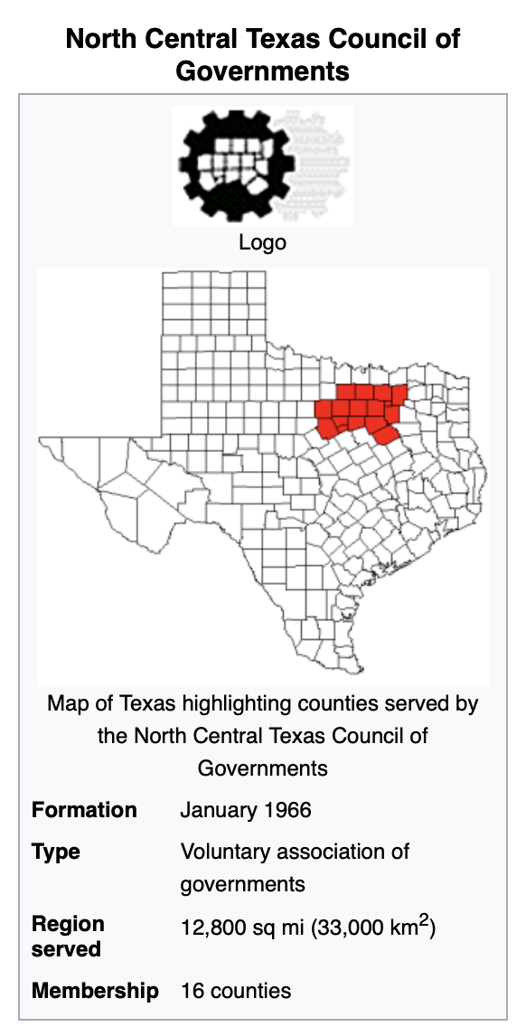
NCTCOG

Slide 16
NCTCOG RESOURCES

Slide 17




NCTCOG RESOURCES
https://www.nctcog.org
https://solsmart.org
https://www.gosolartexas.org
https://comptroller.texas.gov/programs/seco/

Slide 18
THANK YOU
Michael Fladmark
C: 214 929-6640
MJFladmark LLC: mjfladmark@mindspring.com
TRCSS Inc: mjfladmark@trcss.org
City of Tool, TX: mjfladmark@tooltexas.org

