Slide 1

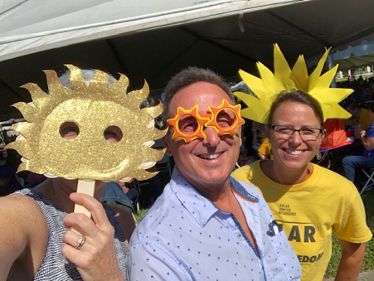
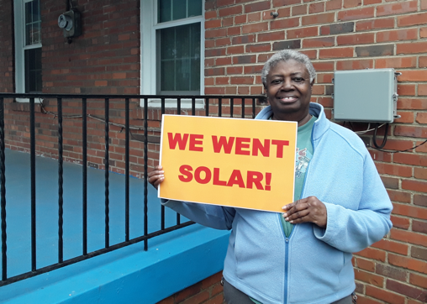
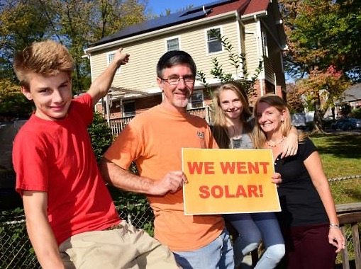
Aggregation of municipalities for purchasing power and/or influence

Slide 2
WHAT IS SOLAR UNITED NEIGHBORS?
We’re a vendor neutral, national 501(c)(3)
nonprofit.

Slide 3
WHAT IS SOLAR UNITED NEIGHBORS?
We help people
go solar,
join together,
& fight for their
energy rights.

Slide 4
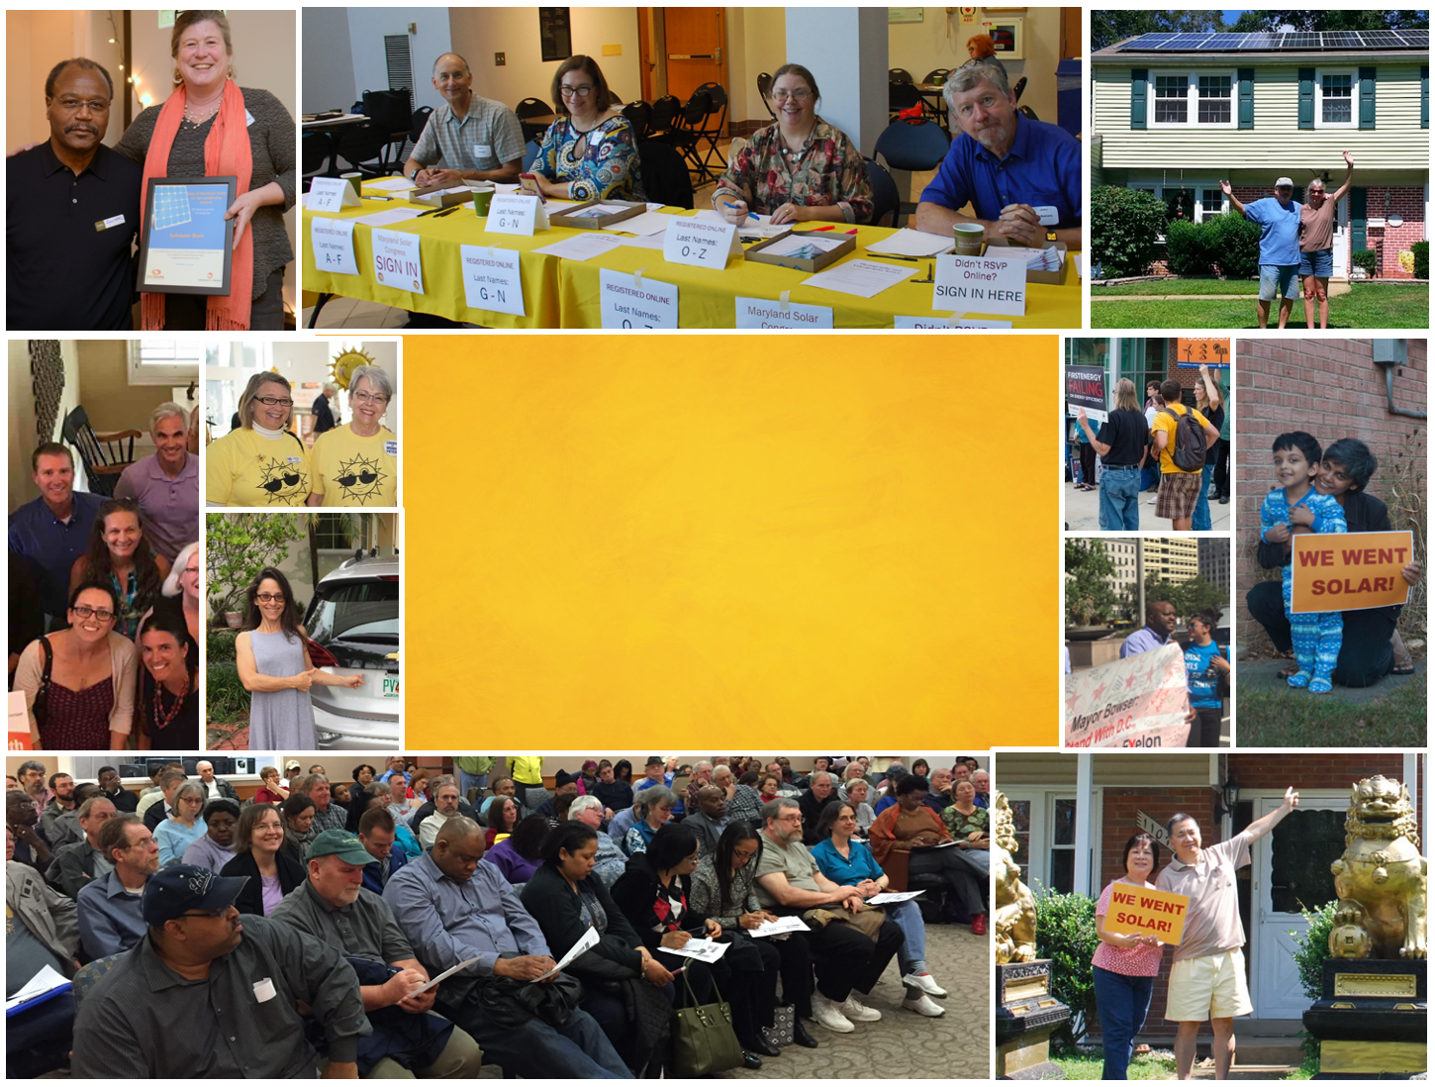
Our National Impact
8,335+ solar households
74 Megawatts of solar
970,000 Tons of CO2 Saved

Slide 5
We know from various sources that solar in an area
drives more solar in that area

Slide 6
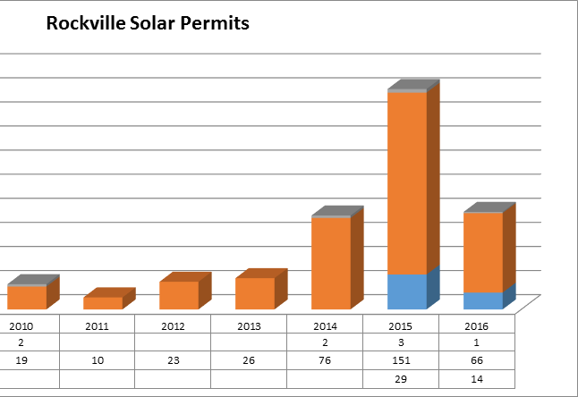

Aggregation helps drive market adoption

Slide 7
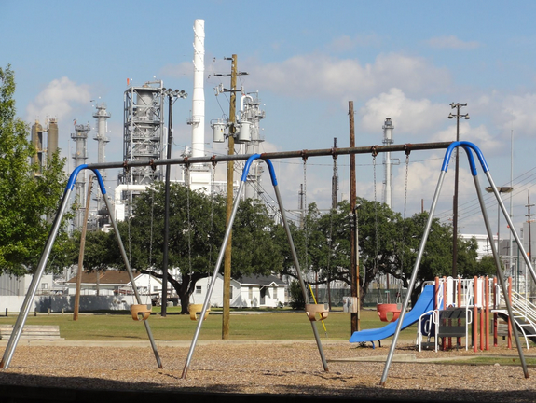
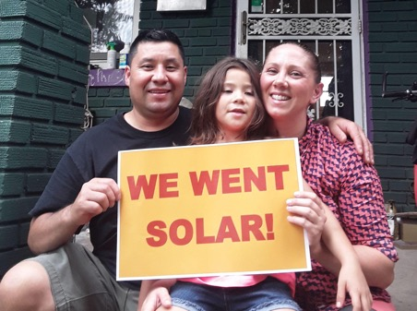
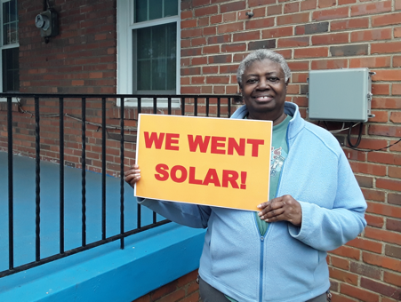
Working for Equity
We’re working toward a new energy system — one that is fair and equitable.

Slide 8
1
Solar (and storage and EV chargers and …) Co-op

Slide 9
When, where, & why
Smaller, less established markets
Gain market insights
Build market installation capacity
Identify market barriers
Build/strengthen municipal relationships
Build constituency for solar support

Slide 10
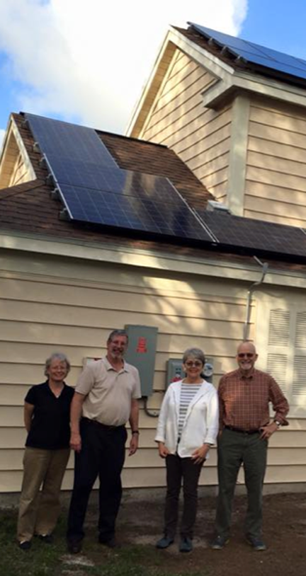
Why join a solar co-op?
Best value on installation
Support throughout the process
Connect with fellow solar enthusiasts
Become part of growing solar movement

Slide 11
The solar co-op process
Months 1-2
Month 3
Months 4-8
1
LEARN
Attend a free solar co-op info session.
4
SELECT INSTALLER
Once the co-op has 30 members, they choose the solar installer.
Solar United Neighbors issues a competitive RFP for solar installers on behalf of the solar co-op. We review bids & check references.
Then, volunteer co-op members review bids & select one installer.
SIGN UP DEADLINE
Last chance to join.
5
PROPOSAL
Co-op pricing, customized for you.
2
SIGN UP ONLINE
Become a co-op member! It’s free to
sign up.
6
SIGN CONTRACT
with the installer
7
INSTALLATION
3
SPREAD THE WORD
Invite neighbors & friends to join!
8
PARTY!
Celebrate & meet your solar neighbors.

Slide 12
2
Solar Switch

Slide 13
When, where, & why
Larger, more established markets
Gain market insights
Expand market installation capacity
Identify market barriers
Support big municipal goals
Expand constituency for solar support

Slide 14
Benefits of Solar Switch
For Residents
For Municipalities
Learn more about solar and whether it’s right for you
Brings down cost & hassle on a quality solar install
Lower electricity bills
Do your part for the environment and the grid
Supports local clean air, sustainability, and climate goals
Improves local resiliency
Removes burden of RFP and installer management
Big results with little effort for municipal staff

Slide 15


Complementary Capabilities
Consumer education and protection
Advocating for solar-friendly public policies
Building a community of solar advocates & supporters
Local staff and experience with a proven track record
Digital platform for large customer groups and multiple installers
Additional marketing resources & expertise to drive broader community engagement
Installer vetting, auction-based selection, & management for quality outcomes
Together, we intend to scale up rooftop solar adoption by making solar easier and more affordable

Slide 16
Solar United Neighbors & Solar Switch
Registrations to date
2,921
3,400
1,767
Houston/Dallas
Denver Metro
Capital Area
8,000+ total registrations
lifetime
Notes:
We’re still tracking overall signed contract rates from registrations but so far:
Texas: ~5%
DMV: ~15%
CO: ~7 to 10% (early stages)
Texas, once a year
DMV, once or twice a year
Denver, twice a year
More municipalities coming in 2024

Slide 17
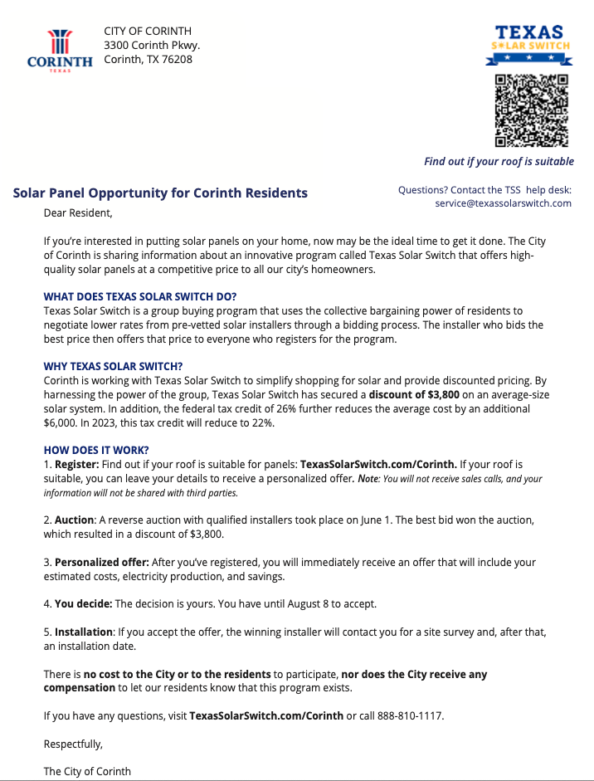
Awareness- Direct Mail
City/county logo drives resident engagement
Call to action, QR Code
Average savings from group buying/most recent auction
City support
Notes:
Understand consumer attitudes based on market research and experience
Transform customer insights into compelling communication campaigns
Implement large scale education/information/awareness campaigns
Provide clear and impartial information; no cost to register, no obligation to proceed

Slide 18
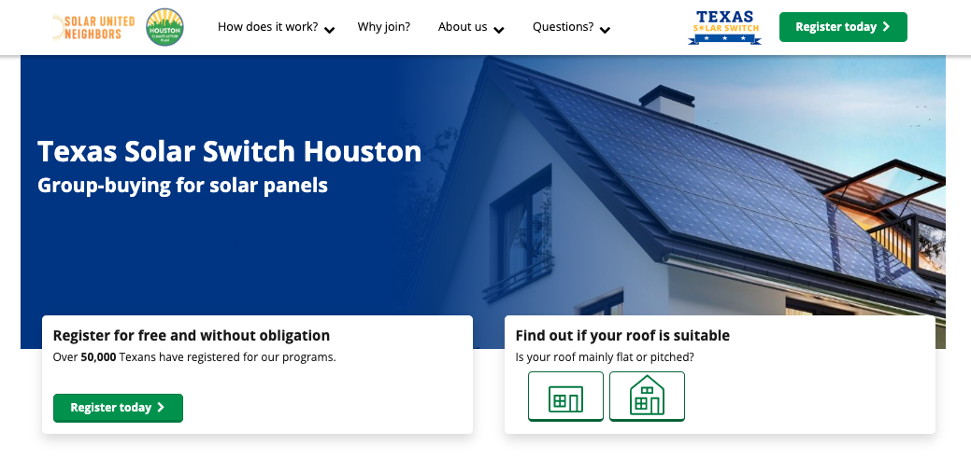
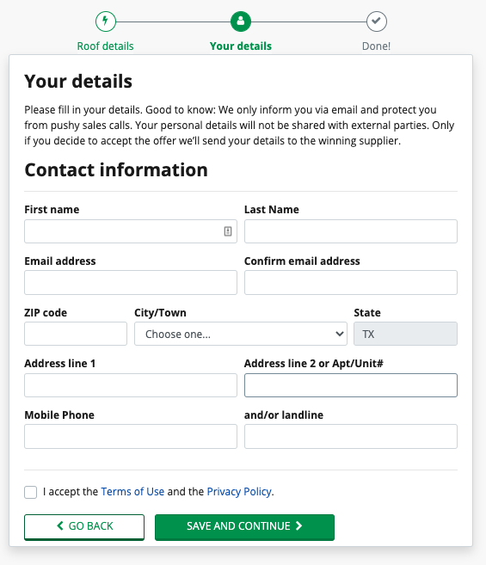
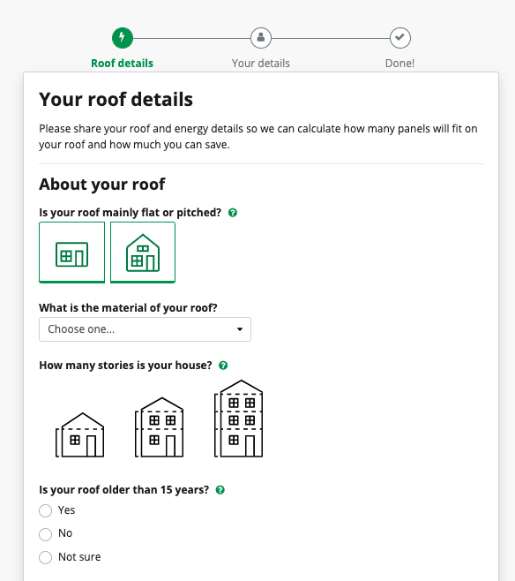
Registration
Community-specific, co-branded landing pages
Customer-friendly, no hassle registration process
Notes:
Understand consumer attitudes based on market research and experience (over 1.1M households have registered for iChoosr programs)
Transform customer insights into compelling communication campaigns (UX testing, A/B testing, etc.)
Implement large scale education/information/awareness campaigns
Provide clear and impartial information; no cost to register, no obligation to proceed

Slide 19
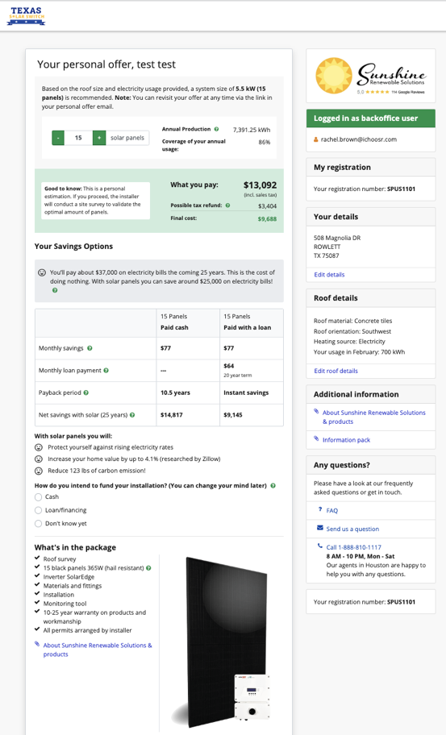
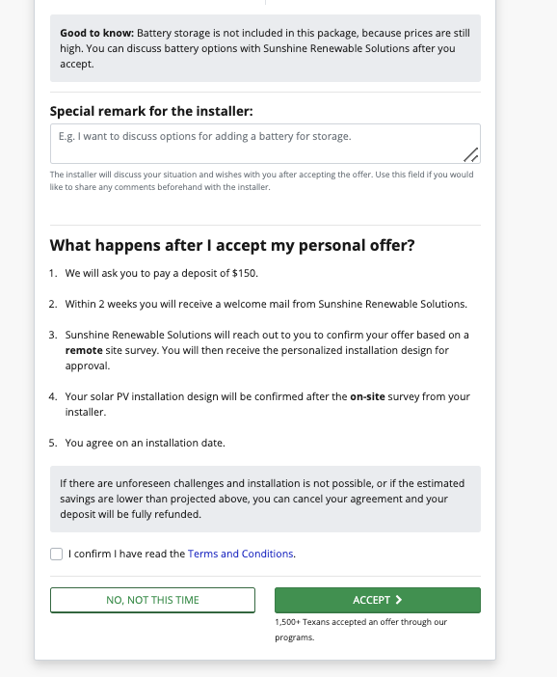
Personal Recommendation
Winning installer
Proposed system size and cost
Customer deposit
Financing options available
Call to action
Notes:
Provide a personalized & fully online offer for a solar installation by a qualified installer
Manage customer service, online and via domestic call center

Slide 20
A growing network of solar supporters

Slide 21
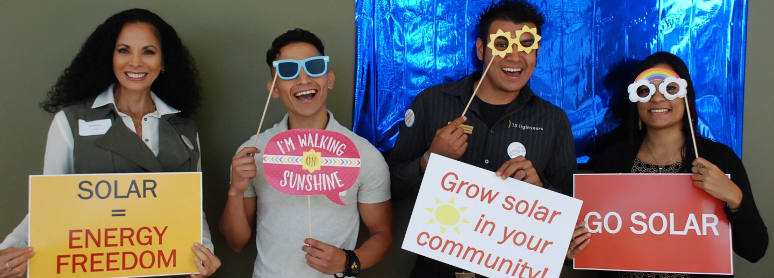
Thank You!
Corey Ramsden
Solar United Neighbors
corey@solarunitedneighbors.org

