Slide 1

A Fixed Charge solution that satisfies legal requirements while preempting another attack by the utilities on Local Solar
Ben Schwartz
Policy Manager
Clean Coalition
626-232-7573 mobile
ben@clean-coalition.org
Josh Plaisted
Principal
Flagstaff Research
510-459-7970 mobile
jplaisted@flagstaffresearch.com
15 August 2023

Slide 2
Conservation, intelligent uses of energy, and long-term rate reform
We are moving toward a world of electrification, smart appliances, and demand response.
Sending price signal that effectively incentivize consumers to use energy during off peak times is critical to ensuring that we do not overinvest in transmission infrastructure.
Not all consumers will be able to shift usage, but even a small percentage of them will make a big different.
Tiered Usage
Time of Use
Real Time

Slide 3
CPUC Proceeding (R. 22-07-005)
Proceeding details:
Track A is creating a residential Fixed Charge.
Track B is aimed at transitioning rates to closer to real-time rates to unlock demand flexibility.
The CPUC adopted Guiding Principles for Electric Rate Design and Demand Flexibility.
Summary of other proposals:
Most of the other Proposals were much higher and included four or more different tiers.
  8 of 9 parties proposed Fixed Charges at, or above, $25 for non-CARE customers.
  4 of 9 parties included at least 4 tiers, with one group proposing 10 tiers.
Other proposals would be harder to implement (likely taking years).
The Clean Coalition’s proposal is both pragmatic and easy-to-implement, compared to other proposals that will require significant changes to the billing system and take years to implement.

Slide 4
Why is a low Fixed Charge the best option?
A Fixed Charge is not the silver bullet solution that will solve the crisis of unaffordable electricity rates in California. Reducing rates is only a temporary respite if the utilities continue to request rate increases that outpace inflation.
Prices are high and low-income customers are not the only ones struggling to make ends meet in California. There are millions of renters, historically disenfranchised groups, and residents located in disadvantaged communities that could see bill increases from a high Fixed Charge.
A one-time rate reduction will not solve the underlying causes of increasing rates.
              PG&E raised rates by 9% earlier this year and could increase rates by as much as 32% by 2026.
              SDG&E is proposing an 8% rate increase for this year.
              Imposing a high Fixed Charge will have significant unintended consequences.
Other issues to consider that are related to rates include:
Energy consumption patterns
Sustainable growth of Local Solar
Electrification/Decarbonization
GHG reduction and environmental justice
Affordability
Notes:
Many things to think about when reforming rates: electrification/decarbonization (policy goals), affordability, and grid safety.
4

Slide 5
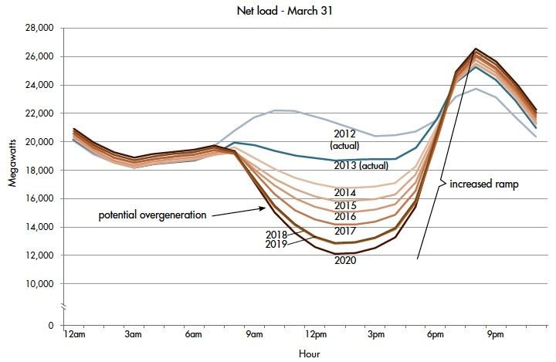
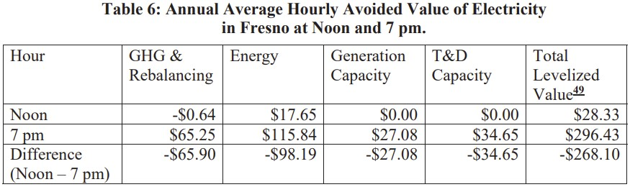
What is the value of volumetric rates?
The cost of delivering energy to end users changes throughout the day.
Time-differentiated prices send signals to consumers about when to use energy.
Volumetric rates incentivize conservation, efficiency, and self-generation.
There are unique location-specific costs and locational value that distributed generation can provide.
d
Volumetric rates are essential to enable system decarbonization and electrification.

Slide 6
Methodology behind the Clean Coalition’s proposal pt. 2
Redistributes the cost of existing minimum bills without increasing the total amount of money being collected from ratepayers.
This is similar to the way CAISO collects Transmission Access Charges (TAC). Each Participating Transmission Owner has a set Transmission Revenue Requirement. However, that is modified based on gross load to determine the final TAC rate.

Slide 7
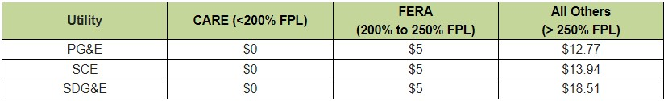
The Clean Coalition’s modest Fixed Charge proposal
The Clean Coalition’s proposed Fixed Charge is modest and will not burden any ratepayers.
All low-income ratepayers will save money on their electricity bills each month.
There are three tiers of Fixed Charges. Lower-income ratepayers will realize greater savings than non-low-income ratepayers.
This proposal incorporates all the costs included in electricity that are truly “fixed”. Since rates are primarily collected on a volumetric basis ($/kWh) very few cost components are fixed.

Slide 8
Methodology behind the Clean Coalition’s proposal pt. 1
Covers the Marginal Customer Costs (e.g., the minimum bill for NEM customers).
  No transmission, generation, or public purpose charge components.
Results in savings for low-income customers on day 1 and a decrease in overall rates.
Three income tiers based on existing low-income subsidy programs.
  CARE: California Alternate Rates for Energy (30-35% bill credit)
  FERA: Family Electric Rate Assistance (18% bill credit)
CARE customers do not pay any Fixed Charge. FERA customers, of whom there are fewer, still see a savings.
All other customers pay as much or slightly more than they currently are.
Notes:
Explain what CARE and FERA are (what customer groups make them up).

Slide 9
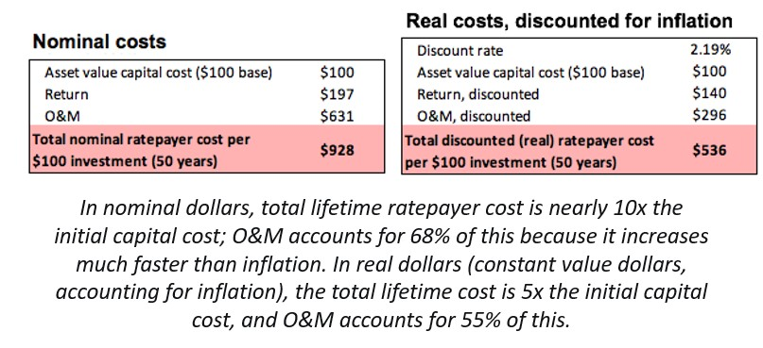
Cost drivers leading to increases in electricity rates
Transmission: $30 billion over 20-years and $9 billion for 2023-2024.
Wildfire Mitigation Costs: PG&E was granted over $1 billion (for 2023).
Wildfire Victim Payouts: So far for payouts to victims in 2015, 2017, and 2018 PG&E has paid $10 billion and is expected to pay a further $8 billion.
Wildfire Insurance Costs: This cost is getting so high (>$1 billion/year) that SCE has chosen so self-insure.
Undergrounding: PG&E’s cost to underground 10,000 miles will likely be close to $25 billion.
Legacy Generation & Nuclear Decommissioning Costs
Notes:
https://www.firevictimtrust.com/#:~:text=%2410%20Billion%20Paid%20to%20Claimants,as%20of%20July%2031%2C%202023.
https://www.kcra.com/article/moving-pge-power-lines-underground-cost-who-foots-the-bill/39960842#:~:text=%22In%202022%20we're%20looking,10%2C000%20miles%20of%20power%20lines.
9

Slide 10

Assessment of Fixed Charge Proposals
JR Plaisted 08.14.2023

Slide 11


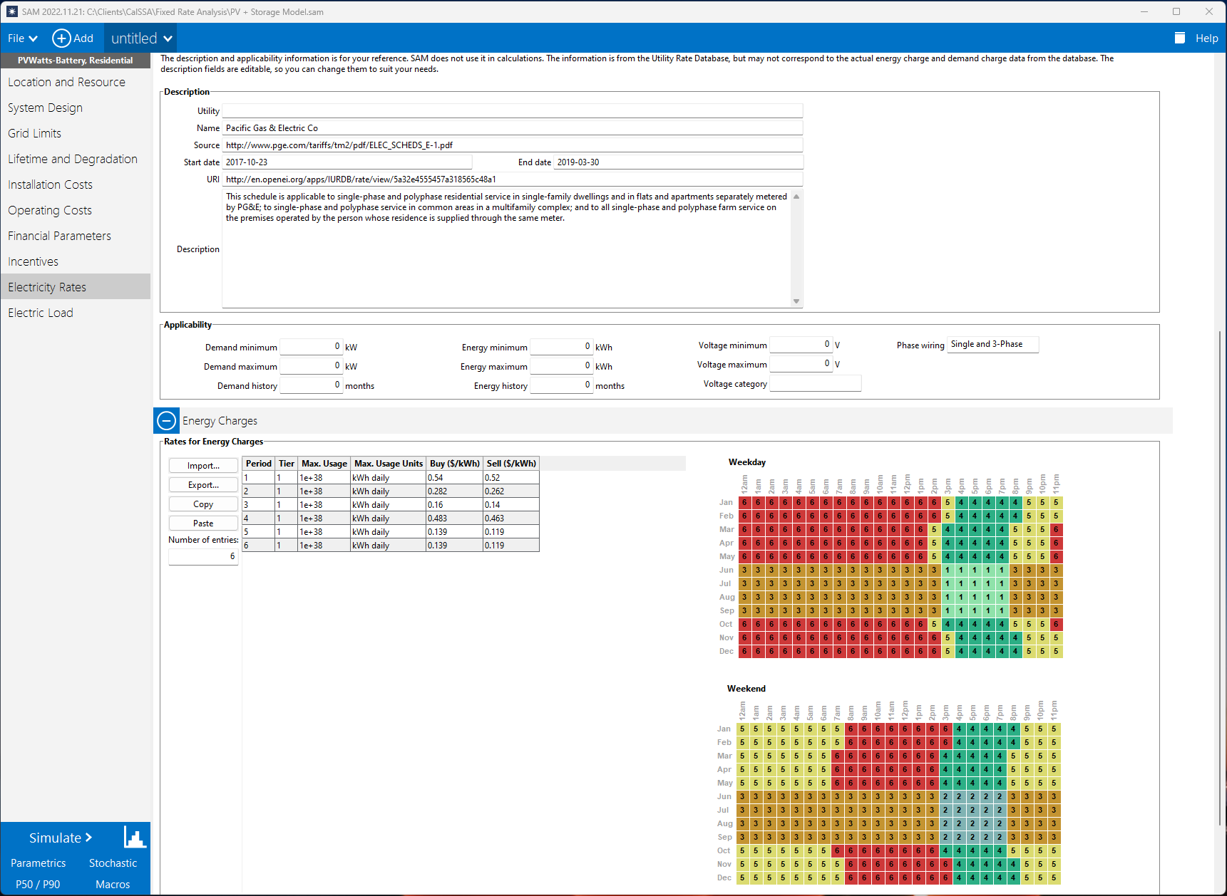
Scope & Approach
Summary
Proposals on fixed charge rates were assessed from: CPUC Public Advocates Office (PAO), TURN/NRDC, and the Joint IOU filing
Costs under current and proposed rates for each utility were analyzed with home load profiles for following climate zones: PG&E - CZ12 Sacramento, SCE - CZ9 Los Angeles, and SDG&E - CZ7 San Diego.
Three separate households were modeled to asses the impact of usage & load shape:
  A 1,250 ft² home with light efficiency upgrades (e.g. lighting + EnergyStar appliances)
  A 2,500 ft² home built to 2016 Title 24 standards. Aligns with typical home consumption.
  A 3,750 ft² larger and older home with lower insulation, increased leakage, and heavier appliance use resulting from higher occupancy
EnergyPlus simulation software (from USDoE) was used to model each home in the respective climates
8760 Hourly home electricity load profiles were monetized using NREL System Advisor Model (SAM) with both current and proposed tariffs from each proposal under 3 separate tariffs representing the following rate types: flat, TOU, and electrification/EV.
Impacts on homeowner annual electric bills as compared to existing rate structures were assessed for each proposal across regions and housing types.
The cost effectiveness of ‘fuel switching’ from natural gas to high efficiency electric appliances was assessed under the new proposed rates, all of which aim to reduce variable energy charges to promote electrification.

Slide 12
Assumptions

Slide 13
Home Energy Usage Profiles
DoE EnergyPlus Baseline Home Assumptions
CEC 2019 RASS Survey
Annual Energy Consumption by dwelling type, profile, and representation in population

Slide 14
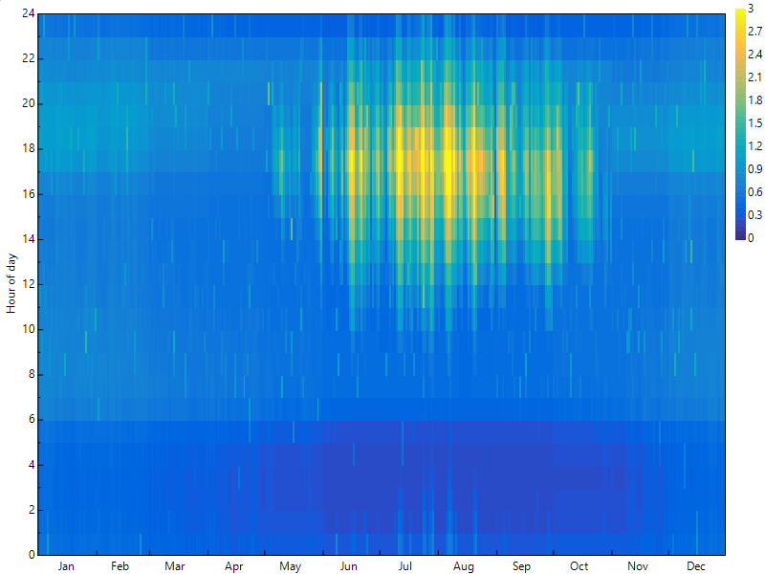
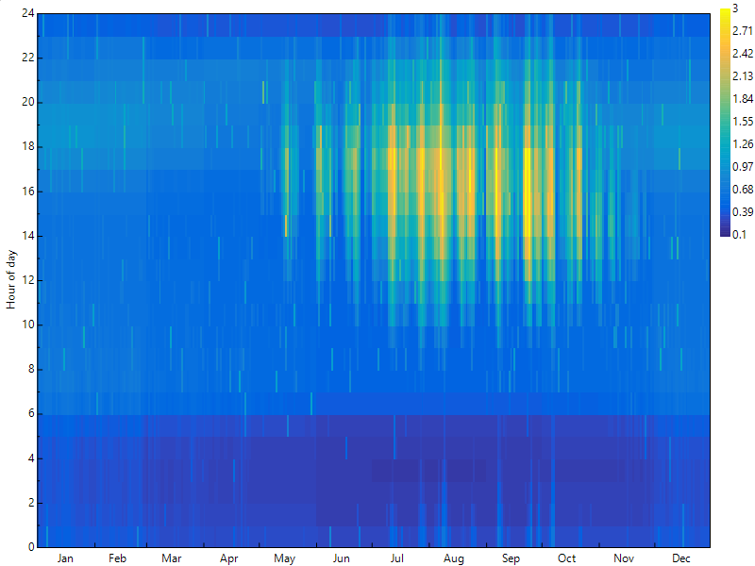
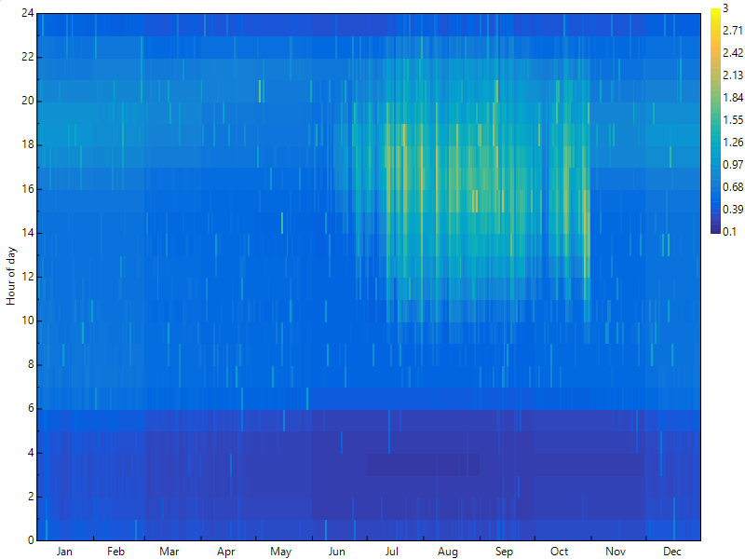
Annual Energy Load Comparison to CEC Baseline
 | PG&E – CZ12 Sacramento | SCE – CZ9 Los Angeles | SDG&E – CZ7 San Diego
Energy Plus Usage (kWh) | 6,310 kWh | 6,263 | 5,665
CEC 2019 Survey Usage (kWh) | 6,266 kWh | 6,424 | 5,230
Variance | +1% | -3% | +8%
Comparison to CEC 2019 RASS survey for ‘Normal Use’ home in each IOU territory

Slide 15
Results

Slide 16
SCE Results
Current Utility Bill
Proposed Variable Energy Component
(Not Impacted by Income)
Proposed Fixed Charge Component
($84,000 Median Income Household)
Annual Bill Impact
Proposed Fixed Charge Component
($150,000 Income Household)
Annual Bill Impact

Slide 17
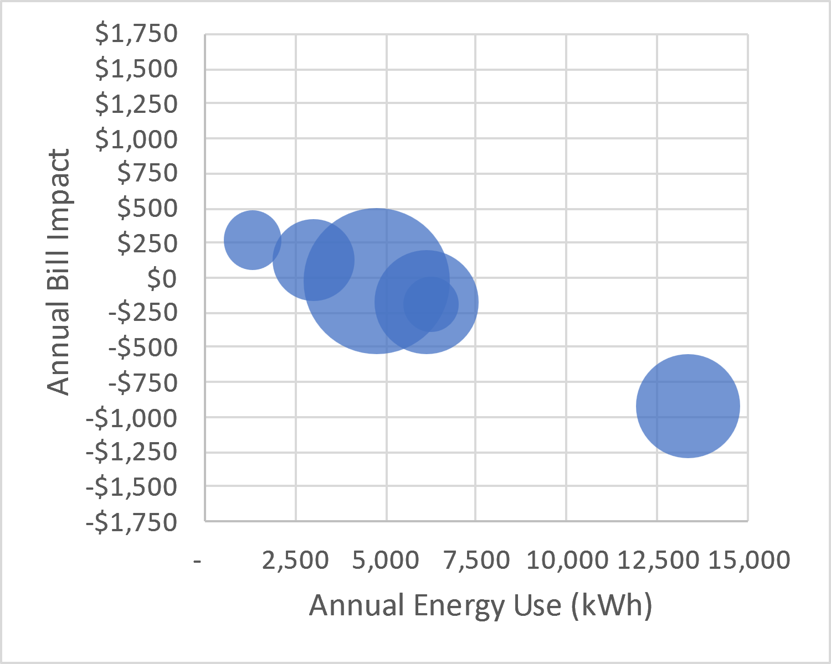
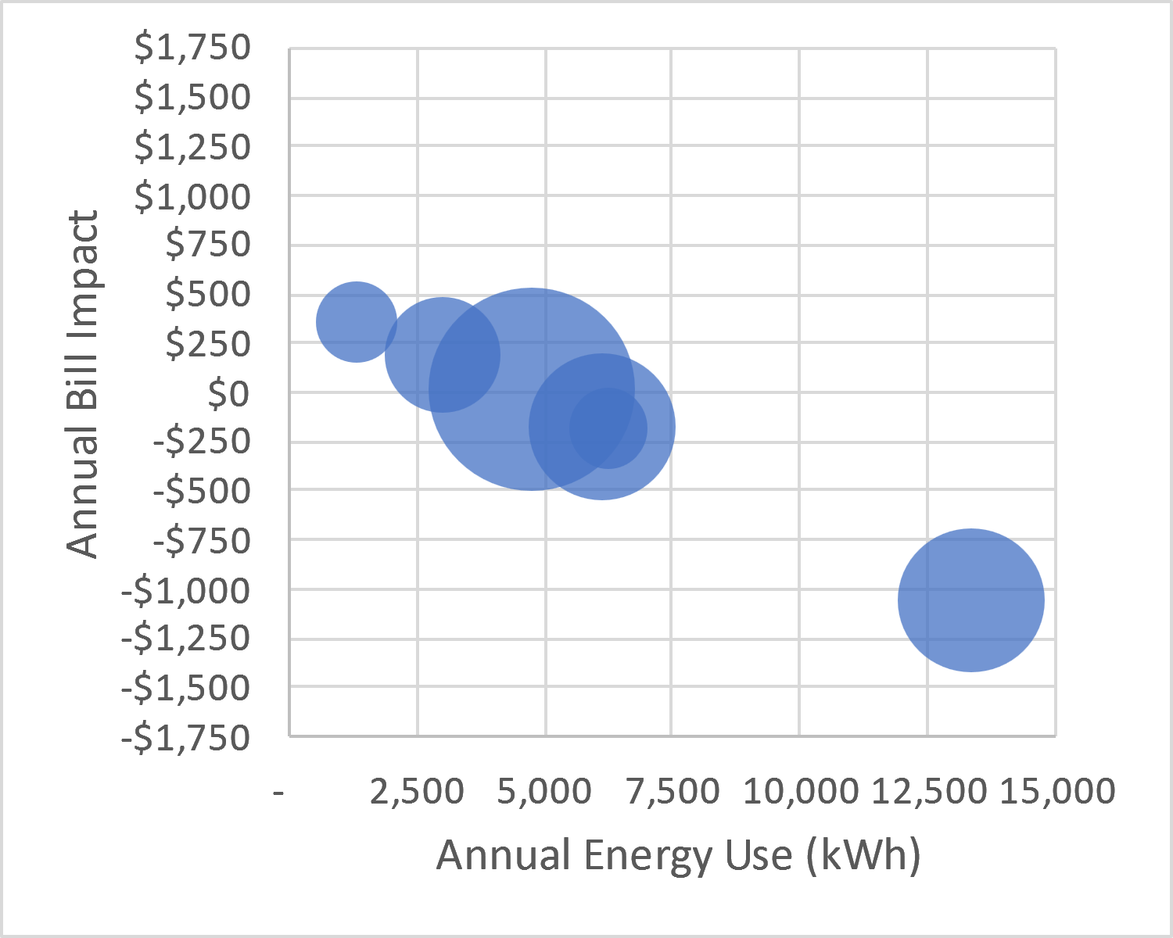
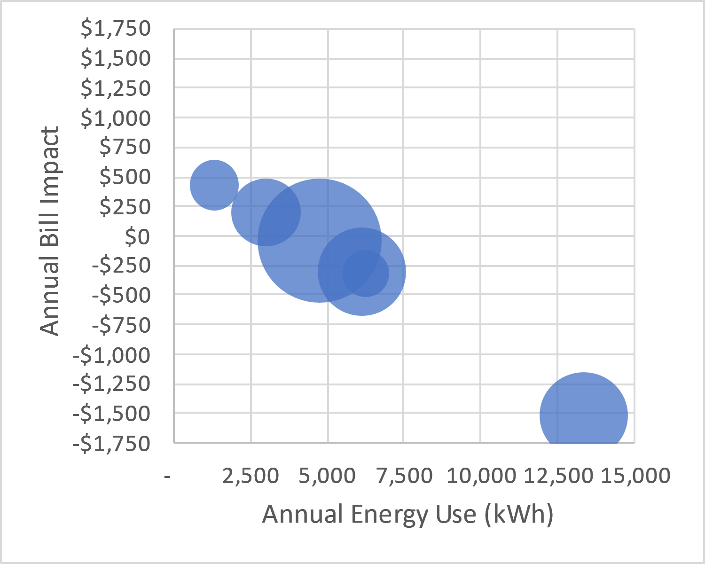
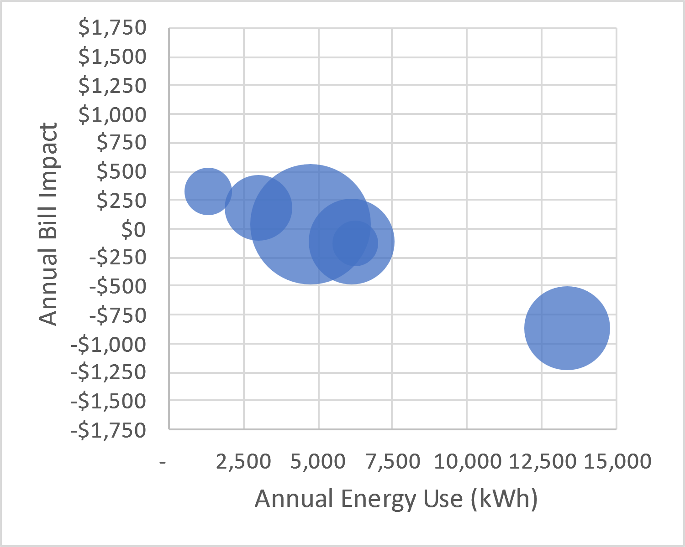
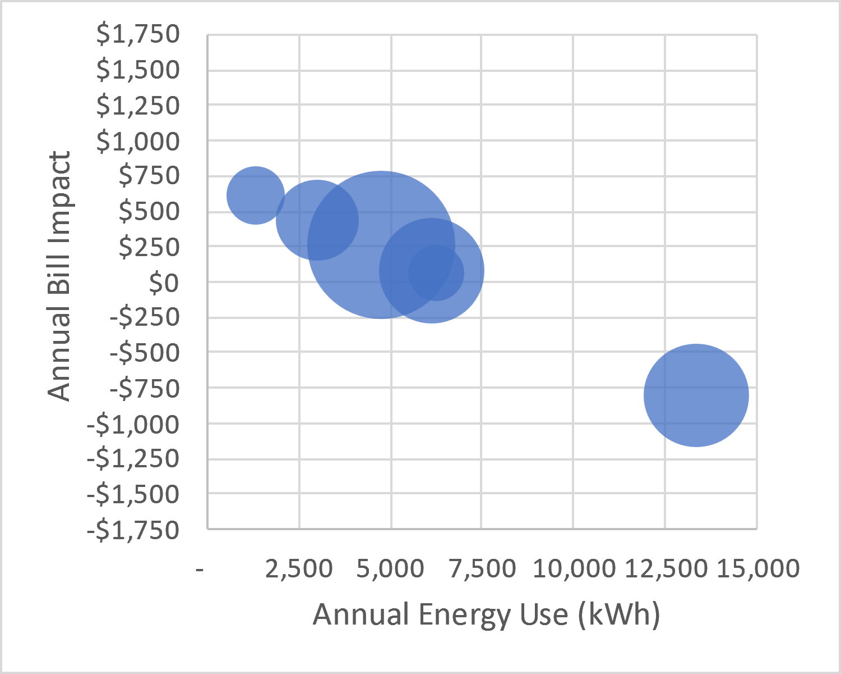
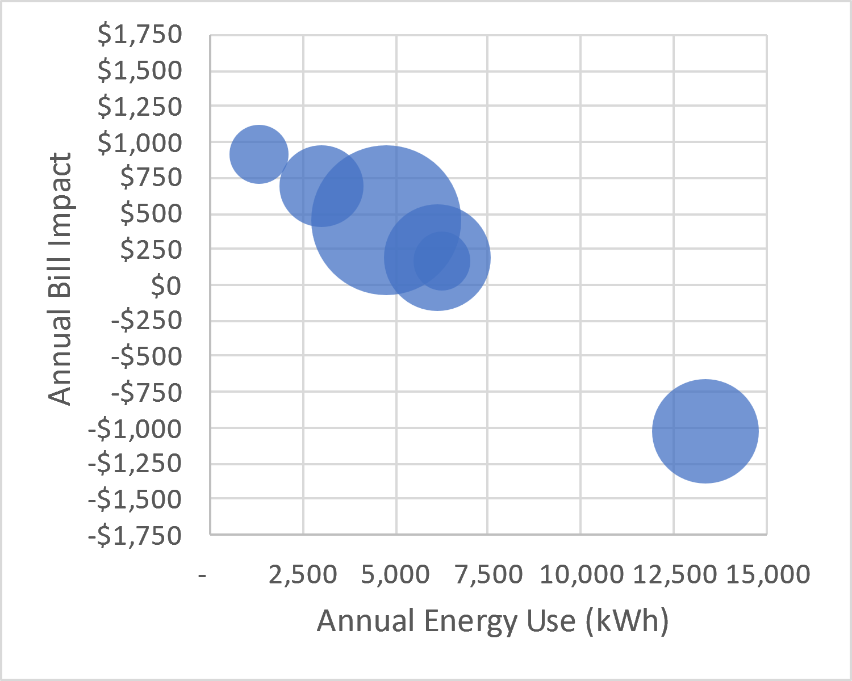
PG&E Results Visually Expanded for All Dwelling Types
CPUC PAO
NRDC/TURN
IOU
Multifamily
(low use)
$150k Household Income
Single Family
(high use)
Median Household Income

Slide 18
Annual Bill Impacts for Electrification
Modeled gas appliance efficiencies and electrification equivalent
 | Gas – Low Efficiency | Gas – High Efficiency | Electric – High Efficiency
HVAC – Heating | 80% AFUE Furnace | 98% AFUE Furnace | 10 HSPF Heat Pump
HVAC – Cooling | SEER 13 Air Conditioner | SEER 21 Air Conditioner | 22 SEER Heat Pump
Water Heating | 0.59 EF Gas Storage | 0.96 Tankless | 3.5 UEF Heat Pump
Cooking | Gas | Gas | Induction Cooktop
Dryer | Gas | Gas | Heat Pump

Slide 19
Using a Highly Differentiated TOU Instead
2
1
1
Notes
Only 2/3rds of electricity usage in electrification happens during winter off-peak, only 3% is summer on-peak
Therefore, you do not need to use a blunt instrument like high fixed charges to make electrification work, you just need to decrease winter off-peak towards the cost basis. Because electrification is not peak intensive, you can even offset this by increasing summer on-peak to make the new tariff revenue neutral while still advantaging electrification
The result of such a highly differentiated TOU is that you can halve the annual operating cost while not impacting fized charges. The decrease in the levelized energy cost to $0.16/kWh is below even the most aggressive IOU proposals.

Slide 20
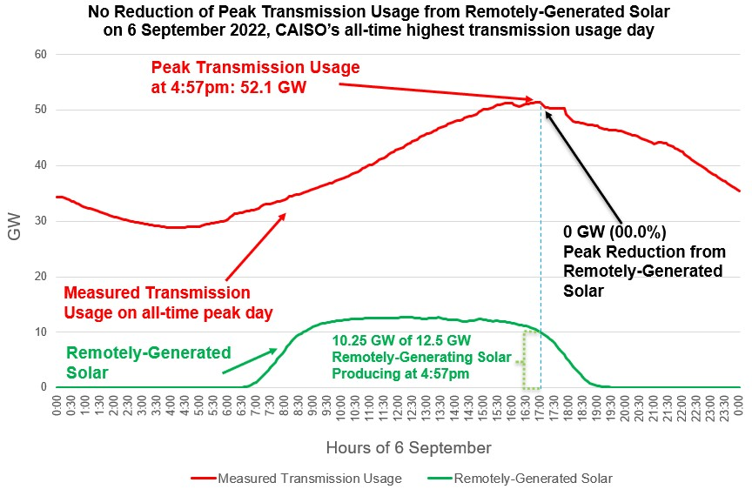
Case Study: CAISO-interconnected solar on the all- time peak usage day (6 September 2022)

Slide 21
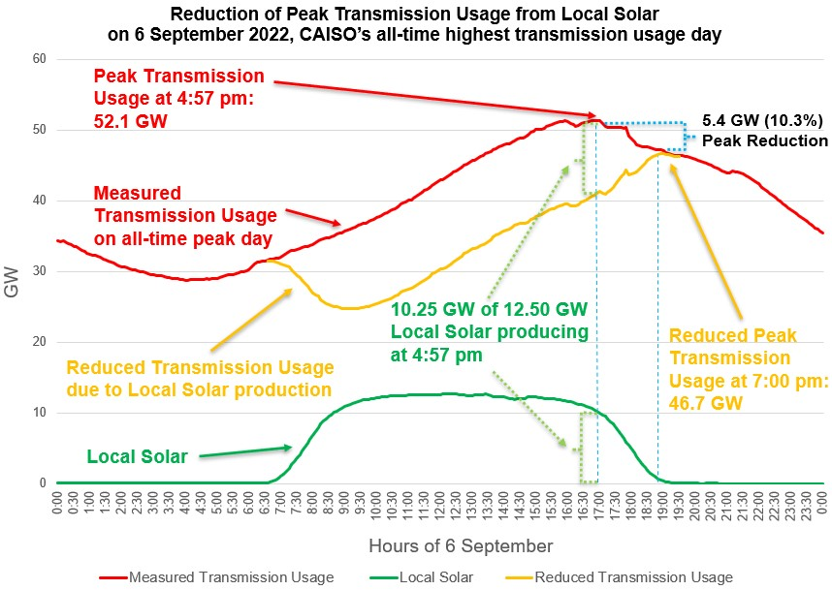
Local Solar is extremely valuable to the grid
Local Solar reduces Peak Transmission Usage by close to 50% of the installed capacity. The effect is amplified by energy storage.
Bringing down the peak with distributed generation and demand flexibility will reduce transmission investments, saving ratepayers hundreds of billions of dollars over the next two decades.
Reducing the Peak Transmission Usage by around 10% is enough to prevent most major outages.

Slide 22
Thank you for listening!
Any Questions?

Slide 23
Backup Slides
Backup Slides
Notes:
23

Slide 24
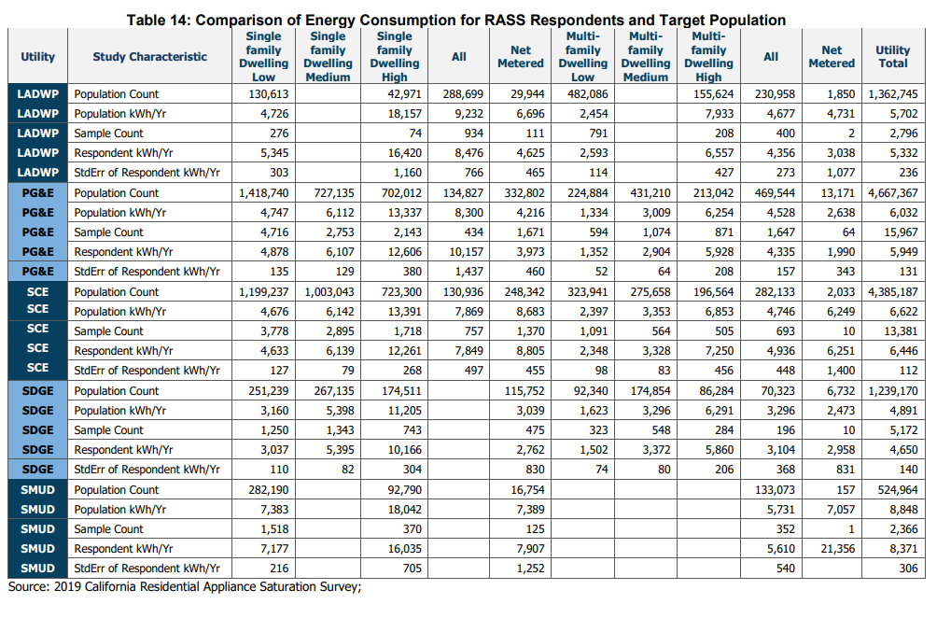
Distribution of Energy Use by Dwelling Type (all IOU)
Notes
The CEC 2019 Survey breaks out 3 classes of customer usage for single family & multi-family homes representing low, medium, and high usage. For each classification, they present a representative annual consumption as well as the number of units in each class as shown in table 14 from the CEC survey shown at the left.
Plotting the energy use of each dwelling type by its percentage representation within each IOU gives us the plot at the lower left. Within this plot, we have indicated the average annual energy consumption for all California homes, which has close alignment with the medium usage single family detached homes you see as close clustering around this usage. However, we see the following representative clusterings far from the average
Low Use: This cluster is made of low and medium use multi-family dwellings using roughly half of the statewide average. Approximately 1:5 IOU households falls in this category
High Use: This cluster is made of high usage single family detached homes using approximately double the statewide average. Just under 1:5 IOU households falls in this category
Efficient Single Family: The highest representation is in low usage single family homes making up nearly 1:3 households and using 24% less energy than the average home
1
1
1
Statewide Average Household Use
6,174 kWh/year
5
4
3

Slide 25
Tariff Schedules Used for A
Notes
We analyzed three separate tariffs under each proposal including: flat non-TOU rate structure, typical TOU rate, and the electrification/EV rate
Standard residential gas tariffs were used with the proper allocation of baseline and excess rates based on modeled home gas consumption
In the analysis of CARE customers, the rates were discounted according to the CARE discounts as shown

Slide 26
SDG&E

Slide 27
PG&E

Slide 28
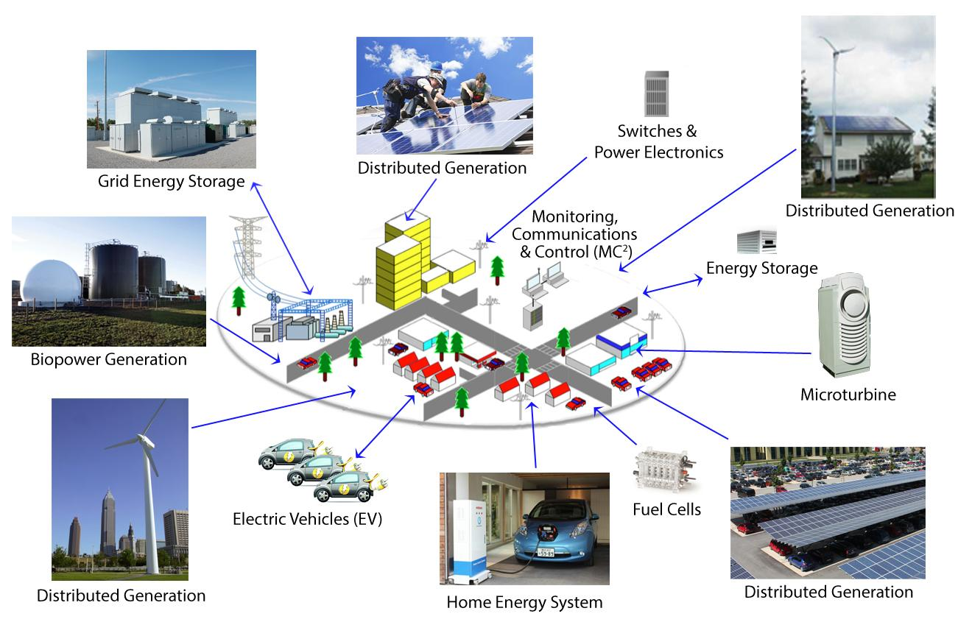
Heading
Notes:
28

