Slide 1

SB 1148: Allowing Master Metering is critical for provisioning solar-driven resilience and economic optimization to Multi-Unit Housing (MUH) facilities.
California must eliminate the existing statute that requires a utility grade meter for all residences, including for each unit in MUH facilities.
Craig Lewis
Founder & Executive Director
Clean Coalition
650-796-2353 mobile
craig@clean-coalition.org
Ben Schwartz
Policy Manager
Clean Coalition
626-232-7573 mobile
ben@clean-coalition.org
27 February 2024

Slide 2
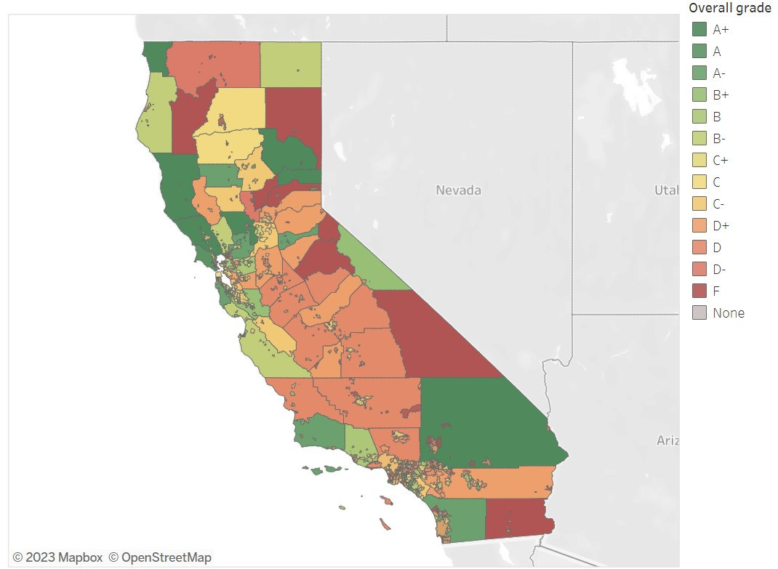
California needs more effective housing policies
Report card scoring cities and counties based on new housing permits issued through the end of 2021.
The average statewide grade was a C-.
In 2023, only 29 of 538 municipalities had housing plans approved by the Governor.
Notes:
SoCal News Group Report: https://www.ocregister.com/2023/01/15/most-cities-still-falling-behind-affordable-housing-mandate-state-numbers-show/
Breakdown of Report: https://www.dailynews.com/2021/01/31/report-card-how-we-graded-every-city-county-in-california-on-meeting-rhna-housing-permit-goals/
Source Data: https://docs.google.com/spreadsheets/d/1J6PeA7s1nwj-du6HM7e1dAxk2PwrzG9AVtveuU3s84I/htmlview
Lawsuit by Attorney General Bonta of La Canada Flintridge: https://oag.ca.gov/news/press-releases/attorney-general-bonta-governor-newsom-and-california-department-housing-and?utm_medium=email&utm_source=govdelivery

Slide 3
Deploying microgrids at Multi-Unit Housing facilities is a solution for numerous intersectional energy issues
Reliability (consistent service)
Resilience (service during major outages)
Reduction in high electricity rates for all ratepayers
Monthly savings on electricity bills
Wildfire Mitigation
Building Electrification
Transportation Electrification
Energy Sector Decarbonization
Improved local air
quality
Optimal Electric Service
The answer:
Deploying microgrids at multi-unit housing (MUH) facilities benefits residents and the ratepayers. Microgrids create an unparalleled trifecta of economic, environmental, and resilience benefits.
Affordable Electricity Rates
Less risky electrical infrastructure
Electrification
Better environment for residents
Notes:
Socal Gas gives $150,000 to multi-family builders for putting gas infrastructure in place.
https://www.theguardian.com/us-news/2023/dec/21/new-home-builder-contractor-fossil-fuel-utilities-natural-gas
Payments for EE over code requirements: https://issuu.com/biasc/docs/bia_online_magazine-april_hr/23

Slide 4




Physical configuration differences between NEM & VNEM systems during normal grid operations
NEM Configuration
VNEM Configuration
Utility Service
Utility Service
Customer Meter
VNEM Solar System
NEM Solar Microgrid System
Customer Meters

Slide 5


Physical configuration differences between NEM & VNEM systems during a grid outage
NEM Configuration
VNEM Configuration
Utility Service
Utility Service
Grid Outage
Grid Outage
Customer Meter
VNEM Solar System
System Operational
System Shutdown
NEM Solar Microgrid System
Customer Meters

Slide 6
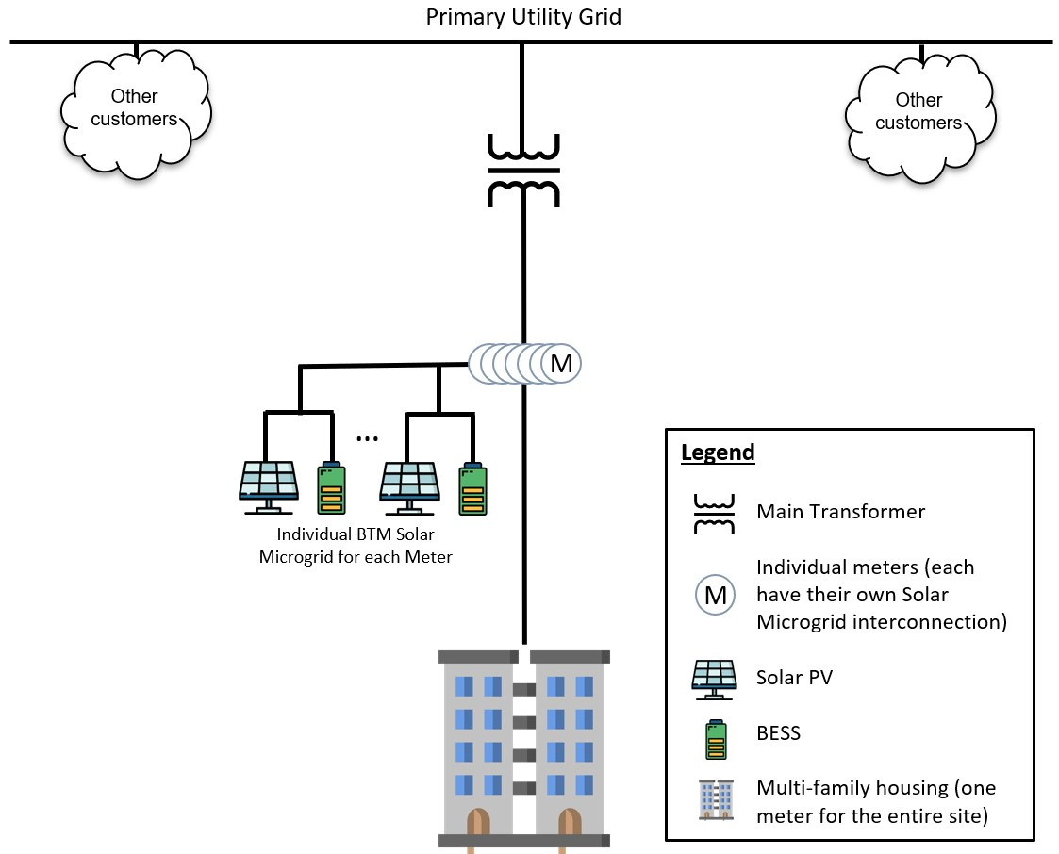
Residential units must be individually metered (no master metering) - issues preventing resilience at MUH facilities
Residential units must be individually metered for electrical service, in compliance with a 1981 California law that prohibits residential master metering (PUC § 780.5).
  Commercial units can be master metered, if proper exemptions are met.
  Mixed-use facilities must meet the exemptions for both commercial and residential master metering.
As a result, there are two ways to achieve resilience, neither of which is ideal:
  PG&E’s Community Microgrid Enablement Tariff (CMET) allows for islanding on the utility side of the grid, which adds complications.
    The CMET only applies to PG&E and only 1 of 32 projects has been completed in three years.
  Behind-the-meter (BTM) microgrids at every residential meter (requiring solar, storage, load management, and microgrid controls), which loses economies of scale.
Behind-the-meter microgrids at MUH facility

Slide 7
Microgrid Definitions
Solar Microgrids: Solar, storage, and microgrid controls for a single meter facility (such as a single-family home or police station.
  The process for deploying Solar Microgrids is simplified and cost-effective.
  Simply interface with the utility and single tariff for on-site resources (usually Net Energy Metering).
  Takes one year or less to deploy.
Microgrids at MUH facilities: No easy way to deploy resilience.
  One interface with the utility (because there is only one property) like a Solar Microgrid, but multiple meters, like a Community Microgrid.
  Cannot deploy a Solar Microgrid but a Community Microgrid has not been deployed at a MUH facility either.
  The only solution is an unnecessarily long design period and costly project price tag.
  This is a unique issue not being considered in the CPUC’s Microgrids proceeding.
Community Microgrids: Comprised of multiple facilities/meters, such as a neighborhood or city, and BTM and FOM resources.
  Complicated process and very few Community Microgrids have been deployed in California.
  Requires usage of the utility grid to island the microgrid, adding complexity and significant limitations.
  Takes 1-3 years to deploy, if everything goes correctly.
  Difficult to optimize economics or resilience under existing regulatory constructs.

Slide 8
The Problem: there is no good pathway for resilience for MUH facilities
MUH facilities are often located on a single property. A single property usually means a resilience through a Solar Microgrid deployment.
But there are multiple meters, so the utility requires a complicated Community Microgrid deployment.
There are also technical challenges related to operating the utility’s distribution grid and meters:
  Special permission is needed to use the utility grid in an outage situation. It is only possible to get that permission in one utility service territory (PG&E) and no MUH project has received approval.
  The utility does not want a non-utility operating the meters in an outage situation. Even after receiving utility approval for resilience, energy must be delivered from a front-of-meter VNEM system to the on-site loads, without spinning the utility meters measuring demand.
    Tariff language: No load can register on the Generating Account (solar+storage) or the Benefitting Accounts (residential units).
    → This requirement is not technically feasible.
  As a result, significant complications and workarounds are needed

Slide 9
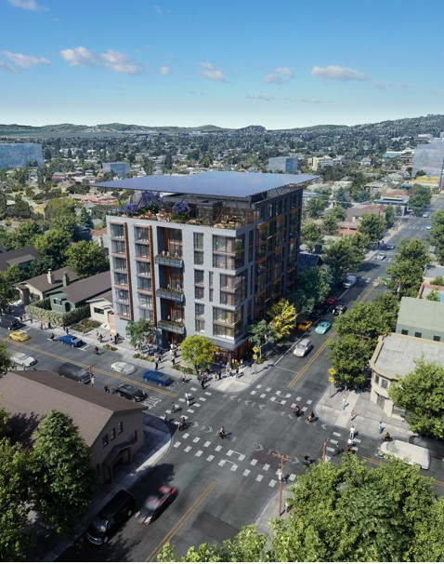
Key features of the Berkeley Efficient and Resilient Mixed-Use Showcase (BERMUS)
All-electric, 8-story, commercial and permanently affordable housing community.
65 units of 100% affordable housing with ground floor commercial offices and retail spaces.
Affordable home ownership via condominiums that provide homeownership benefits from original tenancy, with all being disadvantaged and low-income.
Net Zero Energy (NZE) building with a solar canopy covering the entire roof area, including a large rooftop patio and roof-mounted mechanical equipment for HVAC etc.
Solar Microgrid resilience ensuring indefinite resilience for the critical loads during grid outages of any duration, with significant resilience to all other loads based on solar energy availability and battery state-of-charge. Meets the full performance requirements of the CEC-recommended VOR123 value-of-resilience (VOR) methodology.
GridOptimal with the Solar Microgrid providing all energy during the 4-9pm grid-constrained period daily.

Slide 10
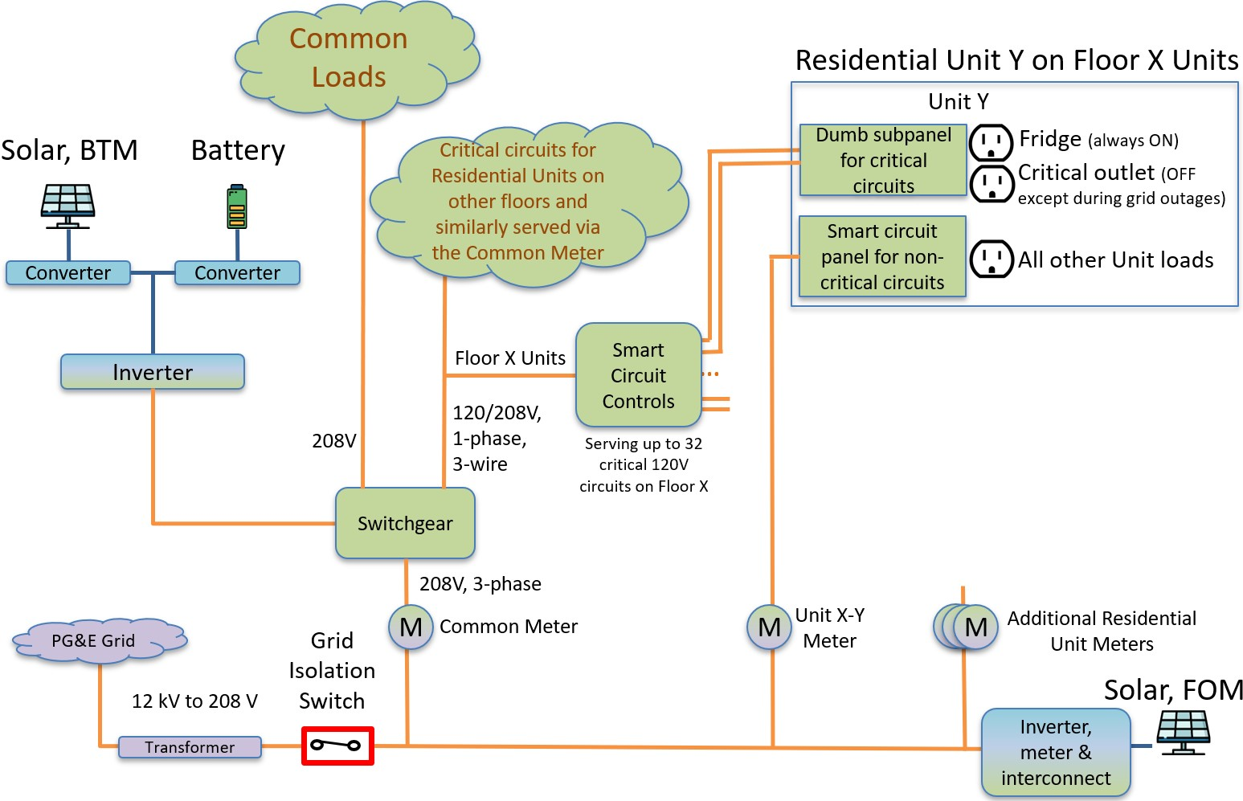
Existing limits make a chaotic/complicated design the only way to achieve the CEC-grant requirements for BERMUS
Note the need for both a BTM NEM array (Solar Microgrid for the non-residential loads) and a FOM VNEM array to financially benefit the residential loads.
Complicated wiring + load management for common loads and residential loads. Critical loads (e.g., fridge, Wifi, etc.…) are wired to common meters to provide resilience during outages.
Solar microgrid behind the Common Meter allows resilience for the HVAC, fridges, Wifi, and a plug load.
Unable to fully optimize energy at the site (in the way we want to) from both a technical and economic perspective.
Grid isolation switch is located on the low voltage side of the transformer, near where a master meter would be sited.
Block Diagram for BERMUS

Slide 11




BERMUS block diagram if a master meter is allowed
Primary Utility Grid
Other customers
Other customers
M
Legend
Main Transformer
  Master Meter (site can be islanded from this point)
  Solar PV
  BESS
Multi-family housing
(one meter for the
entire site)
M
BTM Solar Microgrid

Slide 12
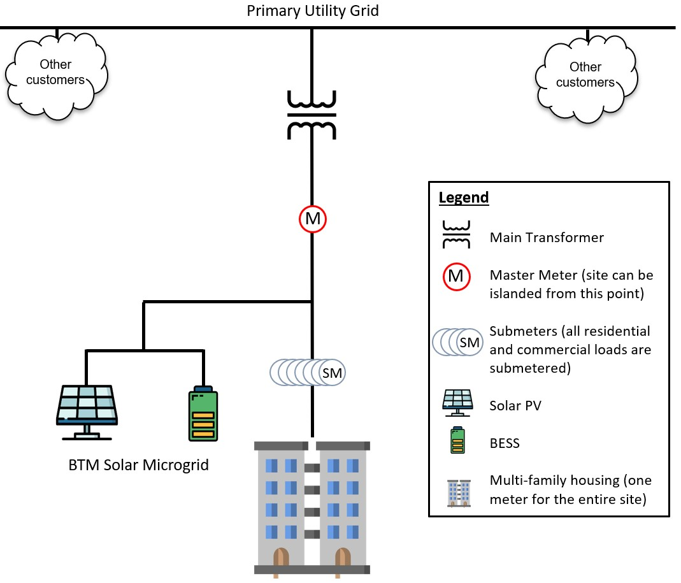
Master Metering with private submeters can work
Most MUH facilities have residential units billed on residential rate tariffs and common areas billed on commercial rate tariffs.
Today, the utilities require exemptions for both types of master metering and struggle with the billing. They are not used to mixed-use properties.
With private submeters, different types of loads would continue to be billed on the applicable tariff (ensuring that the percentage of residential loads and non-residential loads does not change after the master meter is installed).
In this case, residential and commercial loads can be metered separately using private submeters / utility meters to ensure billing stays the same.
The future of urban planning includes more Mixed-Use properties so that people can access essential services nearby.
MUH facility with a Master Meter design and private submeters

Slide 13
Master meter with private submeters
To other customers
Primary Utility Grid
To other customers
M
Master Meter
Rate schedule-level submeters:
Commercial
Residential
CARE/FERA
R
R
R
U
U
U
U
U
U
Unit-level submeters
Notes:
Have the things that come off the master meter be a little lower and put the Solar Microgrid behind the master meter and before the rate-level sub-meters (R 1, 2, and 3).

Slide 14
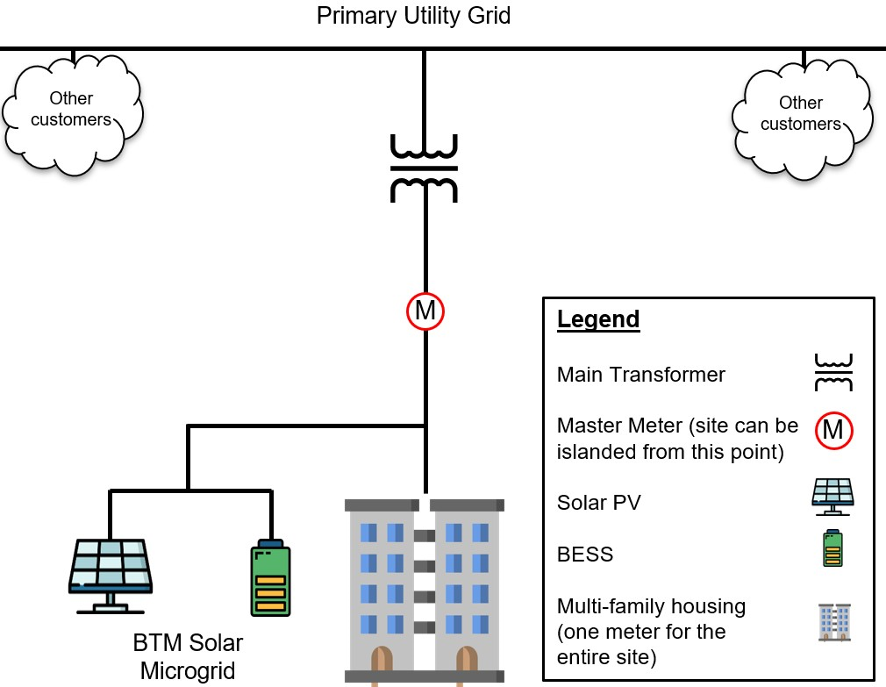
Allow residential master metering through a legislative solution
        Cost-effective for residents and ratepayers alike:
        Residents realize resilience benefits for free, in addition to monthly energy bill savings.
        On-site energy optimization reduces the need for costly distribution upgrades even when electrification leads to increased loads.
        Fewer grid connections will lower utility costs (metering, connection, billing, etc.….).
        Fewer imports during peak periods reduces the amount of transmission required to deliver energy, helping to save ratepayers billions over 20 years.
Greener, streamlined and cost-effective.
Provides substantial resilience benefits and improves project economics.
Optimizes sizing of assets and maximizes space efficiency by deploying a single Solar Microgrid to serve the entire site (one solar array, BESS, set of wiring, etc.…).
Simplifies the customer/utility interface & streamlines design requirements.
Avoids serving PG&E meters with FOM solar.
Promotes green building and electrification.
Lower energy costs for residents.
Cost-effective for residents/ratepayers:

Slide 15
SB 1148 – Enabling Residential Master Metering
PUC § 780.5: The commission shall require every residential unit in an apartment house or similar multiunit residential structure, condominium, and mobilehome park for which a building permit has been obtained on or after July 1, 1982, other than a dormitory or other housing accommodation provided by any postsecondary educational institution for its students or employees and other than farmworker housing, to be individually metered for electrical and gas service, except that separate metering for gas service is not required for residential units which are not equipped with gas appliances requiring venting or are equipped with only vented decorative appliances or which receive the majority of energy used for water or space heating from a solar energy system or through cogeneration technology.
Authored by Senators Blakespear and Wahab.
Makes a change to Public Utilities Code Section 780.5.
Creates a specific exemption for instances where resilience is being pursued (and the economic benefits are an additional benefit).
  Add qualifiers to ensure consumer protection, require prevailing wages, grid optimal performance for large facilities.
Adds a code section allowing government facilities (including schools) and places of worship to deploy a master meter for resilience.

Slide 16
Backup Slides
Backup Slides

Slide 17
Resilience benefits for MUH facilities (when master metered)
BERMUS is designed to achieve Net Zero Energy (NZE), no net exports during the 4-9 pm system peak (GridOptimal), and resilience (VOR123 performance).
  The ratepayers benefit from the GridOptimal performance, which reduces the need for grid energy during peak periods and helps to reduce electricity rates in the long-term.
A single comprehensive Solar Microgrid serves the entire site in a technically viable manner – and in a cost-effective manner.
The site is capable of islanding from the grid during all grid outages, typically ensuring indefinite solar-driven resilience for the most critical loads and significant resilience for the rest of the loads.
  Resilience is an additional value stream, on top of the reduced price of energy (which is enough to pay for the system by itself).
  For the Santa Barbara Unified School District (SBUSD), deploying Solar Microgrids and Solar+Storage led to around $8 million in energy savings and $6.5 million in additional resilience savings.
This solution is technically viable and economically optimal for the facility and ratepayers.
This is how we want future MUH to look — streamlined, simplified, and sensible for all parties involved
MUH facility with a Master Meter design

Slide 18
NEM sizing limitations - issues preventing resilience at MUH facilities
The state Net Energy Metering (NEM) program limits solar deployments to the facility’s on-site load. Anything sized larger is not economically viable.
Existing NEM sizing limits make it difficult to provision sites with resilience since each unit would require a fractionally sized Solar Microgrid that would not be technically feasible due to space constraints and horrendous economics – particularly due to individual BESS, solar, and associated inverters being required behind each unit meter.
  This solution is not a realistic or scalable solution for resilience, which will continue to become a higher priority as the state electrifies.
  Space limitations (cannot have 65 separate batteries, wiring, inverters, etc.….).
NEM storage can either charge from the grid or export energy to the grid, but not both. While understandable, this requirement is very limiting.
For MUH facilities, requiring every residential unit to be individually metered makes it impossible to effectively manage site economics and ensure resilience (at any time of the day).

Slide 19
NEM economic limitations - issues preventing resilience at MUH facilities
NEM3 kills the economics on exported solar. The value of solar was reduced by 75%.
  The average rate for export compensation is close to 0.05 $/kWh (down from close to the retail rate).
  There is slightly more value for solar+storage systems. However, storage is the most expensive component, making it less likely that small BESS will be deployed. (not economically/spatially effective)
NEM limits cycling of the storage.
  Storage can either charge from the grid or export to the grid, but not both.
Projects cannot be sized beyond 110% of the BTM load or the economics are reduced from 0.6 $/kWh to 0.02 $/kWh.

Slide 20
VNEM array required to offset residential loads - issues preventing resilience at MUH facilities
To meet GridOptimal, resilience, and Net Zero Energy requirements for BERMUS, a VNEM array is necessary to offset residential loads.
VNEM is deployed FOM and cannot be used for resilience, and only creates virtual credits for billing purposes.
A VNEM solar deployment cannot effectively be paired with energy storage.
  The site load cannot be managed or shaped.
  Working on BERMUS has shown the complexity and lack of determinism of deploying a VNEM array in a way that increases resilience.
  When there are grid outages, the VNEM array will stop functioning, unless the FOM assets are included in a Community Microgrid (which is difficult to achieve in California in a standard fashion because there is no standard process to deploy them).

Slide 21
VNEM array required to make site economics work - issues preventing resilience at MUH facilities
VNEM economics are being reduced (by 75%) based on the recent Proposed Decision.
  Split Incentive: Site owner makes the investment, but residents end up realizing most of savings.
  Longer payback periods make investing in solar less financially feasible, especially for owners of MUH.
It is unclear whether a VNEM array can function if the grid is down. There are rules against serving PG&E meters with FOM energy. The energy would need to bypass utility meters, adding complexity.
Confusion surrounding a proposed residential Fixed Charge (AB 205) that will further reduce the economics of VNEM is making MUH owners hesitate to invest in solar.

Slide 22
The Fix – Enabling Residential Master Metering
PUC § 780.5: The commission shall require every residential unit in an apartment house or similar multiunit residential structure, condominium, and mobilehome park for which a building permit has been obtained on or after July 1, 1982, other than a dormitory or other housing accommodation provided by any postsecondary educational institution for its students or employees and other than farmworker housing, to be individually metered for electrical and gas service, except that separate metering for gas service is not required for residential units which are not equipped with gas appliances requiring venting or are equipped with only vented decorative appliances or which receive the majority of energy used for water or space heating from a solar energy system or through cogeneration technology.
Make a change to Public Utilities Code Section 780.5.
Either make a strikethrough in the code removing the prohibition or;
Create a specific exemption for instances where resilience is being pursued (and the economic benefits are an additional benefit).

Slide 23
Clean Coalition (non-profit)
Mission
To accelerate the transition to renewable energy and a modern grid through
technical, policy, and project development expertise.
Renewable Energy End-Game
100% renewable energy; 25% local, interconnected within the distribution grid and ensuring resilience without dependence on the transmission grid; and 75% remote, fully dependent on the transmission grid for serving loads.
Notes:
23

Slide 24
Background on MUH facilities (the intersection of housing and energy policy)
45.5% of Californians are renters who do not have the same access to renewable energy, resilience, or bill reduction options as their peers in single-family homes.
MUH facilities accept low-income (Title 8 housing vouchers) and socioeconomically disadvantaged residents.
Just 29 of 538 California municipalities met goals for affordable housing.
Eureka: “For the period of 2014 to 2018, Humboldt County had a target of 212 new housing units for people in the “extremely low” and “very low” income categories. Only 33 such units were actually built during that time, meaning we fell 84 percent short.”
  Next housing period is 2019-2027, with a requirement for 330 units.
Notes:
Number of renters in California (as of 2020): https://www.latimes.com/california/story/2023-06-07/california-housing-2nd-lowest-rate-of-solo-occupancy-2nd-highest-rate-of-renting
California affordable housing plans: https://www.ocregister.com/2023/01/15/most-cities-still-falling-behind-affordable-housing-mandate-state-numbers-show/
Rising utility rates causing housing problems: https://www.kqed.org/news/11970332/rising-utility-costs-compound-californias-housing-crisis
Affordable Housing in Humboldt County: https://www.ahha-humco.org/newsroom/uncategorized/county-makes-bold-choices-to-address-affordability-and-homelessness-in-newly-adopted-housing-element

Slide 25
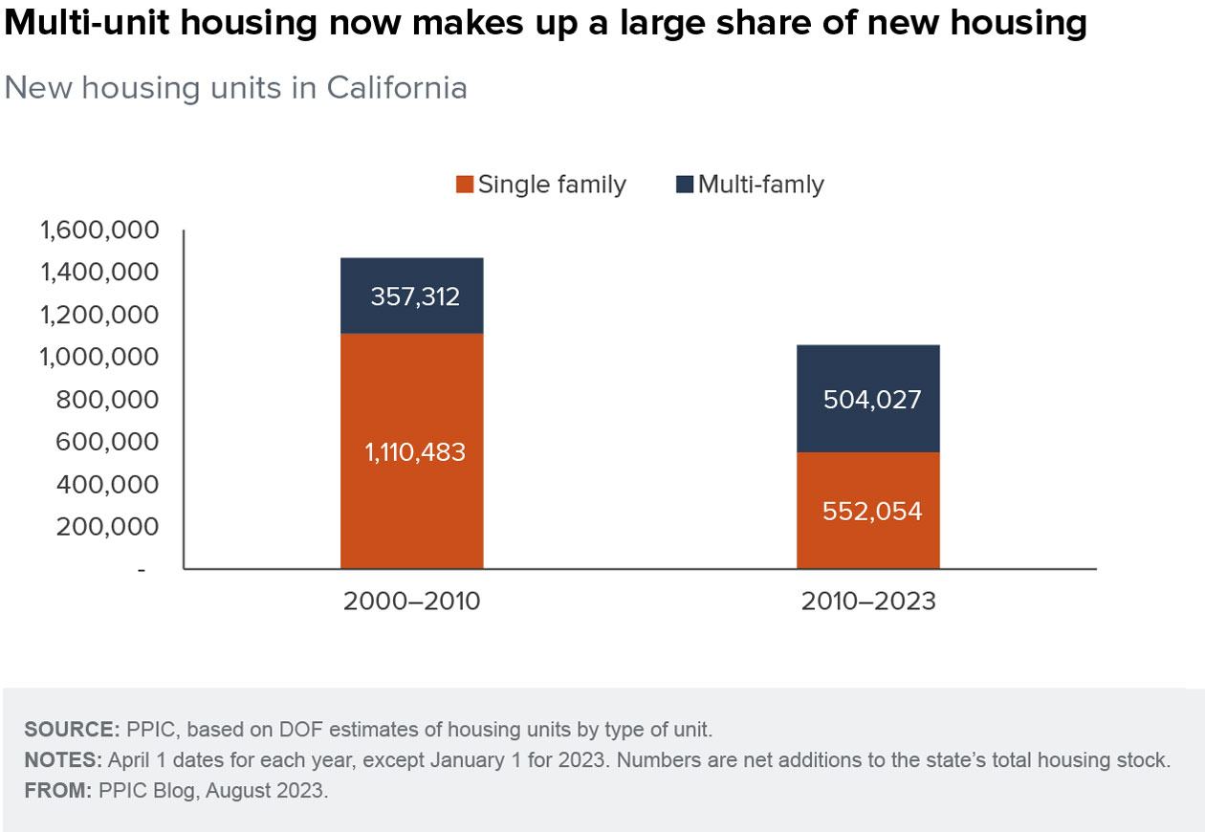
New Housing is Multi-Unit Housing
Notes:
https://www.ppic.org/blog/multi-unit-housing-is-becoming-more-common-but-has-low-homeownership-rates/

Slide 26
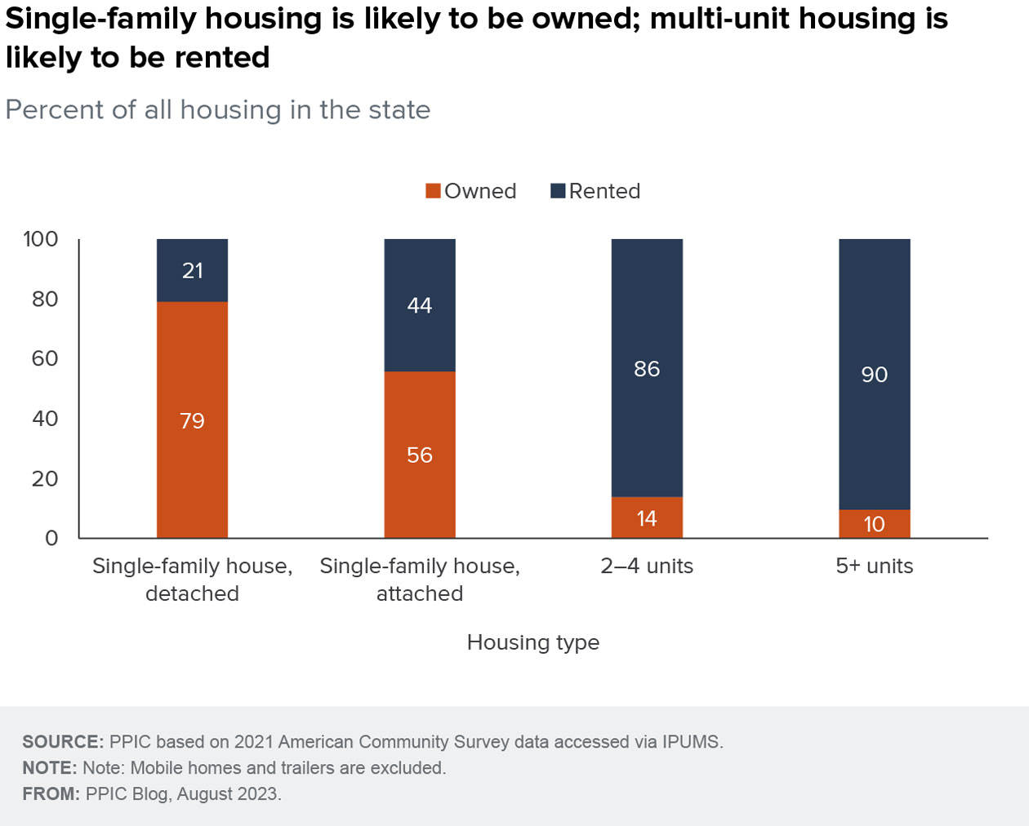
Multi-family housing tends to be rented
Notes:
https://yieldpro.com/2024/01/large-apartment-complexes-account-for-28-percent-of-california-rental-market/#:~:text=Roughly%20three%20eights%20of%20California,the%2039%20percent%20national%20average.

Slide 27
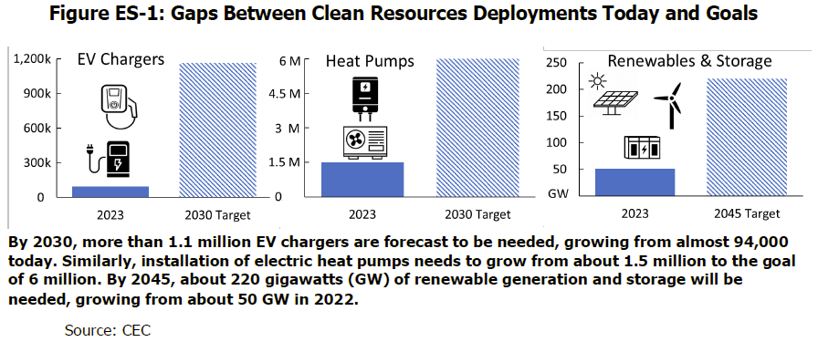
What is needed to achieve climate/energy goals?
Notes:
From the CEC’s Draft 2023 IEPR
“To achieve 100 percent renewable and zero-carbon electricity by 2045, annual solar and wind build rates need to triple compared to the prior decade, and battery storage installation rates need to grow by nearly eightfold relative to 2020.“
- CEC, CPUC, CARB. 2021 SB 100 Joint Agency Report, Achieving 100 Percent Clean Electricity in California: An Initial Assessment, https://efiling.energy.ca.gov/EFiling/GetFile.aspx?tn=237167&DocumentContentId=70349. Referred to as the SB 100 Joint Agency Report.

Slide 28
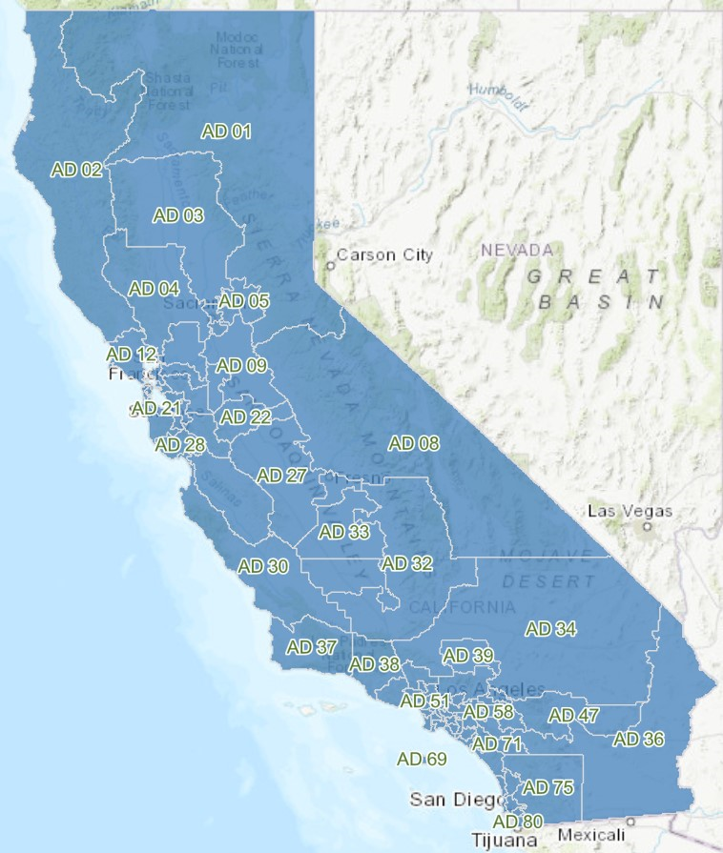
Notes:
From the California Department of Education (GIS Data - Greg Dixon)
https://gis.data.ca.gov/datasets/CDEGIS::legislative-districts-in-california-2/explore?layer=0&location=37.113037%2C-119.034808%2C6.10

Slide 29
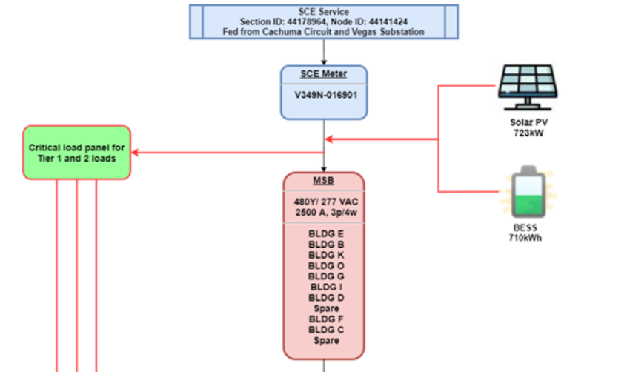
Standard Solar Microgrid Diagram (from a real deployed design at San Marcos High School, in SBUSD)
Main Meter
Main Service Board
Critical Loads
Renewable generation (solar) and energy storage sited behind-the-meter
Notes:
https://clean-coalition.org/wp-content/uploads/2021/09/San-Marcos-High-School-Solar-Microgrid-case-study-10_gy-30-June-2020.pdf

Slide 30
Deployed San Marcos High School Solar Microgrid

Slide 31
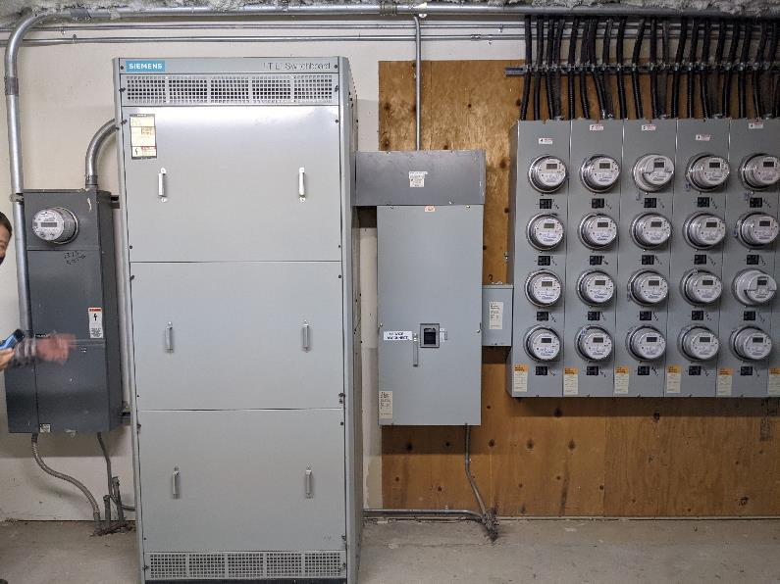
Commercial and residential meters in building 3a electrical room (1 commercial and 27 residential)

Slide 32
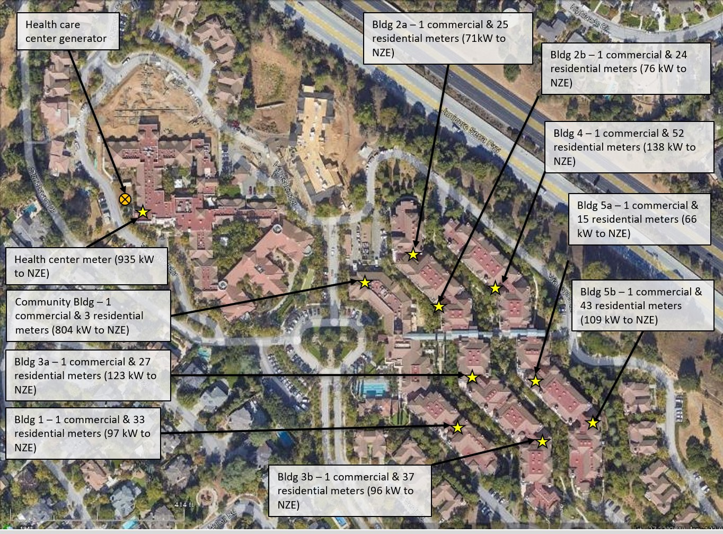
Case Study: The Forum
Retirement community with residential units and hospice/memory care facilities.
Wants to have a single-site microgrid that backs up residential and non-residential facilities.
  Commercial facilities meet the exemptions for master metering, but residential units do not.
As a result, it is impossible to deploy a single microgrid and very difficult/expensive to ensure resilience for residential units.
Master metering solves this problem in the most economical and efficient fashion.

Slide 33
Case Study: EV Charging at MUH
With greater penetrations of EVs, ensuring that charging can occur is essential.
EV Charging Infrastructure can result in an extremely high load, especially if charging occurs at peak periods.
EV Charging stations should be able to deploy microgrids with on-site generation.
  Enabling EV charging facilities to island from the grid and use on-site energy to serve loads will reduce the strain on the grid and help reduce rates for ratepayers.
MUH facilities should include EV Chargers in a master metered microgrid that serves the entire site.

Slide 34
The Fix – Enabling Residential Master Metering
PUC § 780.5: The commission shall require every residential unit in an apartment house or similar multiunit residential structure, condominium, and mobilehome park for which a building permit has been obtained on or after July 1, 1982, other than a dormitory or other housing accommodation provided by any postsecondary educational institution for its students or employees and other than farmworker housing, to be individually metered for electrical and gas service, except that separate metering for gas service is not required for residential units which are not equipped with gas appliances requiring venting or are equipped with only vented decorative appliances or which receive the majority of energy used for water or space heating from a solar energy system or through cogeneration technology.
Make a change to Public Utilities Code Section 780.5.
Either make a strikethrough in the code removing the prohibition or;
Create a specific exemption for instances where resilience is being pursued (and the economic benefits are an additional benefit).

Slide 35
Deploying microgrids at Multi-Unit Housing facilities is a solution for numerous intersectional energy issues
Reliability (consistent service)
Resilience (service during major outages)
Reduction in high electricity rates for all ratepayers
Monthly savings on electricity bills
Wildfire Mitigation
Building Electrification
Transportation Electrification
Energy Sector Decarbonization
Improved local air
quality
Optimal Electric Service
The answer:
Deploying microgrids at multi-unit housing (MUH) facilities, benefitting residents and the ratepayers. Microgrids create an unparalleled trifecta of economic, environmental, and resilience benefits.
Affordable Electricity Rates
Less risky electrical infrastructure
Electrification
Better environment for residents

Slide 36
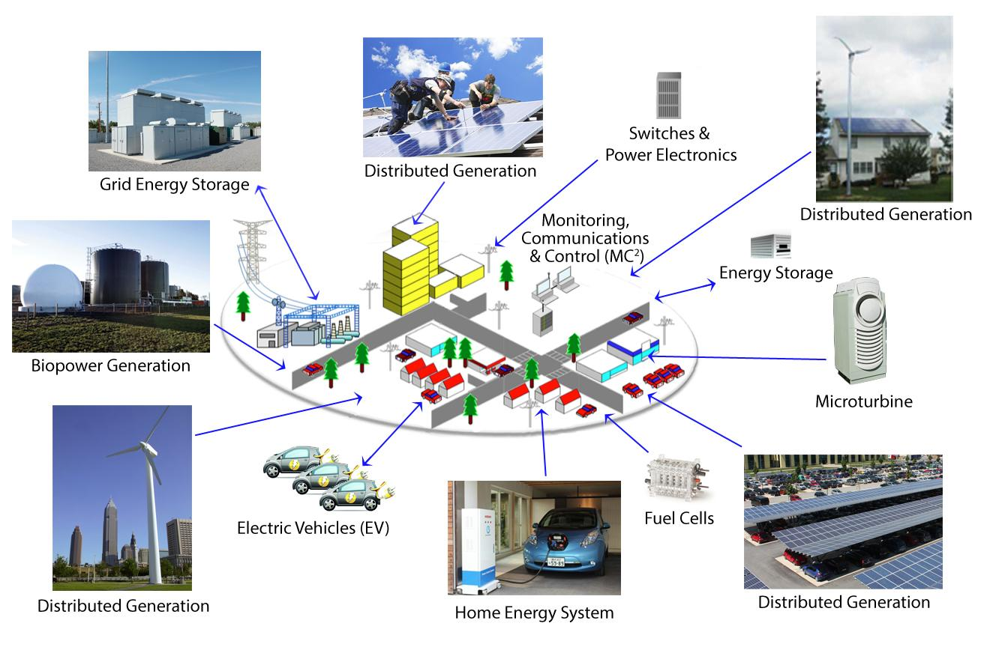
Community Microgrid Components
Notes:
36

