Slide 1
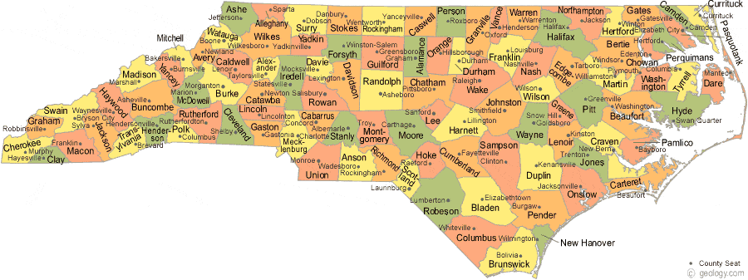
North Carolina: A Case Study of a Bipartisan Approach to Energy Policy
Presented by Jim Dodenhoff
Principal, Silent Running LLC
www.silentrunning.biz
James.Dodenhoff@gmail.com
310-936-9456
February 2024
Source: Geology.com

Slide 2
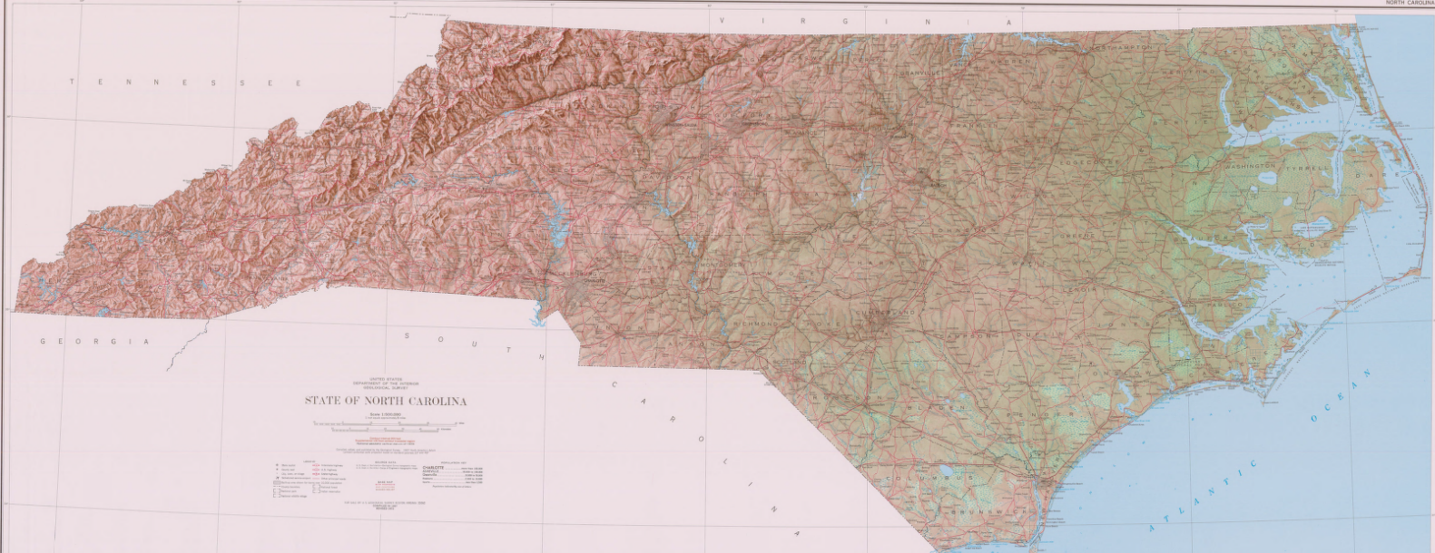
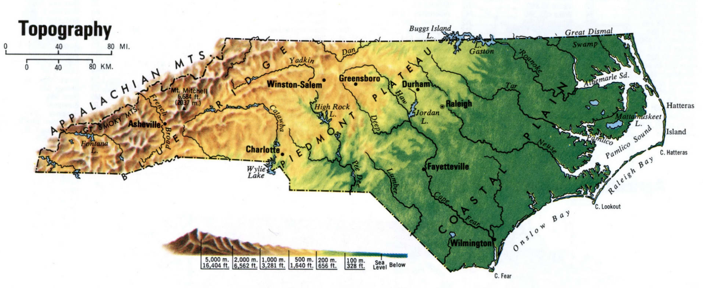
A Topographic View of North Carolina
Source: State of North Carolina Department of Environmental Quality
Source: U.S.-atlas.com

Slide 3
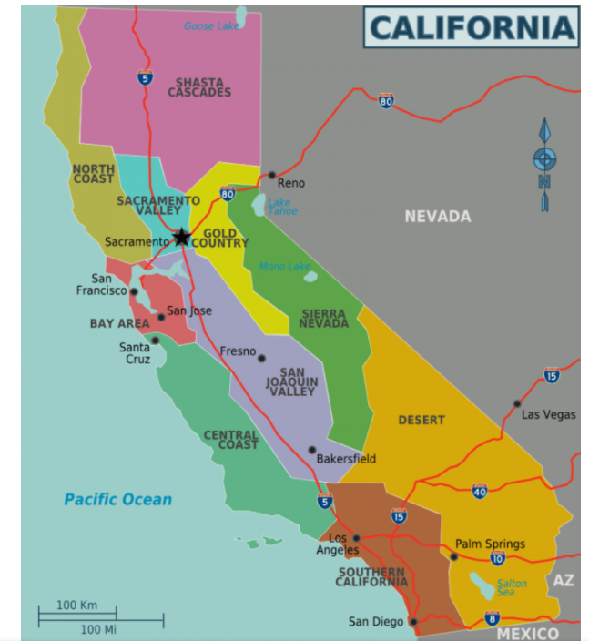
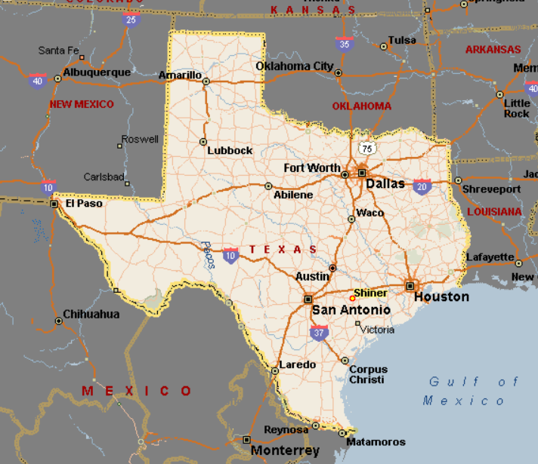
TEXAS
North Carolina
Population | 39.5 Million (2020-Largest in U.S.)
Square Miles | 163,696 square miles (3nd in U.S.)
Coastline (miles) | 840 Miles (3rd Longest in U.S.)
Annual Gross Domestic Product | $3.4 Trillion in 2021 (Ranked #1 in the U.S)
Impacts from Climate Change | California Climate Change Index Score is 54.6. Of the 50 U.S. states. California is the 29th most impacted by climate change.
Climate Change Preparedness | California’s Climate Change Preparedness Score is 100- tied for the best of the 50 U.S. States
Population | 29.1 Million (2020-2nd Largest in U.S.)
Square Miles | 268,596 square miles (2nd in U.S.)
Coastline (miles) | 397 miles (6th longest in U.S.)
Annual Gross Domestic Product | $2.0 Trillion in 2021 (Ranked #2 in the U.S)
Impacts from Climate Change | Texas’ Climate Change Index Score is 25.7. Of the 50 U.S. states. Texas is the 4th most impacted by climate change
Climate Change Preparedness | Texas Climate Change Preparedness Score is 8. It is the least prepared state for addressing climate change impacts
Population | 10.4 Million (2020-9th Largest in U.S.)
Square Miles | 53,819 square miles (28th in U.S.)
Coastline (miles) | 301 miles (7th longest in U.S.)
Annual Gross Domestic Product | $662 Billion (Ranked #10 in the U.S)
Impacts from Climate Change | North Carolina Climate Change Index is Score is 42.4. Of the 50 U.S. states. North Carolina is the 16th most impacted by climate change
Climate Change Preparedness | North Carolina Climate Change Preparedness Score is 83. It is the 10th prepared state in the U.S.
Source for Climate Change Rankings: https://www.policygenius.com/homeowners-insurance/best-and-worst-states-for-climate-change/;
Best and Worst Prepared States for Climate Change, PolicyGenius (October 2021)

Slide 4
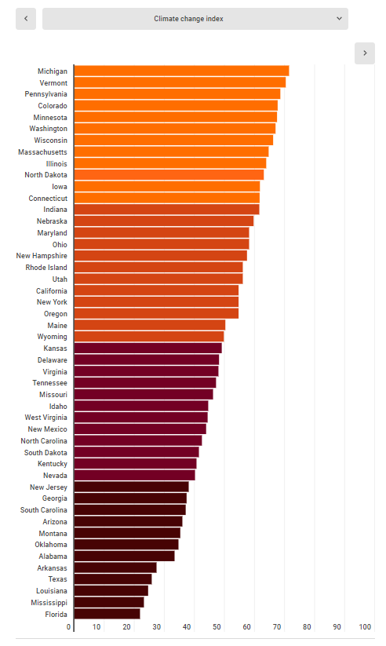
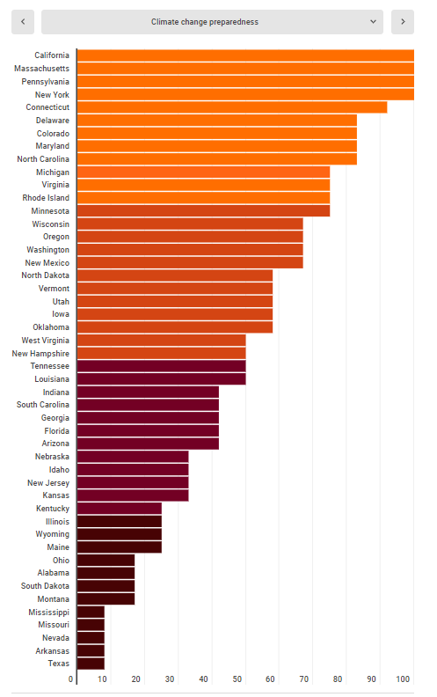
Climate Change Vulnerability
Climate Change Preparedness
Source: Policy Genius

Slide 5
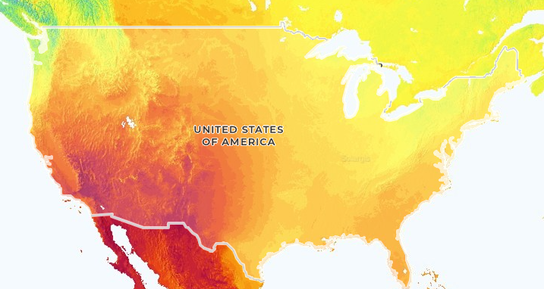
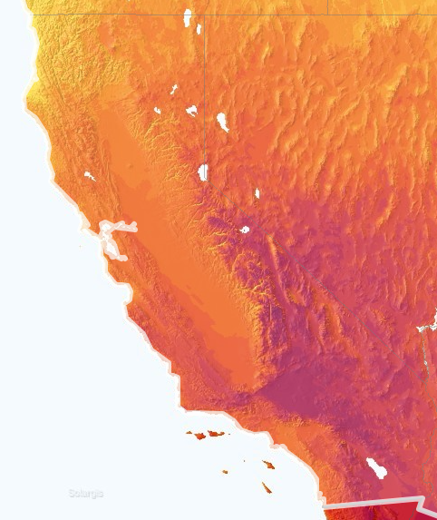
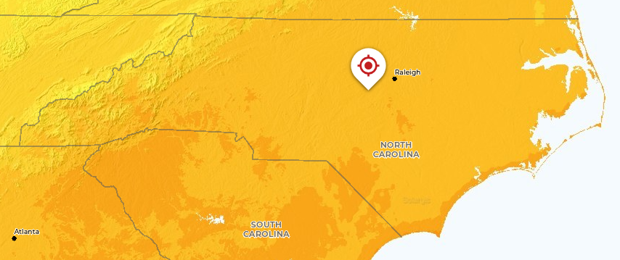
Comparative Solar Irradiation Levels

Slide 6
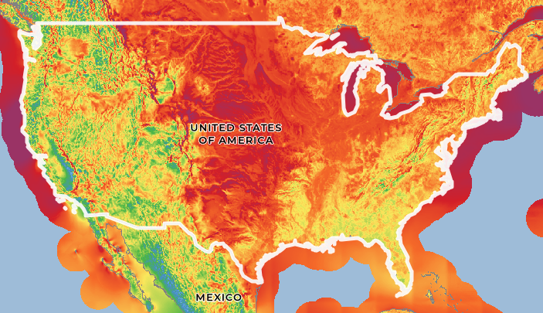
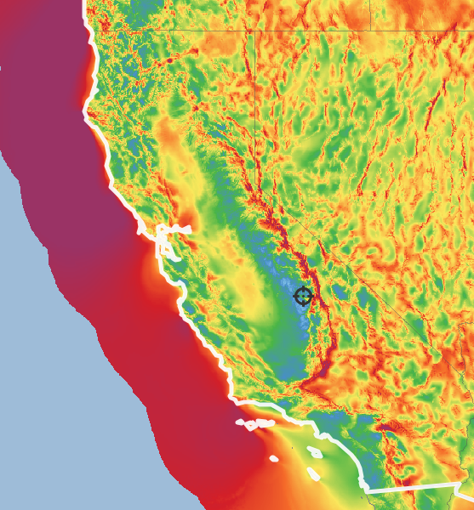
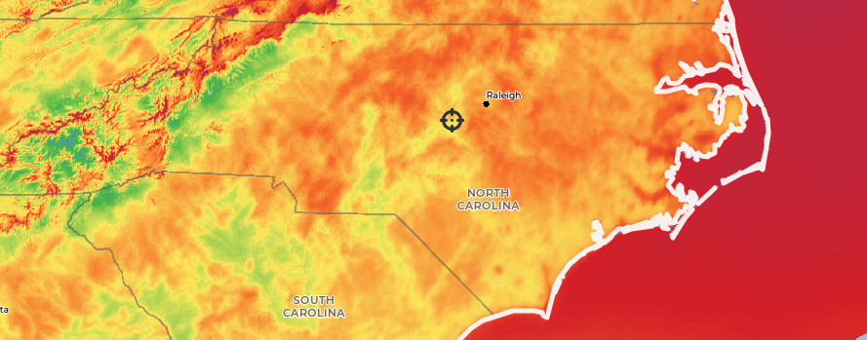
Comparative Off-Shore Wind Potential

Slide 7
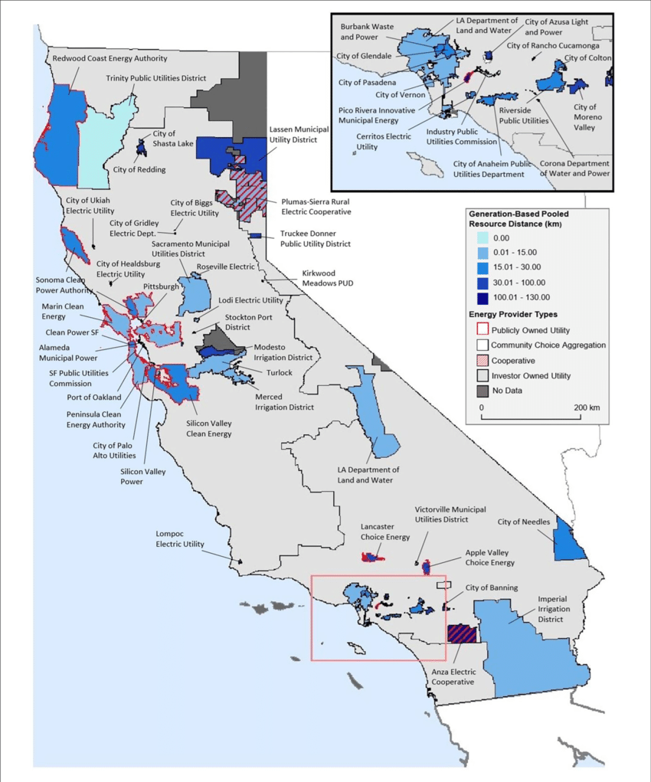
Utility Service Territories-California
Source: Research Gate

Slide 8
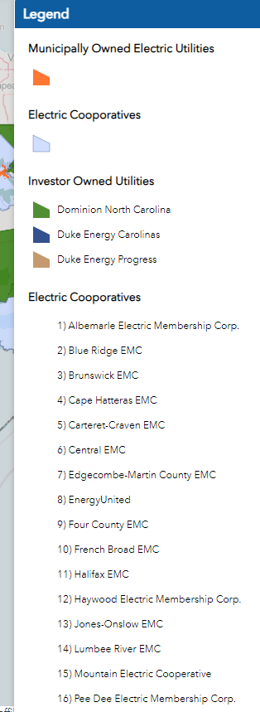
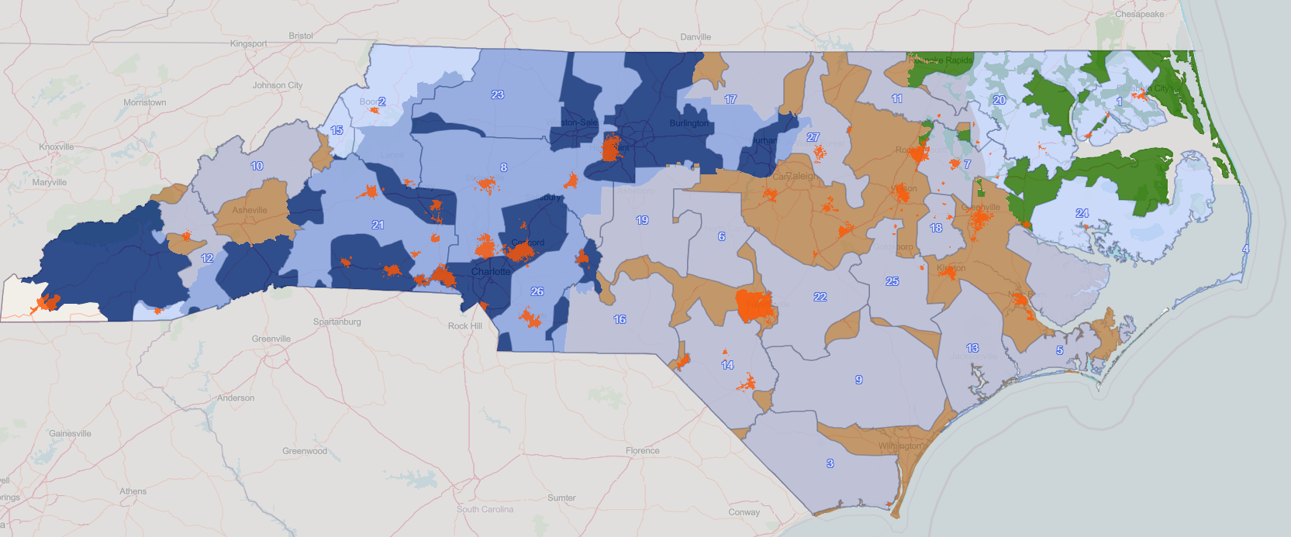
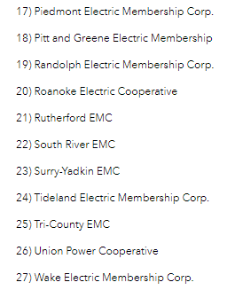
Utility Service Territories-North Carolina

Slide 9
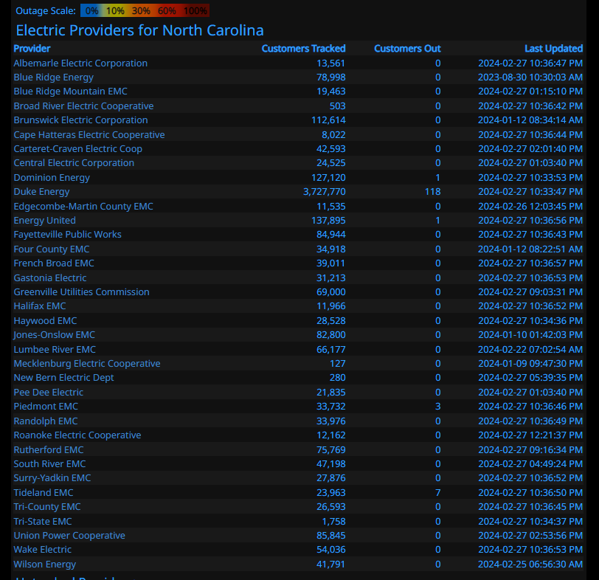
Distribution of Electric Utility Customers in
North Carolina

Slide 10


Comparison of Regulatory Structures
Five Commissioners Appointed by Governor
Subject to Confirmation by Senate
Six Year Terms
Term Limits for Governor/Not for Commissioners
CA has an ISO (CAISO)
Seven Commissioners Appointed by Governor
Subject to Confirmation by General Assembly
Six Year Terms
Term Limits for Governor/Not for Commissioners
No ISO in North Carolina

Slide 11

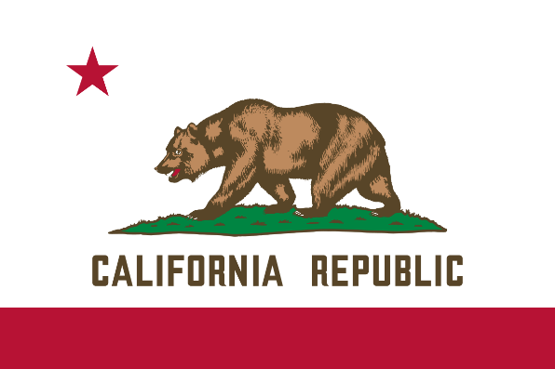
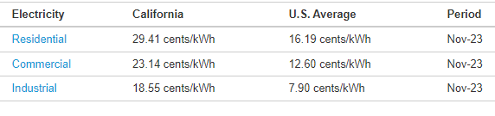
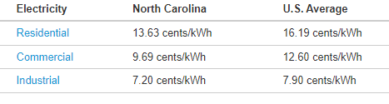
Comparison of Electricity Pricing
California “requires” TOU rates for Industrial, Commercial, and Agricultural Customers
Residential customers can “choose” TOU
North Carolina has “optional” TOU Rates for all customers
Source: EIA, DOE

Slide 12
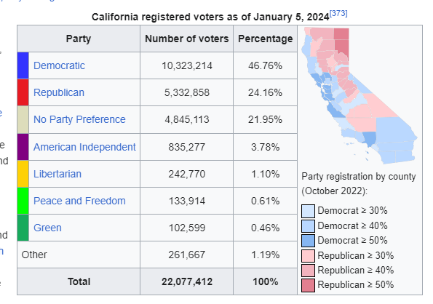
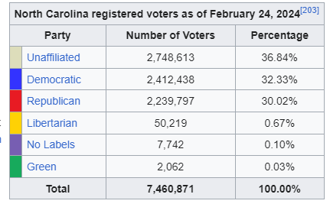
Registered Voter Comparison
Source: Wikipedia

Slide 13
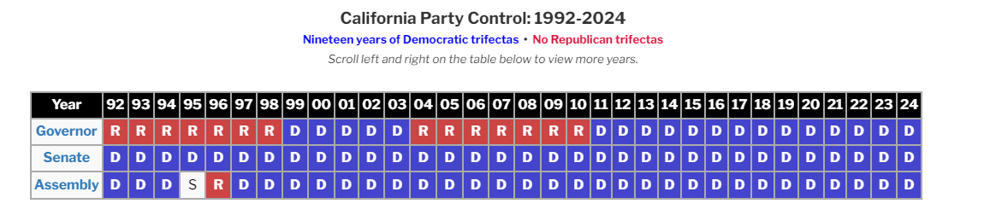
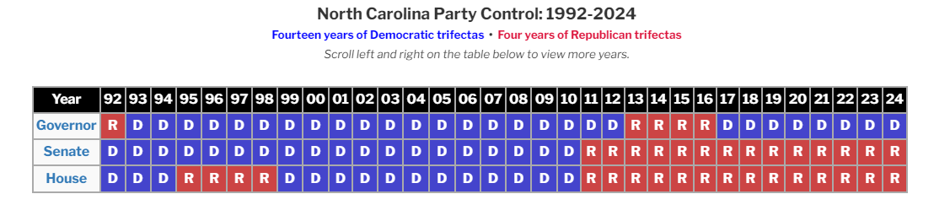
Key Political Trends Over Past 10 Years
Source: Ballotpedia.org

Slide 14
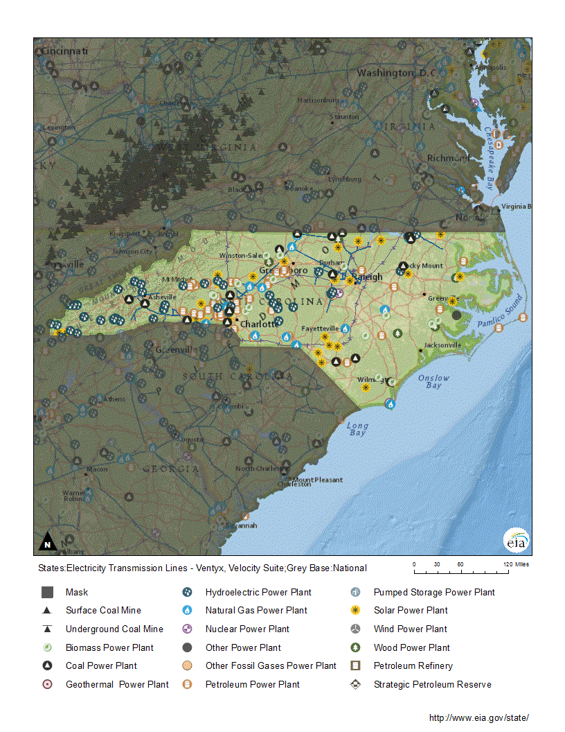
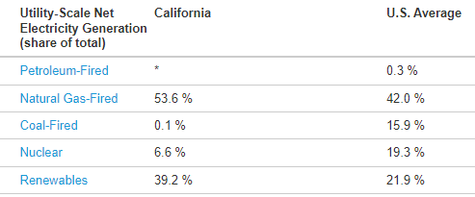
Fuel Sources for Electricity-California

Slide 15
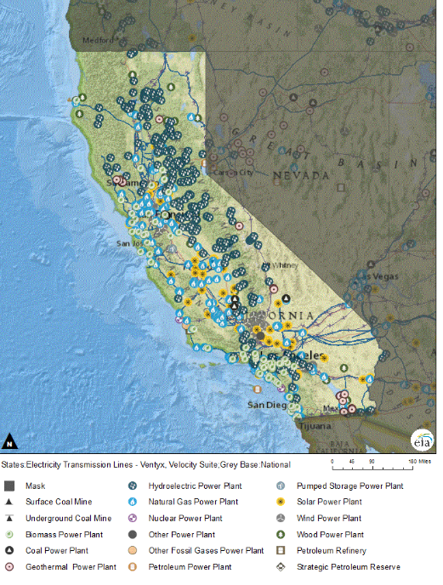
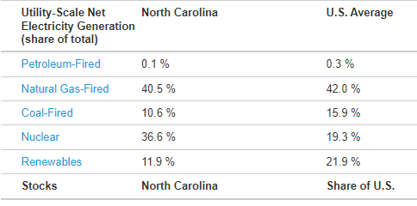
Fuel Sources for Electricity-North Carolina

Slide 16
Historical Elements of NC
Clean Energy Policy
PURPA
1990 state adopted Renewable Energy Tax Credit
Clean Smokestacks Act 2002
SB 3 Passed in 2007, NC becomes first Southeast state to adopt a Renewable Energy and Energy Efficiency Portfolio Standard
HB 589 created competitive process for procurement of utility scale solar
HB 951 Passed in 2021 Established Carbon Reduction Goals

Slide 17
North Carolina Carbon Plan (HB 951)
Passed in October 2021
NCUC to achieve 70% reduction of 2005 Carbon Levels by 2030
Carbon Neutrality by 2050
Achieve Reductions in Least Cost Manner
In March 2023 Order Issued for Consolidation of Carbon Plan and IRP’s for Duke Utilities

Slide 18
Key Elements of Net Energy Metering in NC
(Revised March 2023)
Reduction in Consumer Value of Solar
Monthly Fixed Charge
Grandfathering of Previous through December 31, 2026
Solar Valued at TOU Rate (with limited exceptions)
Summer On Peak: 6-9 pm
Monthly Minimum Bill $22-$28 per moth
In 2022
-4th in U.S. in installed solar
-4th in U.S. in actual solar

Slide 19
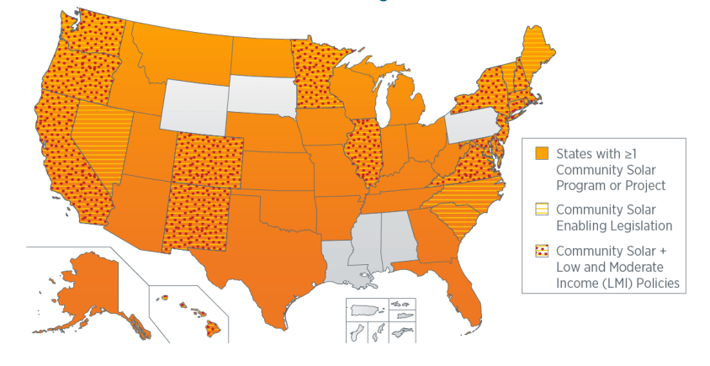
Where is Community Solar Available
Source: U.S. Department of Energy

Slide 20
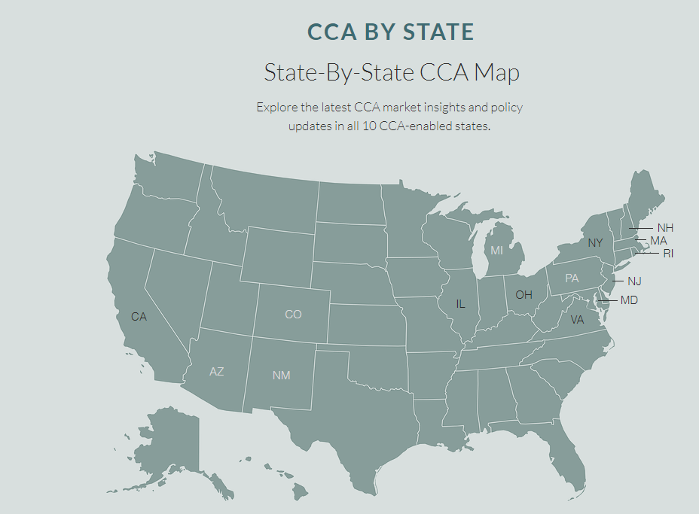
Community Choice Aggregation
Source: Lean Energy U.S.

Slide 21
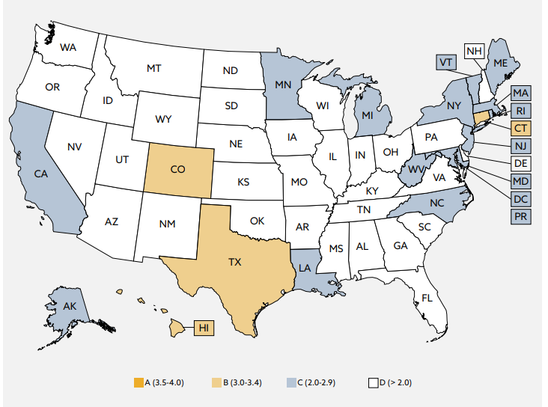
State Microgrid Policies
Source: Think Microgrid, State Scorecard 2023

Slide 22
So What’s the Secret Sauce?

Slide 23
  James Dodenhoff
  Principal, Silent Running LLC
  Culver City, CA
  James.Dodenhoff@silentrunning.biz
  M-310-936-9456
  www.silentrunning.biz

Slide 24
