Slide 1
Virtual Power Plants
Municipal Sustainable Energy Forum
March 27, 2024
C. Baird Brown
eco(n)law LLC
baird@ec0-n-law.net

Slide 2
Transition Progress
While US greenhouse gas emissions are falling, the current rate of decline is not sufficient to meet national and international climate commitments and goals. US net greenhouse gas emissions remain substantial and would have to decline by more than 6% per year on average, reaching net-zero emissions around midcentury, to meet current national mitigation targets and international temperature goals; by comparison, US greenhouse gas emissions decreased by less than 1% per year on average between 2005 and 2019.
  National Climate Assessment 2023, https://nca2023.globalchange.gov/

Slide 3
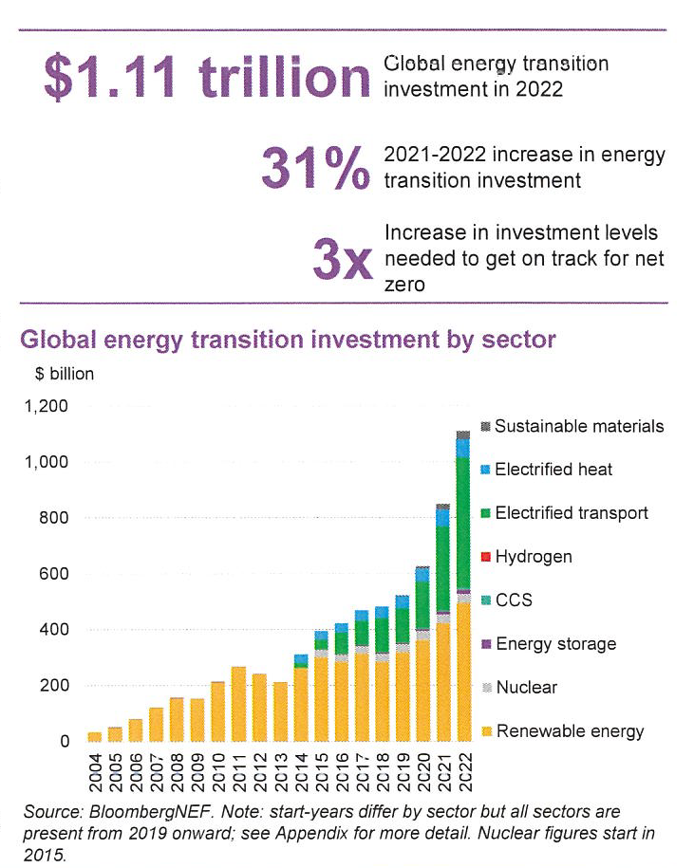
Finance Shortfall
To get on track for global net zero, according to Bloomberg New Energy Outlook, energy transition and grid investment need to average $4.55 trillion between 2023 and 2030. This is more than three times the total spent in 2022.
  https://assets.bbhub.io/professional/sites/24/energy-transition-investment-trends-2023.pdf

Slide 4
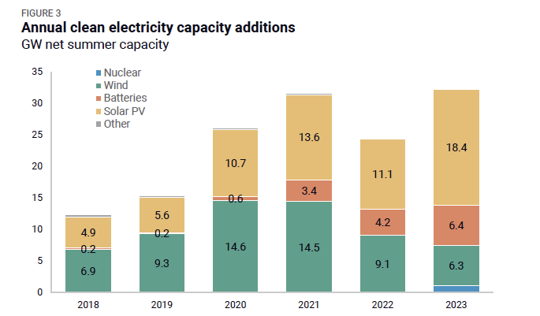
Regulatory and Logistic Delays
The biggest barriers to deployment between now and 2030 are non-cost in nature—like siting and permitting delays, backlogged grid interconnect queues, and supply chain challenges. Tackling these non-cost barriers will be critical for the IRA to achieve its full clean energy deployment and emissions reduction potential.
  https://energyinnovation.org/publication/clean-investment-in-2023-assessing-progress-in-electricity-and-transport/

Slide 5
Two Regulatory Paths
Utility Scale Generation and Big New Transmission
  Entirely under Federal Energy Regulatory Commission (FERC) jurisdiction under the Federal Power Act
Local Generation and Smarter Distribution
  Public Utility Commission (PUC) has jurisdiction over distribution investment and retail sales (utility tariffs)
  Sales by Distributed Energy Resources (DERs) are FERC regulated wholesale sales except:
    Retail tariff (e.g. net metering)
    See Sun Edison LLC, 129 FERC ¶ 61,146 at P 1 (confirming that certain solar energy sales to net metered end-use customers do not constitute the sale of electric energy at wholesale in interstate commerce or the transmission of electric energy in interstate commerce for purposes of the FPA); MidAmerican, 94 FERC ¶ 61,340 at P 1 (objecting to the Iowa Utilities Board's implementation of final orders issued pursuant to Iowa's Alternate Energy Production Statute and § 199-15.11(5) of the regulations thereunder, directing MidAmerican to interconnect with three Alternate Energy facilities and to offer net billing arrangements to those facilities.)
    Qualified Facilities under the Public Utility Regulatory Policies Act (PURPA)
    16 U.S.C. 2601 et. seq.

Slide 6
Benefits of the Local Path
Faster decarbonization
  Investment by and on behalf of customers and communities
  Avoid the interconnection queue and transmission siting battles
Resilience
  Microgrids and Grid Sectionalization
Reduce line losses, failure risk and security risk
Energy Justice
  Reducing environmental hazard
  Building community wealth
Energy Democratization

Slide 7
Finance Depends on Revenue
___Revenue____ _{= Debt Service Coverage Ratio}
Debt Cost + O&M
Also provides return on investment
Revenues/savings come first from behind-the-meter customers
Exports are helpful if you can rely on them
VPP can give access to the wholesale market and a reliable source of revenues

Slide 8
Virtual Power Plant (VPP)
An aggregation that can include demand response from residential users and use of all types of controllable load
Value from real-time sales to the grid can reduce installation costs or regular electric bills
  More valuable to the grid than Time of Use tariff
Two technology paths
  Direct control of customer assets
  Pricing to customers – smart appliance or home controller
Two business models
  Vertically integrated – install and manage
  Platform for multiple installers

Slide 9
DER Issues
Interconnection
  All DERs are at risk for delays and costs
  Need streamlined procedure
Cost of upgrades
  Real inequity in ability to interconnect
  DOE Grid Reliability and Innovation Program (GRIP)
    https://www.energy.gov/gdo/grid-resilience-and-innovation-partnerships-grip-program
Metering
  Can you do device metering
  Home controller solves this, but possible Energy Justice issues

Slide 10
VPP Issues
Aggregator and Wholesale Marketer (FERC Licenses)
  Can buy power from customers and sell to grid
Electric Generation Supplier (EGS)(PUC license)
  Can manage customer DERs through price signals
  More customer control, simpler and more secure
Vertically integrated
  Limits customer choice
  Can lead to dueling dispatch of different equipment
Platform
  Choice of installers – build a competitive market

Slide 11
Questions?
C. Baird Brown
eco(n)law LLC
baird@ec0-n-law.net

