Slide 1
Why aren’t VPPs everywhere?
VPPs = demand response aggregation networks

Slide 2
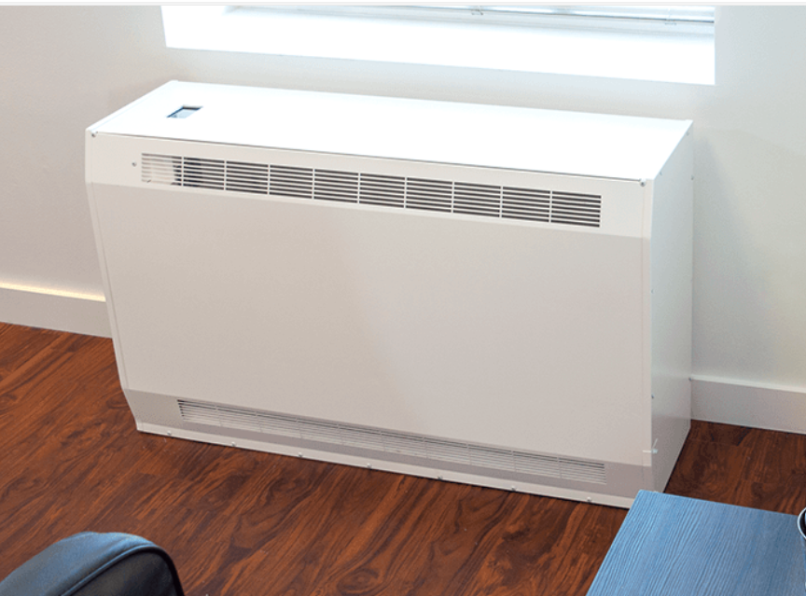
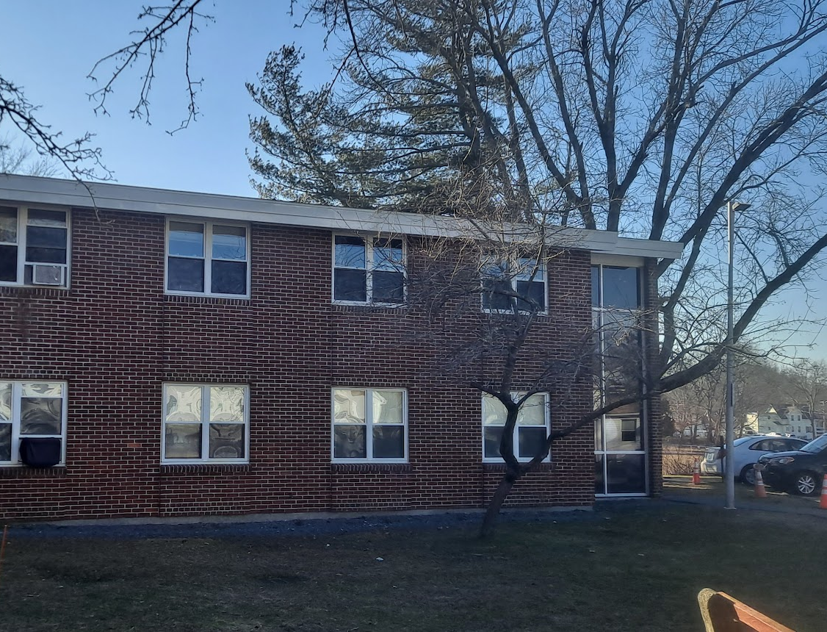
Our Story with THA Pilot
Two low-income senior facilities
25 apartments converted from electric based board to ASHP with integrated thermal storage
2 to 4 hours of storage during heating
1 to 2 hours during cooling
Estimated energy savings 30 to 40%
Estimated aggregated demand reduction capabilities 75 kW
Project awarded in 2021. Installation in summer of 2024.
3 different VPP vendors. None worked out

Slide 3
Barriers that we’re seeing…
WiFi access
End customer apprehension
Billing systems
Costs
Turbulent providers/industry
Complexity

