Slide 1
COMMUNITY SOLAR UPDATE
MSE Forum
March 28,2024
Presented by:
Phyllis J. Kessler, Esq.
Energy, Renewable Resources & Sustainable Development Practice Group

Slide 2
New Jersey Community Solar Rules
NJ Community Solar Energy Program initiated by NJBPU in August 2023
Established requirements for community solar projects:
    5MW size limit
    Block allocation limits number of projects
      FCFS approach to project acceptance
      Tiebreaker mechanism if block oversubscribed
    Subscribers located anywhere in EDC service territory

Slide 3
New Jersey Community Solar Rules, cont.
Stringent application requirements
    Registration package must contain detailed information requiring significant pre-application work:
      Site plan certified by engineer
      Facilities< 1 MW submit to EDC an Interconnection Application and installation agreement
      Facilities 1 MW and greater obtain written authorization from the EDC providing conditional approval to construct
      Evidence of site acquisition, applications for land use approvals and other entitlements such as zoning permits, municipal site plans and other permits
      Community Engagement and Subscriber Acquisition Plan
      Guaranteed bill credit discount of no less than 15%

Slide 4
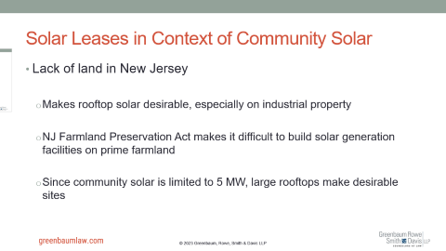
Solar Leases in Context of Community Solar
Lack of land in New Jersey
  Makes rooftop solar desirable, especially on industrial property
  NJ Farmland Preservation Act makes it difficult to build solar generation facilities on prime farmland
  Since community solar is limited to 5 MW, large rooftops make desirable sites

Slide 5
New Jersey Community Solar Rules, cont.
    51% of capacity reserved for LMI customers
    Master metered affordable housing providers required to pass on 75% of the benefit of bill credit to tenants
    Bill credits carry over to the next month until the end of the annual period at which point they are cashed out at the avoided cost of wholesale power
    Subscribers to receive one consolidated bill for solar generation charges and utility charges
    Subscriber standards: minimum 10 subscribers; no maximum number of subscribers

Slide 6
Solar Leases in Context of Community Solar, cont.
Examples of Solar Lease issues:
  Lease treated like real estate deal, rather than solar lease
    Insurance to be provided by building owner (underlying net net lease)
    Insurance to be provided by solar developer (solar generator to be owned by SPE)
    Lease term 35 years
    Easement/transmission equipment
  Developer threatened to use solar site under solar lease for community solar rather than finalize PPA

Slide 7
Solar Leases in Context of Community Solar, cont.
    Developer already bound to solar lease
    Not easy to substitute community solar for PPA due to cost and complexity
      Need 51% of capacity to be subscribed by LMI
      More complex approval process in that community engagement plan required and much more complicated approval process in advance of seeking subscribers

Slide 8
Thank You
Questions?
Phyllis J. Kessler
Energy, Renewable Resources & Sustainable Development Practice Group
pkessler@greenbaumlaw.com | (973) 577-1760

