Slide 1


Using Reality-Based Physics to
Fully Value DERs
Robert Perry,
Principal Analyst
April 25, 2024

Slide 2
Some Background Observations
Current DER Valuation Approaches Center on Grid Benefits and Employ Cost Avoidance Mechanisms. DER value is derived by estimating the amount saved by not overbuilding grid infrastructure to accommodate a higher projected system load.
Problem: Proving a Hypothetical is Extremely Subjective. Trying to calculate possible avoided costs is prone to monopoly bias based on a centralized, top-down model.
Solution: Applying Physics to Determine How DERs Function within a Grid Architecture. Kirchoff’s Circuit Laws dictate the path exported energy travels to serve adjacent loads and should form the basis for DER pricing.
The Question is not “Can We Avoid Grid Modernization?” but “Who Will Pay for it?” Our energy infrastructure will ultimately need a complete overhaul, but future costs should be paid by the beneficiaries and not all ratepayers.

Slide 3
What is Local Energy?
Question Posed in April 3rd Article by Elisa Wood: Do You and I Mean the Same Thing When We Say Local Energy? “Distributed energy resources, or DERs, . . . provide energy (or energy savings) at or near where the power is consumed. Because the power doesn’t have to travel far, it captures efficiencies lost when electricity moves long distances over wires.”
My Response (LinkedIn):
  “Local energy" involves distributed energy systems serving local energy markets.
  To accurately assess grid costs, a complete generation-to-load pathway must be identified so ratepayers are charged only for infrastructure used.
  Today, generation and delivery charges are largely dissociated, supporting the "big lie" that energy exported to the grid is not dependent on actual physics dictating that generated energy always serves the nearest load, or energy demand.
  The primary driver of increasing electric rates involves skyrocketing transmission/ distribution costs. Eliminating most if not all of this superfluous cost, plus the inherent superiority of distributed energy from a resilience perspective, should be sufficient to incentivize widespread DER deployment to serve critical loads.

Slide 4
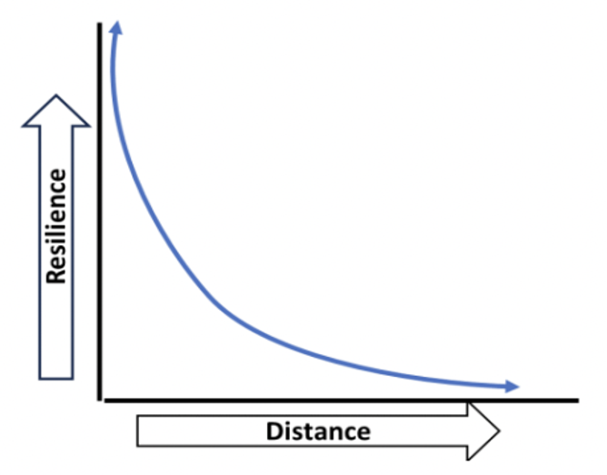
Resilience vs. Distance
The inverse relationship between resilience and distance can be viewed as a parabolic curve, where on-site or adjacent electricity supply capacity provides a virtually complete level of energy resilience, which decreases rapidly with increased capacity-to-load distance and the addition of intermediate grid infrastructure components that are subject to failure at some point during their expected lifespan.
Distributed energy has a resilience superiority that cannot be replicated by the centralized grid.

Slide 5
Role of Grid in Meeting Energy Demand
Source: Sahm White, 350 Bay Area, “High-DER Grid Modernization Workshop #1: Identifying Operational Needs, Panel 3,” February 8, 2024
Operation starts at load, working from the bottom up. Demand is met through resources, and starts with DERs, because all demand begins where the load exists.
Less load = less demand = less grid capacity costs at each layer. Bulk system & wholesale markets provide final, residual supply after serving as much demand as possible with locally owned & operated DERs.
Coordination of individual DERs should include layered aggregation
  Each aggregation functions as a single entity in the next layer.
  This approach greatly simplifies operation and optimization because it allows operational data to reflect a single value at each junction.
  Start from local energy needs & priorities, then plan outward in concentric circles — customer premises => block => neighborhood => campus => town/city/county

Slide 6
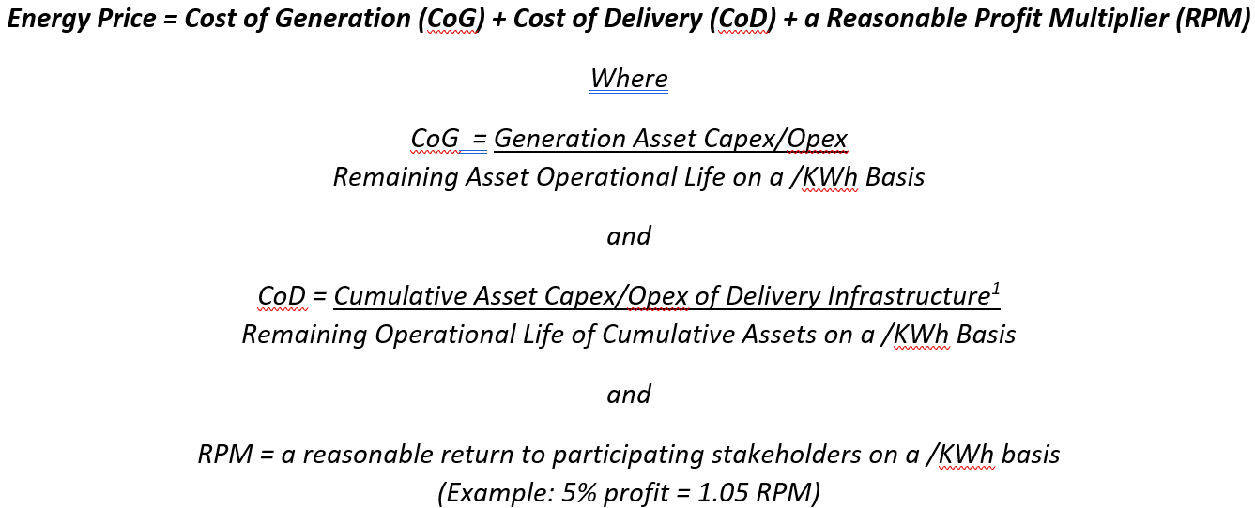
Solution: An Integrated DER Tariff Formula
Source: Robert Perry, Synergistic Solutions, “Comments re Core Concepts and Metrics Conducive to Creating a High-DER Future,” June 17, 2022
¹ Locationally situational and calculated by creating an inventory of distribution infrastructure between the point of generation (PoG) and point of consumption (PoC) and aggregating the cost of those assets over their remaining lifecycles on a /KWh basis, with a reasonable ROI added. This should not be a difficult task for utilities that regularly submit extensive General Rate Cases in support of their proposed rate structures.
Using this formula, DSOs will be incentivized to develop areas of high-DER penetration that continuously utilize predetermined distribution pathways, resulting in foreseeable profits based on KWhs delivered.

Slide 7
Takeaways
DER’s Primary Value is Derived from Providing Local Energy Resilience and Locational Benefits. Proximity to load captures the highest resiliency value at the lowest cost of delivery and should be the guiding star in distribution planning.
Antiquated approaches based on avoiding theoretical future grid costs should be discarded in favor of reality-based formulas that focus on how distributed energy actually functions within small portions of the distribution grid.
Revenues from grid services are the icing, not the cake.
Removing superfluous grid charges from DER pricing is more effective than clawing back such charges via a “grid services” model.
A “pay as you go” model based on infrastructure actually used is a relatively simple concept that an educated public can grasp if properly explained using plain language.
A “bottom-up” approach should prioritize local planning to maximize DER development and defray grid modernization costs.

Slide 8
Thank You!
Robert Perry, Principal Analyst
Robert.Perry108@gmail.com
(818) 384-4557

