Slide 1
INTERCONNECTION ISSUES
Municipal Sustainable Energy Forum
June 25, 2024
C. Baird Brown
eco(n)law LLC
baird@eco-n-law.net

Slide 2
PA PUC ANOPR for FERC Order 2222
PUC issued advance notice of proposed rulemaking to assure that its rules and procedures were consistent with PJM (RTO) rules under Order 2222
“The PUC seeks comment on whether its existing interconnection regulations for customer-generators, 52 Pa. Code §§ 75.31-40, can be adapted to address interconnection of a Component DER participating in a DER Aggregation Resource with EDC distribution facilities, consistent with Order 2222 and PJM's DAPM, and, if so, the specific changes to the PUC's interconnection regulations that would facilitate this adaption.”
.
6
Notes:
Alternate first bullet:
Through CCA, boroughs would preserve existing and future customer choice, enhance competition, and provide additional customer protection, while EGSs participating in an opt-out program led by boroughs, would not violate their Pennsylvania licensing requirements.

Slide 3
Treat Customer DERs Like Customers
Order 2222 is premised on FERC’s conclusion that competition from customer-sited resources will benefit both the grid and ratepayers by providing essential services
Interconnection rules take the grid as a fixed resource and treat interconnection as a privilege that is accorded only to the fortunate for whom there is available space
The cost allocation system was created for wholesale generators, not for retail customers
Inequities of the legacy grid fall disproportionately on disadvantaged communities
…
6
Notes:
Alternate first bullet:
Through CCA, boroughs would preserve existing and future customer choice, enhance competition, and provide additional customer protection, while EGSs participating in an opt-out program led by boroughs, would not violate their Pennsylvania licensing requirements.

Slide 4
A Different View of the Grid
EDCs are default providers but support diverse power sources for customers, including customer DERs and community direct provision as well as Commission-licensed Energy Generation Suppliers (EGSs)
Interconnection rules take the grid as a fixed resource and treat interconnection as a privilege that is accorded only to the fortunate for whom there is available space
The cost allocation system was created for wholesale generators, not for retail customers
Inequities of the legacy grid fall disproportionately on disadvantaged communities
6

Slide 5
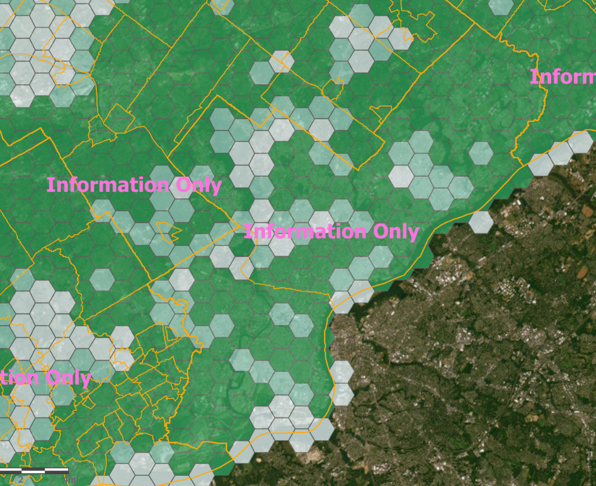
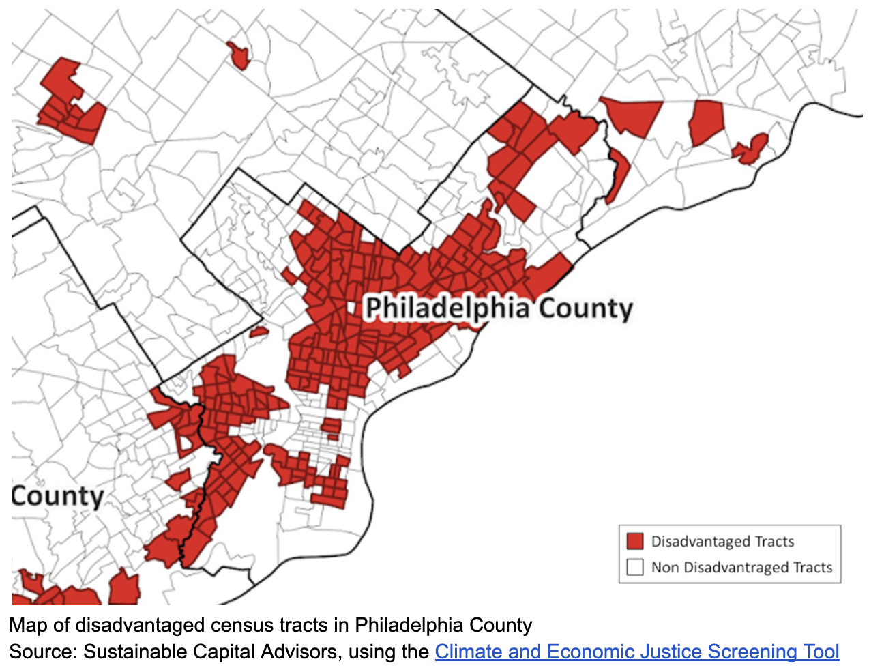
Interconnection Energy Justice
PECO Map of Interconnection Availability
See, Eric Niiler, An Outdated Grid Has Created a Solar Power Economic Divide, Science (September 18, 2021), https://www.wired.com/story/an-outdated-grid-has-created-a-solar-power-economic-divide/.
6

Slide 6
DERs Have Sophisticated Controls
For customers with multiple resources – microgrids, solar+storage, smart thermostats and appliances, EV charging – high quality digital controls and safety equipment are available
EDCs can rely on those controls to limit or eliminate exports or compensate for a behind the meter disturbance
Interconnection should not be based on worst case assumptions but on expected operation (e.g. new FERC storage rules)
Cost of sophisticated home controls is falling, and controller can be managed with a cell phone
Home controller avoids the need for device metering
6

Slide 7
QUESTIONS
C. Baird Brown
eco(n)law LLC
baird@eco-n-law.net

