Slide 1
Community Choice Aggregation
for Pennsylvania Boroughs
Municipal Sustainable Energy Forum
June 26, 2024
C. Baird Brown
eco(n)law LLC
baird@eco-n-law.net

Slide 2

Community Choice Aggregation (CCA)
Enables local governments to aggregate their community’s electricity load to
purchase or develop power on behalf of their residents, businesses &
municipal accounts to meet their energy, economic and environmental goals.

Slide 3

CCA Enables Boroughs’ Goals
Boroughs aim to:
Increase retail supply competition by aggregating enough load to achieve bargaining power.
Procure 100% renewable energy to reduce GHGs to mitigate climate change providing Consumer protection of residents
Provide ongoing energy education
Increase energy resilience
Help create local clean energy jobs
Increase stability in energy prices

Slide 4
PA Public Policy:
PA climate action plans feature C C A as an impactful strategy
Pennsylvania 2019 Climate Action Plan
Philadelphia Energy Transition Plan 2020
West Chester Council of Governments, 2020 Sustainability Plan
Renewable Energy resolutions are integral to Southeastern PA plans.
43 municipalities aim for 100% renewable electricity in the next decade.
Philadelphia
Montco (18): Upper Merion, Narberth, Plymouth Meeting, Norristown, Springfield, Ambler, Whitemarsh, Conshohocken, Cheltenham, West Norriton, Bridgeport, Abington, Hatboro, Montgomery Twp, Lower Merion, Upper Dublin, Whitpain, Lower Gwynedd
Chesco (16): Phoenixville, Schuylkill, Uwchlan, Downingtown, West Chester, East Bradford, Kennett Twp, East Pikeland, Tredyffrin, West Vincent, Pocopson, Charlestown, West Whiteland, West Bradford, East Fallowfield, Honey Brook Twp
Delco (5): Radnor, Haverford Twp, Swarthmore, Lansdowne, Nether-Providence
Bucks (3): Doylestown, Solebury, Buckingham

Slide 5
PA Has Existing Retail Choice Program
Licensed Energy Generation Suppliers (ESGs) can sell energy to utility customers
Utilities send a single bill to customers including the Utility’s charges for transmission and distribution and the EGS’s charge for energy
EGSs energy rates are unregulated
Customers in unless they opt out or make another choice
Utility remains the default supplier
…
.
6
Notes:
Alternate first bullet:
Through CCA, boroughs would preserve existing and future customer choice, enhance competition, and provide additional customer protection, while EGSs participating in an opt-out program led by boroughs, would not violate their Pennsylvania licensing requirements.

Slide 6
Build on the PA Retail Choice Market
Wholesale Markets
Energy
Energy
EGS
Payment
Energy
Bill Info
Utility
Residents
Billing
Payment
Wires Service & Default Energy Supply

Slide 7
Retail Choice Offers Foundation for Opt-out CCA
Wholesale Markets
Borough
CCA
Green Energy
Price
Energy
Fair
Terms
Energy
EGS
Election
Payment
Energy
Bill Info
Utility
Residents
Billing
Payment
Wires Service & Default Energy Supply

Slide 8
Prior Commission Precedent
Pike County (Pike), 2006
  “Opt-out program is not prohibited by Section 2807(d)(1) of the Public Utility Code.”
Retail Energy Supply Association (RESA), 2011
  “Opt-out aggregation programs should be authorized only in unique circumstances where it is clearly in the public interest to do so.”

Slide 9
Boroughs’ Proposal is Different, the Need for Action is Unique
  EGS in RESA appears to have initiated the prior opt-out program for their own benefit
  Boroughs are now acting to achieve their own objectives through CCA –EGSs will be selected after the program is established
  Existing and future customer choice will be preserved
  CCA brings the benefits of competition to customers who lack bargaining power
  The RESA fact pattern did not give the Commission a reason to consider the statutory powers of boroughs
  The Boroughs are acting as trustees under the Environmental Rights Amendment for the benefit of their citizens and the citizens of the Commonwealth – Meeting their renewable energy goals addresses a global crisis

Slide 10
Borough Authority
…
8 Pa. C. S. § 24A02. General powers.
Electric plants and projects.--A borough may, either singly or jointly, manufacture or purchase electricity for the use of its inhabitants and own, construct, acquire by lease, purchase or otherwise gain an interest in, operate and manage or cause to be operated and managed an electric plant or project located within or without this Commonwealth.
.
8 Pa. C. S. § 1401. Power to make contracts.
(a) Authority of borough.--Each borough may make contracts for lawful purposes and for the purposes of carrying into execution this part and laws of this Commonwealth.
6

Slide 11
PA’s Environmental Rights Amendment (ERA)
  Article I, § 27 of the Pennsylvania Constitution provides:
The people have a right to clean air, pure water, and to the preservation of the natural, scenic, historic and esthetic values of the environment. Pennsylvania’s public natural resources are the common property of all the people, including generations yet to come. As trustee of these resources, the Commonwealth shall conserve and maintain them for the benefit of all the people.
Only 6 states have something equivalent

Slide 12
Responsibilities under the ERA
PA Supreme Court has held that municipalities such as Boroughs bear the same responsibility as the Commonwealth itself to serve as a trustee for their citizens to preserve clean air and clean water and natural values in the Commonwealth
  Robinson Twp. v. Commonwealth, 83 A.3d 901, 969 (Pa. 2013)
Commonwealth Court has held that the Commission is also a trustee and must consider the Environmental Rights Amendment as an independent source of authority
  Marple Township v. Pub. Ulil. Comm’n., No. 319 C.D. 2022 (Commonwealth Court, Unreported Opinion, March 9, 2023).

Slide 13
Seeking Commission Confirmation
EGSs will not violate their Pennsylvania licensing requirements by participating in an opt-out program led by Boroughs that preserves existing and future customer choice, enhances competition, and provides additional customer protection.
To support customers’ prior choices, utilities need to provide boroughs with information as to who has chosen a competitive supplier, and who has elected a utility-administered tariff including the Customer Assistance Program, net-metering program, or time-of-use program. Boroughs supplying residents need not be licensed EGSs
An administrator assisting a Borough CCA program need not be a licensed EGS
…
.
6
Notes:
Alternate first bullet:
Through CCA, boroughs would preserve existing and future customer choice, enhance competition, and provide additional customer protection, while EGSs participating in an opt-out program led by boroughs, would not violate their Pennsylvania licensing requirements.

Slide 14
CCA for PA Outreach
Utilities
  Wants to make transition as smooth as possible
  Office of Consumer Advocate
  Consumer protection, Benefits for LMI, and relationship to default supply
  Delaware Valley Regional Planning Commission
  See Intersection with county procurement effort & with other DVRPC initiatives
Pennsylvania Department of Environmental Protection (DEP)
  Pennsylvania Energy Development Authority application for ‘Solar for All’ funds application cites CCA as a valuable deployment mechanism
Governors Office
  Following closely and actively furnishing advice

Slide 15
Electric Choice Record, to-date:
Number of PA customers served by an EGS
Date | Residential | Commercial | Industrial | Total
January 1, 2016 | 1,713,081 | 315,371 | 6,946 | 2,035,398
October 30, 2023 | 1,256,266 | 293,418 | 10,397 | 1,560,081
Change | -456,815 (-27%) | -21,953 (-7%) | +3,451 ( +50%) | -475,317 (-23%)
Source: PA Office of the Consumer Advocate
Electric Choice, as originally designed, works well for large customers and for those who can join together with other similar customers, e.g. large commercials; but it is not working well for residential and small commercial customers.
Notes:
A tanking market. Are regulators losing faith?

Slide 16
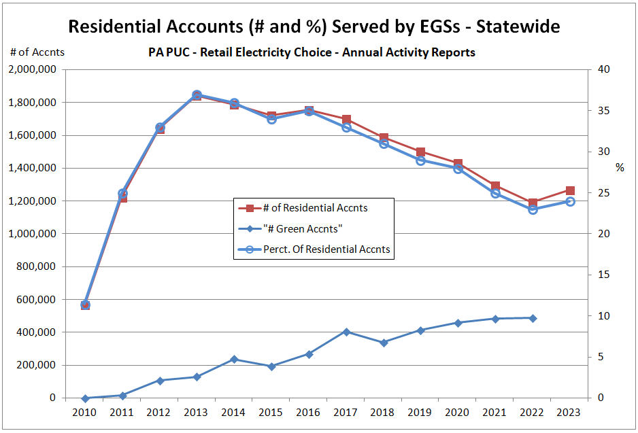
Electric Choice is Sustained by Renewables

Slide 17

CCA Administrator: Joule Community Power
Piloted the NY program in launching Westchester Power with 20 Westchester County, NY municipalities *
Expanded to 57 new NY municipalities; 450,000 households, roughly half are actively buying, half are not. We advise communities re optimal times for communities to enter the market, set prices, blend and extend, etc.
We seek to spark the construction of new renewable and storage resources.
Joule clients have historically renewed. Eighty-six of active Joule municipal clients are on their second or third electric power agreement .
Community empowerment is the core Joule ethic. We seek to couple this with salient expertise re what is available and actionable, for each community client, then educating on its implications +/-
* https://sustainablewestchester.org/ ; https://www.jouleassets.com/
.

Slide 18
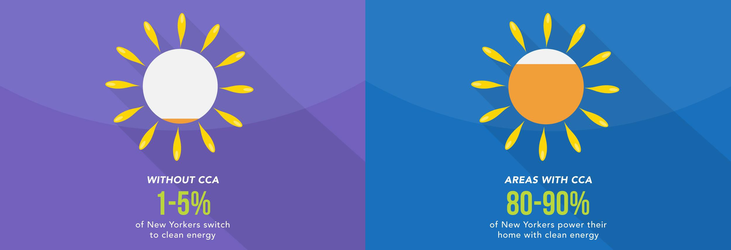
NY Market Results 2016 - 2021
150 municipalities, 3.2 million CCA participants, including 1.2 million low- to moderate-income residents.
3 million MWh of renewable energy¹
Avoided 770,000 Tons of CO2 emissions
117,000 hours of public education
^{11.}New York State GATS-registered Renewable Energy Certificates

Slide 19
Envisaged CCA Implementation Process
Borough adopts resolution enabling a CCA
Borough and administrator conduct resident education and work with the local utility to obtain information needed for smooth implementation
Residents who have already selected an EGS or a special rate such as net metering or CAP will not be included in the initial aggregation
Resident customers who do not opt out or make another choice will be transferred to CCA supply
Residents can leave CCA supply at any time with no penalty
Borough and administrator issue an RFP and select EGS(s) to provide CCA supply
The EGS service agreement gives Borough approval over price and terms to residents and the energy supply mix, including ability to procure local projects.

Slide 20
QUESTIONS
C. Baird Brown
eco(n)law LLC
baird@eco-n-law.net

