Slide 1
Progress on Microgrids in California:
Community Microgrids & Solar Microgrid Training
Ben Schwartz
Policy Manager
626-232-7573 mobile
ben@clean-coalition.org
27 August 2024

Slide 2
Clean Coalition (non-profit)
Mission
To accelerate the transition to renewable energy and a modern grid through
technical, policy, and project development expertise.
Renewable Energy End-Game
100% renewable energy; 25% local, interconnected within the distribution grid and ensuring resilience without dependence on the transmission grid; and 75% remote, fully dependent on the transmission grid for serving loads.
Notes:
2

Slide 3
Outage Statistics in IOU Service Territories 2023
A small percentage of outages were from Public Safety Power Shutoffs (PSPS).
For SDG&E, 100% of outage hours were from other unplanned and planned outages.
For SCE, 93% of outage hours were from other unplanned and planned outages.
For PG&E, 5.86% were from other planned outages and 94.01% were from unplanned outages.
Single facilities can easily deploy Solar Microgrids for resilience and the Microgrid Incentive Program (MIP) has been rolled out in 2024 for Community Microgrids in equity communities.
  Very few Community Microgrids have been deployed. Mostly one-off, unicorn projects.
  In 2023 there were zero multi-unit facilities that had solar deployed via Virtual NEM (VNEM) with paired storage or capable of any type of resilience.

Slide 4
CPUC Multi-Property Microgrids Tariff
The CPUC released a Proposed Decision last week that rejects proposals by 6 stakeholder groups and approves the proposal by the utilities.
The PD makes small changes to the Community Microgrid Enablement Tariff (CMET) and adopts it for all three IOUs.
  PG&E’s existing CMET has been active for close to 4 years now. Only 1 out of more than 32 projects has been successfully completed.
  That 1 project is RCAM, which began planning in 2017.
Argues that the Microgrid Incentive Program is sufficient to meet the needs of equity communities.
Changes include a flat $75,000 fee for the Microgrid Islanding study, removing any sizing limits for Community Microgrids, allows projects on distribution circuits of any voltage.

Slide 5
CPUC Multi-Property Microgrids Tariff pt. 2
The biggest issue has been a lack of evaluation of PG&E’s CMET.
The timeline in the PD could lead to the delay of Community Microgrid deployments.
Evaluation of the new CMET will likely take place a few years after it is rolled out.
  If identifying problems only occurs then, it will take another few years before problems are solved and more time before widespread deployment of Community Microgrids is possible.

Slide 6
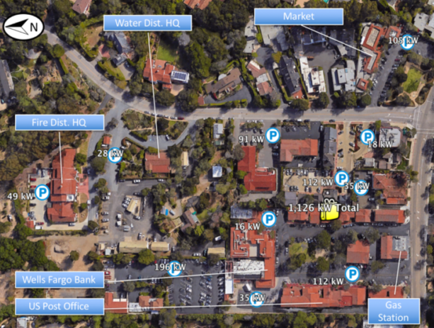
The Resilient Energy Subscription (RES) addresses three Community Microgrid financing challenges
The RES helps finance Community Microgrids while properly valuing their significant resilience benefits, addressing these three challenges:
Establishing initial Community Microgrids to provide resilience to Critical Community Facilities (CCFs).
Enhancing Community Microgrids to offer resilience opportunities within the initial Community Microgrid footprint.
Expanding Community Microgrids to larger footprints that can guarantee resilience to a wider list of facilities and include additional communities.
Some Critical Community Facilities (CCFs) in a Southern California community.

Slide 7
Resilient Energy Subscription (RES) defined
A straightforward fee-based market mechanism that finances the enhancement and expansion of Community Microgrids
  Community Microgrids provide guaranteed daily delivery of locally generated renewable energy during grid outages, ensuring unparalleled energy resilience.
Allows any facility within a Community Microgrid to procure this unparalleled energy resilience
  A facility pays a simple monthly $/kWh fee — separate from any existing rate tariffs — on top of their normal electricity rates for guaranteed daily delivery of locally generated renewable energy during grid outages.
  Usually reserved for a facility’s most critical loads.
Facilitates the deployment and expansion of Community Microgrids
  Allows the Community Microgrid owner-operators to recover the cost-of-service (COS) required to meet contracted RES obligations.
  COS is determined by the capital expenditures (capex) associated with Community Microgrid assets, operational expenditures (opex) associated with operations and maintenance (O&M), and an appropriate rate of return.
Notes:
In California, typical Community Microgrid assets include local solar, energy storage, and Monitoring, Communications, and Control (MC2) solutions — including BTM smart circuit panels, Advanced Metering Infrastructure (AMI, aka smart meters), and grid isolation switches. Anticipated rates of return should be bookended by standard COS calculations, which in California are about 8% for the return on equity (ROE) allowed for distribution grid infrastructure and the 12% ROE for transmission grid infrastructure. (The California Public Utilities Commission (CPUC) allows the 8% ROE for distribution grid infrastructure, and the Federal Energy Regulatory Commission (FERC) allows a 12% ROE for transmission grid infrastructure.

Slide 8
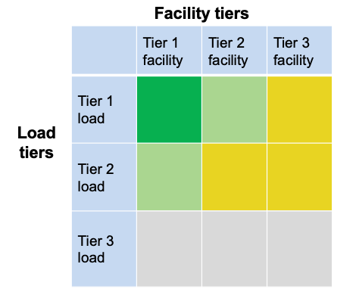
VOR123 for a Community Microgrid
The top emphasis is to provision 100% resilience for Tier 1 loads at Tier 1 facilities (the darker green square in the chart).
  Tier 1 facilities include CCFs such as fire stations and emergency shelters — and can also include grocery stores, data centers, pharmacies, gas stations, EV charging stations, & apartment complexes that can provide sheltering-in-place during grid outages.
The second emphasis is for Tier 1 loads at Tier 2 facilities and Tier 2 loads at Tier 1 facilities (the lighter green squares).
= Critical for the entire community, such as Tier 1 loads at
Tier 1 facilities like fire stations
= Priority for the entire community, such as Tier 2 loads at
Tier 1 facilities and Tier 1 loads at Tier 2 facilities like multi-
unit housing facilities that can provide safe and easy
sheltering in place
= Priority for individual facilities but not the entire community
= Discretionary loads that are not impactful to the community,
whether on or off

Slide 9
Benefits of a Solar Microgrid
Economic
  Provides electricity costs savings compared to buying electricity from the utility.
  Provides value-of-resilience (VOR) compared to implementing & operating a fossil-fueled generator.
  Provides a fixed cost of electricity compared to rapidly rising utility costs.
Environmental
  Provides solar electricity, a pure renewable energy resource.
  Optimizes grid citizenship by reducing peak usage of the grid when it is most stressed, during the peak periods, which throughout California are currently 4-9pm.
  Eliminates energy losses associated with traversing transmission & distribution grids. Losses are due to resistance and congestion, both of which are generally exacerbated by distance. Typically, 15% of remotely generated energy is lost.
  Reduces the environmental impact of central generation, which typically consumes open space for the generation & transmission assets.
Resilience
  Provides 100% ride-through during grid outages of limited durations. Any ride-through duration can be accommodated with cost being correlated to duration.
  Provides optionality for indefinite resilience for at least the most critical loads, again with cost being correlated to the percentage of load being served with 100% resilience.
  Accommodates optional fossil generation as an emergency backup resource that can be minimized.

Slide 10
Solar Microgrid Methodology Curriculum overview
Who: Taught by Professor Bill Dinklage during his Energy and Natural Resources course, including 16 students, Clean Coalition tools and support, and other industry standard tools.
What: Six-week curriculum based on the Clean Coalition’s Solar Microgrid Methodology
When: Fall 2023 semester. With two classes per week, an hour and twenty minutes per class, and one class for a holiday, this calculates to just under 15 hours of class time.
Where: Santa Barbara City College (SBCC)
Why: To provide students with a unique combination of practical challenges and professional guidance in order to transform the classroom into a vibrant launchpad for their careers, equipping them with not just theoretical knowledge, but the tangible skills and confidence to thrive in the burgeoning field of clean energy.

Slide 11
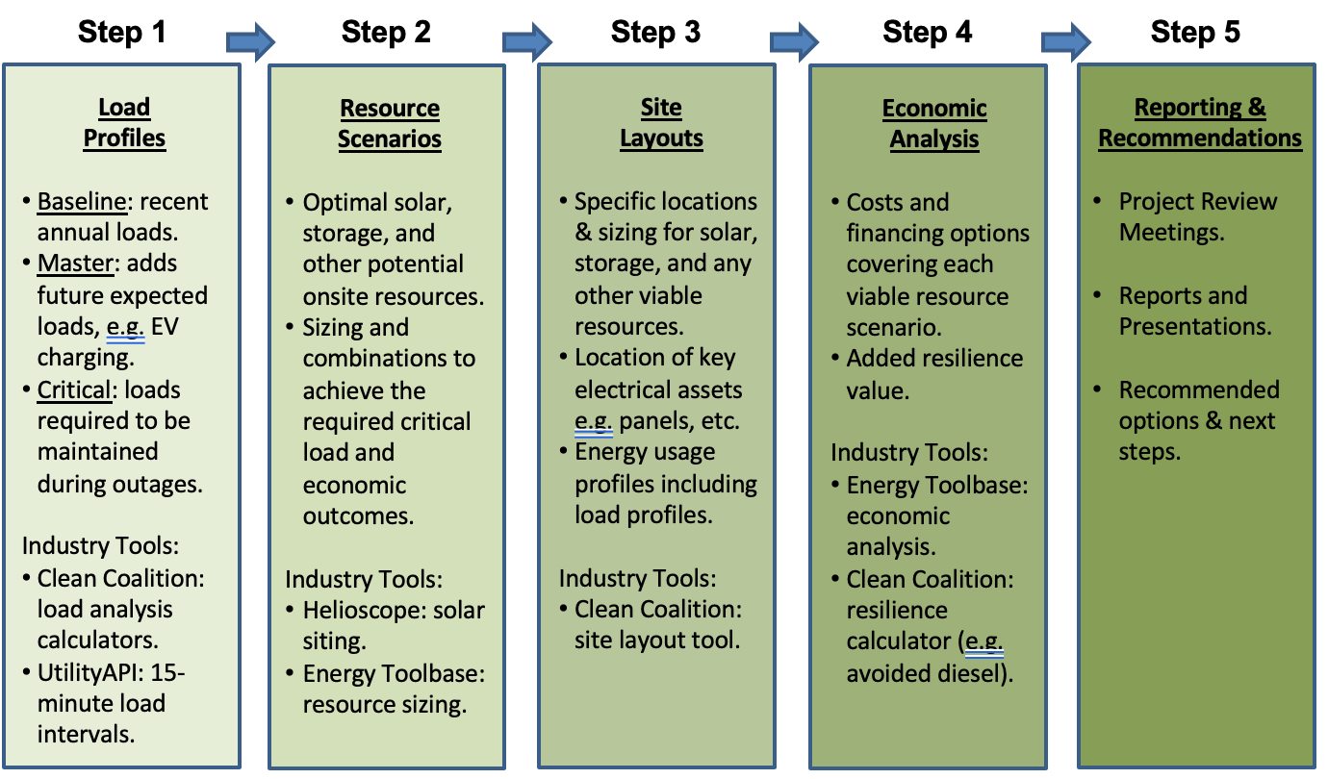
Solar Microgrid Methodology for feasibility studies
Notes:
11

Slide 12
Solar Microgrid Methodology Curriculum outline
Week 1: Electricity interval data and billing details
Week 2: Solar design details and modeling
Week 3: Value of Resilience 123 (VOR123) and sizing the BESS
Week 4: Economic analysis
Week 5: Project table creation and presentation preparations
Week 6: Review & Presentations

Slide 13
Week 1: Analyzing Electricity Interval Data and Billing Details
Topics covered:
  Distinguishing between power and energy, kilowatt (kW) and kilowatt hour (kWh).
  Understanding the common practice of recording electricity usage in 15-minute intervals.
  Interpreting and cleaning electricity data to establish a full calendar year's Baseline Load Profile.
  Calculating the total annual load and peak demand from the Baseline Load Profile.
  Deciphering electric utility bills and meter rate schedules.
  Developing an Adjustments Load Profile based on the anticipated addition of electric vehicle (EV) charging stations.
  Combining the Baseline Load Profile and Adjustments Load Profile at every 15-minute interval to create the Master Load Profile.
Tools used:
  The Clean Coalition's Solar Microgrid Analysis Processor (SMAP) Utility Data Cleaner: This tool simplifies the cleaning of electricity data downloaded from UtilityAPI, a secure, third party utility data service.
  The Clean Coalition's EV charging profile creator: This tool assists in constructing an Adjustments Load Profile based on specified EV charging station quantities and usage patterns.

Slide 14
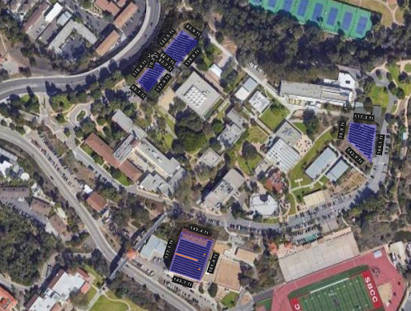
Week 2: Mastering Solar Modeling with HelioScope
Topics covered:
  Solar panel and inverter operation: Conversion of sunlight to direct current (DC) electricity and subsequent DC-to-AC (alternating current) transformation for grid integration.
  Impact of tilt, azimuth, spacing, and shading: Understanding how these factors influence a system's energy output.
  Mounting system options: Differentiating between fixed tilt racking, flush mount, ground mount, and carport structures.
  Net Zero Energy (NZE) calculation: Determining the percentage of NZE achievable based on solar system design.
Equipped with the industry-standard HelioScope, students embarked on designing their own solar systems. This involved:
  Drawing the system layout: Accurately mapping the physical constraints of the East Campus site.
  Defining obstructions and shading: Placing virtual "keepouts" for existing structures and trees.
  Selecting optimal components: Choosing suitable solar panels and inverters for efficient energy generation.
  Leveraging Light Detection and Ranging (LiDAR) data: Utilizing LiDAR technology to map building and tree heights for accurate shading analysis.

Slide 15
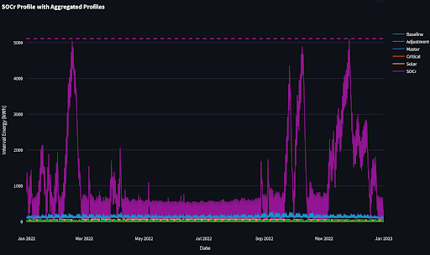
Week 3: Value of Resilience (VOR) 123 and BESS Sizing
Topics covered:
  Clean Coalition’s VOR123: This methodology tiers electrical loads into three categories — critical, priority, and discretionary loads — across all facility types. The level of resilience anticipated from a Solar Microgrid at a facility where the Tier 1 load is 10%, Tier 2 load is 15% and Tier 3 load is 75% and where enough solar can be included onsite to net-zero the site’s annual electricity consumption. The average anticipated resilience, in terms of percentage of time online, is as follows:
    Tier 1: 100%
    Tier 2: 80% (at least)
    Tier 3: 25% (at least)
Tools used:
  The Clean Coalition's Solar Microgrid Analysis Processor (SMAP) Aggregated Profile Spreadsheet (APS) Builder: This tool takes user-defined inputs (Baseline Load Profile, Adjustments Load Profile, Critical Load Profile or percentage of critical load, and solar generation profile) to generate the Master Load Profile and an APS. The APS comprises:
    Baseline Load Profile
    Adjustments Load Profile
    Master Load Profile
    Critical Load Profile
  The Clean Coalition’s SMAP State of Charge reserved for resilience (SOCr) calculator: When fed the APS, this calculator sizes a BESS to indefinitely cover (with the help of the solar system) the user-specified critical load percentage or profile.

Slide 16
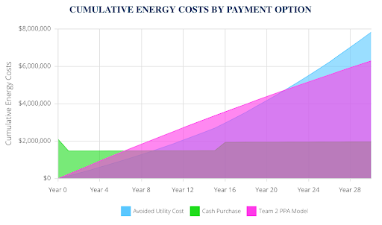
Week 4: Solar Microgrid Financial Analysis
Topics covered:
  Capital and operational costs for installing solar panels and BESS
  Incentives for Solar Microgrid components
  Discount rates and electricity escalation rates
  Demand charge management and energy arbitrage strategies
  Cash purchase versus power purchase agreement (PPA) options
  Electrical bill savings and 25 year cash flow projections
Leveraging Energy Toolbase, students meticulously conducted a financial analysis of their Solar Microgrid designs. This comprehensive process involved:
  Data Integration: Importing the Master Load Profile and aligning it with the specific rate schedule of the East Campus meter.
  Solar Generation: Entering their HelioScope solar generation profile and defining a $/W value.
  BESS Configuration: Selecting a standard BESS option and specifying its operational strategy, encompassing demand charge management, energy arbitrage, or both. Additionally, they set a $/kWh value for the BESS.
  Cost Accounting: Establishing Operations and Maintenance (O&M) expenses and costs associated with system component replacements.
  Rate Analysis: Comparing the available solar- and BESS-friendly rate schedules and performing rate switches to understand their economic impact.
  Financial Scenarios: Selecting a transaction type, such as cash purchase or PPA, to explore different financing options.

Slide 17
Week 5: Project Table Creation and Presentation Preparations
Week 5 of the Solar Microgrid Methodology curriculum consisted of students compiling their hard work into project tables and presentations. These tables summarized their actions and key findings from the previous four weeks, including analysis steps, system sizing, resilience benefits, and economic results.
Students were guided on formatting their Solar Microgrid Feasibility Study presentations using Google Slides to:
  Start by presenting compelling key economic results and details on system sizing.
  Provide a concise overview of the analysis steps taken.
  Go in-depth into each major step of the process.
  Conclude with clear recommendations and next steps.

Slide 18
Week 6: Review & Presentations
The culminating week of the Solar Microgrid Methodology curriculum saw student groups polishing their presentations and confidently showcasing their completed Solar Microgrid Feasibility Studies to a distinguished audience of SBCC, Santa Barbara Foundation, and Clean Coalition personnel. Key members in attendance or who were involved in the curriculum included:
  Erika Endrijonas, SBCC Superintendent/President
  Jens Uwe-Kuhn, SBCC Dean of Sciences
  Erik Fricke, SBCC Director of Campus Safety and Emergency Response
  Maria Villagómez, SBCC Assistant Superintendent/VP of Academic Affairs
  Dr. Bill Dinklage, SBCC Professor Dept. of Earth and Planetary Sciences
  Brian Morales, SBCC Director of Campus Safety and Emergency Response
  Mark Broomfield, SBCC Facilities Supervisor
  Craig Lewis, Clean Coalition Executive Director
  Gregory Young, Clean Coalition Program Manager

Slide 19
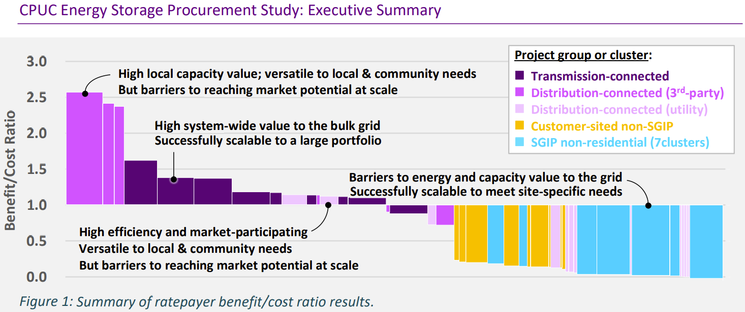
The Value of Local Storage
This image shows the value of each type of storage deployed from 2017-2021.
The trend has likely accelerated with the decrease in storage prices.
Local FOM energy storage is the most cost-effective, increasing the case for resilience and Community Microgrids

