Slide 1

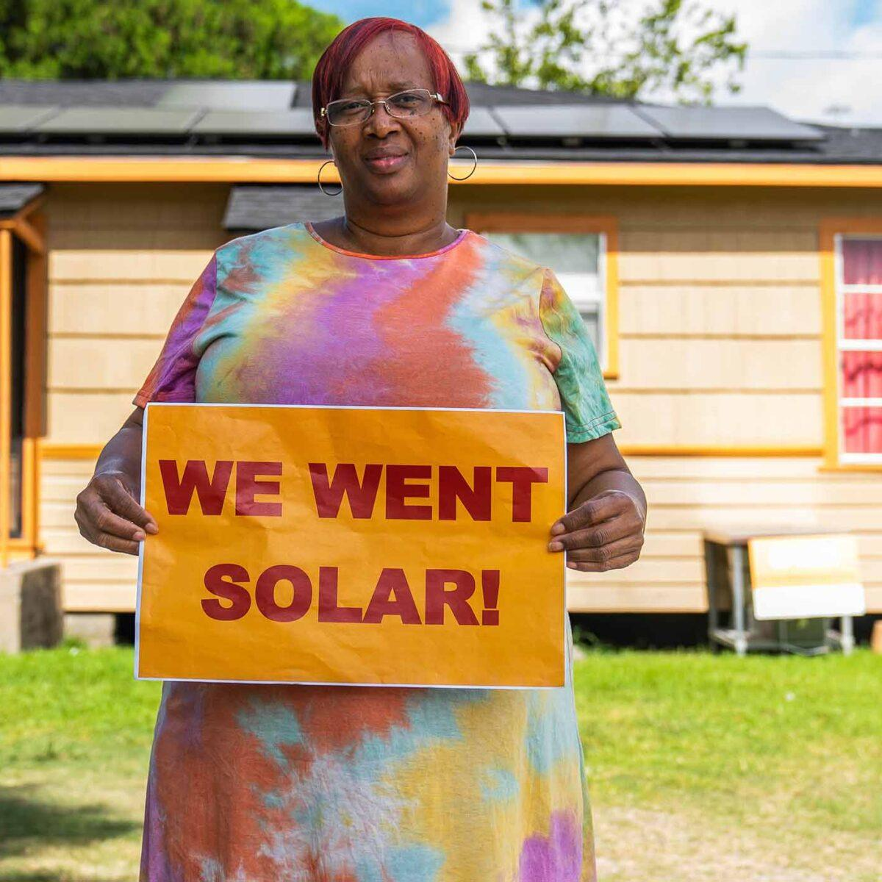
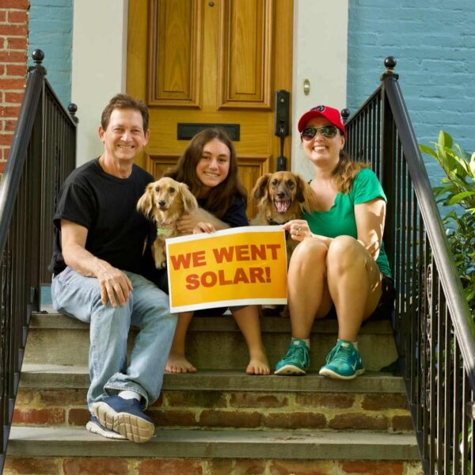

Solar
Consumer Protection:
Stories and Solutions

Slide 2
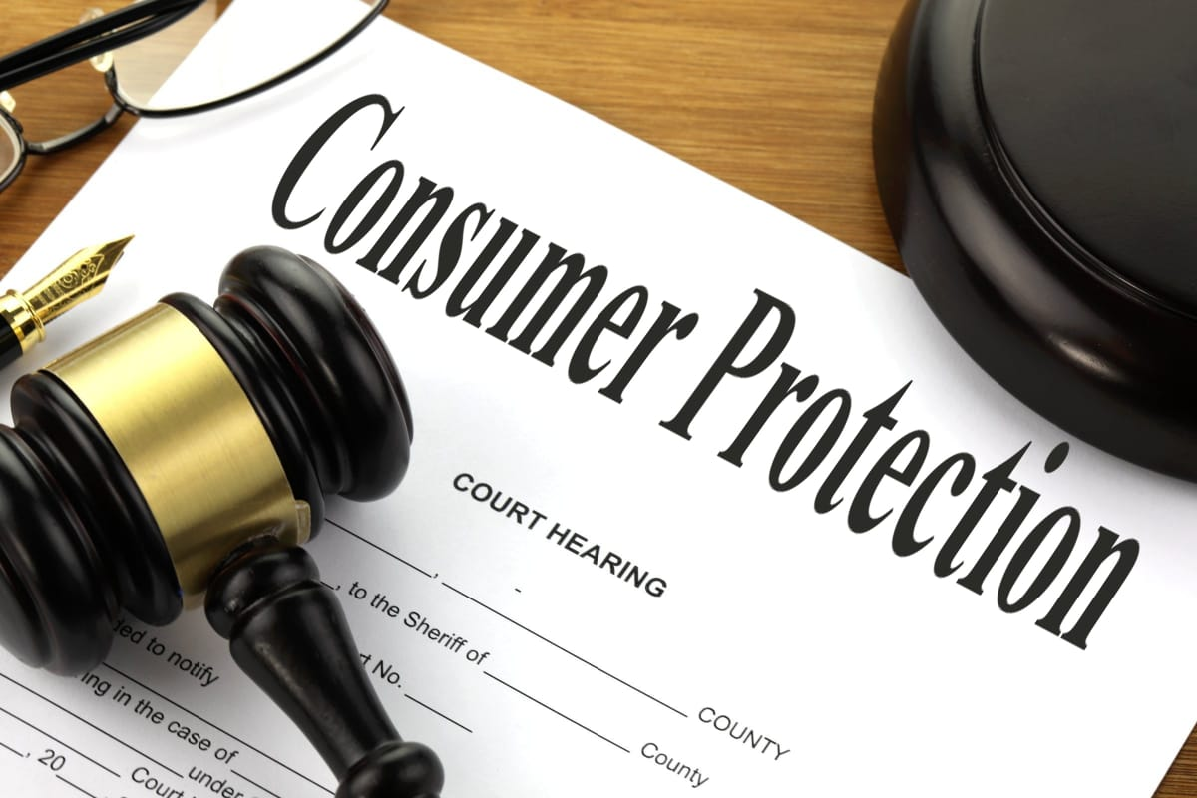

What we’ll cover today
Importance of Consumer Protection in solar
Solar Helpdesk
Common complaints*
Solutions
Additional Resources
* Do you have one you’ve heard?

Slide 3
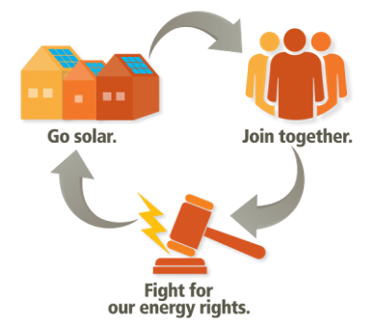
Importance of Consumer Protection
Solar Consumer Protection is the practice of safeguarding buyers of goods and services, and the public, against unfair practices in the marketplace.
Consumer Protection is linked to the idea of consumer rights which helps consumers make better choices.
Varying entities promote consumer protection and pursue complaints against unscrupulous businesses.

Slide 4
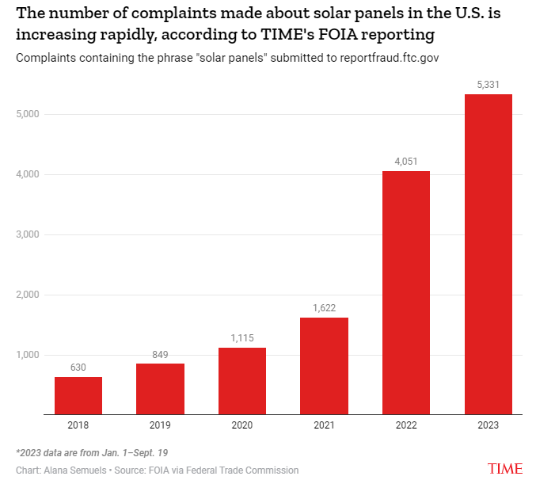
Importance of Consumer Protection
Notes:
There were 5,331 complaints containing the words “solar panels” in 2023 - Overpromising energy offset and installing underperforming equipment
Helpdesk Complaints
2022: 54
2023: 324*
2024: 1,463

Slide 5
Who we are
The Solar Help Desk (SHD) started to provide support to folks who needed assistance going solar outside of our state-based programs. The SHD also serves as a resource for customers who are having issues with their solar companies and as our list has grown with national installer partnerships, we have started to receive requests for help from more folks.

Slide 6
Is the Help Desk just complaints?
Definitely not! Our purpose is to help people wherever they are on their path. We regularly assist people very early on in their investigation of solar with services like basic education and resource sharing, proposal comparisons, and free roof reviews.
Notes:
We're here to assist the consumer at any stage of their solar journey.

Slide 7
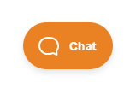


What we do
Bilingual support and materials
Direct assistance to anyone in all 50 states, the District of Columbia and Puerto Rico
Support customers who are having issues
Answer common and complex solar questions:
  Do I need battery storage with solar?
  Why am I not saving money?
  How do I know if my roof is good for solar?

Slide 8
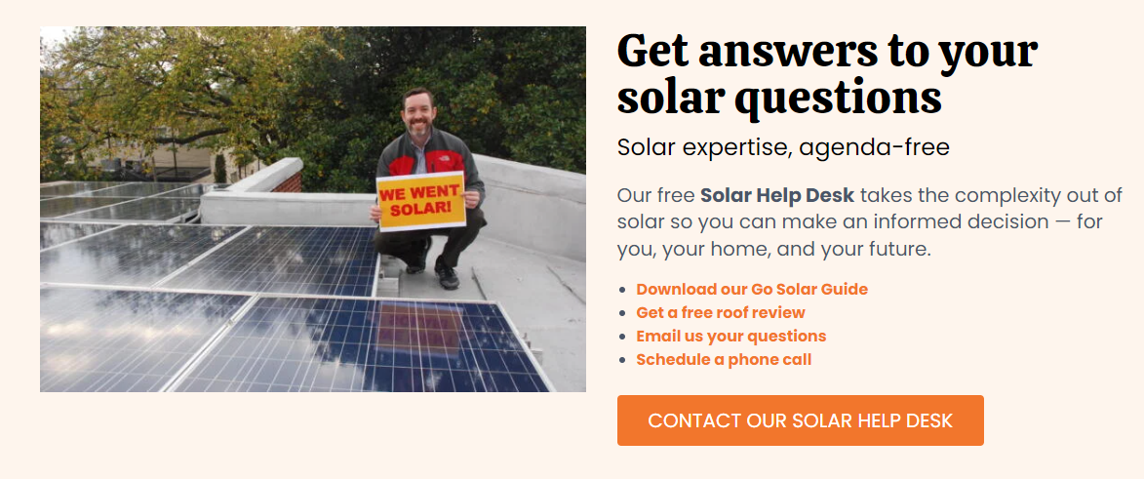
What we offer
Roof review
Proposal comparison
Utility bill / solar app data review
Financial incentives resource
Consumer education, protection & remediation

Slide 9
Why the Solar Help Desk matters
Backstops all the rest of our programming and advocacy work. By providing a free, neutral, customer-focused offering we:
Support market development with practical, action-oriented education and guidance
Gain critical market intelligence on sales practices and equipment and services trends
Identify market barriers

Slide 10


Consumer Resources
Go Solar Guide
Ready, Set, Solar! Residential version
Solar FAQ
Solar 101 webinars
Understanding Your Proposal Guide
Utility bill review
Production app assessment
Contract Summary Sheet

Slide 11
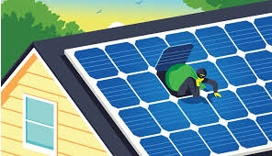
Common consumer topics
Going solar questions
Proposal comparison requests
Financing & tax credits
Abandoned systems
Under-producing/over-estimate on kWh
Solar scams
Interconnection/permitting
Bad contracts
Liens
Warranty wars
Equipment issues / maintenance
Property damage
Insurance inquiries
Utility hearings
Recycling/removal
Upgrade/addition
Battery storage, EVs, smart panels, etc.
Note: There are bad apples that have used deceptive tactics to take advantage of customers and gain from solar. BUT most installers do not intend to be unscrupulous yet may be perceived as so by the homeowner due to their mismanagement of resources and growing pains of the industry.
Notes:
Group participation where presenter writes what folks put in chat and elsewhere
– Which of these challenges you face in your area?
– Leave space for people to share stories – dialogue (back pockets questions)
Vignette:
Earlier this week we had a national webinar for our list on consumer protection. 148 people showed up. Tons of questions. Top Q’s
Taxes
PPAs
Battery backup (incl if you can use EV)
Bankrupt/out of business installers
Chinese tech and safety
Warranties!!!

Slide 12
How we help people?
Customer questions and concerns come in many shapes and sizes with a wide variety of customer knowledge background. We support them in both English and Spanish.
For each contact we:
Listen & empathize to understand root causes
Ask questions to assess impact and confirm expectations
Clarify their concerns
Reflect back emotions: “We understand how frustrating this must be…”;
Set a positive frame for communications
Offer guidance and solutions
Notes:
Especially on inbound call, where we have no background information

Slide 13

Example: Incomplete + Financing
"Ended up in a bad situation with a solar company. It’s been a year since we signed. We still are not connected. Wanted to pick someone’s brain about it."
"It has been over a year and we have been paying our lender the monthly payment but the solar system is still not on. They installed on the roof without permit and now we discovered the system was installed oversized and panels need to be removed. We can’t get them to get this system to work and we are stuck paying for a solar system that does not work. I need help please!"

Slide 14

Example: Abandoned system
”{Solar company} located in Honolulu Hawaii, went out of business. Solar panels not working, high electric bill. In addition, paying monthly payments to {loan company}. What recourse do we have?”
What we did:​
Respond with empathy​
Ask clarifying questions​
Affirm for customer that equipment warranties are still valid even if installer gone
Provide guidance on finding another installer​
As a last resort, provide guidance on how to file a complaint in various venues
Notes:
One of our most popular complaints is installer OOB. Consumer seldom get back to us about the outcome.

Slide 15
Abandoned solar customers
We have responded to over hundreds of abandonment complaints in the past year. In one case, a company was being sued by 2 state attorney general offices in FL and CT. Unfortunately for the consumer, SUN can not provide legal counsel for those who may need to hire an attorney or accounting advice for those who need help filing tax credits and rebates.
What we can do:
Advise consumers on how to submit grievances
Provide a basic solar education
Provide a listing of maintenance providers
Notes:
with their state AG, share our resources and encourage them to share their story on forums like BBB and Solar Reviews to inform & warn others.
understanding of their system’s energy production, utility bill savings, warranties, & incentives
Providers that could give services to solar homeowners who are seeking repair when we know of providers in their area. We regularly work to expand this list.

Slide 16
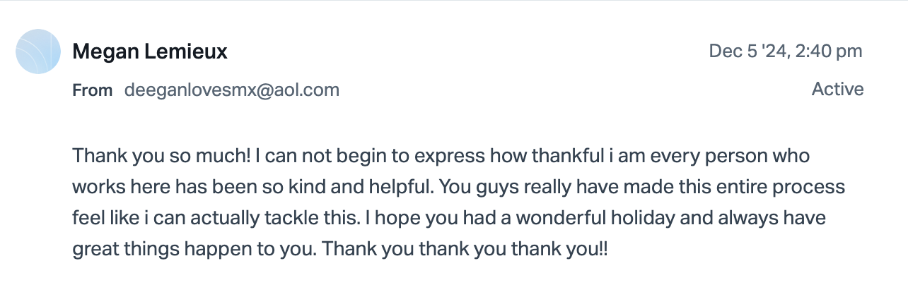
Program spotlight: Inspection & Remediation
Help Desk Inspection & Remediation Program:
Assist unsupported homeowners
Inspections conducted by licensed local companies
SUN pays for qualified households
Identify issues & offer future maintenance recommendations
Re-build consumer confidence in solar
Prioritize safety, reliability, and ethical business practices.
SUN’s Cost: ~$500/ inspection
Eligibility:
Installer out of business
Cash or loan-financed
Other resources exhausted
Performance or safety issues

Slide 17
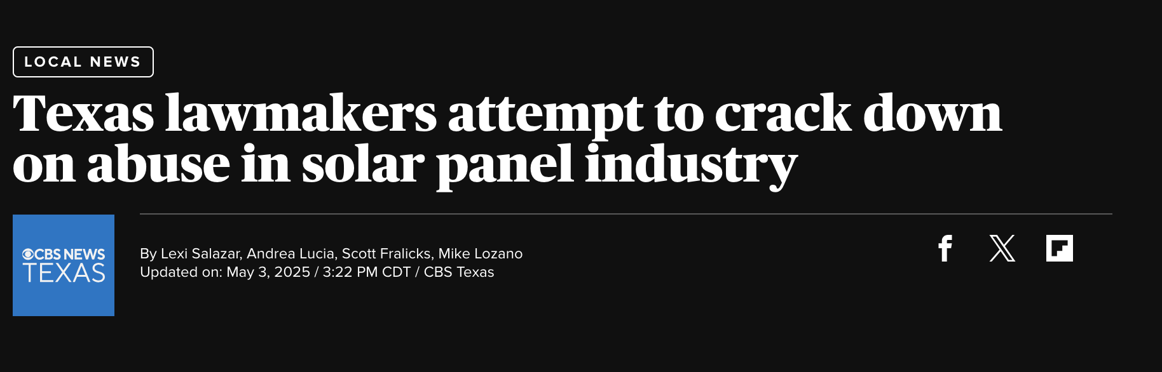
Policy spotlight: Texas SB 1036
“Residential Solar Retailer Regulatory Act”
Includes provisions like:
Salespersons register with the state
Background checks
Specific disclosures to consumers
Notes:
Enforce existing laws
When writing new laws make them broadly applicable to home improvement contractors whenever possible
Only write solar-specific laws when required by the nature of the topic

Slide 18
SEIA’s ANSI 401 Solar Sales Standard
Coming Summer, 2025!
Main topic areas:
    Performance
    Customer Acquisition
    Residential Sales (Training requirements)
    Contracting
    Disclosures
Disclosures
  Who am I interacting and transacting with?
  What am I getting?
  How much does it cost?
  Are there warranties?
  What will impact the value of this to me?
  What else should I know and where can I find it?
Notes:
I was on the technical cmte. but I am not here today representing SEIA or the standard in any official capacity. More details about the standard will come out from SEIA directly when it is released.

Slide 19
Additional Resources:
SolarUnitedNeighbors.org/consumer-protection
How to spot solar scams
How to read your proposal and How to read your contract
Having problems with your installer? – Having a contract problem or serious complaint with your installer? Check out these steps you can take to get it resolved.
HOA Solar Action Guide – Thinking about solar for your property that’s part of a Homeowners Association? Learn your rights and get prepared.
Problems getting your system connected to the utility? – Learn more about the process of interconnection and how to file a complaint with the state agency that oversees them.
SEIA’s Consumer Protection resources, the SEIA’s Solar Business Code, and their Consumer Protection Primer – Learn what the Solar Energy Industry Association (SEIA) has to say about consumer protection and good solar company practices.
Solar owner resources – Already a solar owner and looking for resources and assistance?

Slide 20
SHD Solar Success Stories!
“Love the feedback and help. I have no words to express my gratitude. Thanks for all the info provided. We now have a clear path and know what to do thanks to you. Blessings for that hard work and pouring into others.” - Angie Scott, The Tidwell Team
“I would rate your support as really good and perhaps a first step in getting "unscrewed" 🙂...” -L. Raines
“Thank you very much for answering my email very quickly. For now you explained everything that I want in a clear and friendly way. I am confident about your organization to answer my future questions.”
"FINALLY, SOMEONE THAT TOOK THE TIME TO SEE THE PROBLEM FOR WHAT IT IS. I have contacted most of these people only to be told to contact somebody else. It's an eternal merry-go-round. Thank you for caring." -Nilda Baucage
"Thank you. I didn't know there was an operation such as yours. I think you are a godsend. I truly appreciate the patience and passion of Johnnie. She is most informed and I felt comforted just speaking to her. I will do everything she suggested.” -Eddie Jones
Just having such a group as Solar United Neighbors is tremendous. Knowing that there is support when dealing with unscrupulous entities is a game changer. I highly recommend them and fully support their mission.

Slide 21
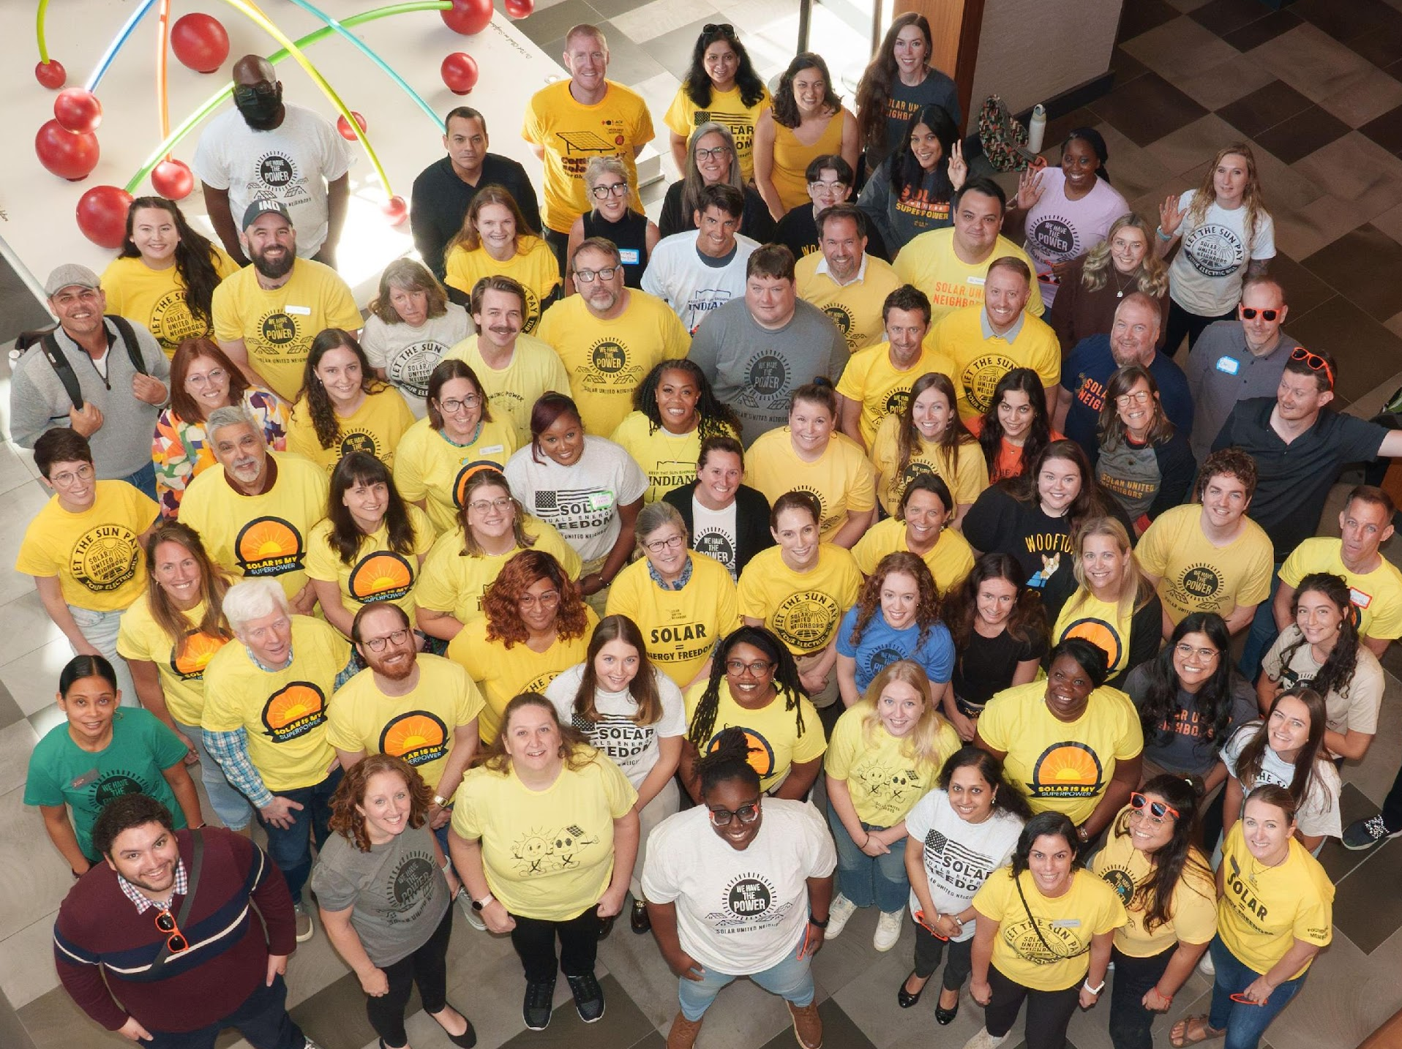
Thank You!
Solar United Neighbors
helpdesk@solarunitedneighbors.org

