Slide 1

Sierra Blanca
Community & Solar Microgrids
Craig Lewis
Executive Director
650-796-2353 mobile
craig@clean-coalition.org
31 Aug 2023

Slide 2
Sierra Blanca community overview
Sierra Blanca community overview
Notes:
2

Slide 3
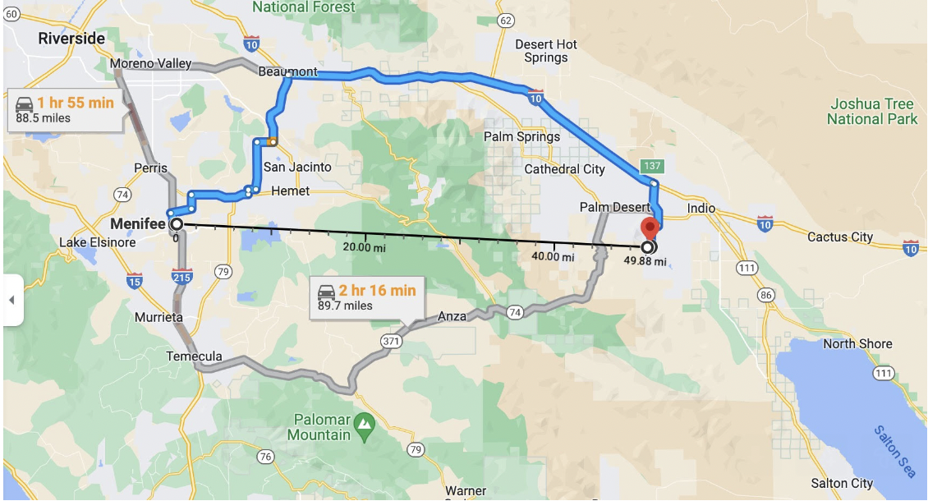
Menifee solar community provides local example
https://www.latimes.com/opinion/story/2023-07-09/la-home-electrification-new-construction-menifee-microgrid
https://www.cbsnews.com/losangeles/news/menifees-microgrid-community-offers-energy-self-sufficiency/?intcid=CNM-00-10abd1h

Slide 4
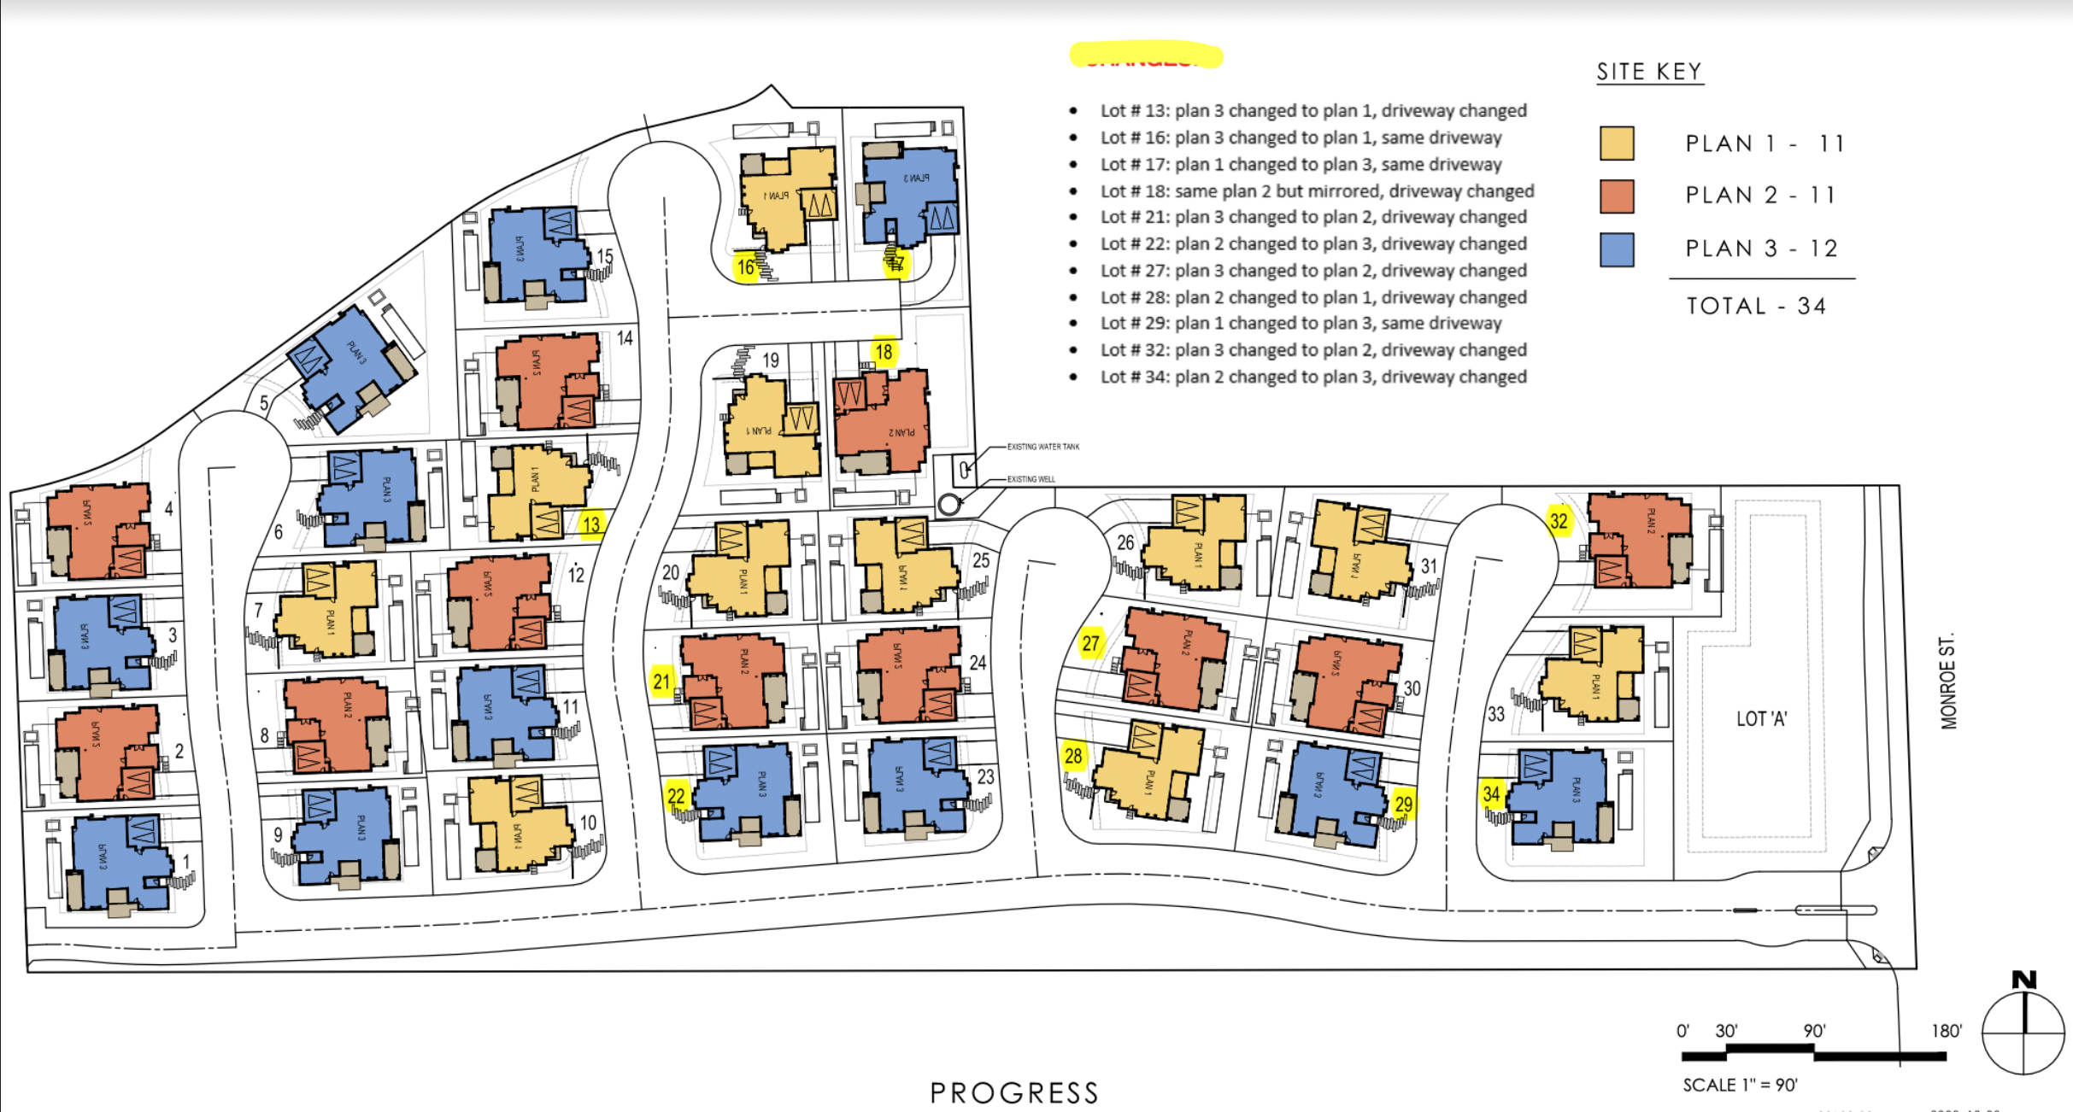
34-home Sierra Blanca community

Slide 5
Sierra Blanca energy system scenarios
Scenario A - Individual Solar Microgrids (solar+storage) at each home electrically connected by a private electricity grid to form a Community Microgrid
654 kW of solar across the community
  19.25 kW of solar on the average home. This includes an extra 90 kW of solar across the community where an average of 6 kW is added to 15 homes with the worst solar performance, by modifying the following roof plans that each apply to 5 homes:
    P1-B
    P2-B
    P3-B
1,340 kW & 2,898 kWh Battery Energy Storage System (BESS) across the community
  10 kWac & 26.4 kWh battery at each of the 34 homes
  Two 500 kW & 1,000 kWh BESS’s
Scenario B – Individual Solar Microgrids (solar+storage) at each home and electrically connected by a private electricity grid to form a Community Microgrid. Also includes two central BESS systems and a central gas generator
564 kW of solar across the community
  16.6 kW of solar on the average home
1,170 kW & 2,450 kWh BESS across the community
  5 kWac & 13.2 kWh battery at each of the 34 homes
  Two 500 kW & 1,000 kWh BESS’s
230 kWac gas generator
Scenario C – Individual Hybrid Solar Microgrids (solar+storage+gas generator) at each home and connected by a SoCalGas line
564 kW of solar across the community
  16.6 kW of solar on the average home
170 kW & 448.8 kWh BESS across the community
  5 kWac & 13.2 kWh battery at each of the 34 homes
884 kWac gas generation across the community
26 kWac gas generator at each of the 34 homes

Slide 6
Sierra Blanca energy system layout – Scenario A
Legend
Average house with average Solar Microgrid:
19.25 kWdc solar
10 kWac / 26.4 kWh battery
20’x10’ battery container hosting 500 kW & 1 MWh
Private electricity grid

Slide 7
Sierra Blanca energy system layout – Scenario B
Legend
Average house with average Solar Microgrid:
16.6 kWdc solar
5 kWac / 13.2 kWh battery
20’x10’ battery container hosting 500 kW & 1 MWh
Private electricity grid
230 kWac gas generator
SoCalGas line

Slide 8
Sierra Blanca energy system layout – Scenario C
Legend
Average house with average Solar Microgrid plus standard gas generator:
16.6 kWdc solar
5 kWac / 13.2 kWh battery
26 kWac gas generator
SoCalGas line

Slide 9
Solar sizing & siting
Solar sizing & siting
Notes:
9

Slide 10
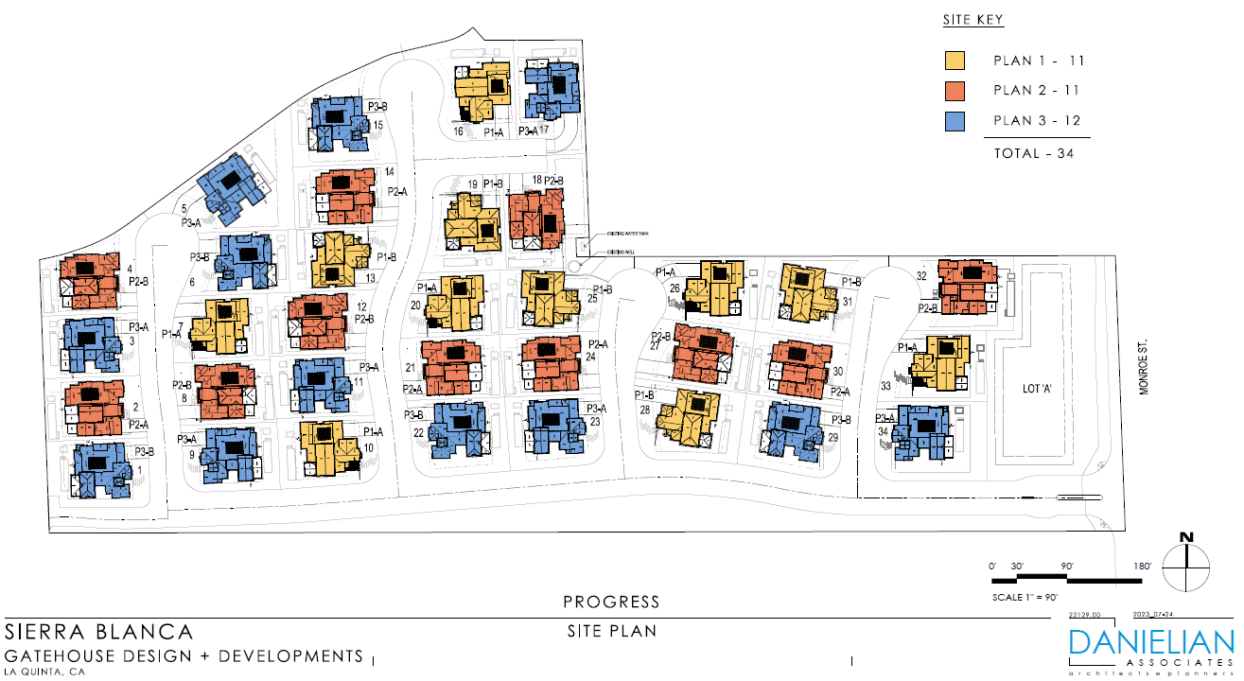
Solar sizing per Sierra Blanca home

Slide 11
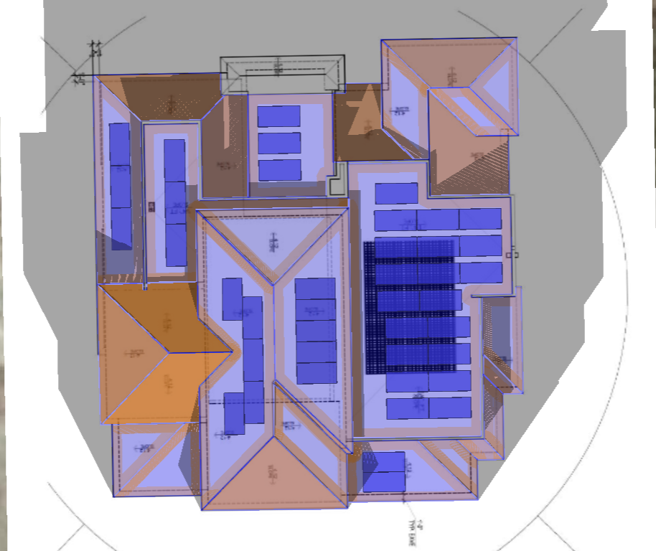
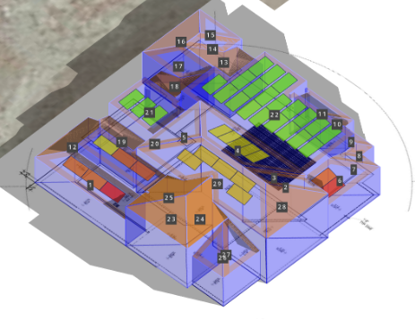
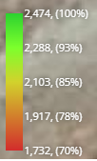
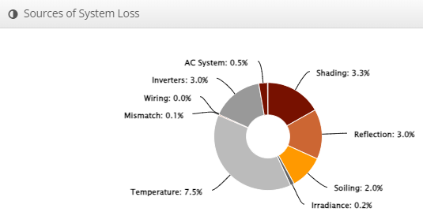
Lot 18 – Plan 2B w 16.4 kWdc solar (close to Scenario B average home)
Shaded Irradiance
(kWh/m2

Slide 12
Load analyses
Load analyses
Notes:
12

Slide 13
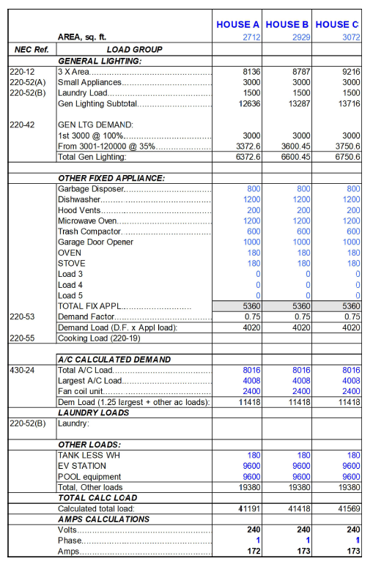
Sierra Blanca provided appliance list vs bottom up load profile appliance list
Sierra Blanca’s appliance list
Clean Coalition’s appliance list used to create bottom up load profile
Ceiling fan
Clothes dryer
Clothes washer
Cooling fans pumps
Cooling
Dishwasher
Refrigerator
Freezer
Heating fans pumps
Heating
Hot Water
Hot tub pump
Lighting exterior
Lighting garage
Lighting interior
Mechanical vent
Plug loads
Pool pump
Range oven
Electrical pool heater
Electrical hot tub heater
Electric vehicle charging
Gouvis Engineering, project 66206, sheet E-0.4

Slide 14
Scenario A, B, and C appliance lists
Scenario A & B appliance list
Electric appliances
  Ceiling fan
  Clothes dryer
  Clothes washer
  Cooling fans pumps
  Cooling
  Dishwasher
  Refrigerator
  Freezer
  Heating fans pumps
  Heating
  Hot Water
  Hot tub pump
  Lighting exterior
  Lighting garage
  Lighting interior
  Mechanical vent
  Plug loads
  Pool pump
  Range oven
  Electrical pool heater
  Electrical hot tub heater
  Electric vehicle charging
Gas appliances
  No gas appliances
Scenario C appliance list
Electric appliances
  Ceiling fan
  Clothes dryer
  Clothes washer
  Cooling fans pumps
  Cooling
  Dishwasher
  Refrigerator
  Freezer
  Heating fans pumps
  Heating
  Hot Water
  Hot tub pump
  Lighting exterior
  Lighting garage
  Lighting interior
  Mechanical vent
  Plug loads
  Pool pump
  Range oven
  Electric vehicle charging
Gas appliances
  Gas pool heater
  Gas hot tub heater

Slide 15
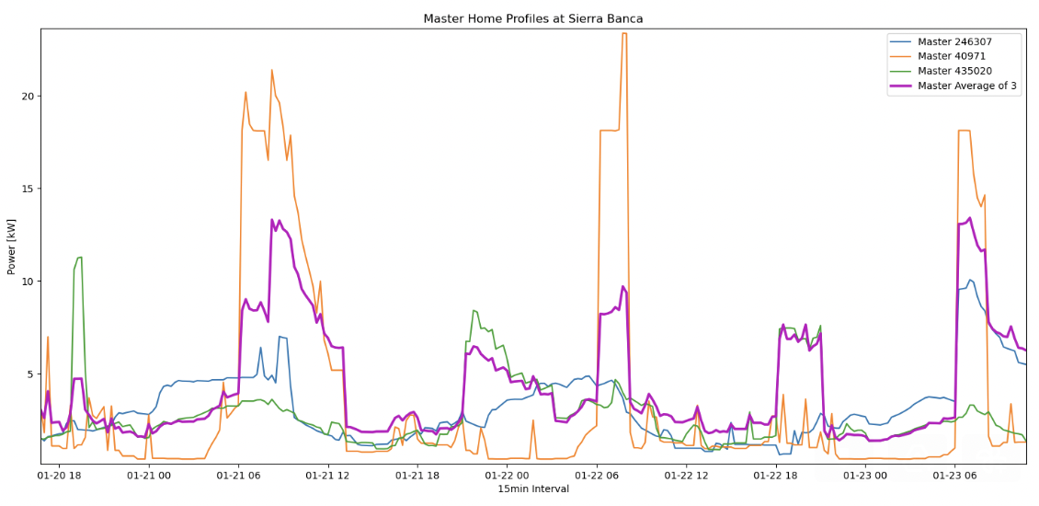
Loads created by aggregating appliance-level loads for three sample homes and then averaging
Notes:
15

Slide 16
Indicative all-electric home loads for Sierra Blanca
Notes:
16

Slide 17
Energy analyses
Energy analyses
Notes:
17

Slide 18
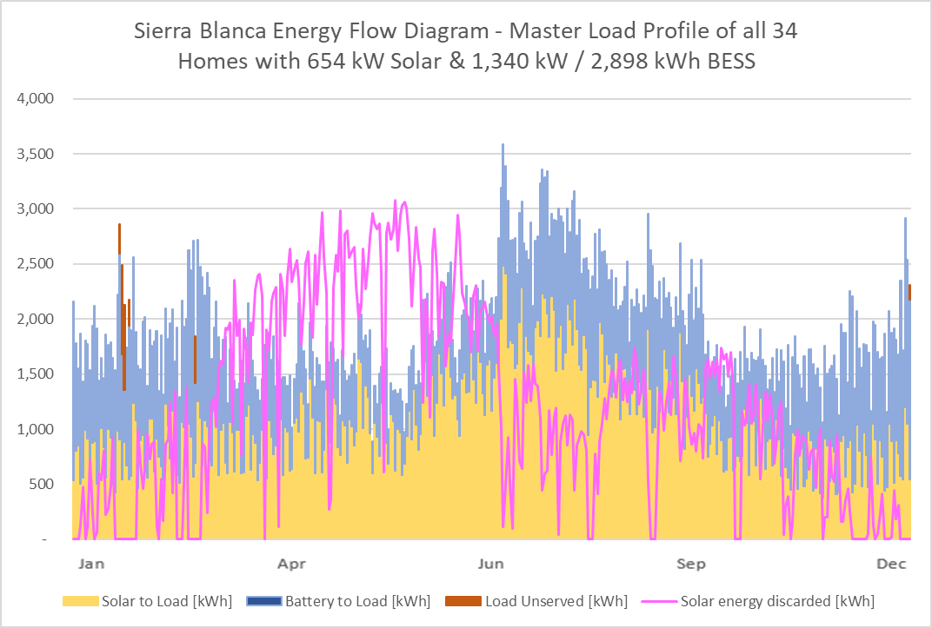
Scenario A: 654 kW solar and 1,340 kW & 2,898 kWh BESS across the community

Slide 19
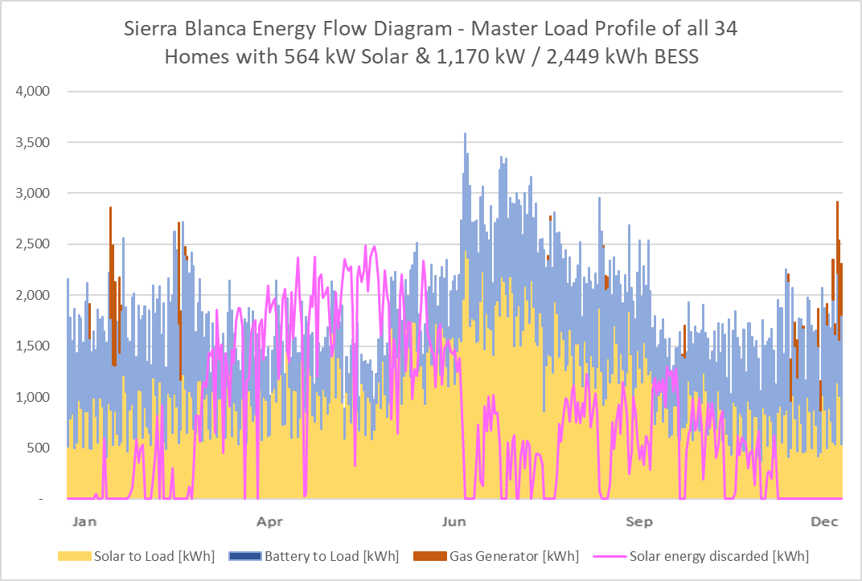
Scenario B: 564 kW solar and 1.17 MW & 2.45 MWh BESS across the community

Slide 20
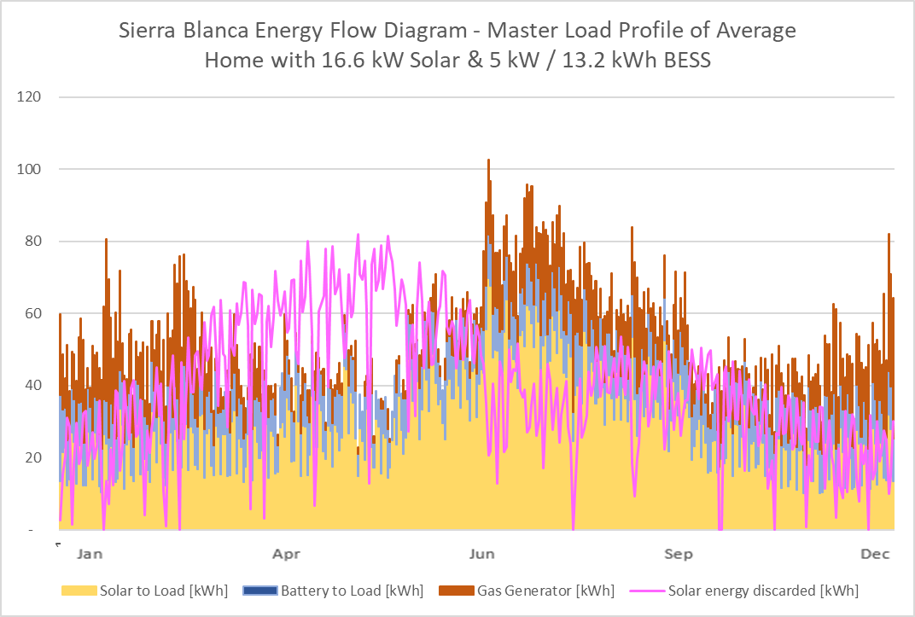
Scenario C: 16.6 kW solar (average), 5 kW & 13.2 kWh BESS, and 26 kW gas generator per home

Slide 21
Economic analyses
Economic analyses
Notes:
21

Slide 22
Federal and state tax benefits
Federal tax benefits
Investment Tax Credit (ITC, 30%)
  The Inflation Reduction Act (IRA) of 2022 establishes and extends the federal Investment Tax Credit (ITC) for solar photovoltaic (PV) systems at a rate of 30% of the total solar, energy storage, microgrid controller, load management, and grid-related costs. The 30% ITC was extended for 10 years, through 2032. Unlike tax deductions, this tax credit can be used to directly offset your tax liability dollar-for-dollar.
Federal MACRS, Bonus Depreciation – 60% (2024 place-in-service)
  Under the federal Modified Accelerated Cost Recovery System (MACRS), businesses may recover investments in solar property through depreciation deductions over a 5-year established lifespan. For solar, the taxable basis of the equipment must be reduced by 50% of any federal tax credits associated with the system. The Tax Cuts and Jobs Act of 2017 included provisions that modified bonus depreciation under Code Section 168(k). Solar projects that were placed in service after September 27, 2017 and before January 1, 2023 were eligible for 100% bonus depreciation, allowing eligible entities to deduct the entire allowable tax basis of the system in the first year of operation. Projects placed in service in 2024 qualify for 60% bonus depreciation, which means in the first year of service, companies can elect to depreciate 60% of the basis while the remaining 40% is depreciated under the normal MACRS schedule.
California tax benefits
Califorania 10-year straight-line depreciation
  The straight-line method divides the cost or tax basis, into equal amounts over the estimated useful life of the property.

Slide 23
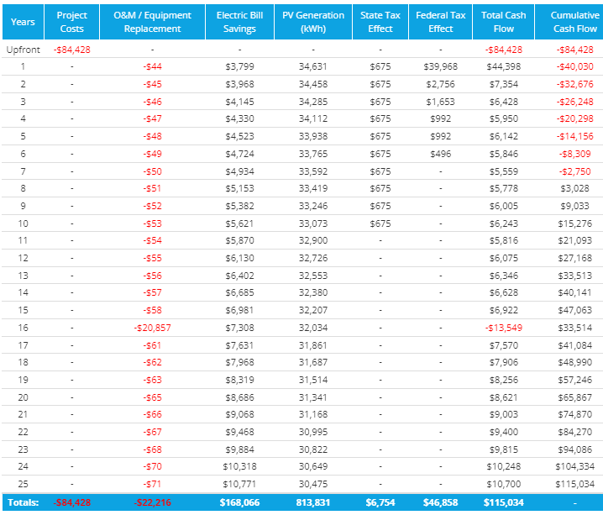
Grid connected economics with tax benefits for the Scenario A average home
Federal tax benefits
30% Investment Tax Credit (ITC)
  $25,328 total in Year 1
Modified Accelerated Cost Recovery System (MACRS) 60% (2024 Place in Service)
  $21,530 total over 6 years
State tax benefits
10 year straight line depreciation
  $6,754 total over 10 years
Tax and discount rate assumptions
Federal income tax rate: 30%
Regional income tax rate: 8%
Discount rate: 5%
Degradation rate assumptions
Solar degradation: 0.5% per year
BESS degradation: 3% per year

Slide 24
Inflation Reduction Act (IRA) electrification incentives
Heat Pump Air Conditioner/Heater
Provides households a 30 percent tax credit for heat pumps and heat pump water heaters, capped at $2,000 per year. The credit resets each tax year, effectively becoming available again for additional projects.
Heat Pump Water Heater
Provides households a 30 percent tax credit for heat pump water heaters, capped at $2,000 per year. The credit resets each tax year, effectively becoming available again for additional projects.
EV Charger
Only applicable in rural or low-income communities
Provides $1,000 tax credit
Source: https://www.rewiringamerica.org/

Slide 25
Comparison to IID as utility with no Solar Microgrid

Slide 26
Comparison to SCE as utility with no Solar Microgrid

Slide 27
Comparison to SDG&E as utility no Solar Microgrid

Slide 28
CEC forecast natural gas prices, baseline case
Data from: Ryan Ong, CEC, 18 Apr 2023 presentation

Slide 29
Backup slides
Backup Slides
Notes:
29

Slide 30
Energy storage sizing
Energy storage sizing
Notes:
30

Slide 31
Gas generator sizing
Gas generator sizing
Notes:
31

Slide 32
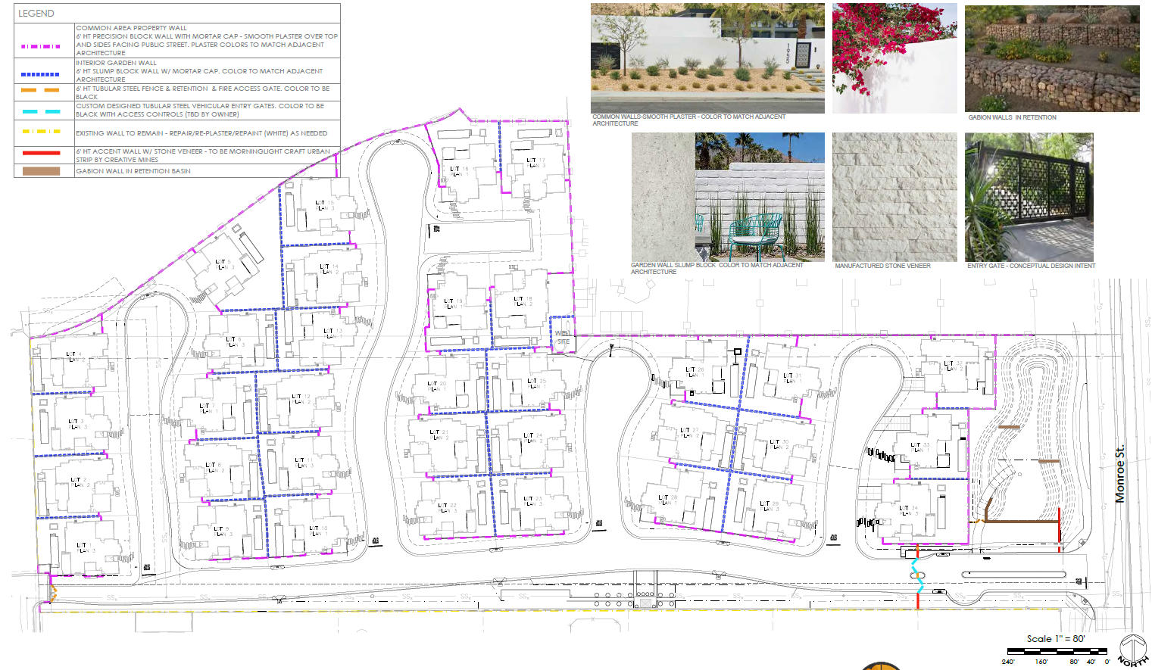
Sierra Blanca property boundary items

Slide 33
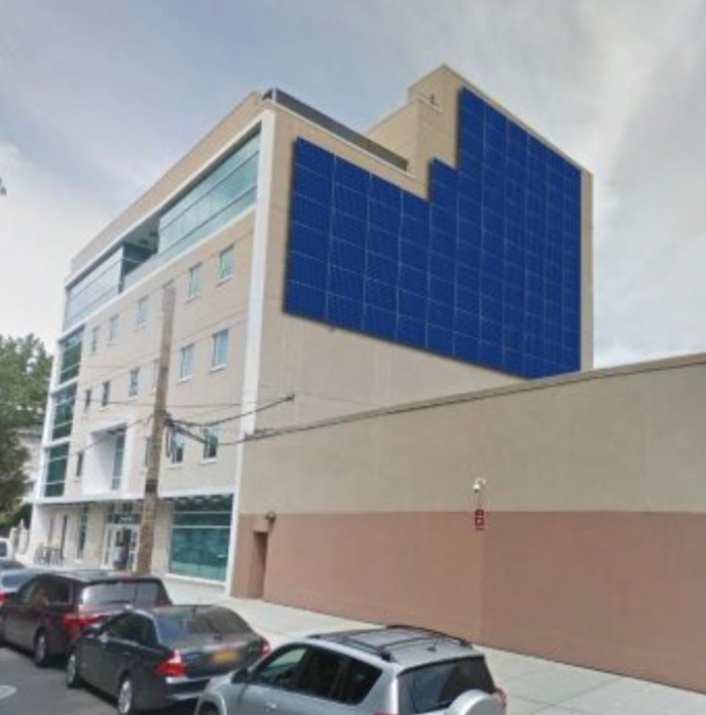
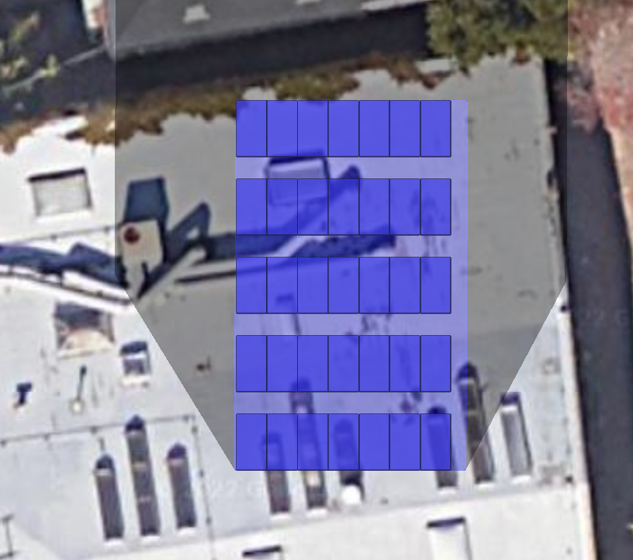
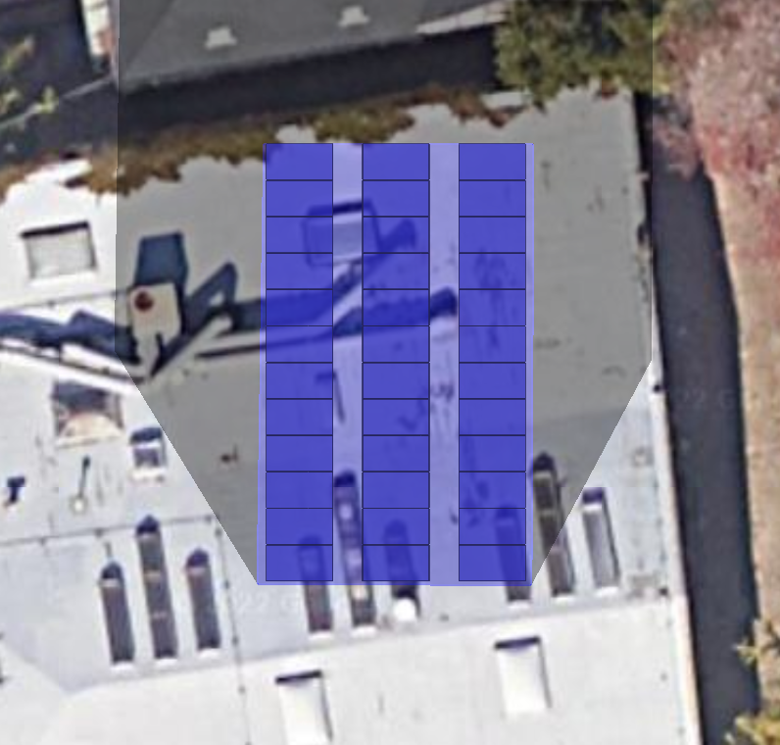
Solar sizing and generation per 1,000 sf by orientation type
Example Façade (Not as shown in table)
Fixed Tilt South Facing
Fixed Tilt West Facing

Slide 34
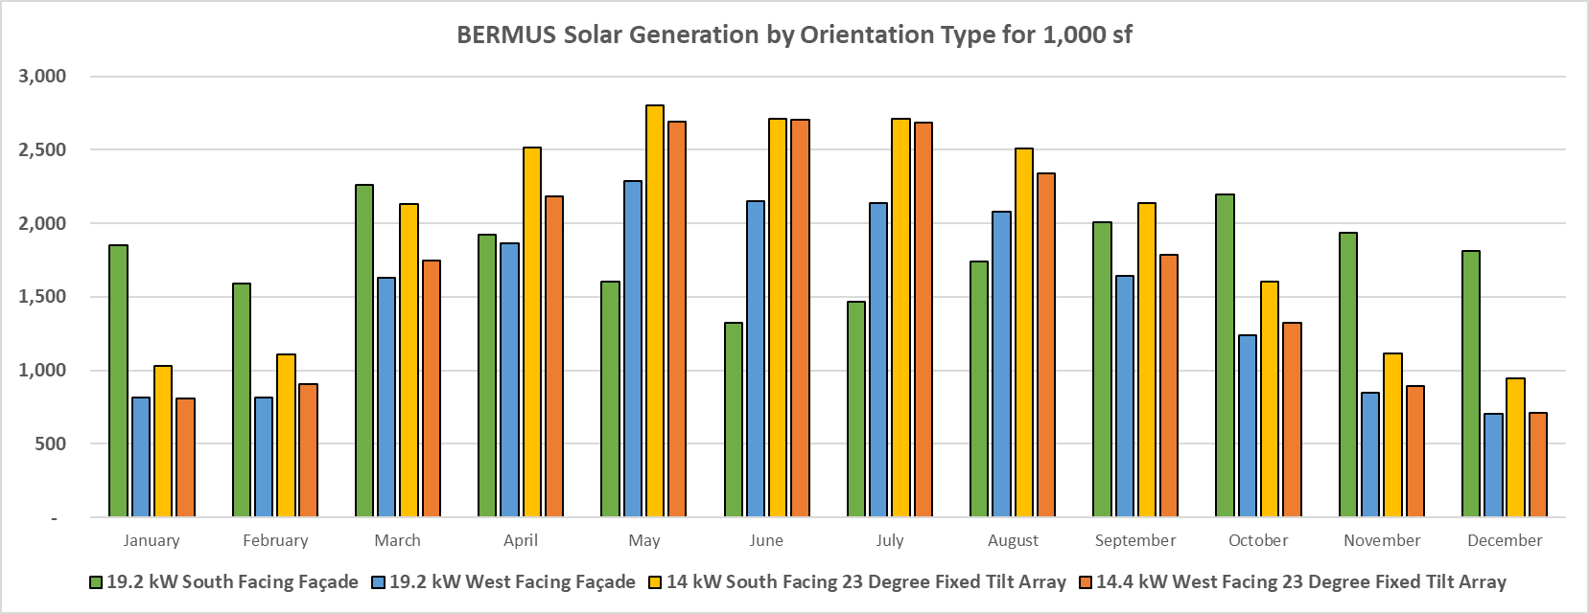
Think vertical to maximize winter solar production

