Slide 1
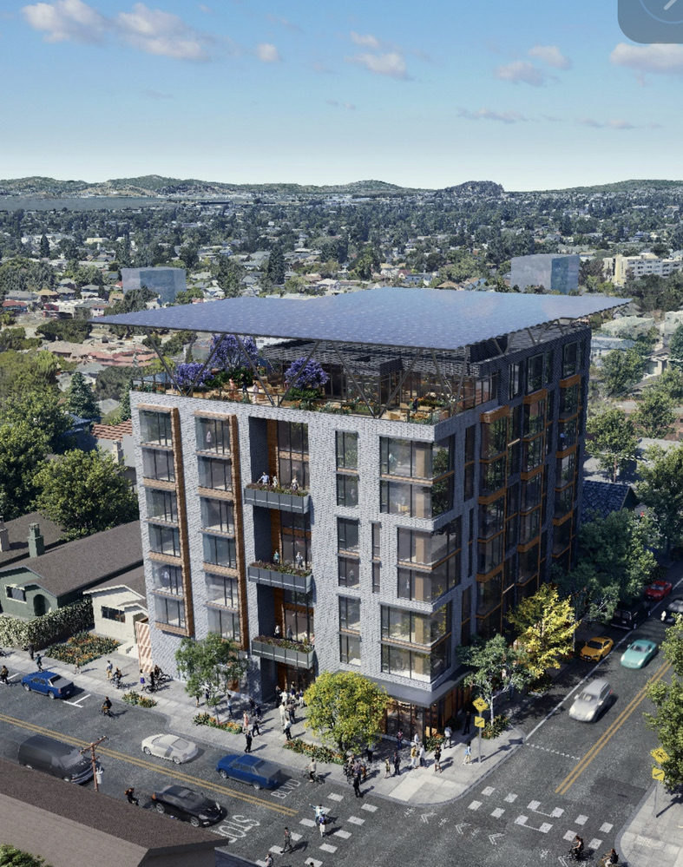
Community Microgrid Initiative
Craig Lewis
Executive Director
650-796-2353 mobile
craig@clean-coalition.org
6 March 2025

Slide 2
Types of microgrids
A microgrid is a combination of energy resources, definitely including generation, that are coordinated to serve specified loads, including in an islanded fashion.
A Solar Microgrid is a behind-the-meter (BTM) microgrid that solely relies on solar for energy generation when islanded. A Solar Microgrid relies on energy storage to time-shift solar and ensure energy availability at night etc.
A Hybrid Solar Microgrid is a Solar Microgrid that includes additional sources of energy generation, beyond just solar.
A Community Microgrid a microgrid that covers a target grid area and relies on existing distribution feeders (ie, power lines) to operate when islanded. Community Microgrids typically include both front-of-meter (FOM) and BTM resources, including Solar Microgrids, and require effective participation from utilities, which have mostly erected barriers to date.

Slide 3
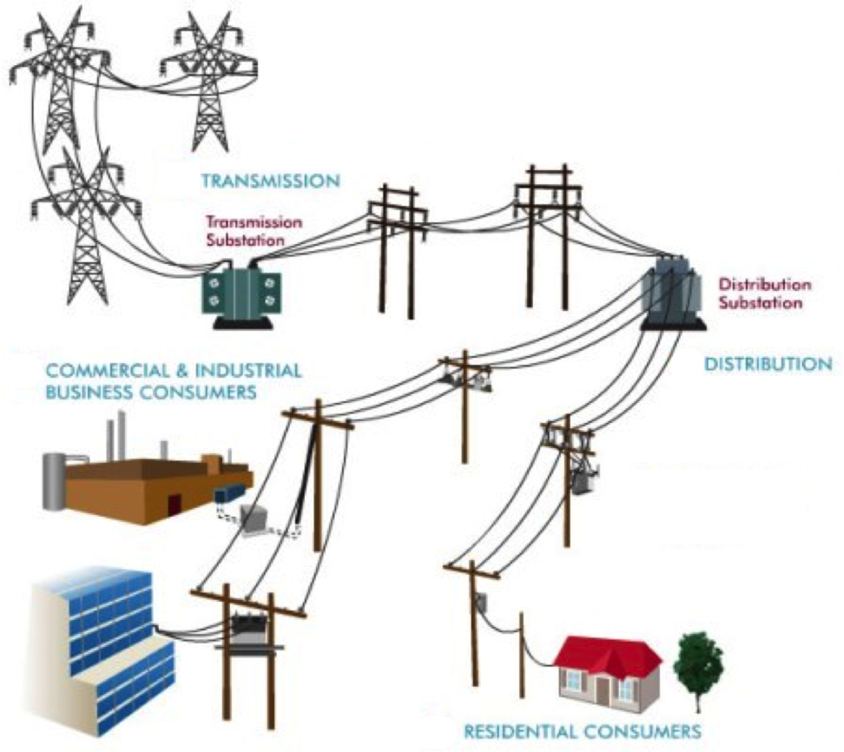
Community Microgrids within Distribution grids
High-Voltage
Transmission
grid
Low-Voltage
Transmission
grid
Distribution
grid
Notes:
Market distortions like the erroneous metering & assessment of Transmission Access Charges (TAC) for California IOUs creates massive market distortions that steal value from local generation, hurt ratepayers, and preempt energy resilience.
Non-PTO utilities (metered sub-systems) currently operate under the system we are proposing. The Clean Coalition TAC fix would bring consistent TAC treatment to DG resources in all utility service territories.

Slide 4
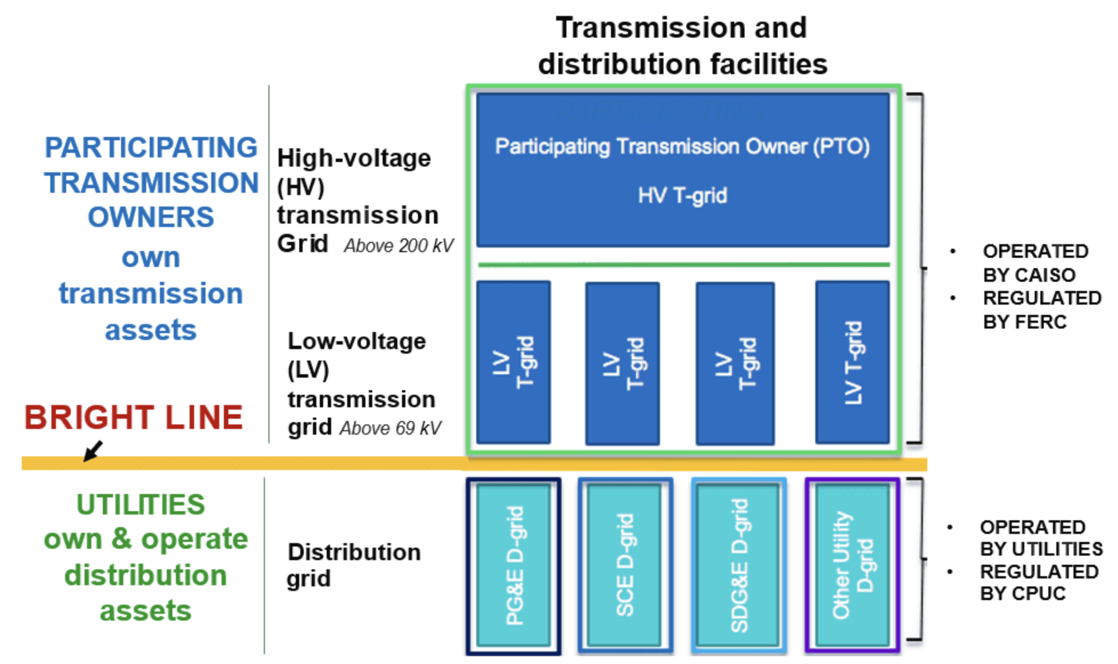
Transmission & Distribution grids are different
70 KV
70 KV

Slide 5
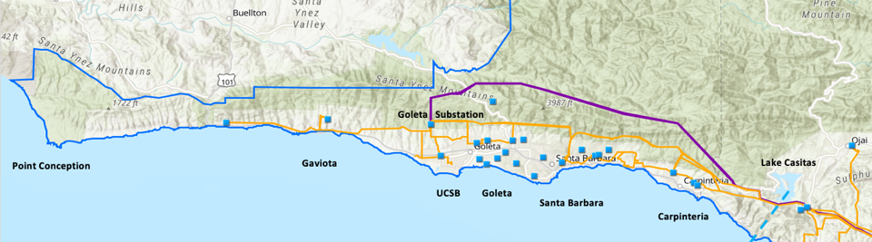
Goleta Load Pocket (GLP)
The GLP is the perfect opportunity for a comprehensive Community Microgrid
GLP spans 70 miles of California coastline, from Point Conception to Lake Casitas, encompassing the cities of Goleta, Santa Barbara (including Montecito), and Carpinteria.
GLP is highly transmission-vulnerable and disaster-prone (fire, landslide, earthquake).
200 megawatts (MW) of solar and 400 megawatt-hours (MWh) of energy storage will provide 100% protection to GLP against a complete transmission outage (“N-2 event”).
  200 MW of solar is equivalent to about 5 times the amount of solar currently deployed in the GLP and represents about 25% of the energy mix.
  Multi-GWs of solar siting opportunity exists on commercial-scale built-environments like parking lots, parking structures, and rooftops; and 200 MW represents about 7% of the technical siting potential.
  Other resources like energy efficiency, demand response, and offshore wind can significantly reduce solar+storage requirements.

Slide 6
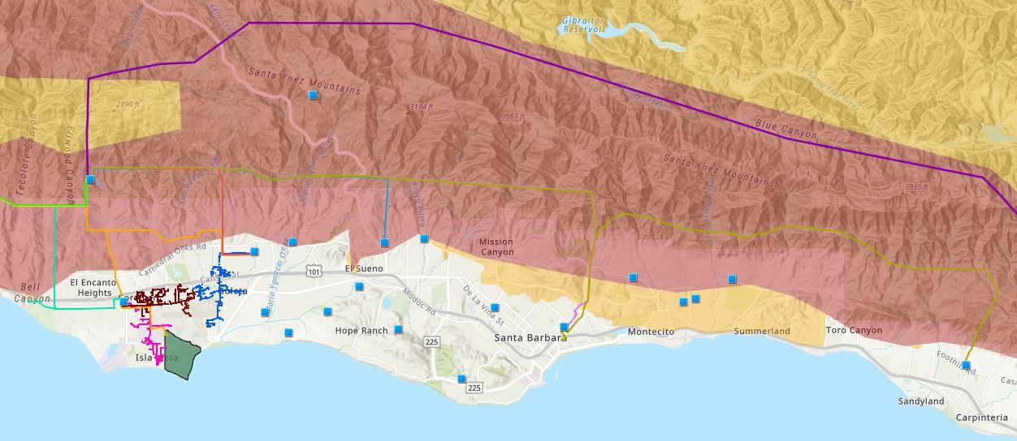

Core load area of the GLP
Legend
Feeder #4157
Feeder #4169
220 kV Transmission
Tier 3 Fire Threat
16kV Gladiola Feeder
Feeder #3556
Feeder #4227
Santa Barbara Airport
Tier 2 Fire Threat
16kV Gaucho Feeder
Feeder #4311
Feeder #3565
Substations
UCSB
16kV Professor Feeder
Feeder #3559

Slide 7
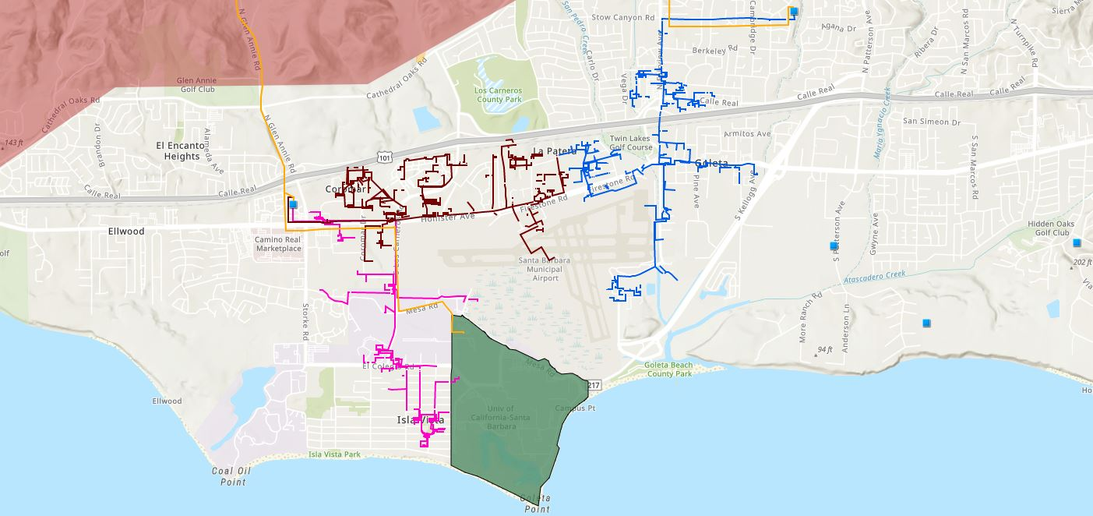








Target 66kV feeder serves critical GLP loads
Bella Battery Energy Storage Project (120 MWh)
Direct Relief (Solar Microgrid)
Vegas Substation
Dos Pueblos High School (Solar Microgrid)
Goleta Energy Storage Project
(240 MWh)
SB Airport
Fire Station # 8
Ellwood Gas Peaker Plant
Isla Vista Substation
UCSB
Fire Station # 17
Goleta Sanitary District
Legend
16kV Gladiola Feeder
University of California Santa Barbara
Goleta Valley Cottage Hospital
66 kV Feeder #4311
16kV Gaucho Feeder
Dos Pueblos High School
Direct Relief
Substations
16kV Professor Feeder
Fire Stations
Deckers
Tier 3 Fire Threat
Santa Barbara Airport
Goleta Sanitary District
Planned Battery Energy Storage

Slide 8
GLP Community Microgrid – first big chunk
Goleta Substation (220-to-66kV)
66kV distribution feeder #4311 with multiple branches
Vegas Substation (66-to-16kV)
Goleta Substation has eight feeders, seven 66 kV & one 16 kV, that serve the entire GLP
Fire Station #8
Direct Relief
+ Solar Microgrid
San Marcos
+ Solar Microgrid
66kV underground interconnection
Tier 2 & 3 facilities
Dos Pueblos
+ Solar Microgrid
Tier 2 & 3 facilities
Karl Storz + Solar Microgrid
GridStor BESS
(240 MWh)
City of Goleta
+ Solar
Isla Vista Substation (66-to-16kV)
Deckers
+ Solar
Goleta Cottage Hospital
Ellwood Gas Peaker Plant
Greenbark BESS
(120 MWh)
Tier 2 & 3 facilities
SBA (runway lights & ATC)
Diagram Elements
66 kV Distribution Feeder #4311
16 kV Gladiola Feeder
16 kV Gaucho Feeder
16 kV Professor Feeder
16 kV Los Carneros Feeder
16 kV Ace Feeder
16 kV Storke Feeder
Planned Battery Energy Storage
Ellwood Gas Peaker Plant
Grid isolation switch (open, closed)
Smart meter switch (open, closed)
Fire Station #17
SBA (Main Terminal)
Costco
+ Solar
Goleta Sanitary District
UCSB
+ Solar

Slide 9
Community Microgrid Initiative
The Clean Coalition established the Community Microgrid Initiative in 2010 to harness local solar and energy storage to deliver an unparalleled trifecta of economic, environmental, and resilience benefits to communities.
https://clean-coalition.org/community-microgrid-initiative/
Notes:
9

Slide 10
Long history of Community Microgrids
  Hunters Point Community Microgrid (San Francisco, CA)
  Long Island Community Microgrid (East Hampton, NY)
  Valencia Gardens Energy Storage (San Francisco, CA)
  Redwood Coast Airport Microgrid (Humboldt County, CA)
  Montecito Community Microgrid (Montecito, CA)
  Goleta Load Pocket Community Microgrid (Santa Barbara County, CA)
  Berkeley Efficient Mixed-Use Showcase (Berkeley, CA)
  Orcas Community Microgrid (San Jaun Islands, WA)
  Sierra Blanca Community Microgrid (La Quinta, CA)
  Tomales West Community Microgrid (Marin County, CA)
  East LA Community Microgrid (Los Angeles County, CA)
  Kapalama Container Terminal Community Microgrid (Honolulu, HI)

Slide 11
Community Microgrid stakeholders
Municipalities
Property Owners
Policymakers
Residents
Community Microgrid
Utilities
Philanthropic
Funders
Solution Providers
Financiers

Slide 12
Value-of-Resilience methodology
VOR123
VOR123 is the value-of-resilience (VOR) from Solar Microgrids methodology that the Clean Coalition has developed to normalize VOR across all types of facilities & geographies. The VOR normalization is founded in tiering loads into three categories: Tier 1 (critical), Tier 2 (priority), and Tier 3 (discretionary). Since each Tier has its own resilience requirement and VOR, this methodology is called VOR123.
VOR123 webinar
https://clean-coalition.org/news/webinar-valuing-resilience-solar-microgrids-thursday-5-nov-2020/
Notes:
12

Slide 13
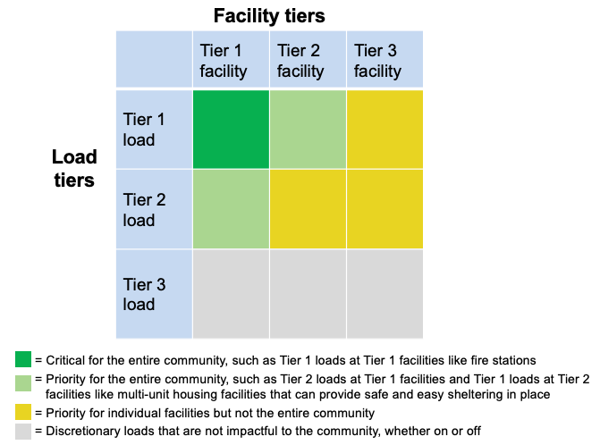
Resilient Energy Subscription
Resilient Energy Subscription is a market mechanism designed to ensure that facilities can subscribe to guaranteed levels of daily energy generation while the associated fees maximize Community Microgrid proliferation.
https://clean-coalition.org/resilient-energy-subscription-res/
Notes:
Community Microgrids have the same solar+storage ratios as individual Solar Microgrids.
Facilities in a grid area can be tiered in a similar manner to loads, based on how critical a facility is to a community.
For Critical Community Facilities (CCFs), the Community Microgrid costs should be rate-based, on a cost-of-service basis, just like the cost of every other grid asset that serves the community at large.

Slide 14
Community Microgrid examples in focus
Community Microgrid examples in focus

Slide 15
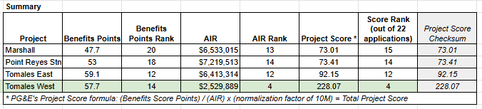
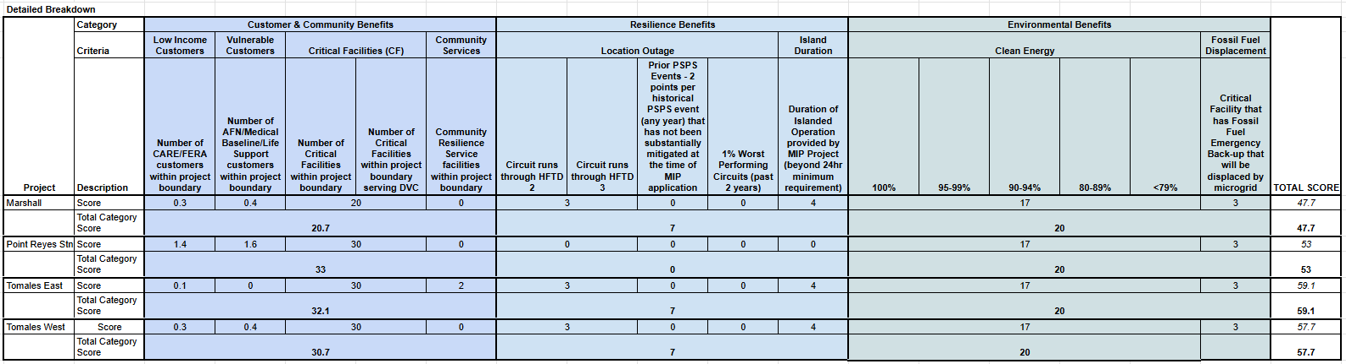
PG&E MIP Tranche 1 Master Scorecard Results

Slide 16
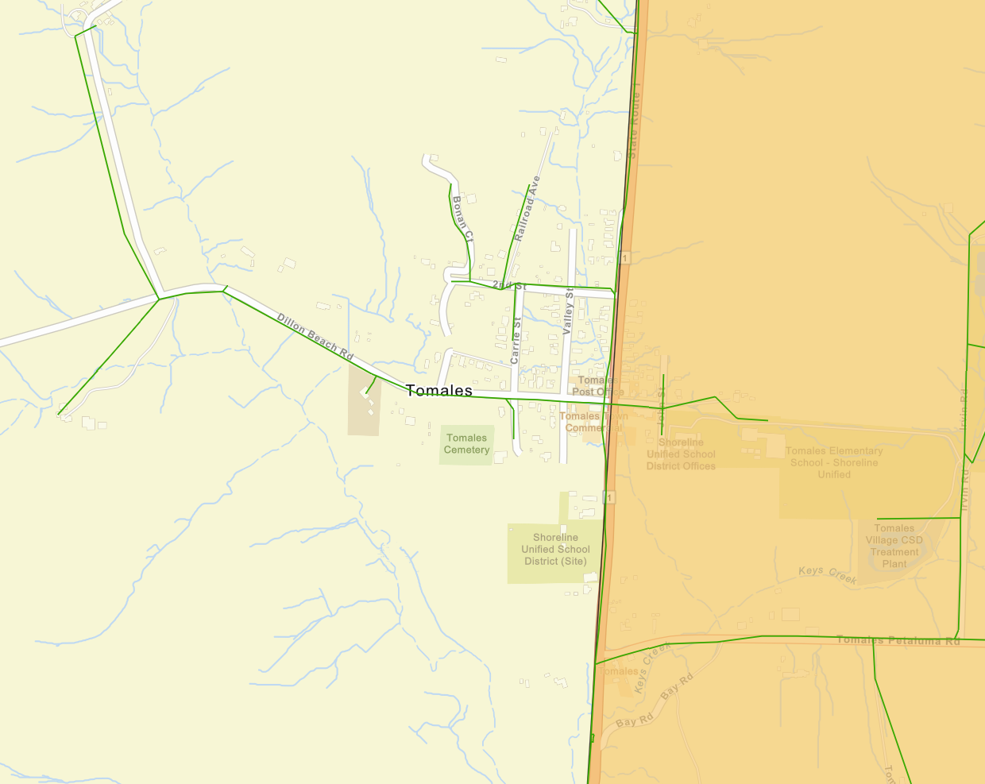




Tomales West Community Microgrid (TWCM) project area
Fire Station
Presbyterian Church
(Sheltering Center)
Church of the Assumption
(Sheltering Center)
SUSD Bus Parking and Surplus Facilities
(Solar & BESS Siting)
Undergrounding
Existing Feeder
(250 feet)
297 kWdc solar &
326 kW / 1,306 kWh BESS
Tier 2 High Fire Threat
Cotati 12kV feeder
Grid Isolation Switch
Wastewater
Lift Station

Slide 17
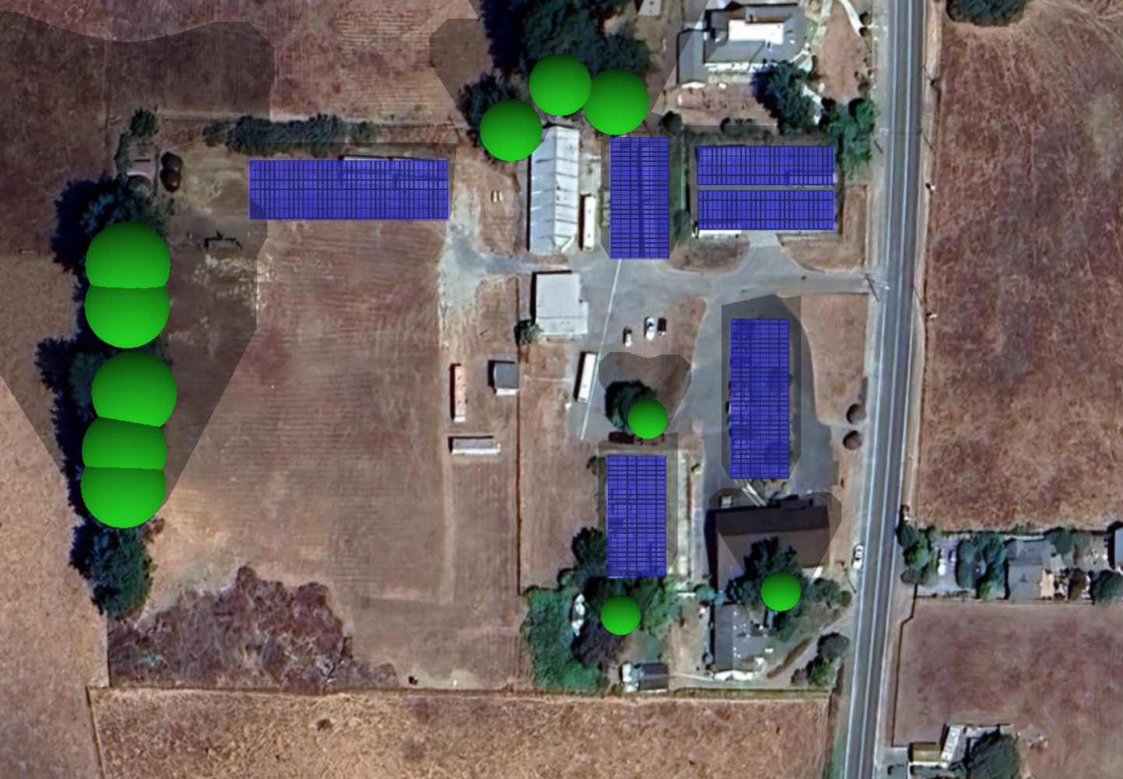
534 kW solar siting potential on SUSD parcels
(only need 300 kW to satisfy MIP resilience requirement)
Solar Canopy
83 kW
Ground Mount
135 kW
Solar Canopies (2x)
124 kW total
Solar Canopy
109 kW
Solar Canopy
83 kW

Slide 18
Tomales West Community Microgrid diagram
Cotati 12kV continues
Residential Customers
Primary Point of Interconnection
LR3
LR2
Cotati 12kV along 1st Street
Wastewater Lift Station
Residential Customers
Fire Station
Cotati 12kV along
Tomales-Petaluma Rd
Sheltering Station
LR4
LR148
BESS
326 kW
1,306 kWh
Sheltering Station
Solar
297kW
Grounding Transformer
Microgrid Controller
Legend
Existing infrastructure, outside of CMG
Existing Sites
PG&E Distribution Control Center
Existing infrastructure, included in CMG
Communications
Cotati 12kV continues
Existing infrastructure to be undergrounded
PG&E Resources
New infrastructure, CMG, undergrounded
New Resources
Preliminary design pending PG&E approval
Notes:
18

Slide 19
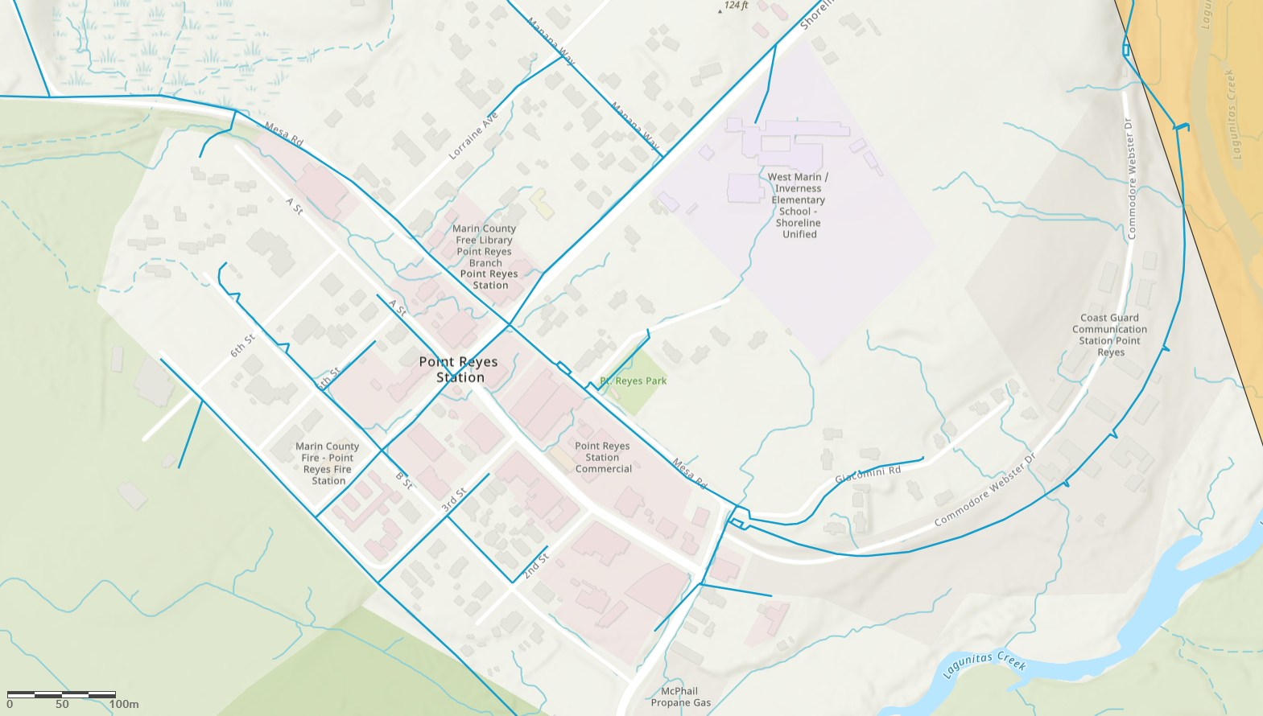




Point Reyes Station West
Low-Income Senior Housing
Health & Human Services and Clinic
Dance Palace Community Center
Fire Station & Sheriff Office
737 kWdc solar &
1,467 kW / 5,875 kWh BESS
Tier 2 High Fire Threat
Olema 12kV feeder
Grid Isolation Switch

Slide 20



Point Reyes Station East
Presbyterian Church
Elementary School
Food Pantry & Radio Station
246 kWdc solar &
489kW / 1,958 kWh BESS
Tier 2 High Fire Threat
Olema 12kV feeder
Grid Isolation Switch

Slide 21
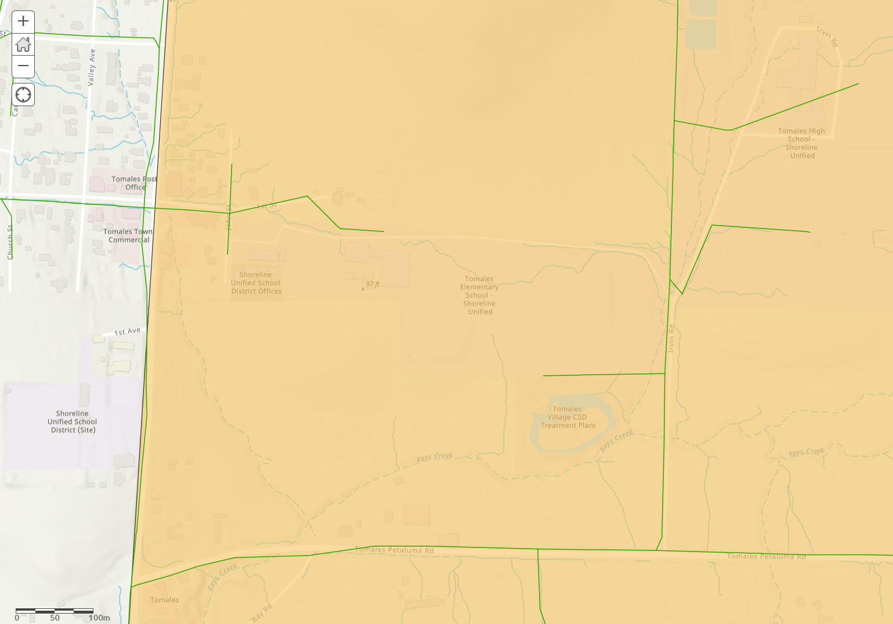


Tomales East critical community facilities and distances within Tier 2 Fire Threat for potential undergrounding
High School
Existing Feeder
0.27 miles
New Feeder
0.25 miles
1,144 kWdc solar &
964 kW / 1,927 kWh BESS
School District Office
Elementary School
Existing Feeder
0.79 miles
Wastewater System
Tier 2 High Fire Threat
Cotati 12kV feeder
Grid Isolation Switch

Slide 22
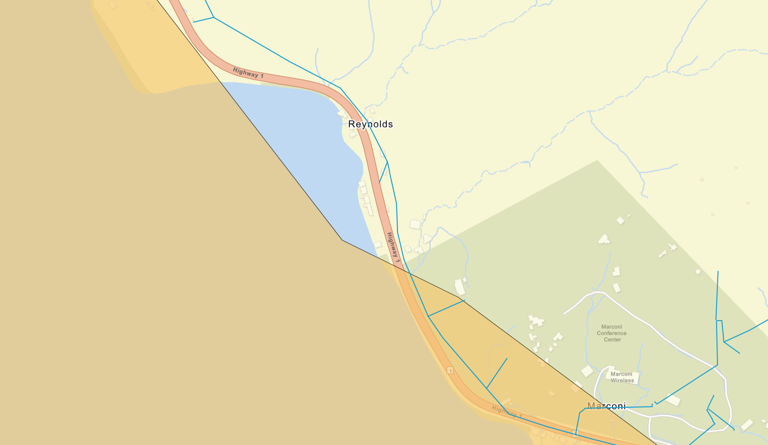

Marshall critical community facilities and distances within Tier 2 Fire Threat for potential undergrounding
Wastewater System
1,500 kWdc solar &
653 kW / 2,611 kWh BESS
Marconi Conference Center
(Sheltering)
Tier 2 High Fire Threat
Olema 12kV feeder
Grid Isolation Switch
Existing Feeder
0.4 miles

Slide 23
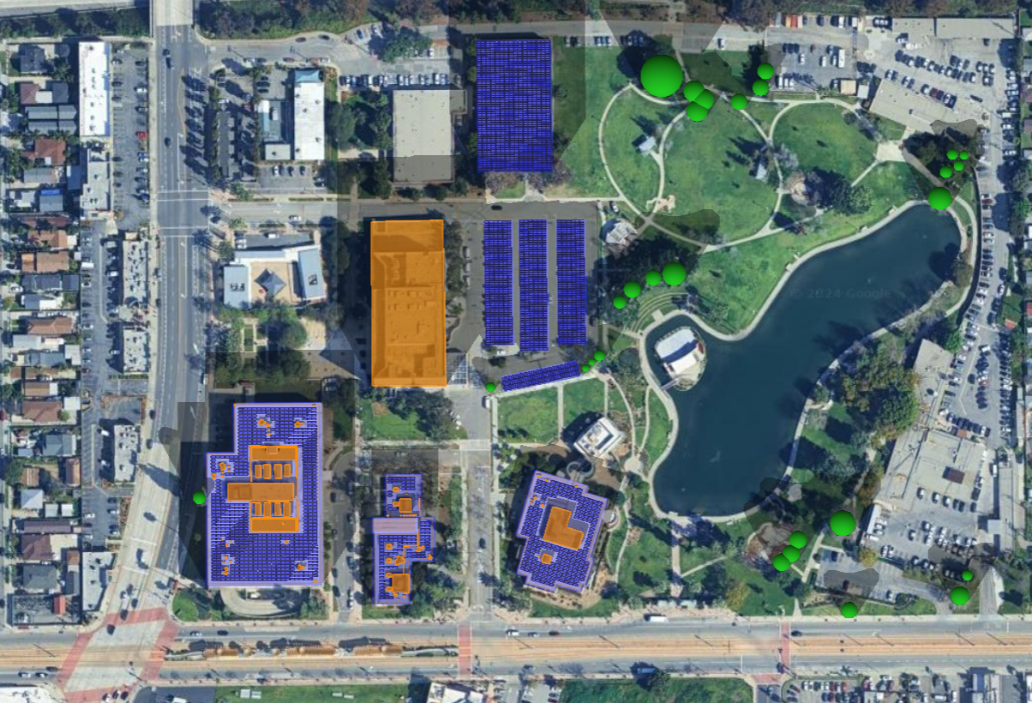
East LA Community Microgrid layout
“Solar 5”
502 kW
Solar Parking Garage Canopy
“Solar 4”
598 kW
Solar Parking Canopies
“Solar 1”
357 kW Rooftop Solar
“Solar 2”
54 kW Rooftop Solar
Transformer
#5482396
“Solar 3”
137 kW Rooftop Solar
Transformer
#5147414
BESS 1 & Resource Controller Location Option #1
BESS 1 & Resource Controller Location Option #2
MIP application pending final SCE approval

Slide 24
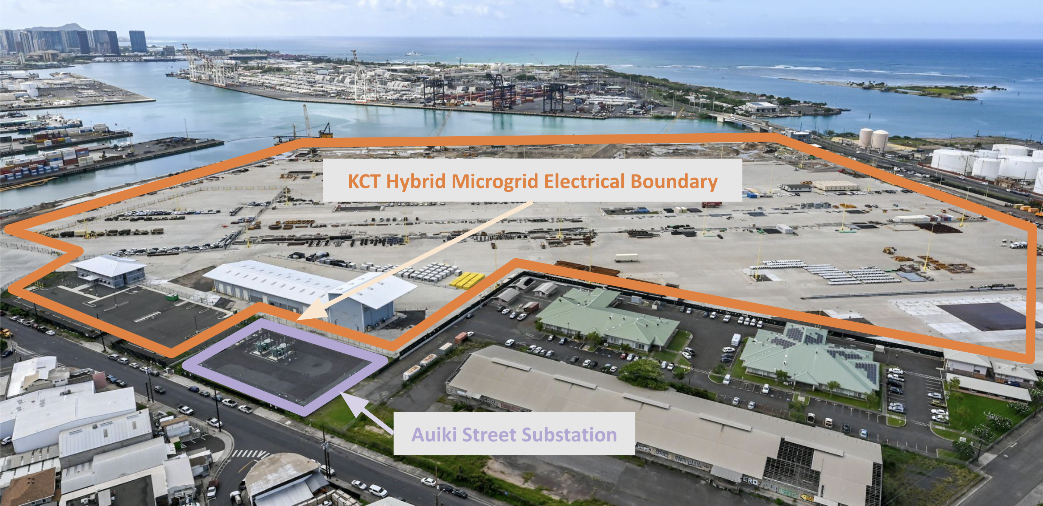
KCT Community Microgrid
KCT Community Microgrid
Kapalama Container Terminal is fully electrified and under construction in Honolulu, HI.

Slide 25
KCT Community Microgrid diagram
Reefer canopies not committed
PV
PV
BESS
BESS
Reefer Loads*
5
6
Reefer Loads*
Reefer Loads*
7
8
Reefer Loads*
BESS
BESS
Auiki
Substation
PV
PV
HECO “Macrogrid”
Guard Shack
2
Grid
Isolation
Switch
Comfort Station
4
3
Admin & Maintenance Bldgs
Marine Ops Bldg
1
BESS
BESS
PV
9
Yard
Lighting
10
Cranes
PV
EVCI
BESS
EVCI
“Hybrid Microgrid” application pending HECO approval
Notes:
The reefers are not part of the microgrid.
Feeder operates like a normal feeder when the Grid Isolation Switch (GIS) is closed.
When the GIS is open, everything to its left becomes self-sustaining (ie, islanded).

Slide 26
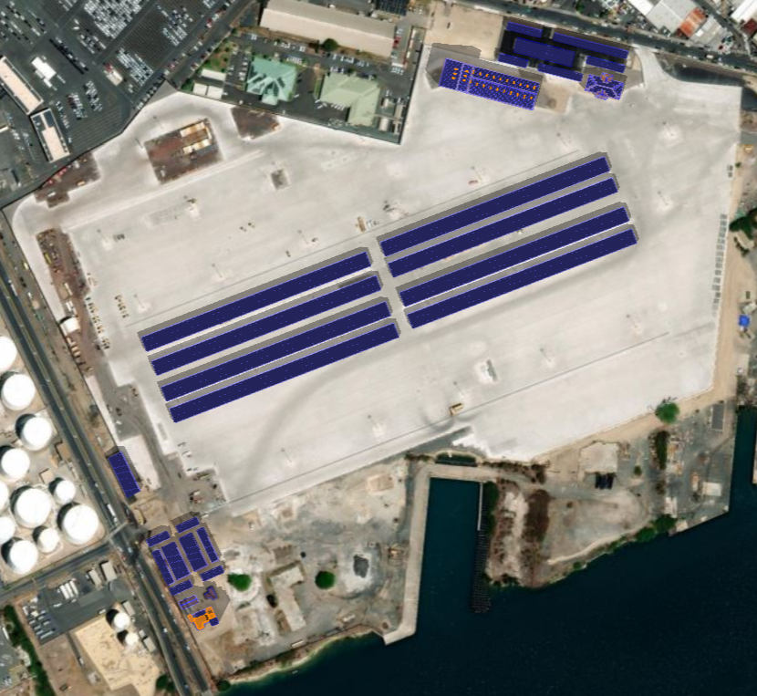

KCT site overview (7MW solar siting potential)
SUB
C-1
Pasha Kapalama Container Terminal
19 Sand Island Access Rd, Honolulu
Full Site Overview
SUB
Auiki Substation
R-2
R-1
Potential EVSE (<20 kW, 150+ kW)
Meter locations
14,453 kW / 28,905 kWh BESS
C-2
Total Solar Siting Potential: 7,000 kWdc
R-1
Admin building (58 kWdc)
C-2
R-2
Maintenance building (398 kWdc)
R-3
Marine Ops rooftop (15 kWdc)
C-1
Admin parking canopy (482 kWdc)
C-2
Reefer canopies x8 (5,491 kWdc)
C-3
C-3
Marine Ops north canopy (122 kWdc)
C-3
C-4
Marine Ops parking canopies (430 kWdc)
Baseline Load Profile: 48,409,206 kWh
Adjustment Load Profile: 1,497,393 kWh
Master Load Profile: 49,906,599 kWh
Annual Solar Generation: 12,488,963 kWh
R-3
N

