Slide 1
Colorado’s Innovative Governance in Transmission Development
20 August 2025

Slide 2
CETA Organizational Structure
In 2021, the State of Colorado created CETA (S.B. 21-072) to facilitate the expansion of electric transmission facilities to 1) increase grid reliability, 2) help Colorado meet its clean energy goals, and 3) aid in economic and community development.
CETA is an independent public body. It is a public instrumentality and political subdivision of the state. CETA performs an essential public function.
CETA is not an agency of state government and is not subject to administrative direction by any commission, board, or agency of the state.
Authority is vested in the independent Board of Directors.
Fact Sheets and Much More: cotransmissionauthority.com

Slide 3
General and Specific Powers
Engage in transmission planning activities that would increase grid reliability, help Colorado meet its clean energy goals, and aid in economic development.
Identify and establish corridors for the transmission of electricity within the state and negotiate with entities to establish interstate corridors.
Enter into partnerships with public or private entities.
Issue transmission revenue bonds to finance and develop transmission and related infrastructure.
Use the power of eminent domain to acquire transmission rights-of-way.
Transmission Developer of First, and Last, Resort

Slide 4
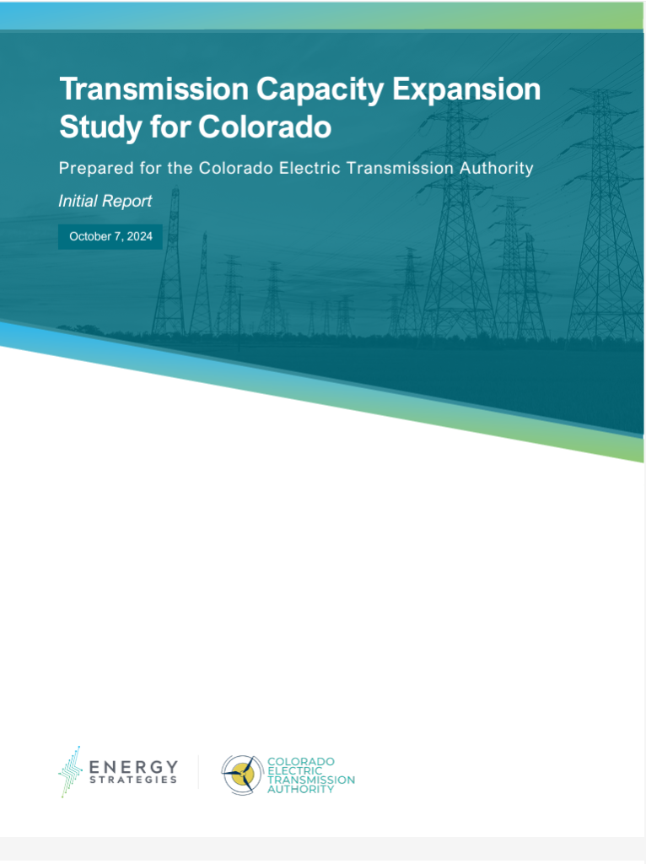

CETA 2024 Transmission Study
In 2023, the State of Colorado directed CETA (SB23-016) to study the need for expanded transmission capacity in the State.
In response, CETA conducted an RFP process seeking an independent consultant to conduct a transmission planning study that analyzes the need for expanded capacity in Colorado to:
  Help meet forecasted demand for electricity
  Achieve the State’s emission reduction goals
  Improve power flows on the system
  Improve grid reliability
CETA hired Energy Strategies & Team to conduct the study.

Slide 5
Community Engagement Principles
INFORMATION SHARING
Principle 1: Require a transparent, credible, and open process
COMMUNICATION
Principle 2: Require meaningful engagement with local communities
COMMUNITY BENEFITS
Principle 3: Advocate for public resources and both financial and non-financial benefits that support local communities
ACCOUNTABILITY
Principle 4: Require long-term commitments to host communities
Approved by the CETA Board Oct. 10, 2024
Notes:
Principle 1: documentation, information repository that is publicly available, timely project updates
Principle 2: pre-application information sessions in local communities, project design that adapts to community input, makes meaningful effort to reach underrepresented groups
Principle 3: fair and consistent landowner compensation, tangible benefits to host communities, third party advisory services to local govts to review applications
Principle 4: monitoring metrics, construction and restoration milestones

Slide 6
THANK YOU
Questions?
Karl R. Rábago, Board Member
karl@rabagoenergy.com
Maury Galbraith, Executive Director
mgalbraith@cotransmissionauthority.com

