Slide 1
How Energy Usage Affects Energy Source
Ron Sinton
Municipal Sustainability & Energy Forum
11 November, 2025

Slide 2

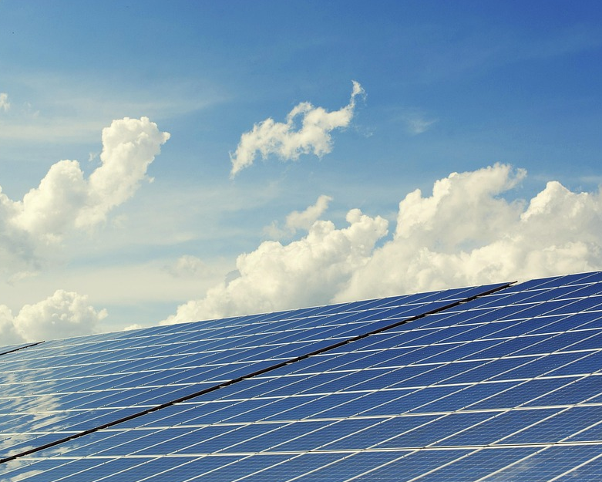
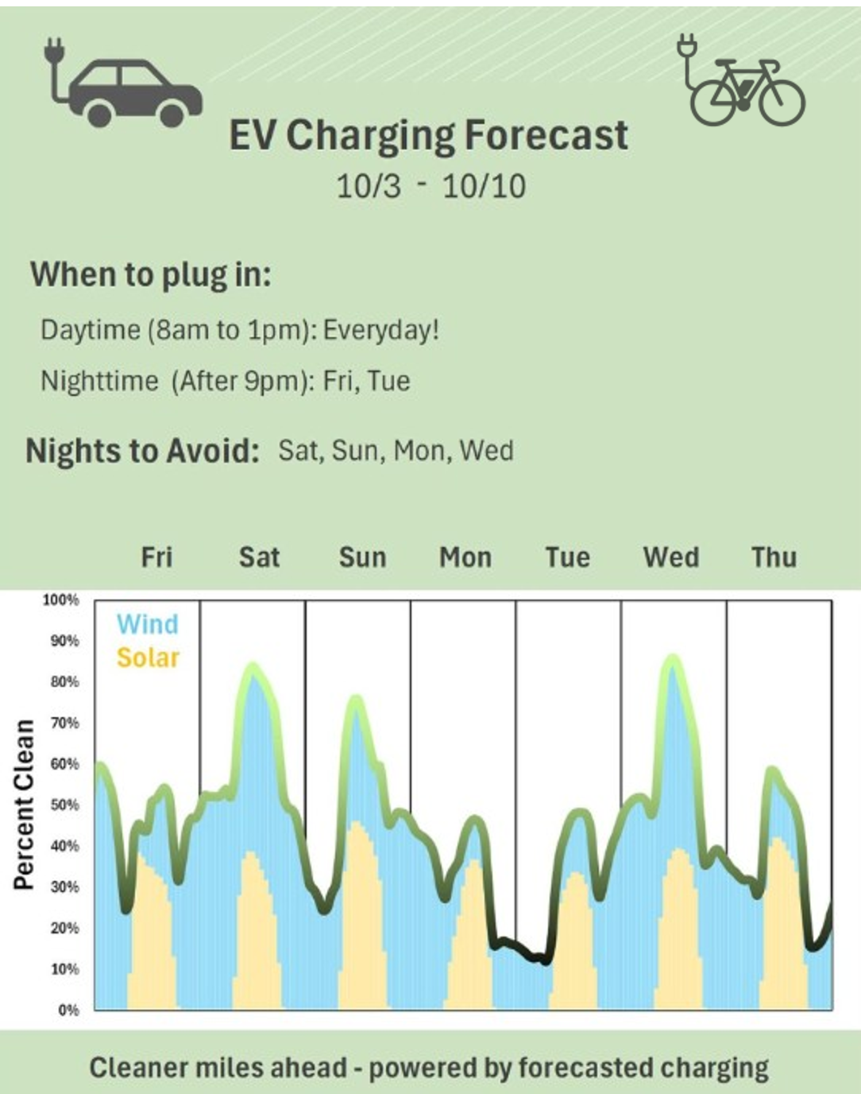


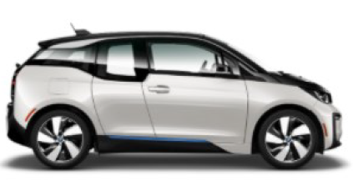
Hourly Forecast for
Wind/PV
Utility Regulatory Proceedings
Cleaner Energy
😁
Informed Customer Choice
Flexible Demand

Slide 3
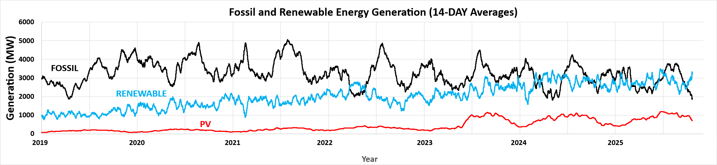
We Have Nearly 50% Renewable Energy*
*PSCo Balancing Area at 48.6% Year-to-Date 2025, based on EIA data

Slide 4
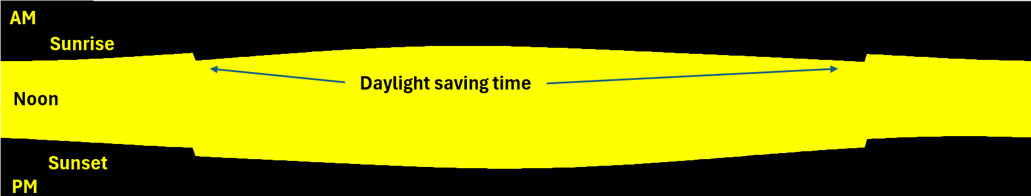
The sun rises and sets every day
January June Dec.
AM
Noon
PM
NOAA Data for Boulder

Slide 5
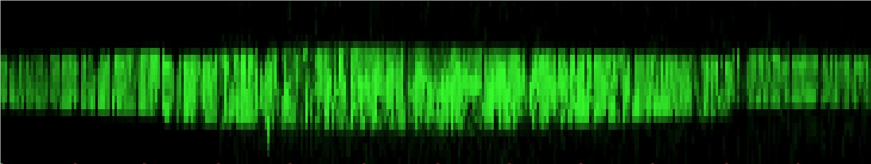

No Surprise, PV looks the same (except for clouds)
January June Dec.
AM
Noon
PM
Green Energy from PV (MW)
Based on 2024 EIA data
PV electricity produced in Public Service Company of Colorado Balancing Area

Slide 6
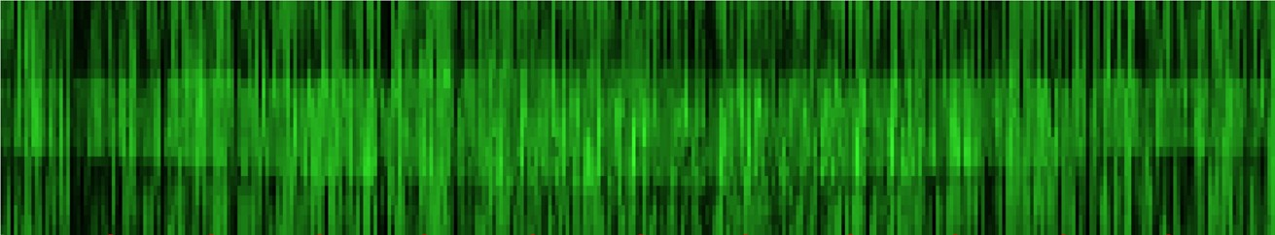
Add wind to supplement solar and fill in nights
January June Dec.
AM
Noon
PM
Green Energy from Wind or PV (MW)

Slide 7
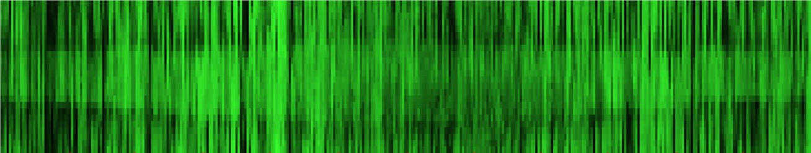
Percent Renewable Electricity of Load
January June Dec.
AM
Noon
PM
100% renewable power
100% fossil-generated power
The black zebra stripes during night hours: Dirty, calm nights

Slide 8
Percent renewable electricity
AM
Noon
PM
Air conditioning on hot afternoons into evening after sunset
Mystery: Why isn’t daytime cleaner?

Slide 9
Percent renewable electricity
AM
Noon
PM
Air conditioning on hot afternoons into evening after sunset
Projection from 2020 for renewable % in 2024. Daytime is cleaner than above. Why?

Slide 10
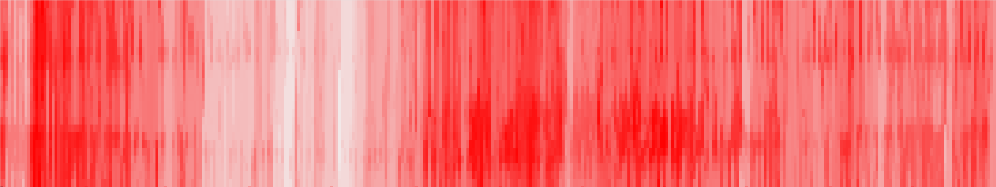

We are ALWAYS burning coal….(until 2031)
January June Dec.
AM
Noon
PM
Comanche III Coal Plant Offline for repair
Electricity from burning coal
22% of electricity generation

Slide 11
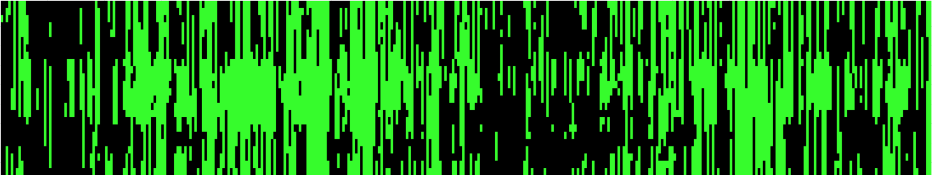
Hours with excess renewables on the grid*
January June Dec.
AM
Noon
PM
Hours with Excess Renewables (curtailed or exported)
Daytime is clean most frequently
Night can be clean when the wind is blowing—or very dirty when calm
Marginal power from fossil fuel
*Reasonable assumptions

Slide 12
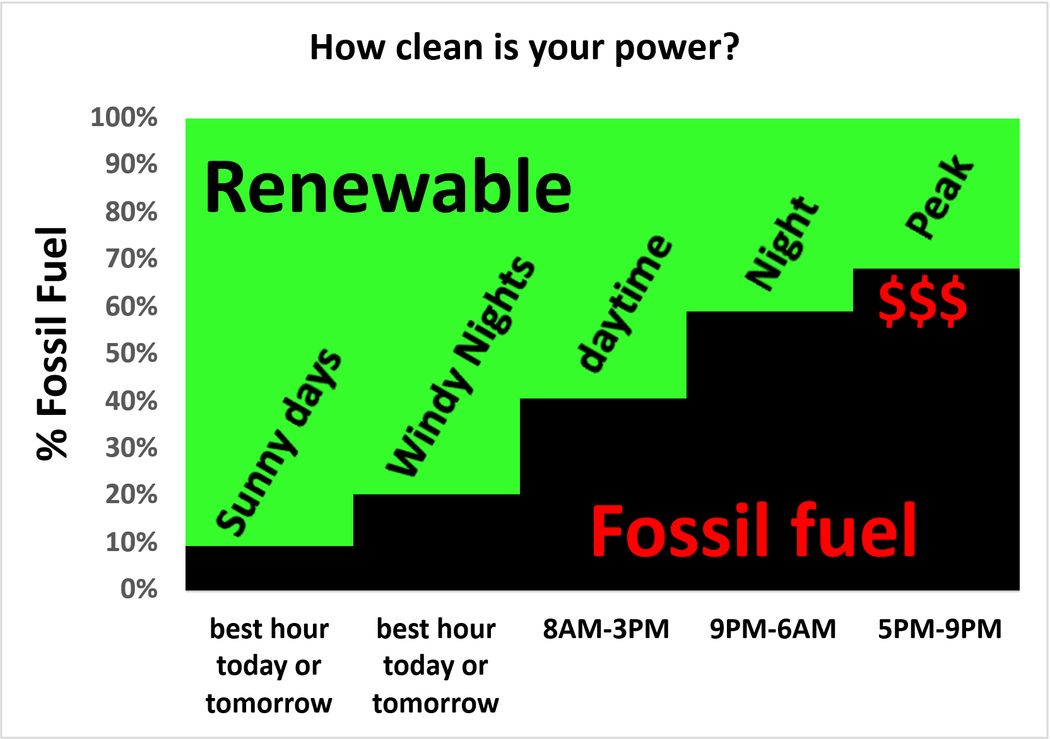

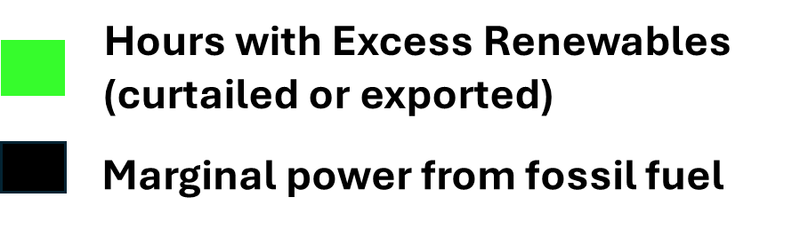
Discounted hours $
$$$$$

Slide 13


It’s easy to shift towards cleaner energy: EV example

Slide 14
It’s easy to shift towards cleaner energy: EV example
It’s easy to avoid 5PM-9PM using existing apps
It’s easy to charge more on sunny days
To choose windy nights…..

Slide 15
It’s easy to shift towards cleaner energy: EV example
It’s easy to avoid 5PM-9PM using existing apps
It’s easy to charge more during daytime
To choose windy nights…..

Slide 16
It’s easy to shift towards cleaner energy: EV example
It’s easy to avoid 5PM-9PM using existing apps
It’s easy to charge more during daytime
To choose windy nights…..

Slide 17
It’s easy to shift towards cleaner energy: EV example
It’s easy to avoid 5PM-9PM using existing apps
It’s easy to charge more during daytime
To choose windy nights…..

Slide 18

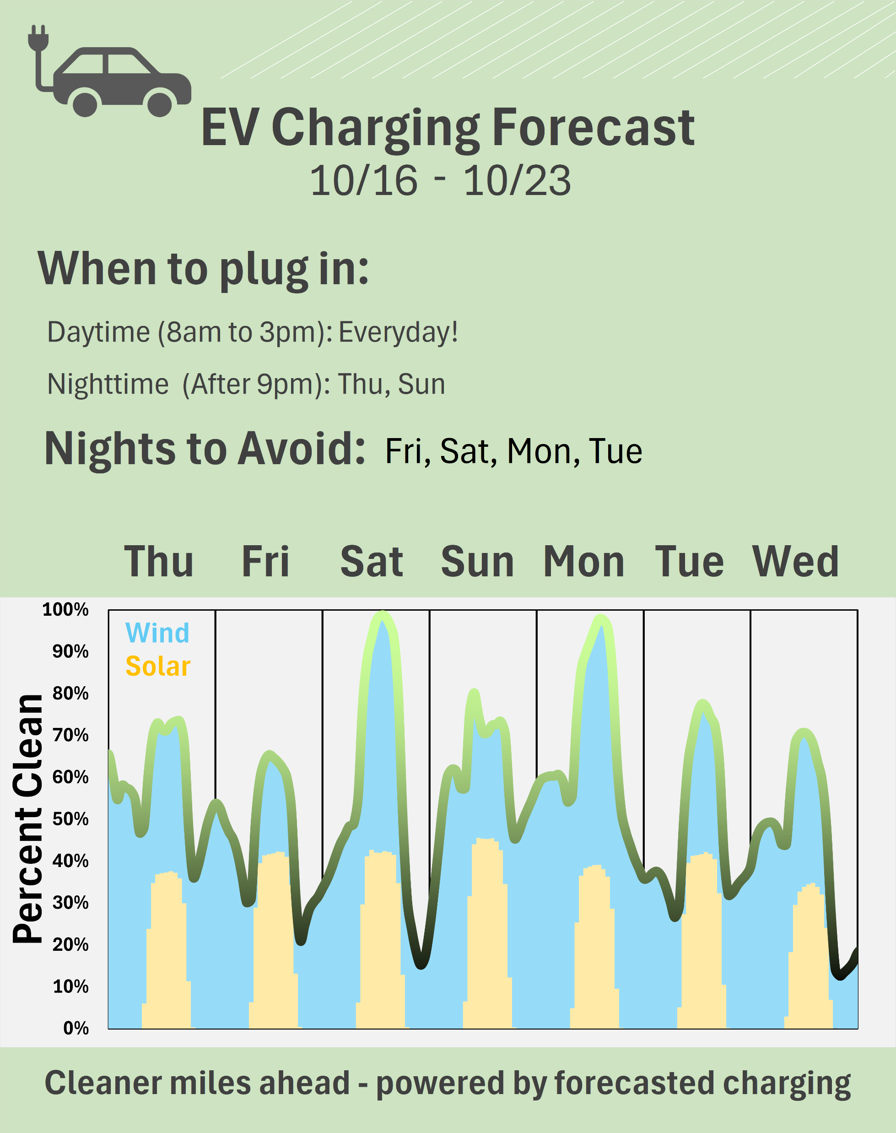
Use a renewable forecast
Forecast : Adrienne Karpen @ Sinton instruments
Based on public data from SPP WEIS

Slide 19

Utilities
Weather Forecast
7-day renewable forecast
SPP WEIS

Slide 20
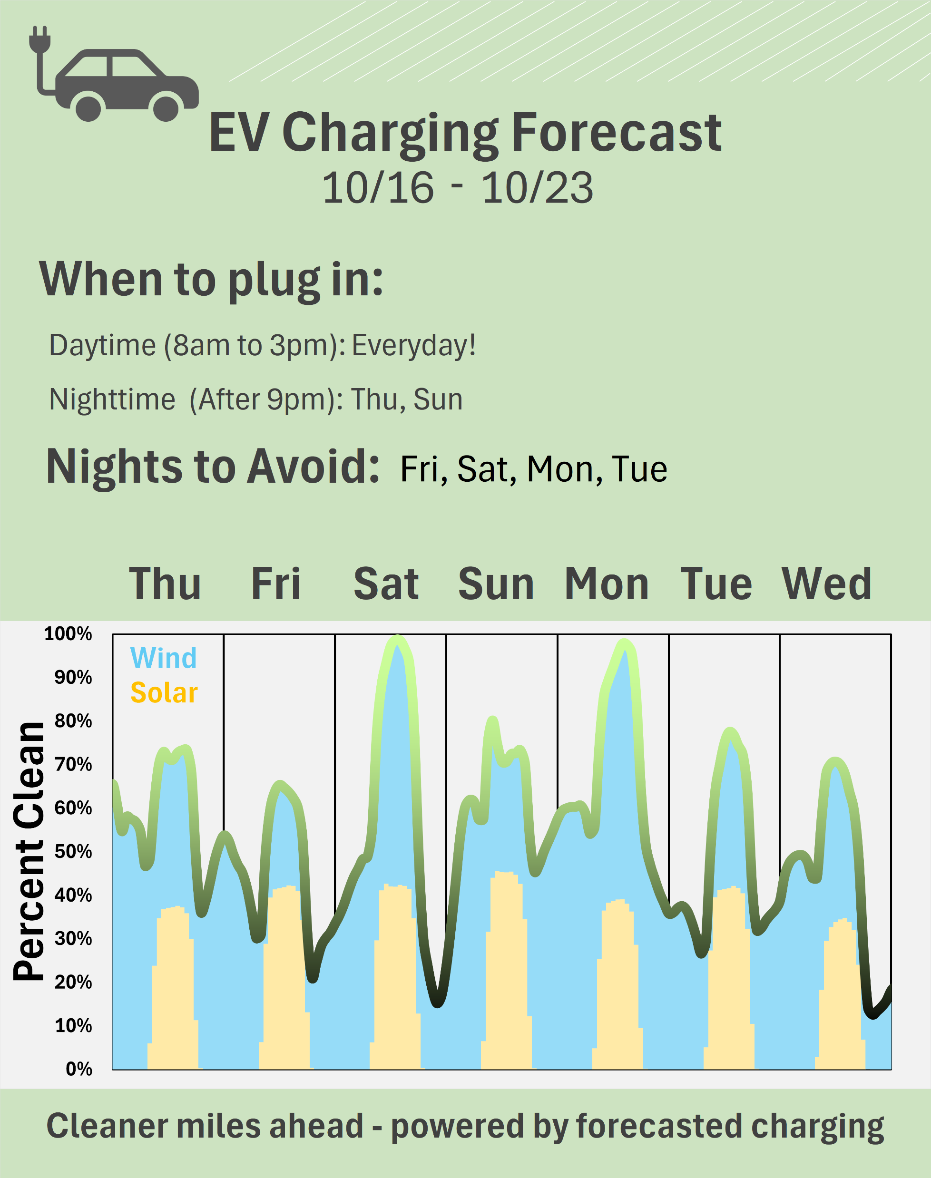
Weather Forecast
Utilities
7-day renewable forecast
SPP WEIS
Algorithm:
Wind, Solar, Rooftop Solar, Load ⇒ Ideal EV Charging Hours

Slide 21
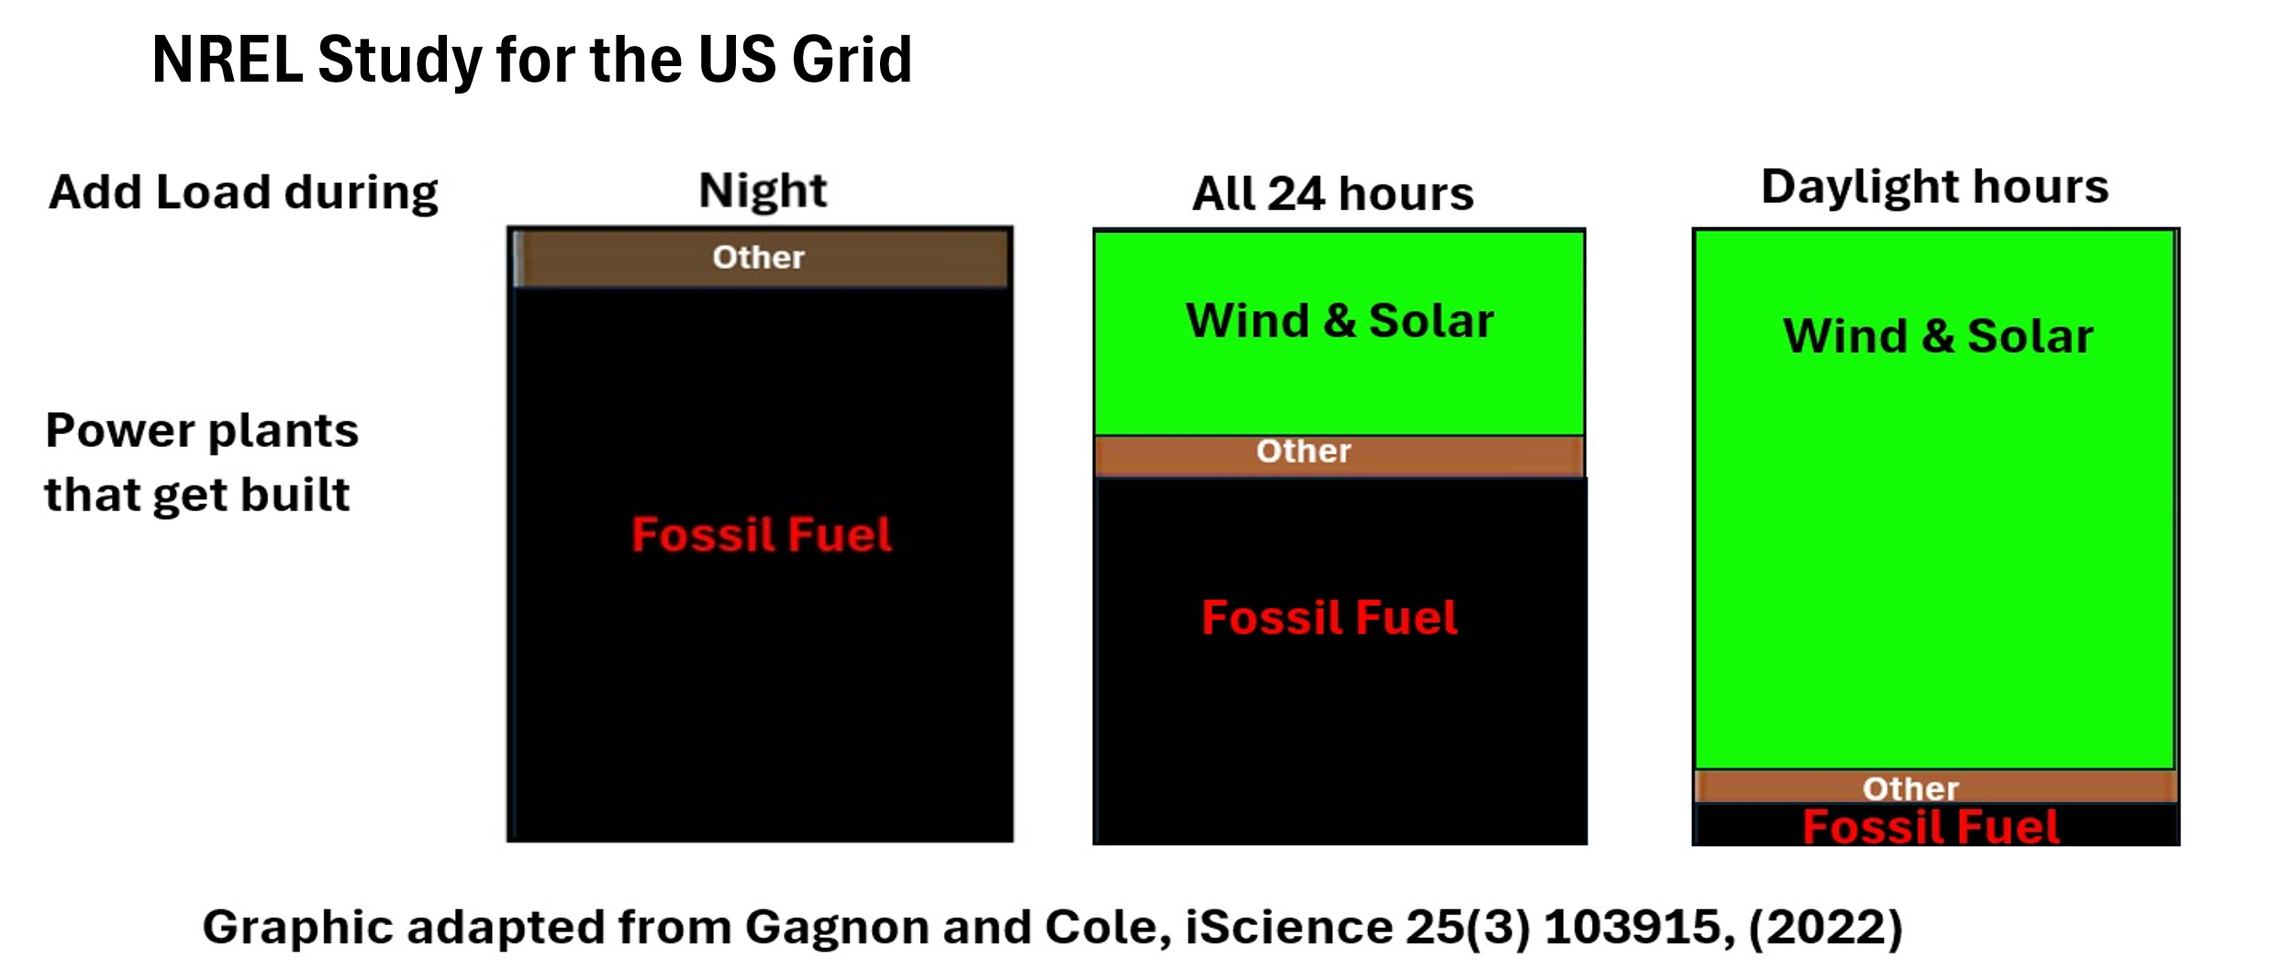

Customers choose which power plants get built
😁

Slide 22
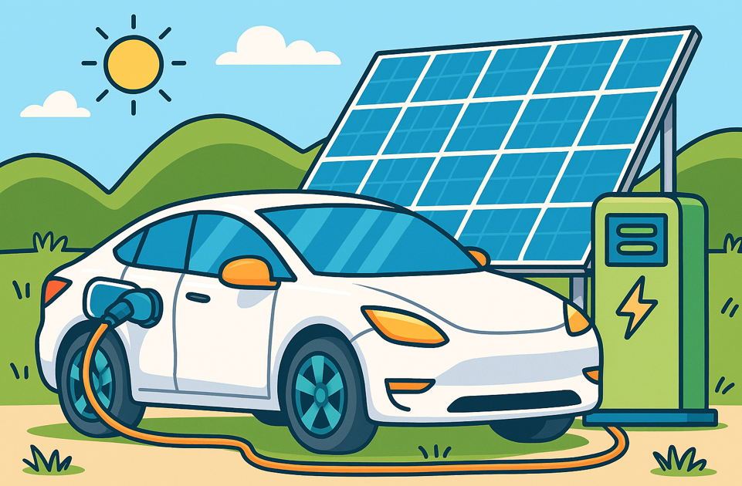
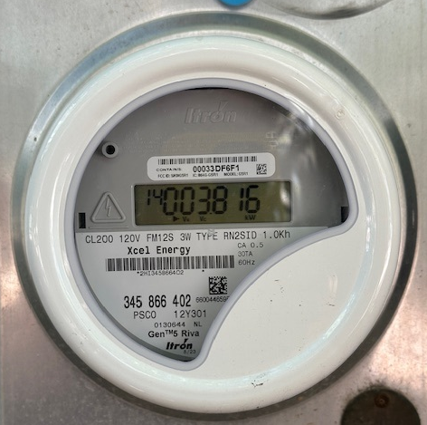
In my dream……
Charge EVs on clean energy, NOW
This shows up in the meter data NOW
Taking this trend to the PUC…
…results in more PV & Wind in resource plans!
EVs are IMMEDIATELY cleaner!
AMI meter

Slide 23
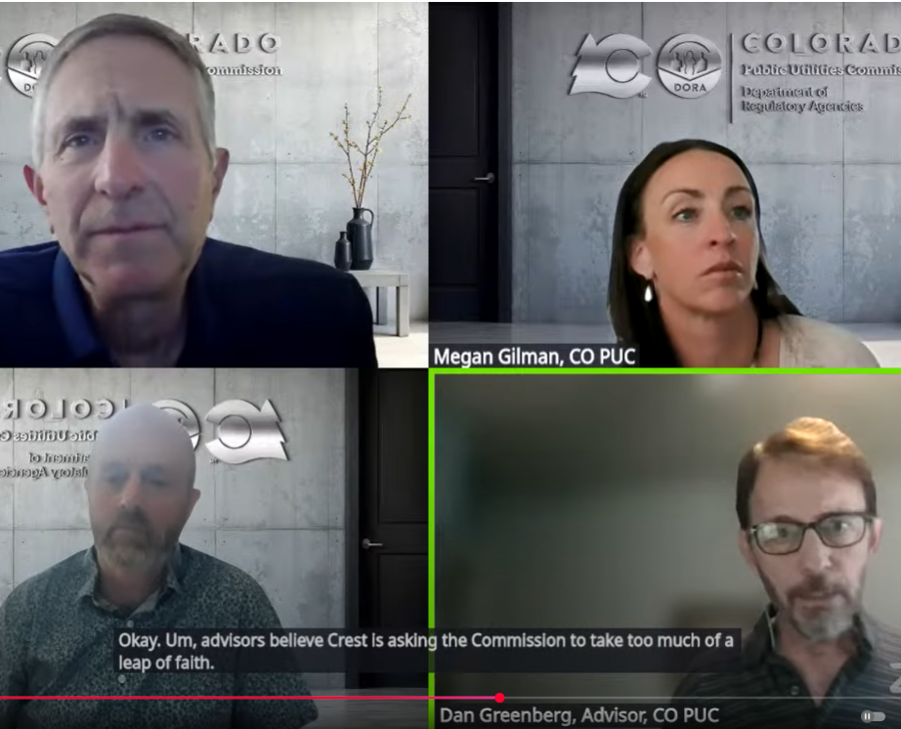
The stakes……
Xcel projects 446 MW of EV charging DURING PEAK HOURS in 2030.
Can we shift this to be off-peak and clean?
PUC Commissioners:
This has to change
Data needed: Will People Respond?

Slide 24
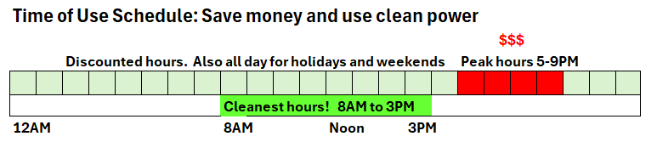
Now is the time!
New TOU rates in November
~$90-$240/year discounts for off-peak EV charging.
Use the EV-Charging Forecast to find the best of 20 hours

Slide 26
Observations based on hourly meter data
Households with EVs can save money on TOU rates ($90-$240/EV per year)
Households with heat pumps save money on TOU rates
People that set back heat pump thermostats may incur peaks when ramping back up! (The resistive backup heat comes on)
Electricity bills will go up for people with net-metered PV, old TOU to new TOU, because sending electricity to the grid from 1PM-5PM will be paid less
  The old TOU encouraged selling power to the grid at 1-5PM but penalized using it!
  The new TOU encourages battery storage and self-consumption
  COSSA/SEIA supported the new TOU, or even lower rates during daytime

Slide 27
One Day When Grid was 52% Renewable (Sept. 1, 2025)
Little wind at night
Excess clean energy during day
Adding renewables to grid would not help on this day

Slide 28

One Day When Grid was 52% Renewable (Sept. 1, 2025)
Effective solutions
Battery Storage
100% fossil
Discharge
100% Clean
Charge
No cost
Now
$$$$
15% loss
Adding renewables to grid would not help on this day
Do this first

Slide 29
Why do I like this approach?
We don’t need permission. We can just do this! Now!
It will be very effective, very quickly!
Progress can be easily tracked (AMI meters and hourly grid emissions)
The price is right (FREE!!!) We don’t need subsidies to do this
Changing the hourly demand curve sets us on a path for low-cost, clean energy—An unstoppable trend
Contrast this with utility pilot projects, aggregators, DERMS, VPPs, rules, regulations, middlemen, PUC proceedings, etc…
Slow, complicated, and expensive!

Slide 30
Change Hourly Demand to Use Clean Energy
Now: Choose to make Residential Electricity Growth Cleaner
-EVs
-Electric Water Heaters
-Heat pumps
Next: Enable Industrial Flexibility with Dynamic Pricing
-Workplace EV charging (both daytime and equitable)
-Industrial heat storage
-Industrial cooling
-Data centers? AI?

Slide 31
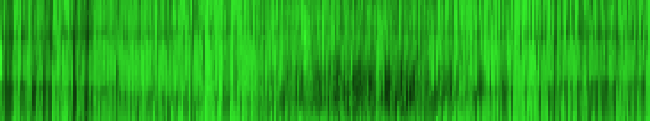
All Roads Lead to Rome (2024 data)
*
% Renewable of Load (Average emissions)
%
MW
$0-0.05
kWh
Clean
hours
Net load (Load – Renewables)
(Reliability, Dispatchable Power)
Wholesale Price (Grid @ Comanche Power plant)
*
Hours with Excess Renewables
(Marginal emissions)

Slide 32
In a Utility-Regulatory Resource-Plan Context
MW
Net load (Load – Renewables)
(Reliability, Dispatchable Power)
Net demand, a frequently discussed metric in PUC proceedings, is a lagging indicator of the future renewable grid. Low demand during night until dawn masks the fact that these hours will be among the most expensive and dirty hours to use power for the future grid when coal plants are retired.

Slide 33
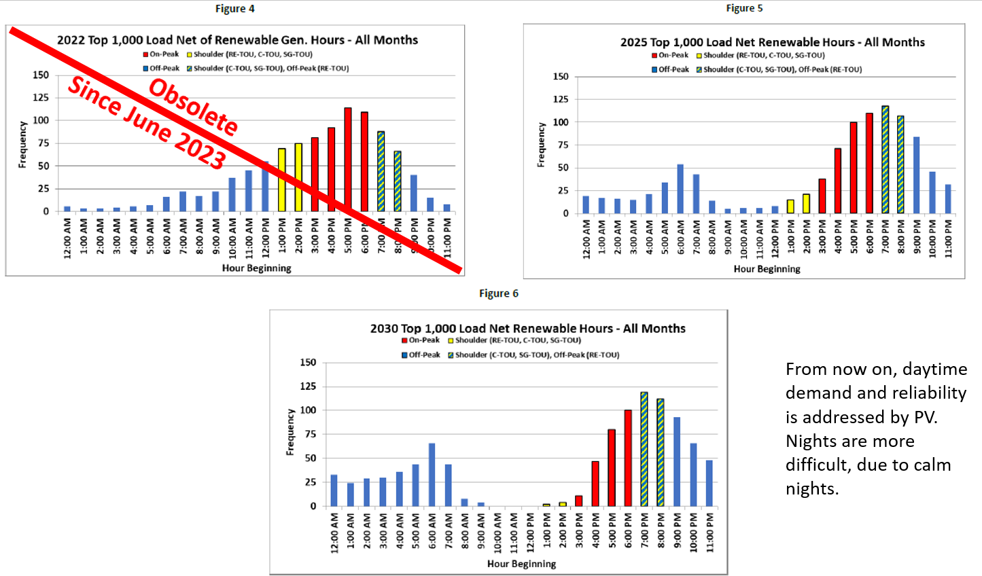
Utility PV installations in 2023 are supplying air conditioning load!
5PM-9PM
Residential rates are determined by use from 5PM-9PM
These hours determine:
-% of total grid cost paid by residential “class” compared to commercial and industrial “classes”
-Total grid cost

Slide 34
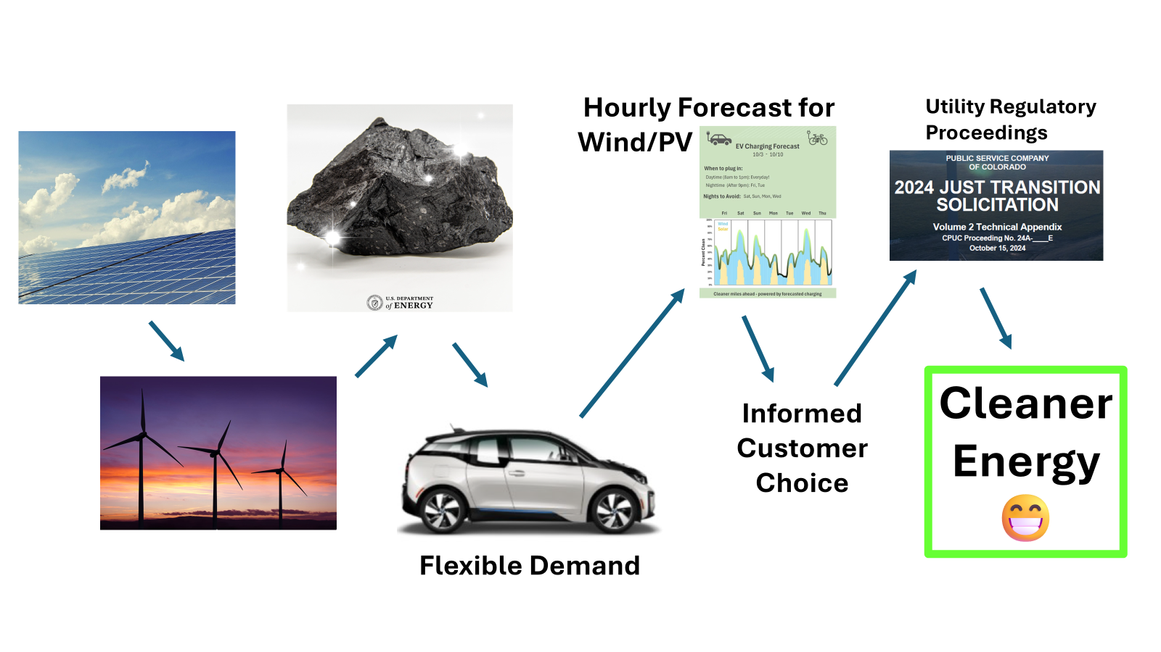
Conclusions

Slide 35
Advocate for better rate design to reward clean, low-cost energy use
Conclusions
A “renewable friendly” demand curve will result in a more renewable future, faster.
We can just do this—Today!

Slide 36

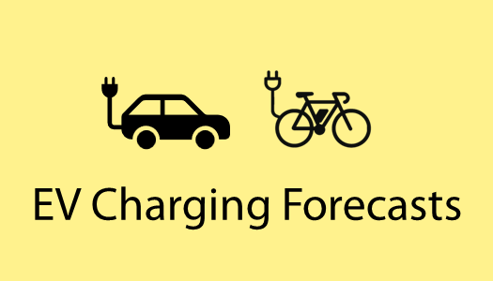
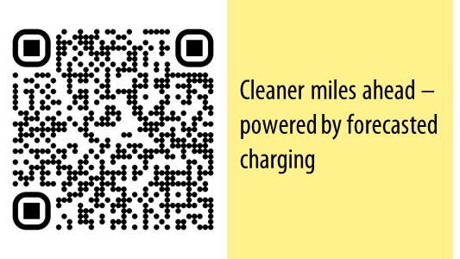
ron@sintoninstruments.com
With thanks to Adriene Karpen, especially for EV forecast!

Slide 37
New Time of Use Rates Starting Nov. 1, 2025

Slide 38
Why Have Time-Of-Use Rates?
-Much of the cost of the grid is due to peaking power plants and infrastructure that are used very few hours per year. Reducing the need for these “peaker” plants would lower the cost of electricity
-If residential demand for power were reduced during these few peak hours, then
-The cost of the power grid would be less, leading to lower rates
-The fraction of this total cost for the grid paid by residential customers (compared to commercial and industrial customers) would be less.
-TOU rates allow individuals to lower their power bills in ways that lower the power bill for all residential customers. Savings during off-peak hours compensate for higher rates on-peak.
-The ability to lower power use during peak periods is becoming much easier due more “flexible” load on the system like EVs, electric water heaters, and heat pump heating.

Slide 39
Result from Rate Case: 1000 highest hours of fossil fuel dispatch
1PM to 7PM
Peak
Mid peak

Slide 40
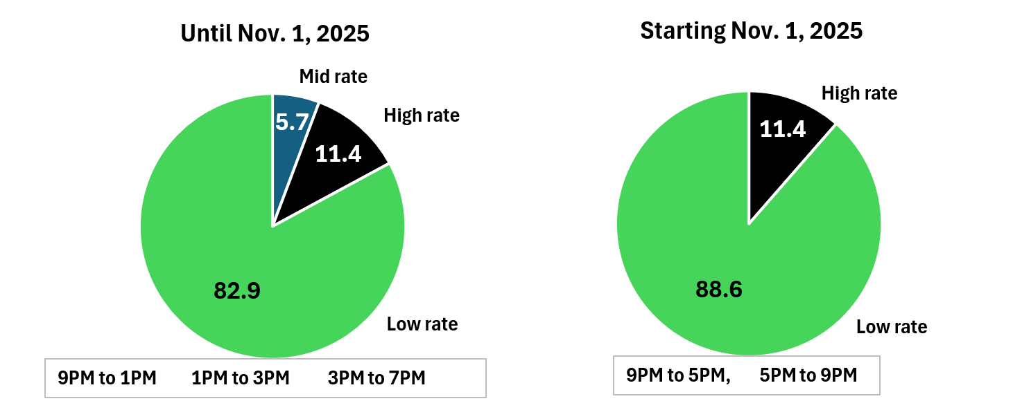
Time-of-use rates: Past and future: 89% of hours are now at lowest rate
5 days per week. Weekends and holidays at lowest rates

Slide 41
Designed for Revenue Neutrality
The average residential annual bill will be nominally the same for the new TOU rate as the old TOU rate and the flat rate
"This is in ‘ALL CAPS’ with an exclamation mark—THIS IS NOT A BILL INCREASE!," said PUC Commissioner Eric Blank*.
*9News, May 7, 2025

Slide 42
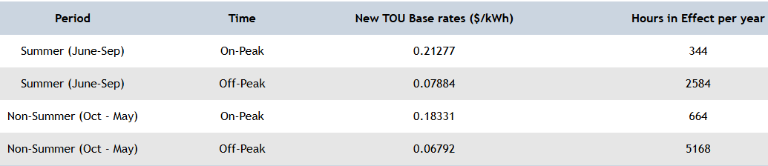
TOU Rates (Nov. 1, 2025)
(Ron)
(Ron)
All In Est.
0.33
0.124
0.284
0.105
Flat Rates
0.1038
0.0857
All In Est.
0.16
13.3
About $90 savings from charging during off-peak compared to flat rates.
Total of $140 discount if you sign up for “Optimize Your Charge” 80% of charging between 12AM and 2PM
Total of $240 discount if you sign up for “Charging Perks” and let the utility pick the hours each session.
All are compatible with an EV-charging forecast, if you choose the best hours within the rules (only plug in on windy nights or windy/sunny days).
Estimated approximate all-in rates based on 2024-2025 bills

Slide 44
How to save money between 5PM and 9PM
When you buy an EV, charge it on low rates anytime other than 5-9PM on weeknights. (89% of all hours) I estimate savings of $90-$240/yr/EV.
Shade the west windows. (Shutters, awning, white curtains, plant a tree, etc.)
Leave the AC off on nights when you are not home during these hours.
When your AC dies, replace with an energy-efficiency heat pump.
Ask Go-Electric Colorado for more hints.

Slide 45

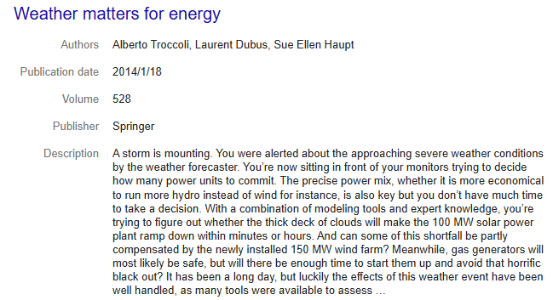
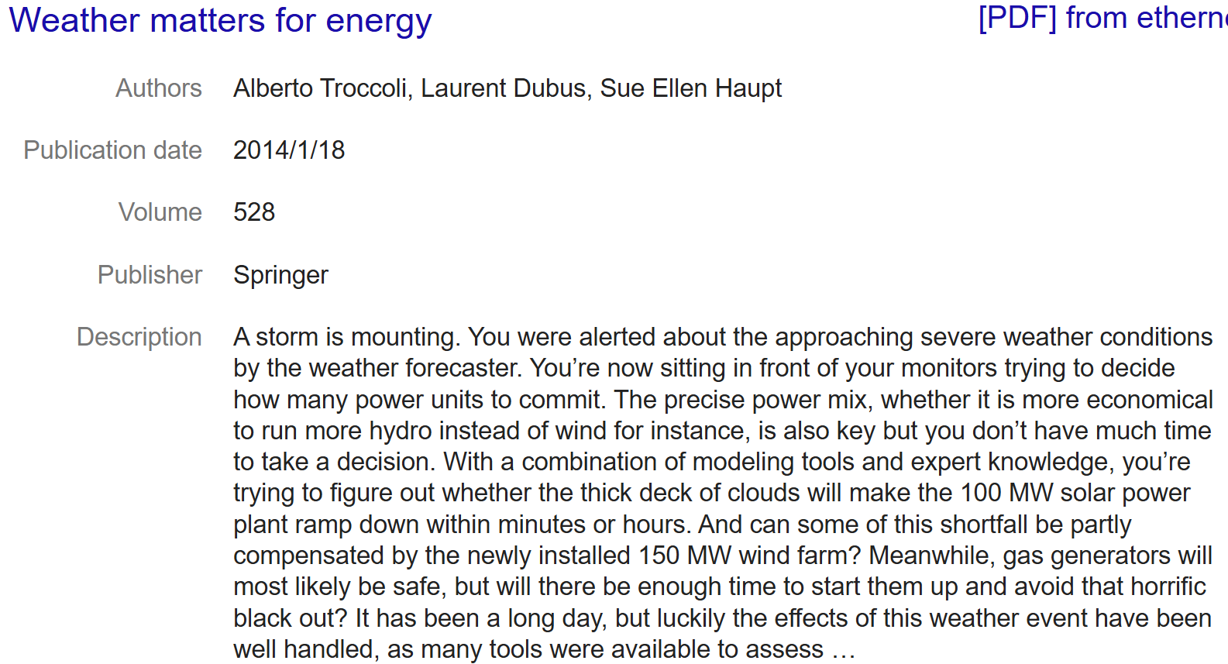


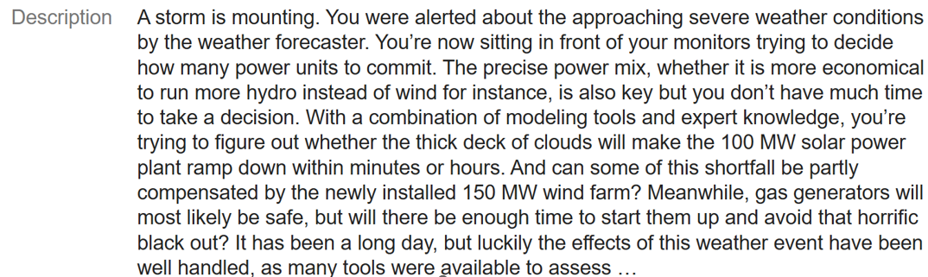
NCAR Senior Scientist

Slide 46
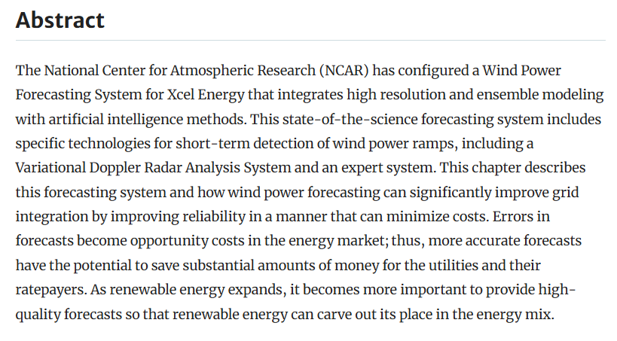
One chapter in the 2014 book with co-authors from NCAR and Xcel

Slide 47
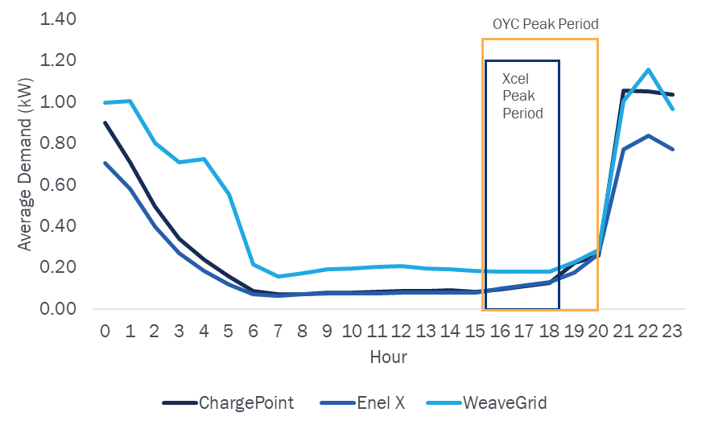
Xcel’s “Optimize your charge” EV charging
Fig. 1. Fig. 9 from the Attachment H_2021-2023 TEP Final Evaluation Report, pg. 38., Sept 2025

