Slide 1

Connecticut’s Energy Crossroads The Path to a Clean Energy Future
Municipal Sustainable Energy Forum
December 10, 2025

Slide 2


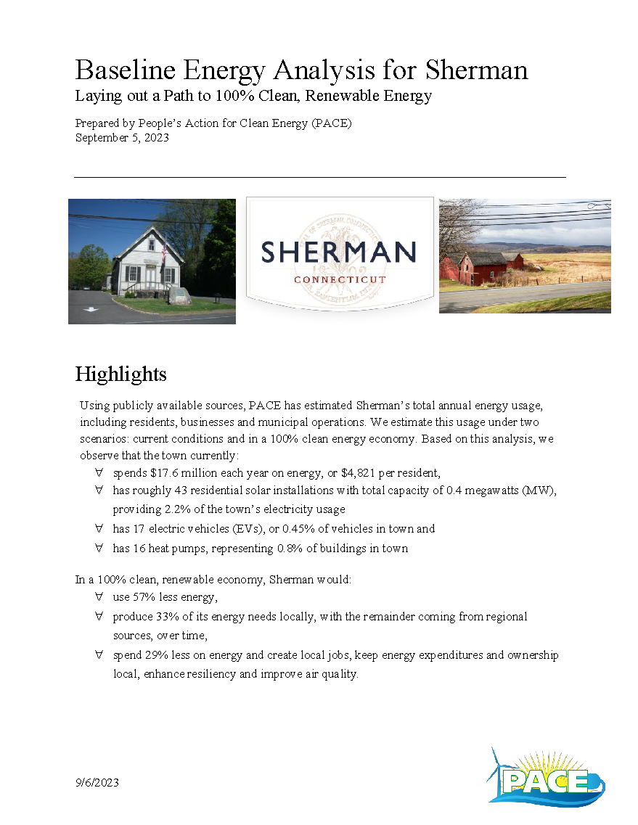
The Clean Energy Action Center
CEAC
Buildings
Climate Action Plans
PACE Energy Model
Vehicles
Energy Analysis
Renewables
Electricity & Gas Usage
Clean Energy Campaigns
HeatSmart
Other Data Sources
Efficiency
PowerSmart
Solarize

Slide 3
Where do our GHG emissions come from?
Energy generates 30 million tons of GHG in CT, or 8.5 tons per resident.
State targets call for us to get to less than 3 tons.

Slide 4
The Path to Eliminating GHG Emissions
Buildings
Efficiency
Heat Pumps
EVs
Clean Electricity
Solar
Storage
Microgrids
TENs
Offshore Wind
Notes:
Connecticut currently emits roughly 30 million tons of GHG per year on energy, or 8.6 tons per person

Slide 5
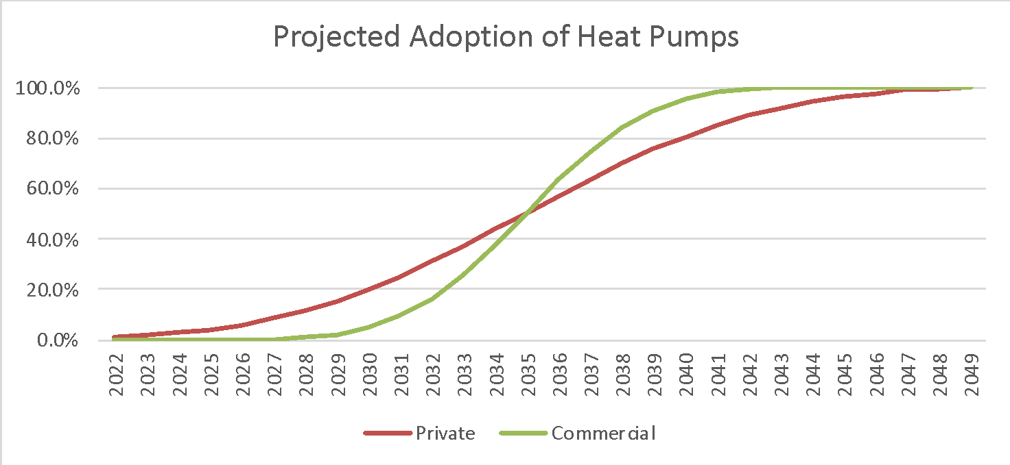
Electrification of Heating & Cooling
Granby has a relatively high rate of heat pump adoption to date

Slide 6
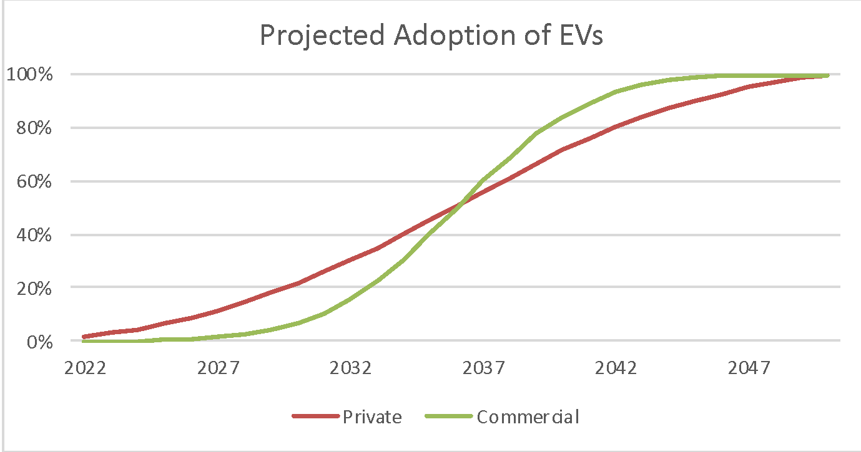
Electrification of Transport
As with many technologies, initial adoption is slow

Slide 7
Connecticut’s Solar Programs are Growing
Sources:
PURA 2024 Clean & Renewable Energy Report, February 19, 2025
ISO-New England 2023 CELT Report

Slide 8
It is now time to ramp these programs up
We Are
Here
Notes:
Source: PACE Energy Model 4.2
100% represents roughly 21 gigawatts (GW) of solar in CT

Slide 9
We will use less energy, and it will be all electric,
It will come from a mix of local and regional resources

Slide 10
The path to clean energy is the path to lower and more stable energy costs
Source: PACE Energy Model v. 4.2.14

Slide 11
The path to clean energy is the path to lower and more stable energy costs
Source: PACE Energy Model v. 4.2.14

Slide 12
The path to clean energy is the path to lower and more stable energy costs
Source: PACE Energy Model v. 4.2.14

Slide 13
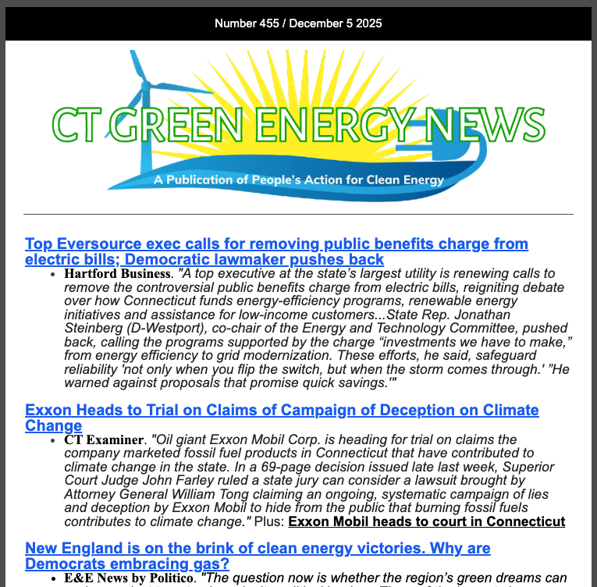
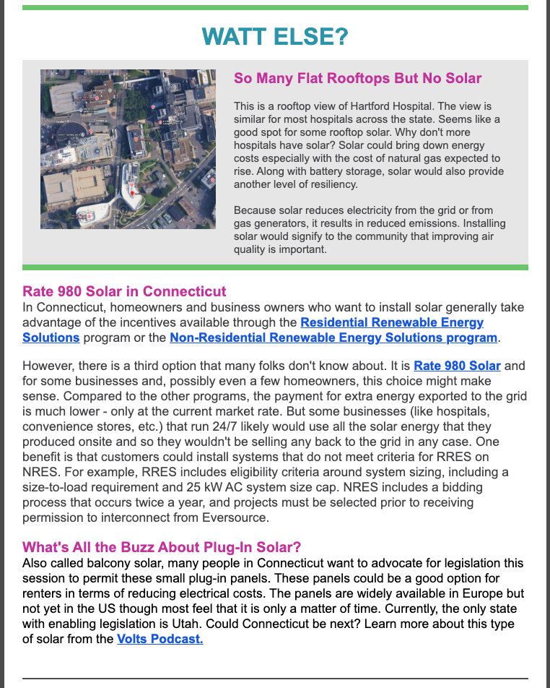
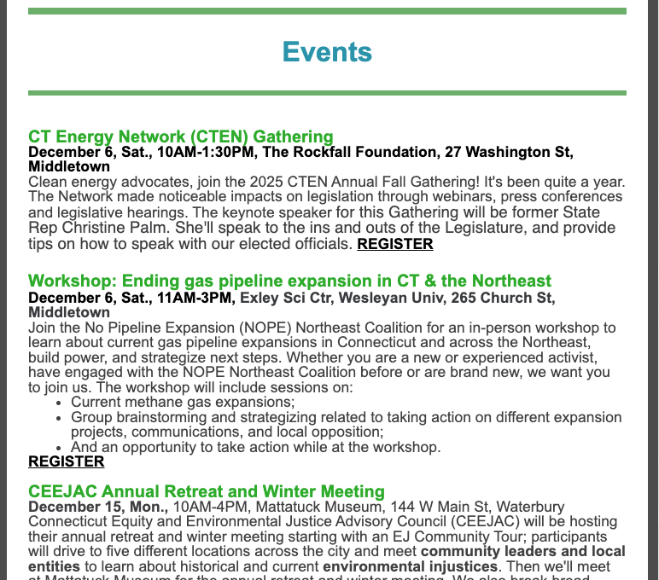

Sign up for the weekly PACE recap of CT clean energy education, news & events
Comes every Friday pm
It’s free
Educational,
Informative on current news & events
Sign up here:
Go to: https://lp.constantcontactpages.com/su/PeMwcqa

Slide 14
Appendix

Slide 15
We are locked into ever increasing costs until we transition to clean energy
Source: PACE Energy Model v. 4.2.14

Slide 16
With financing, we can make the clean energy transition at no additional cost
Source: PACE Energy Model v. 4.2.14

